Slide 1

Note: The data and information in this document is reflective of a hypothetical situation and client. This document is to be used for KPMG Virtual Internship purposes only.
Sprocket Central Pty Ltd
Data analytics approach
Sahil Shah
Data Analytics Consulting Virtual Intern

Slide 2
Note: The data and information in this document is reflective of a hypothetical situation and client. This document is to be used for KPMG Virtual Internship purposes only.
Agenda
Introduction
Data Exploration
Model Development
Data Interpretation

Slide 3
Note: The data and information in this document is reflective of a hypothetical situation and client. This document is to be used for KPMG Virtual Internship purposes only.
Agenda
Important Aspects for evaluation :
Age
Bike purchased
Job industry
State

Slide 4
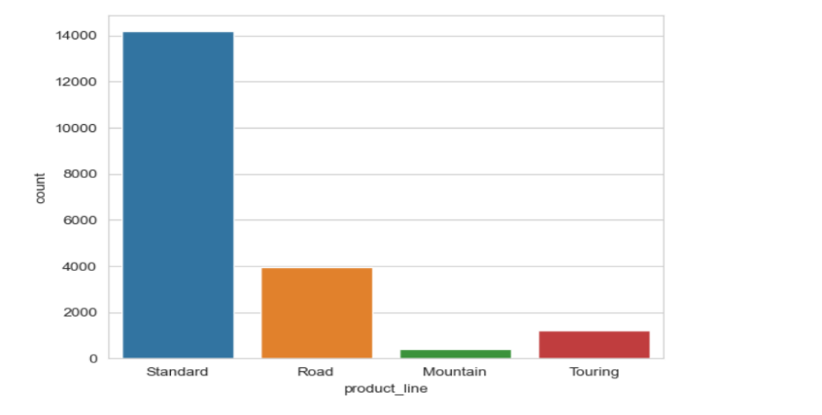
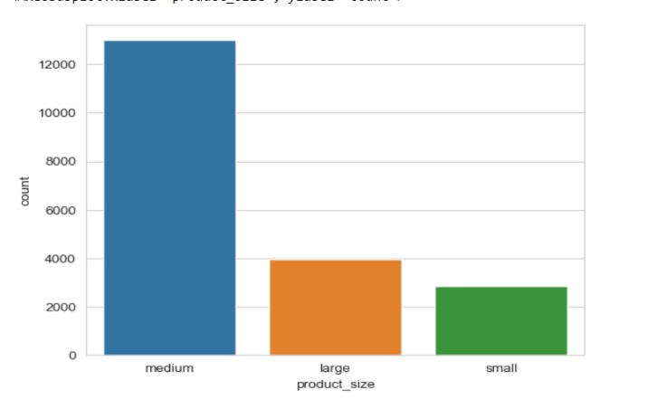
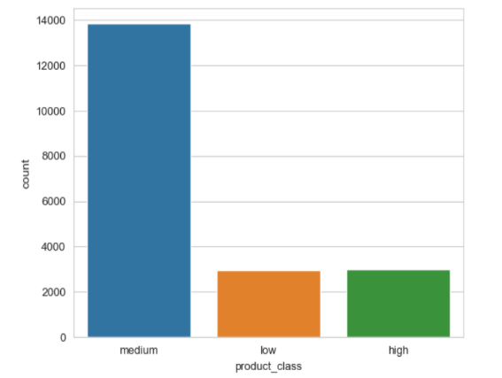
Note: The data and information in this document is reflective of a hypothetical situation and client. This document is to be used for KPMG Virtual Internship purposes only.
Introduction
Product details
Data Cleaning
Age and Profit added.
Corrected misspelled values.
Missing fields dropped
Records pertaining to Deceased Customers were Dropped.

Slide 5
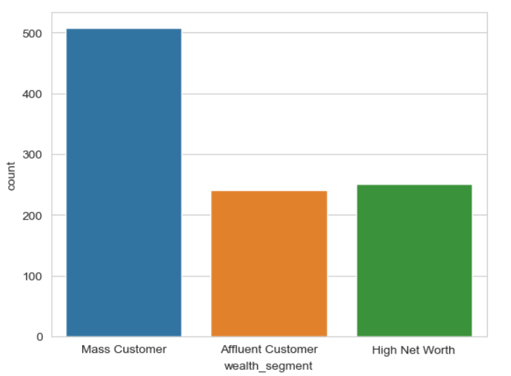
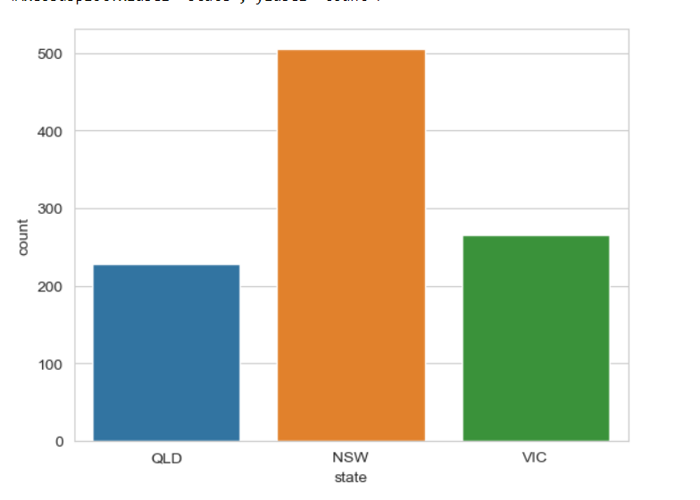
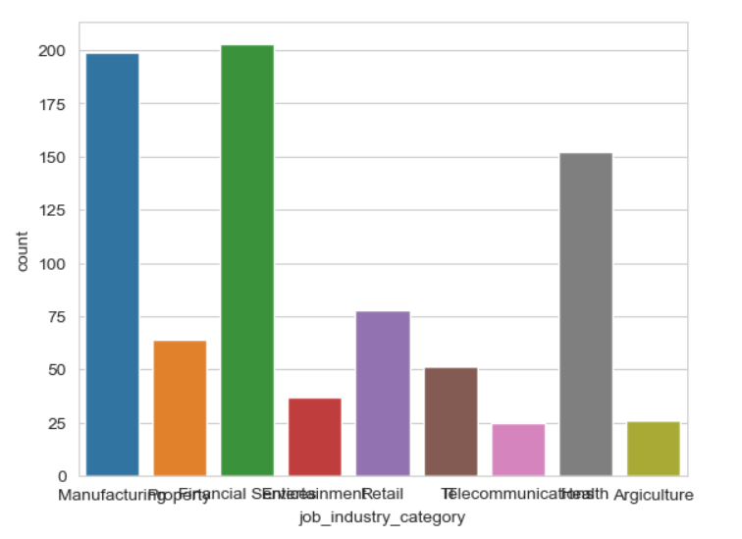
Note: The data and information in this document is reflective of a hypothetical situation and client. This document is to be used for KPMG Virtual Internship purposes only.
Data Exploration
Based on State, Job industry and wealth segment
We can say NSW state has more customers.
Financial sector is more profitable and agriculture is the least.
Mass customer segment is leading

Slide 6
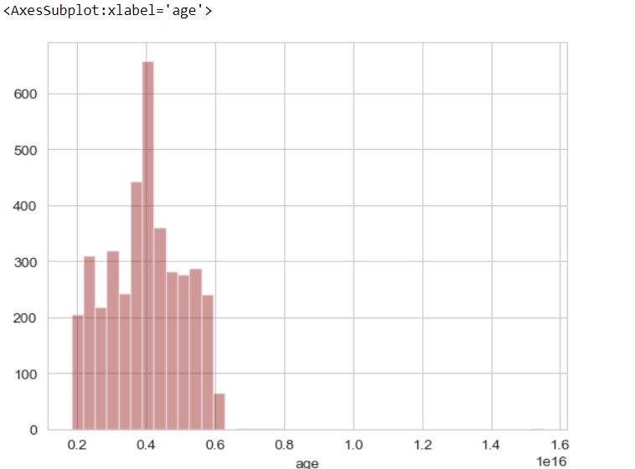
Note: The data and information in this document is reflective of a hypothetical situation and client. This document is to be used for KPMG Virtual Internship purposes only.
Data Exploration
Age distribution

Slide 7
Note: The data and information in this document is reflective of a hypothetical situation and client. This document is to be used for KPMG Virtual Internship purposes only.
Model Development
We will target high-value customers
Age group 40-50
Female customers
Working in financial and manufacturing sector
From state NSW(New South Wales)

Slide 8
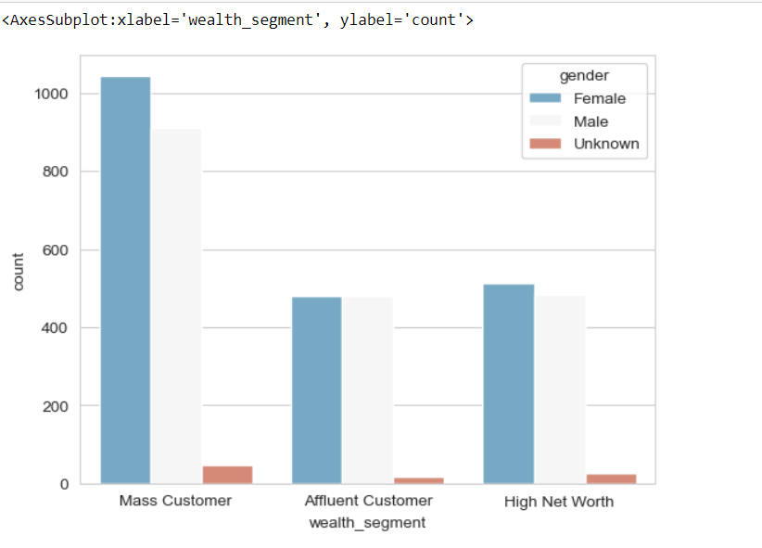
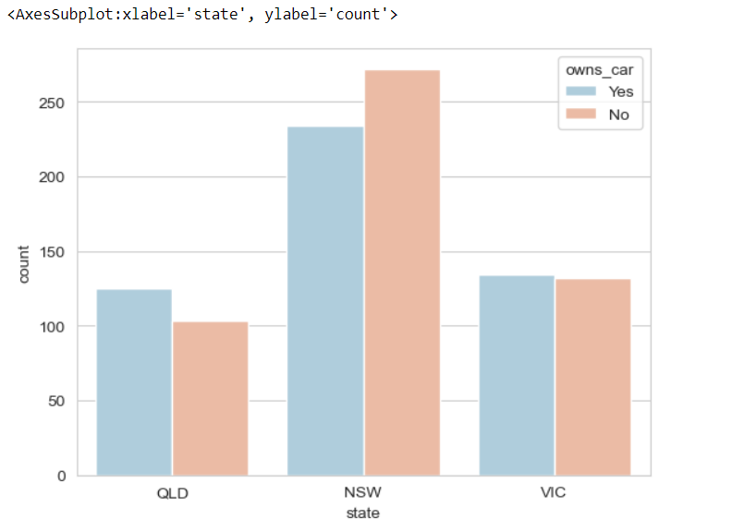
Note: The data and information in this document is reflective of a hypothetical situation and client. This document is to be used for KPMG Virtual Internship purposes only.
Interpretation
High valued customers
These above charts shows the high valued customers.

Slide 9
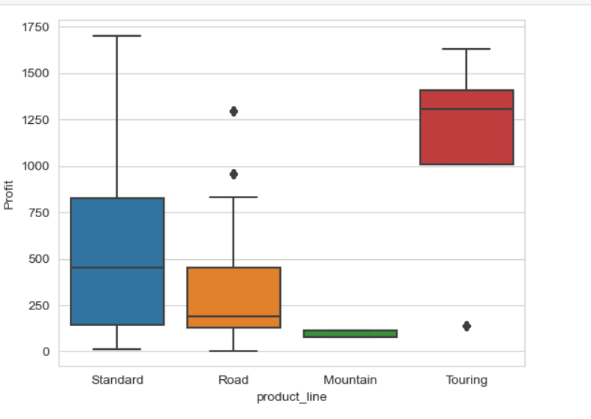
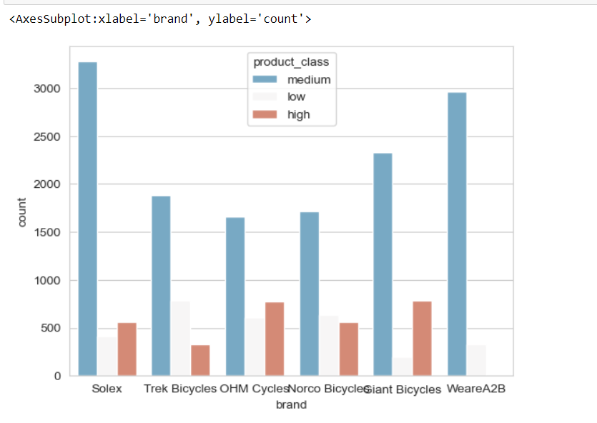
Note: The data and information in this document is reflective of a hypothetical situation and client. This document is to be used for KPMG Virtual Internship purposes only.
Appendix

