Slide 1

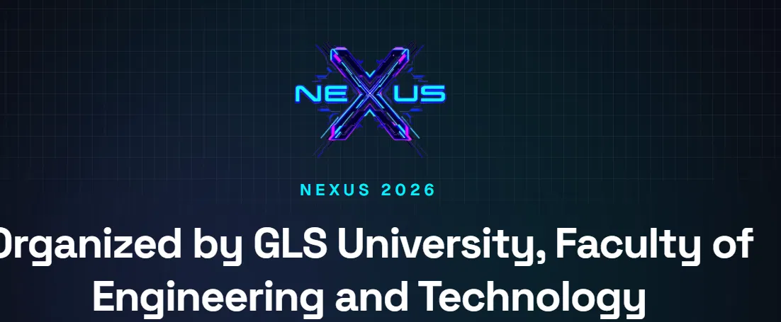
NEXUS 2026 // HACKATHON PRESENTATION
AegisNexus
Detect the Signal. Defend the Decision.
AI-Powered Real-Time Deepfake and Phishing Detection & Defense System
PRESENTED BY
Mohammad Sahil · Zainab Memon
Tech Creature Solutions
GLS University · Faculty of Engineering and Technology
SYSTEM BRIEF // NEXUS 2026 // SEC-01

Slide 2
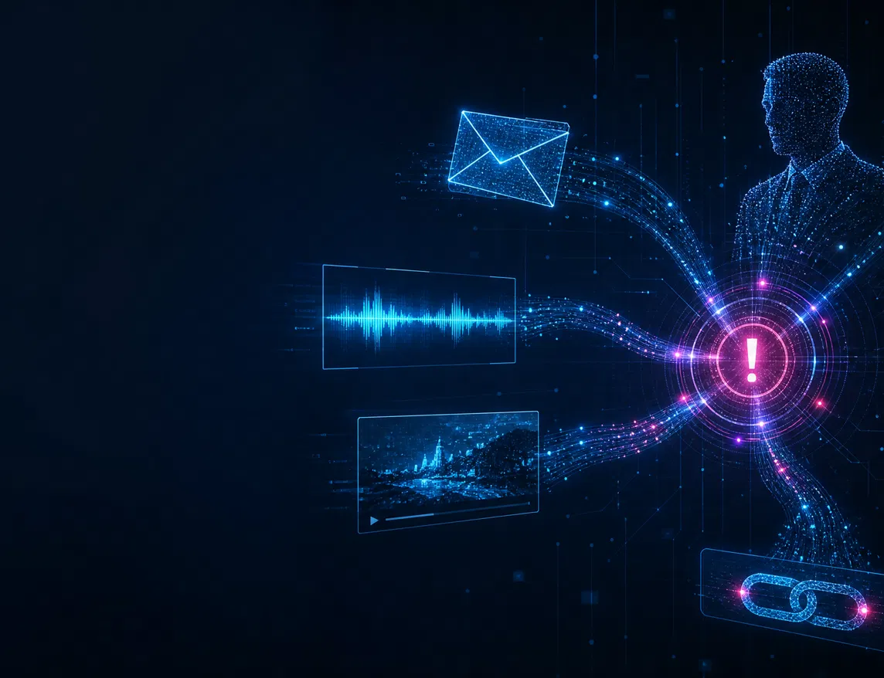



MANDATORY 01 // PROBLEM STATEMENT
NEXUS 2026
AI turned one phishing email into a coordinated impersonation attack
Polished phishing
Trusted language, urgent payment requests, look-alike links.
Synthetic presence
Cloned voice and manipulated video imitate authority.
Multiple channels
Email, URL, voice, video, and network activity converge.
Sources: NSA, FBI & CISA deepfake-threat guidance · FBI business-email-compromise guidance
SEC-02 // THREAT

Slide 3




PROBLEM DETAIL // WHY LEGACY CONTROLS MISS CAMPAIGNS
NEXUS 2026
Separate alerts hide the full attack story
Attackers coordinate signals; traditional tools often isolate them. AegisNexus correlates them before a payment or access decision is made.
TRADITIONAL VIEW // 4 SEPARATE ALERTS
AEGISNEXUS VIEW // 1 CORRELATED INCIDENT
Suspicious payment email
HIGH RISK
Possible CFO impersonation
Look-alike payment URL
CORRELATE
EVIDENCE
Urgent-payment intent + look-alike domain + unknown voice channel + identity anomaly + linked alert history.
Unknown voice note
RECOMMENDED ACTION
Related domain activity
Quarantine · block · notify analyst
SEC-03 // PROBLEM CONTEXT

Slide 4






MANDATORY 02 // EXPECTED OUTCOME + PROPOSED SOLUTION
NEXUS 2026
AegisNexus converts signals into one defensible decision
Multiple signals. One explainable risk decision. Safe human-controlled response.
Phishing Intelligence
Deepfake Analysis
Executive Digital Twin
Intent, sender, URL, attachment, and urgency checks.
Voice mismatch, replay clues, facial and lip-sync indicators.
Approved channels, behavior, and transaction patterns.
Threat + Network Context
AI Attack Graph
Explainable Risk + Response
Domains, IPs, devices, DNS activity, and policy signals.
Links people, URLs, phones, devices, and past alerts.
Score, evidence, confidence, action, and analyst approval.
EXPECTED OUTPUT
Risk score · confidence · evidence · attack graph · recommended response
SEC-04 // SOLUTION

Slide 5






MANDATORY 03 // WORKFLOW DIAGRAM
NEXUS 2026
The real-time defense workflow
From a suspicious event to an explainable, human-controlled response.
Multimodal input
Evidence ingest
Parallel verification
AI Attack Graph
Risk + response
Email · voice · video · network
Text · URLs · metadata · media features
Phishing · deepfake · digital twin · threat checks
Connect identities, assets, and prior alerts
Explain score · select safe playbook · approve
Security Dashboard + AI Copilot
Risk score · evidence · attack graph · reason codes · recommended action
SEC-05 // WORKFLOW

Slide 6
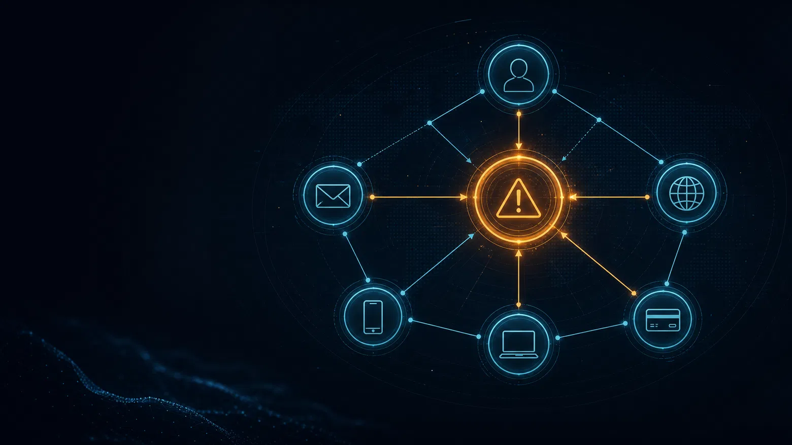



05 // CORRELATION LAYER
NEXUS 2026
The attack graph is the system’s memory
One event is uncertain. Connected evidence is actionable.
Correlation
Find shared infrastructure, repeated targeting, and campaign overlap.
Context
Add identity anomalies and business impact to technical signals.
CORRELATED INCIDENT
Explanation
HIGH-RISK CFO IMPERSONATION
Show analysts why the risk score increased and what to do next.
SEC-06 // ATTACK GRAPH

Slide 7





MANDATORY 04 // TECHNOLOGIES + TOOLS
NEXUS 2026
A feasible prototype stack maps directly to the workflow
Modular by design—each layer can be built, tested, and demonstrated independently.
Experience
React 19 · TypeScript · Vite · Tailwind CSS · SVG Topology
HACKATHON MVP BOUNDARY
Orchestration
Node.js & Express Gateway · REST APIs
Build the decision engine first
Intelligence
scikit-learn / Transformers · librosa / SpeechBrain · OpenCV / MediaPipe
Prioritize phishing and URL analysis, audio indicators, identity rules, attack graph, explainable risk scoring, dashboard, and response simulation.
Correlation
NetworkX · threat rules · Digital Twin profiles
Data + deployment
Vercel Cloud CI/CD · Encrypted Browser Persistence
Video analysis remains modular with sample input.
SEC-07 // STACK

Slide 8
MANDATORY 05 // PSEUDOCODE + ALGORITHM
NEXUS 2026
The algorithm fuses evidence before choosing action
Each available modality contributes evidence; missing modalities are excluded, never guessed.
FUNCTION ANALYZE_SECURITY_EVENT(event)
Risk policy → response
01 features ← extract(text, URL, media, identity, network)
02 scores ← detectPhishing + detectAudio + detectVideo
03 scores ← scores + verifyDigitalTwin + checkThreatSignals
04 graph ← updateAndQueryAttackGraph(features)
05 risk ← fuse(scores, graph, businessImpact, confidence)
06 reasons ← generateExplanation(scores, graph)
07 action ← selectSafeResponse(risk)
08 return risk, confidence, reasons, graph, action
LOW
Allow, monitor, and log
MEDIUM
Warn and verify independently
HIGH
Quarantine content and block URL
CRITICAL
Open incident; analyst approves action
Output is an explainable decision package—not simply “fake” or “genuine”.
Confidence + business impact influence escalation.
SEC-08 // ALGORITHM

Slide 9



08 // LIVE INCIDENT DEMO
NEXUS 2026
A fake CFO request becomes one clear incident
The cross-modal value appears when each clue points to the same impersonation attempt.
01 // ATTACKER SIGNALS
02 // AEGISNEXUS CHECKS
03 // RISK DECISION
Urgent CFO request
Identity mismatch
High-risk incident
CFO-looking email
Look-alike payment link
Cloned-sounding voice note
Unapproved channel
Unusual payment behavior
Related graph indicators
Quarantine message
Block URL
Notify analyst for approval
EXPECTED DASHBOARD OUTPUT
CRITICAL RISK (95/100) — CFO Impersonation
5 Correlated Signals • ,500 Target • 94% Confidence
SEC-09 // DEMO

Slide 10



MANDATORY 06 // ASSUMPTIONS + CHALLENGES + QUERIES
NEXUS 2026
Ambitious by design. Responsible by default.
A credible prototype declares its boundaries, risks, safeguards, and open questions clearly.
PROTOTYPE ASSUMPTIONS
CHALLENGE → MITIGATION
Simulated or uploaded test events are used instead of live corporate data.
False alerts
Risk bands, confidence, evidence, thresholds, analyst review.
Pre-trained models and rules are used; no large model is trained from scratch.
Privacy + biometrics
Consent-based samples, minimal storage, restricted access.
Not every event includes text, audio, video, identity, and network signals.
Latency + scope
Lightweight checks first; deeper checks run in parallel; critical actions need analyst approval.
OPEN QUERIES
Are simulated data and pre-trained models acceptable? Which evaluation criterion matters most: accuracy, workflow, UX, or response?
SEC-10 // SAFETY

Slide 11





10 // EXPECTED OUTCOME
NEXUS 2026
The outcome: earlier, clearer, safer decisions
AegisNexus turns isolated indicators into action-ready intelligence for people and security teams.
Earlier detection
Cross-modal confidence
Campaign visibility
Flag suspicious activity before a risky action completes.
Combine evidence sources instead of trusting one clue.
Transform related indicators into one incident view.
Explainable security
Safer response
Show score, evidence, graph, and recommended response.
Contain risk while preserving human control.
SEC-11 // OUTCOMES

Slide 12
NEXUS 2026 // FINAL PROTOCOL
Detect the signal. Verify the identity.
Correlate the threat. Make the response safe.
Tech Creature Solutions
Mohammad Sahil · Zainab Memon
AegisNexus — AI-Powered Deepfake and Phishing Defense
THANK YOU // QUESTIONS
SYSTEM CLOSE // TECH CREATURE SOLUTIONS

