Slide 1
MATRICES CET LEVEL Questions
Class 12
BY

Slide 2

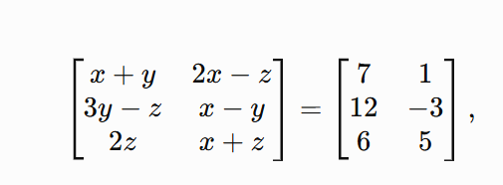

MATRICES
* Formation and Basic of Matrix
1. If
A) -10 B) -11
C) 10 D) 11
Answer: C)10

Slide 3
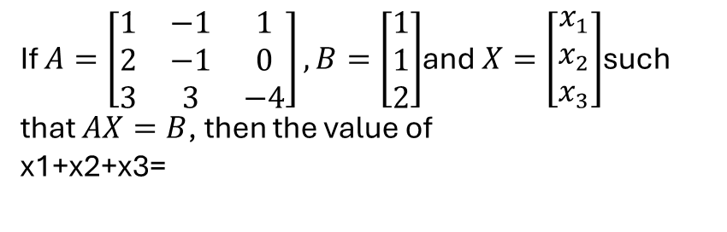
MATRICES
* Formation and Basic of Matrix
MHT CET 2021 (23 Sep Shift 2)
2.
If $A=\left[\begin{matrix}1 & −1 & 1 \\ 2 & −1 & 0 \\ 3 & 3 & −4\end{matrix}\right],B=\left[\begin{matrix}1 \\ 1 \\ 2\end{matrix}\right]$and $X=\left[\begin{matrix}x_{1} \\ x_{2} \\ x_{3}\end{matrix}\right]$such that $AX=B$, then the value of
x1+x2+x3=
A) 04 B) 05
C) 06 D) 03
Answer: D) 03

Slide 4
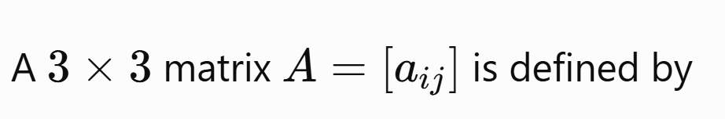
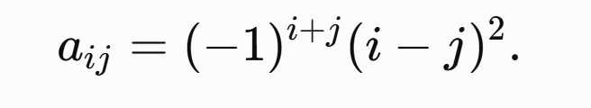
MATRICES
* Formation and Basic of Matrix
3.
A) 2 B) 4
C) -4 D) -2
Answer: B) 4

Slide 5
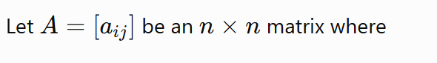


MATRICES
* Formation and Basic of Matrix
4.
A) 07 B) 09
C) 08 D) 10
Answer: C)10

Slide 6
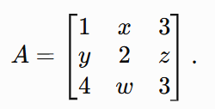

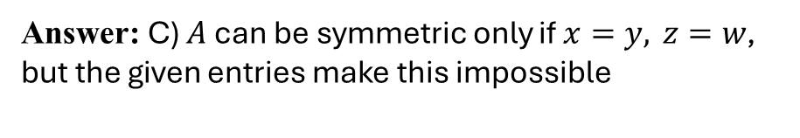
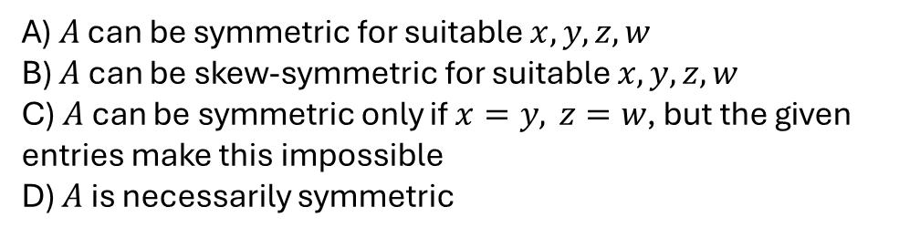
MATRICES
* Formation and Basic of Matrix
5. Consider
A) $A$ can be symmetric for suitable $x,y,z,w$
B) $A$ can be skew-symmetric for suitable $x,y,z,w$
C) $A$can be symmetric only if $x=y, z=w$, but the given entries make this impossible
D) $A$ is necessarily symmetric
Answer: C) $A$can be symmetric only if $x=y, z=w$, but the given entries make this impossible

Slide 7
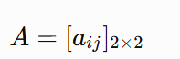

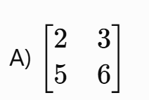
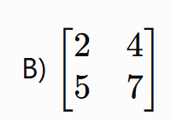
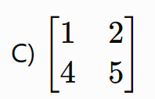
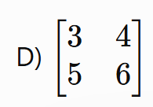
MATRICES
* Formation and Basic of Matrix
6. If
where
then $A$ is:
Answer:

Slide 8
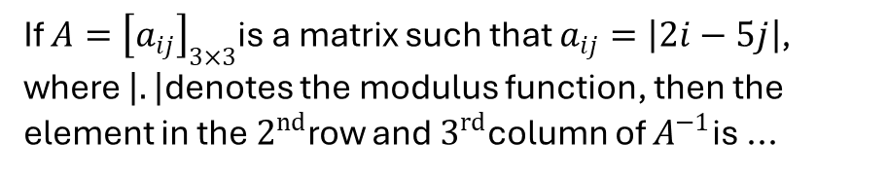
MATRICES
* Formation and Basic of Matrix
MHT CET 2026 (16 April Shift 2)
7
If $A={\left[a_{ij}\right]}_{3×3}$is a matrix such that $a_{ij}=\left|2i−5j\right|$, where $\left|.\right|$denotes the modulus function, then the element in the $2^{nd}$row and $3^{rd}$column of $A^{−1}$is ...
A) 03 B) 01
C) 00 D) -01
Answer: D) -01

Slide 9
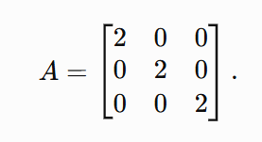

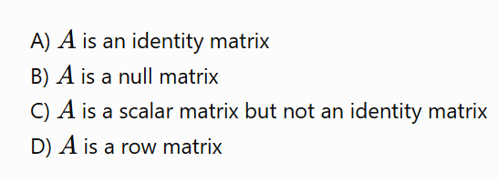
MATRICES
* Formation and Basic of Matrix
8. Let
Answer: C) Scalar matrix, but not identity matrix

Slide 10
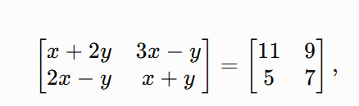

MATRICES
* Formation and Basic of Matrix
9. If
A) 10 B) 17
C) 13 D) 25
Answer: D)25

Slide 11
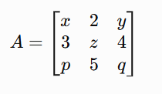

MATRICES
* Formation and Basic of Matrix
10. If
A) 3 B) 5
C) 4 D) 6
Answer: B) 05

Slide 12
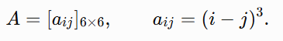
MATRICES
* Formation and Basic of Matrix
11. If
Which statement is correct?
A) A is symmetric B) A is skew-symmetric
C) A is diagonal D) A is scalar
Answer: B) A is skew-symmetric

Slide 13
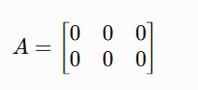

MATRICES
* Formation and Basic of Matrix
12. If
A) Identity matrix B) Scalar matrix
C) Null matrix D) Diagonal matrix
Answer: C) Null matrix

Slide 14
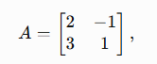

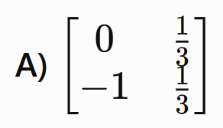
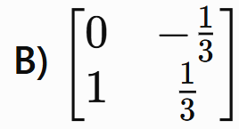
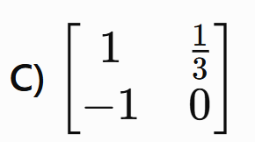
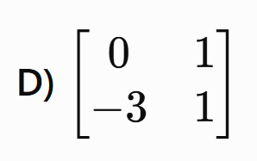
MATRICES
* Basic Algebra of Matrices
13. If
Answer:

Slide 15
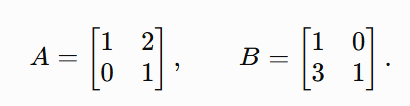





MATRICES
* Basic Algebra of Matrices
14. If
Answer:

Slide 16
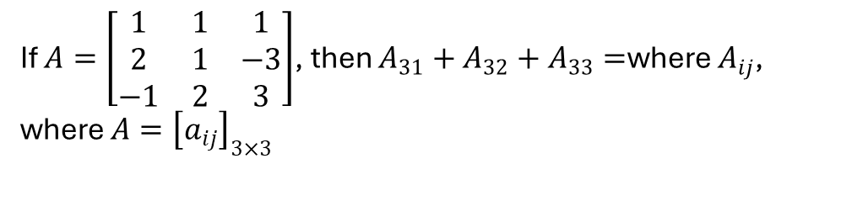
MATRICES
* Basic Algebra of Matrices
MHT CET 2022 (07 Aug Shift 1)
If $A=\left[\begin{matrix}1 & 1 & 1 \\ 2 & 1 & −3 \\ −1 & 2 & 3\end{matrix}\right]$, then $A_{31}+A_{32}+A_{33}=$where $A_{ij}$, where $A={\left[a_{ij}\right]}_{3×3}$
15.
A) 10 B) 01
C) 00 D) 11
Answer: C) 00

Slide 17
MATRICES
* Basic Algebra of Matrices
If A is a 3 × 3 matrix and Aᵀ = −A, which of the following must be true?
16.
A) All diagonal elements are 1
B) All diagonal elements are 0
C) A is a symmetric matrix
D) det(A) = 1
B) All diagonal elements are 0

Slide 18


MATRICES
* Basic Algebra of Matrices
17. If
A) 0 B) I
C) 2I D) A
Answer: A) 0

Slide 19
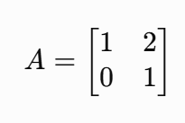
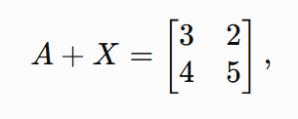
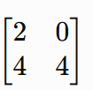
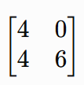


MATRICES
* Basic Algebra of Matrices
18.
If
then X is:
B)
C) D)
A)

Slide 20


MATRICES
* Basic Algebra of Matrices
19. If
A) 1 B) -1
C) 0.5 D) -0.5
Answer: D)-0.5

Slide 21
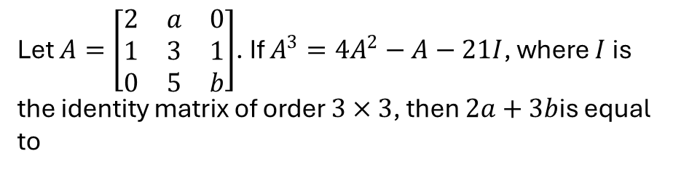
MATRICES
* Basic Algebra of Matrices
Let $A=\left[\begin{matrix}2 & a & 0 \\ 1 & 3 & 1 \\ 0 & 5 & b\end{matrix}\right]$. If $A^{3}=4A^{2}−A−21I$, where $I$ is the identity matrix of order $3×3$, then $2a+3b$is equal to
20.
A) -09 B) -12
C) -10 D) -13
D) -13

Slide 22





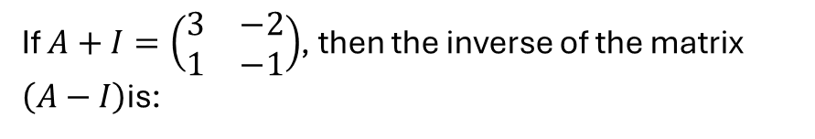
MATRICES
* Basic Algebra of Matrices
If $A+I=\left(\begin{matrix}3 & −2 \\ 1 & −1\end{matrix}\right)$, then the inverse of the matrix $\left(A−I\right)$is:
21.
A)
B)
C)
D)
Answer: B)

Slide 23
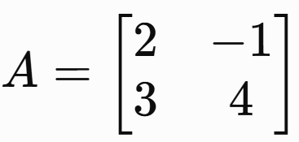
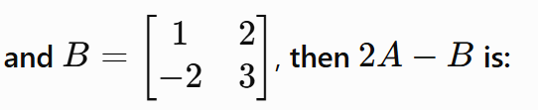
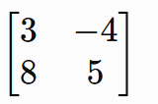
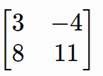
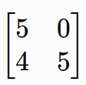
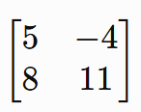
MATRICES
* Basic Algebra of Matrices
22. If
A) B)
C) D)
Answer: A)

Slide 24
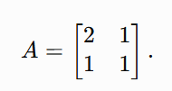
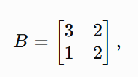

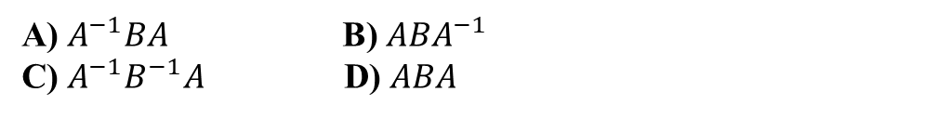

MATRICES
* Basic Algebra of Matrices
23. If
then X is
A) $A^{−1}BA$ B) $ABA^{−1}$
C) $A^{−1}B^{−1}A$ D) $ABA$
Answer A) $A^{−1}BA$

Slide 25
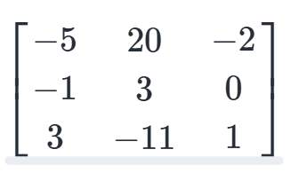
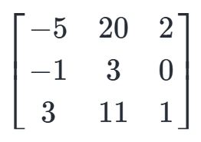
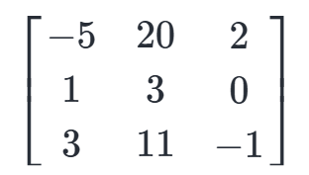
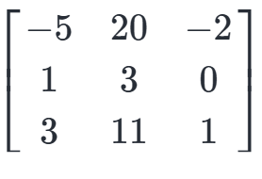
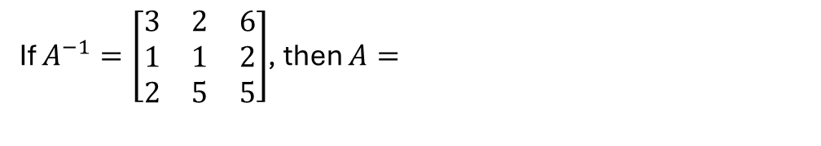
MATRICES
* Basic Algebra of Matrices
If $A^{−1}=\left[\begin{matrix}3 & 2 & 6 \\ 1 & 1 & 2 \\ 2 & 5 & 5\end{matrix}\right]$, then $A=$
24.
A)
B)
C)
D)

Slide 26
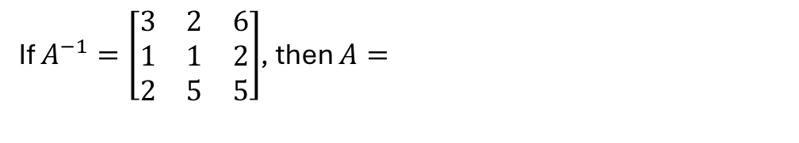
MATRICES
* Basic Algebra of Matrices
If $A^{−1}=\left[\begin{matrix}3 & 2 & 6 \\ 1 & 1 & 2 \\ 2 & 5 & 5\end{matrix}\right]$, then $A=$
Answer: A)

Slide 27
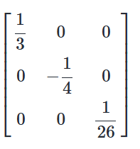
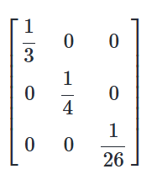



MATRICES
* Basic Algebra of Matrices
MHT CET 2026 (17 April Shift 2)
If $A=\left[\begin{matrix}3 & 0 & 0 \\ 0 & −5 & 0 \\ 0 & 0 & 7\end{matrix}\right]$; $B=\left[\begin{matrix}−1 & 0 & 0 \\ 0 & 2 & 0 \\ 0 & 0 & 4\end{matrix}\right]$then, ${\left(2A+3B\right)}^{−1}=$_______
25.
B)
A)
C)
D)

Slide 28
MATRICES
* Basic Algebra of Matrices
Answer: A)

Slide 29

MATRICES
* Basic Algebra of Matrices
The solution of the equation
$\left[\begin{matrix}1 & 0 & 1 \\ −1 & 1 & 0 \\ 0 & −1 & 1\end{matrix}\right]\left[\begin{matrix}x \\ y \\ z\end{matrix}\right]=\left[\begin{matrix}1 \\ 1 \\ 2\end{matrix}\right]$is $\left(x , y , z\right)=$
26.
A)
(1,1,1)
B)
(0,−1,2)
C)
(−1,2,2)
D)
(−1,0,2)
Answer: D)
(−1,0,2)

Slide 30




MATRICES
* Basic Algebra of Matrices
QUESTION TYPE SAME AS LAST QUESTION
The solution of the equation
27.
is ( x , y, z ) =
B) $\left(2,1,3\right)$
A) $\left(1,2,3\right)$
C) $\left(1,3,2\right)$
D) $\left(2,3,1\right)$
Answer: D)
(1,2,3)

Slide 31

MATRICES
* Basic Algebra of Matrices
28. If
is skew-symmetric, then (a, b) is:
A)
(1,−1)
(0,0)
B)
C)
(2,-1)
D)
(0,1)
Answer: A)
(0,0)

Slide 32

MATRICES
* Basic Algebra of Matrices
29. If
is symmetric, then the relation between (x) and (y) is
A) x = y B) x + y = 5
C) x = 3 and y = 2) D) No restriction on x and y
Answer: A)
(0,0)

Slide 33
MATRICES
* Basic Algebra of Matrices
30. If A and B are matrices of the same order such that
A + B = A - B
A) A = 0 B) B = 0
C) A =B D) A = I
Answer: B)
B = 0

Slide 34




MATRICES
* Basic Algebra of Matrices
31. If A is a skew-symmetric matrix, then which statement is always true?
B) B)
C) D)
Answer: B)

Slide 35
MATRICES
* Basic Algebra of Matrices
32.
Which of the following represents the transpose of a matrix?
A) Interchanging rows and columns
B) Changing all elements to their negatives
C) Interchanging diagonal elements only
D) Multiplying every element by itself
Answer: B)
B = 0

Slide 36





MATRICES
*Product of Matrices
MHT CET 2026 (20 May Shift 1)
Let $X=\left[\begin{matrix}4 & 2 \\ −1 & 3\end{matrix}\right]$, $Y=\left[\begin{matrix}−1 & 2 \\ 1 & −3\end{matrix}\right]$, then ${\left(XY\right)}^{−1}$is equal to
33

Slide 37

MATRICES
*Product of Matrices
MHT CET 2026 (19 May Shift 1)
If $A=\left[\begin{matrix}−\frac{1}{2} & −\frac{\sqrt{3}}{2} \\ \frac{\sqrt{3}}{2} & −\frac{1}{2}\end{matrix}\right]$, the value of $\left|Adj\left(A^{2026}\right)\right|$is equal to:
34)
A) 1 B) -1
C) -0.5 D) 0.5
A) 1

Slide 38


MATRICES
*Product of Matrices
MHT CET 2026 (15 May Shift 2)
If $A=\left[\begin{matrix}0 & 1 & 2 \\ 1 & 2 & 3 \\ 3 & a & 1\end{matrix}\right]$and $A^{−1}=\left[\begin{matrix}\frac{1}{2} & −\frac{1}{2} & \frac{1}{2} \\ −4 & 3 & c \\ \frac{5}{2} & −\frac{3}{2} & \frac{1}{2}\end{matrix}\right]$, then ...
35
B) a = 1, c = −1

Slide 39





MATRICES
*Product of Matrices
If $A=\left[\begin{matrix}2 & 3 \\ 5 & −2\end{matrix}\right]$, $B^{−1}=\left[\begin{matrix}\frac{1}{5} & \frac{2}{5} \\ \frac{2}{5} & −\frac{1}{5}\end{matrix}\right]$, then ${\left(AB\right)}^{−1}=$
36.

Slide 40


MATRICES
*Product of Matrices
37.
$$A=\left[\begin{matrix}2 & 1 \\ 3 & 2\end{matrix}\right], B=\left[\begin{matrix}1 & −1 \\ 2 & 1\end{matrix}\right],$$
If
then (AB) is
$$\left[\begin{matrix}−1 & −1 \\ 7 & 4\end{matrix}\right]$$
$$\left[\begin{matrix}4 & −1 \\ 7 & −1\end{matrix}\right]$$
A)
B)
$$\left[\begin{matrix}4 & 1 \\ 7 & 1\end{matrix}\right]$$
$$\left[\begin{matrix}2 & −1 \\ 4 & 1\end{matrix}\right]$$
C)
D)
$$\left[\begin{matrix}4 & −1 \\ 7 & −1\end{matrix}\right]$$
A)

Slide 41






MATRICES
*Product of Matrices
$$A=\left[\begin{matrix}a & 1 \\ 0 & a\end{matrix}\right],$$
38.
If
A)
B)
D)
C)
A)

Slide 42



MATRICES
*Product of Matrices
If $A=\left[\begin{matrix}\cos^{2}{α} & \cos{α}\sin{α} \\ \cos{α}\sin{α} & \sin^{2}{α}\end{matrix}\right]$and
$B=\left[\begin{matrix}\cos^{2}{β} & \cos{β}\sin{β} \\ \cos{β}\sin{β} & \sin^{2}{β}\end{matrix}\right]$ are two matrices
such that the product $AB$is null matrix, then $α−β$is
39.
A) 0
B) multiple of $π$
C) an odd multiple of $π/2$
D) None of above
A) 0

Slide 43





MATRICES
*Product of Matrices
40. If
$$A=\left[\begin{matrix}2 & 1 \\ 1 & 3\end{matrix}\right],$$
then $A^{2}−5A+6I$ is
A)
B)
C)
D)
B)

Slide 44




MATRICES
*Product of Matrices
MHT CET 2026 (20 May Shift 1)
If $A=\left[\begin{matrix}1 & −1 & 1 \\ 2 & −1 & 0 \\ 1 & 0 & 0\end{matrix}\right]$, then which of the following is not
true?
41.
A)
B)
$A^{2}$is a triangular matrix.
C)
$A$is a non-singular matrix.
$A^{3}$is an identity matrix.
D)
B) $A^{2}$is a triangular matrix.

Slide 45

MATRICES
*Product of Matrices
MHT CET 2020 (15 Oct Shift 2)
If $A=\left[\begin{matrix}1 & 0 \\ −1 & 7\end{matrix}\right],I=\left[\begin{matrix}1 & 0 \\ 0 & 1\end{matrix}\right]$and $A^{2}=8A+kI$, then the value of $K$is
42.
A) 1/7
B)
-1/7
C) 7
D)
-7
D) -7

Slide 46
MATRICES
*Product of Matrices
43.
If A and B are matrices such that AB = I , then B is:
A) The transpose of A B) The zero matrix
C) A right inverse of A D) Equal to A
D) -7

Slide 47





MATRICES
*Product of Matrices
44. If
then BA is:
A) B)
C) D)
A)

Slide 48





MATRICES
*Product of Matrices
$A=\left[\begin{matrix}\cos{θ} & −\sin{θ} \\ \sin{θ} & \cos{θ}\end{matrix}\right]$and $AB=BA=I$, then $B$ is
equal to
45.
A) B)
C) D)
B)

Slide 49


MATRICES
*Product of Matrices
If matrix $A=\left[\begin{matrix}a & b \\ c & d\end{matrix}\right]$, then ${\left|A\right|}^{−1}$is equal to
46.
A) ad - bc B)
C) D) None of these
B)

Slide 50

MATRICES
*Product of Matrices
MHT CET 2022 (11 Aug Shift 1)
47.
If $A$is non-singular matrix of order 3 such that $\left(A−2I\right)\left(A−4I\right)=0$, then $\frac{1}{6}A+\frac{4}{3}A^{−1}$is (where I is a unit matrix of order 3 and 0 is a null matrix of order 3)
A) 6I B) I
C) 0 D) 2I
B) I

Slide 51





MATRICES
*Product of Matrices
MHT CET 2022 (11 Aug Shift 1)
48.
If $A=\left[\begin{matrix}\cos{θ} & −\sin{θ} \\ \sin{θ} & \cos{θ}\end{matrix}\right]$, then the matrix $A^{−3}$ where
$θ=\frac{π}{6}$ is equal to...
A) B)
C) D)
A)

Slide 52

MATRICES
*Product of Matrices
MHT CET 2026 (20 April Shift 1)
If $A=\left[\begin{matrix}3 & 2 & 6 \\ 1 & 1 & 2 \\ 2 & 2 & 5\end{matrix}\right]$, $B=\left[\begin{matrix}1 \\ 0 \\ 1\end{matrix}\right]$such that $XA=B^{T}$and $A^{−1}Y=B$, then $XY=$
49.
A) [−1] B) [1]
C) [−2] D) [2]
D) [2]

Slide 53





MATRICES
*Product of Matrices
MHT CET 2022 (11 Aug Shift 1)
If matrix $A=\left[\begin{matrix}1 & 2 \\ 4 & 3\end{matrix}\right]$is such that $AX=I$, where $I$is $2×2$ unit matrix, then $X=$
50.
A) B)
C) D)
B)

