Slide 1

Final project progression presentation
Title : “Chhay.a” Chat Application
Presented By:
1. Nakul Mahale | PRN: 220105131180
2. Sahil Shirsath | PRN: 220105131228
3. Yash Gunjal | PRN: 220105131138
Group ID :- B-22

Slide 2
Problem Statement
• Need secure and scalable Indian chat platform
• Data privacy and control
• Real-time communication
• Modern UI/UX experience

Slide 3
Technology Stack
Frontend: React / Modern UI
Backend: Node.js + Express
Database: MongoDB
API Testing: Postman
Authentication: JWT

Slide 4
System Architecture
Client (Frontend)
↓
REST API / Socket
↓
Server (Backend)
↓
MongoDB Database

Slide 5
Key Features
• User Registration & Login
• One-to-One Chat
• Group Chat
• Media Sharing
• Dark/Light Theme
• Profile Management

Slide 6
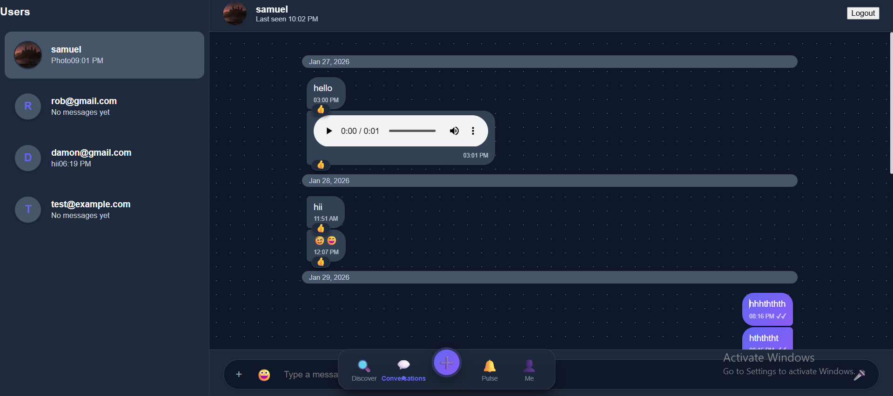
Chat Interface UI

Slide 7
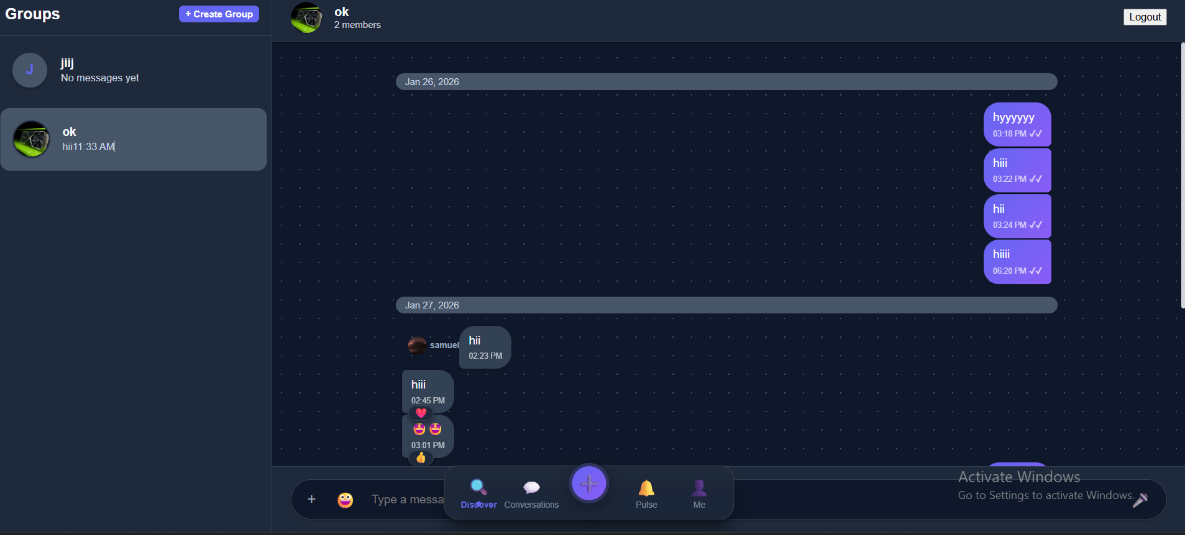
Group Chat UI

Slide 8
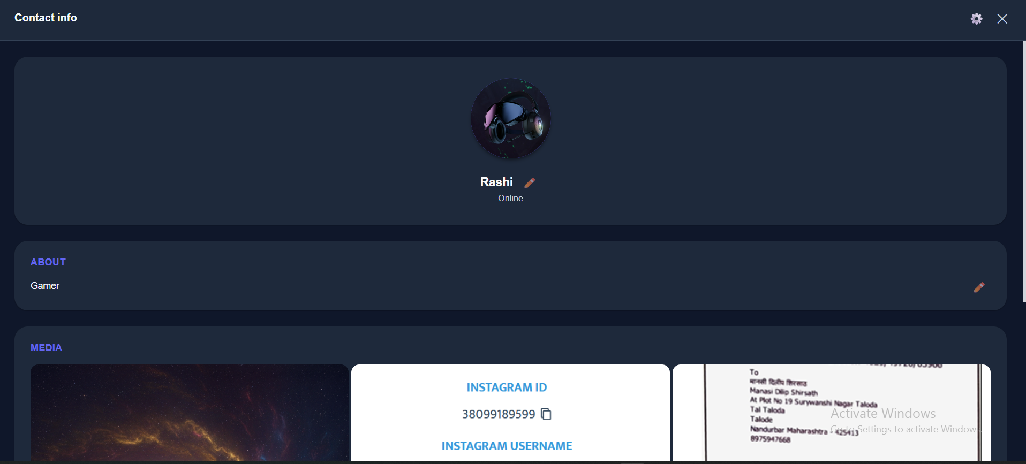
Contact Info UI

Slide 9
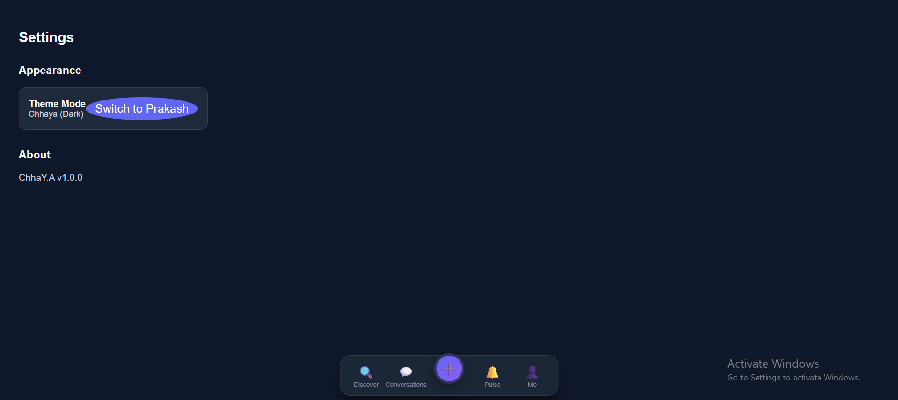
Settings UI

Slide 10
Future Scope
• End-to-End Encryption
• Voice & Video Calling
• Cloud Deployment
• Mobile App Version
• AI-based Smart Replies

Slide 11
Market Opportunity
• India has 800M+ internet users
• Growing demand for secure communication
• Opportunity for Made-in-India platform
• Focus on privacy & scalability

Slide 12
UI & Design Highlights
• Modern dark/light theme (Chhaya & Prakash)
• Clean chat bubbles & real-time updates
• Profile management & media sharing
• Responsive layout design

Slide 13
Development Workflow
1. Requirement Analysis
2. UI Design & Frontend Implementation
3. Backend API Development
4. Database Integration (MongoDB)
5. Testing using Postman
6. Deployment Planning

Slide 14
Product Roadmap
Phase 1: Basic Messaging System
Phase 2: Group Chat & Media
Phase 3: Encryption & Cloud Hosting
Phase 4: Mobile Application Launch
Phase 5: AI-powered Smart Features

Slide 15
Conclusion
A scalable and secure full-stack chat application
Built using modern web technologies
Ready for real-world deployment and expansion

Slide 16
Thank You

