Slide 1
NephroTwin
A personal digital twin of kidney function for early detection and management of chronic kidney disease
[Team name] · [Institute]

Slide 2
CKD is silent, common in India, and judged one noisy result at a time
101 M
136 M
~315 M
Indians with diabetes (ICMR-INDIAB-17, 2023)
with prediabetes
with hypertension, the other leading cause of CKD
Kidney function falls for years without symptoms; many people are diagnosed late.
A single eGFR value is noisy: a real decline is easy to miss and a one-off bad result is easy to over-react to.
Clinicians need the trajectory: where this person is heading, how sure we are, and what would change it.

Slide 3
A twin, not a risk score: six properties shown in the demo
Personal
Continuously updated
Predictive
Own state per patient: current eGFR and slope.
Bayesian (Kalman) update after every result.
Forecast eGFR; P(eGFR < 30) and P(eGFR < 15).
Simulatable
Honest
Two-way
What-if care plans with trial-based effects.
Conformal 80% intervals, checked on unseen patients.
Recorded plans are compared with later results.

Slide 4
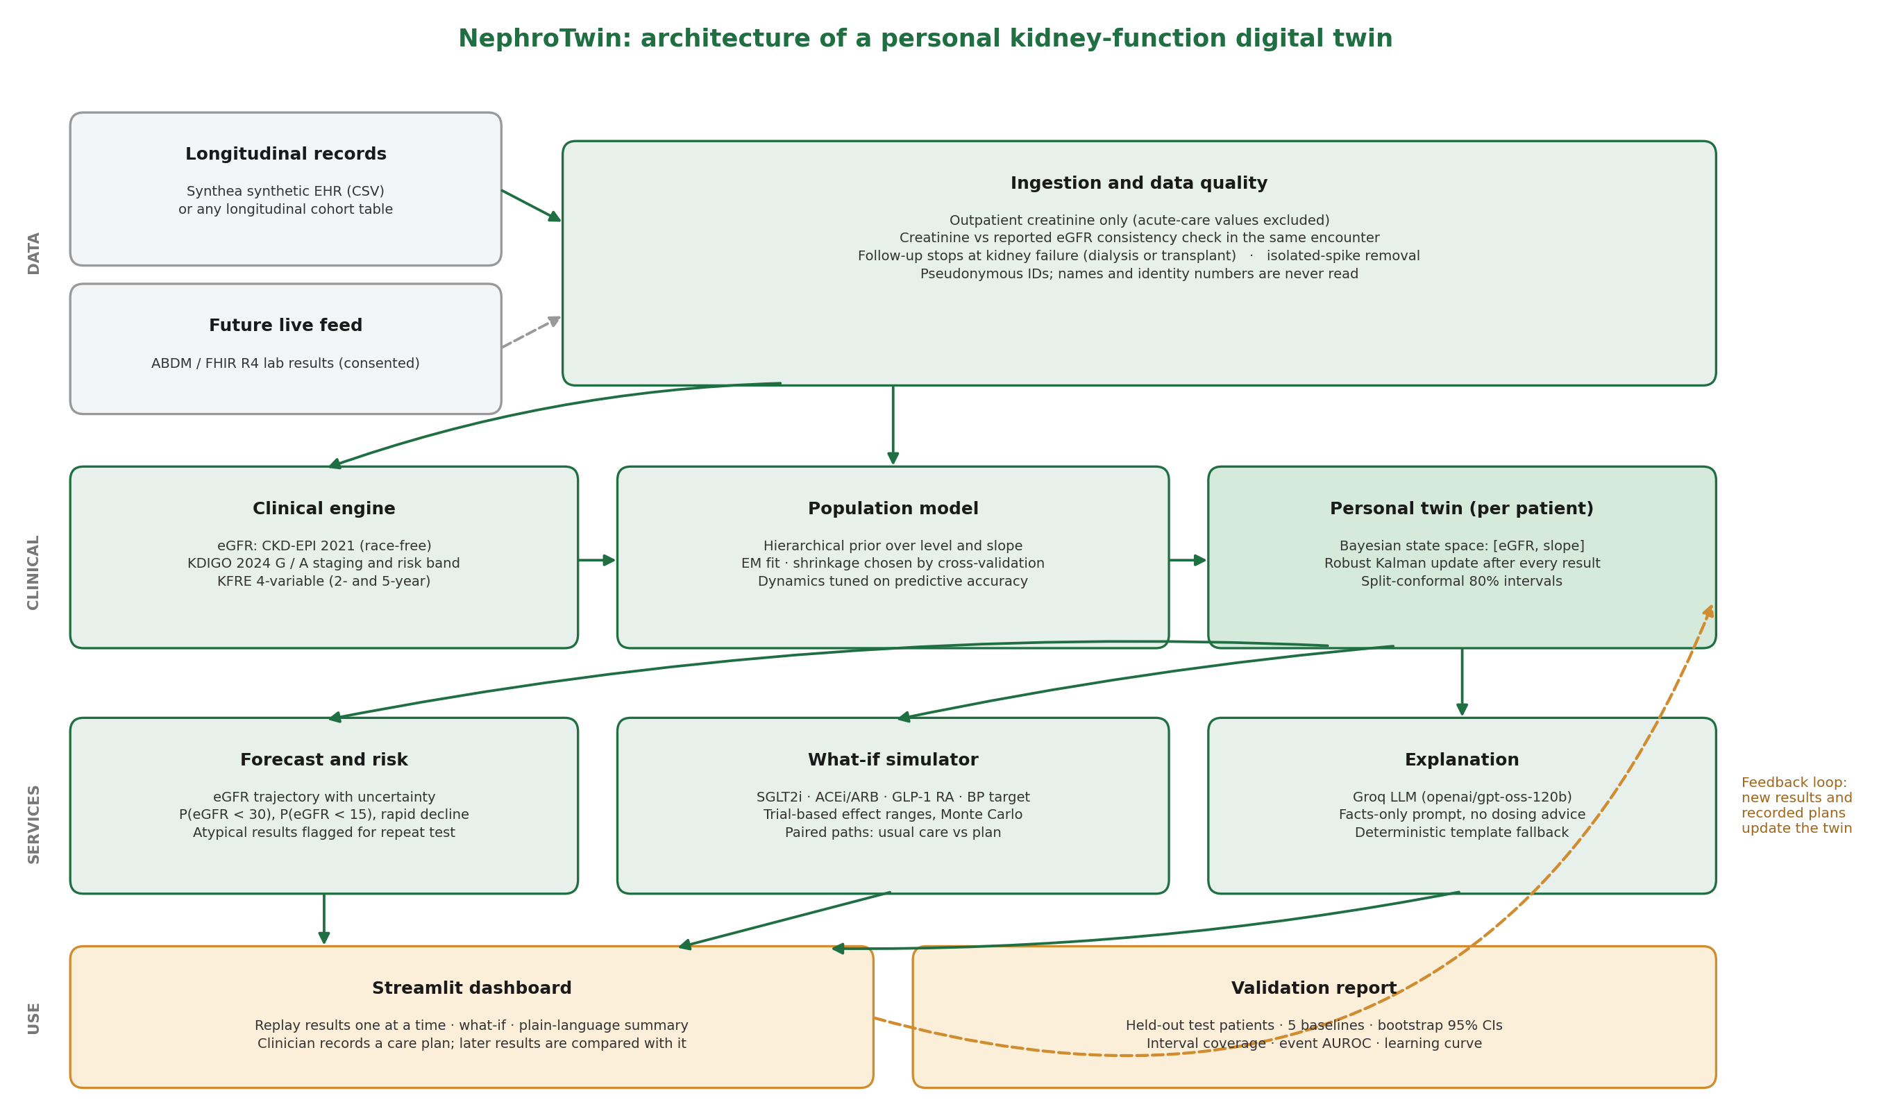
Architecture

Slide 5
How the twin works
Clinical engine
eGFR by CKD-EPI 2021 (race-free) · KDIGO 2024 staging · KFRE 4-variable where valid
Population model
Hierarchical prior over starting eGFR and slope · EM fit · shrinkage chosen by cross-validation
Personal twin
State-space model [eGFR, slope] · robust Kalman update · atypical results flagged for repeat test
What-if simulator
SGLT2i, ACEi/ARB, GLP-1 RA, BP target · triangular effect ranges from trials · paired Monte Carlo
Explanation
Groq LLM (openai/gpt-oss-120b) writes patient and clinician notes from computed facts only · template fallback

Slide 6
Data: synthetic patients, cleaned like real records
404
4,274
9 yrs
21%
patients after cleaning (Synthea v4.0.0, ages 40-85)
outpatient creatinine results
median follow-up per patient
CKD G3 or worse at entry
Acute-care results excluded (6,712): hospital values reflect acute kidney injury, not chronic function.
Creatinine that contradicts the lab eGFR in the same visit removed (7,412). Without this, healthy people look like severe CKD.
Follow-up stops at dialysis or transplant (1,541 results); isolated spikes removed (103).
Names and identity numbers are never read; only pseudonymous IDs leave the pipeline.

Slide 7
Results on 121 unseen test patients
Beats straight-line extrapolation
2.1 points better next result; 13.4 points better at 1 year+ (95% CIs exclude zero).
Ties last value carried forward
Difference not significant. Stable synthetic cohort makes this baseline strong.
Honest uncertainty
82% of next results and 84% at 1 year+ fell inside the 80% interval.

Slide 8
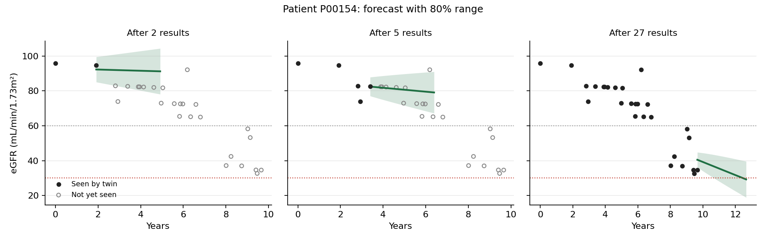
The twin learns each patient as results arrive
After 2 results the forecast leans on the population and is wide; after 5 it narrows; after 27 it tracks the decline and projects crossing eGFR 30.
Event prediction (eGFR below 30 at about 2 years): AUROC 0.93 vs 0.58 for the population model, but only 5 events, so preliminary.

Slide 9
What-if care plans and plain-language summaries
Scenario | Slower decline (range) | Evidence
SGLT2 inhibitor | 30% to 55% | DAPA-CKD, EMPA-KIDNEY, DAPA advKD
ACE inhibitor / ARB optimisation | 5% to 25% | RENAAL, IDNT
GLP-1 RA (semaglutide) | 20% to 40% | FLOW
Blood pressure to target | 0% to 20% | KDIGO 2021 BP guideline
Usual care vs plan
Both arms use identical random draws, so the gap reflects the plan. Output: eGFR difference and kidney-failure probability, each with a range.
Explanation
Scenarios show trial averages applied to this twin, not personal predictions of treatment response.
Patient and clinician summaries from computed numbers only. No diagnosis, no dosing. Works without a key through a fixed template.

Slide 10
Limitations, safeguards and next steps
Limitations
Safeguards
Next steps
Synthetic US-modelled data with mostly stable kidney function.
Few progression events, so event metrics are preliminary.
Treatment effects are trial averages.
Not yet validated on Indian patients.
No real patient data; identity fields never read.
Atypical results flagged for repeat testing.
KFRE labelled outside its validated range.
Decision support only; shown on every screen.
Validate on an Indian CKD cohort with ethics approval.
Calibrate eGFR and KFRE for Indian populations.
Connect to ABDM-linked lab results through FHIR, under DPDP Act 2023 consent rules.

