Slide 1
Superstore Sales & Profit Dashboard
Interactive Dashboard for Business Stakeholders
Presented by: Sahil Jaronde | June 2025

Slide 2
Objective & Tools
Objective: Create an interactive dashboard for stakeholders to analyze sales, profit, and growth.
Tools Used:
- Power BI (Data Visualization & DAX)
- Excel/CSV (Dataset)

Slide 3
Dataset Summary
Dataset Source: Kaggle - Superstore Dataset
Key Features:
- Sales, Profit, Discount, Quantity
- Region, Segment, Category, Sub-Category
- Order Dates for time-based trends
- ~10,000+ records

Slide 4
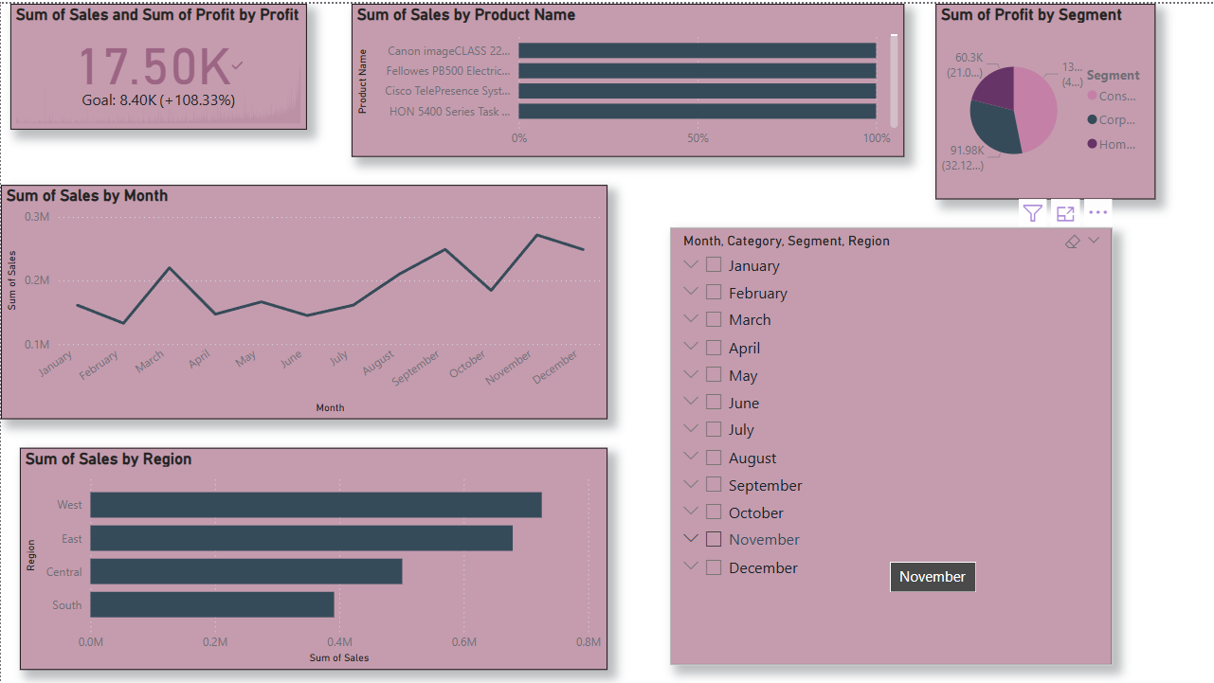
Dashboard Screenshots

Slide 5
KPIs & Visuals
KPI | Example Value | Visual Type
Total Sales | ₹2,975,000 | Card
Total Profit | ₹430,000 | Card
Profit Margin (%) | 14.46% | Card
Monthly Sales | — | Line Chart
Sales by Region | — | Bar / Map
Profit by Segment | — | Pie / Bar
Top 5 Products | — | Bar Chart

Slide 6
Business Insights
Highest Sales in West Region, especially in Technology category.
Corporate Segment shows highest profit margin.
Top-selling products: Office Chairs, Phones, Binders.
Office Supplies: High volume, low margin.
Seasonal trend: Q4 peaks in sales.

Slide 7
Conclusion
Built a dynamic and interactive dashboard with KPI tracking.
Enabled stakeholders to make informed decisions based on visuals.
Outcome: Improved visibility into regional, segment, and product performance.

