Slide 1
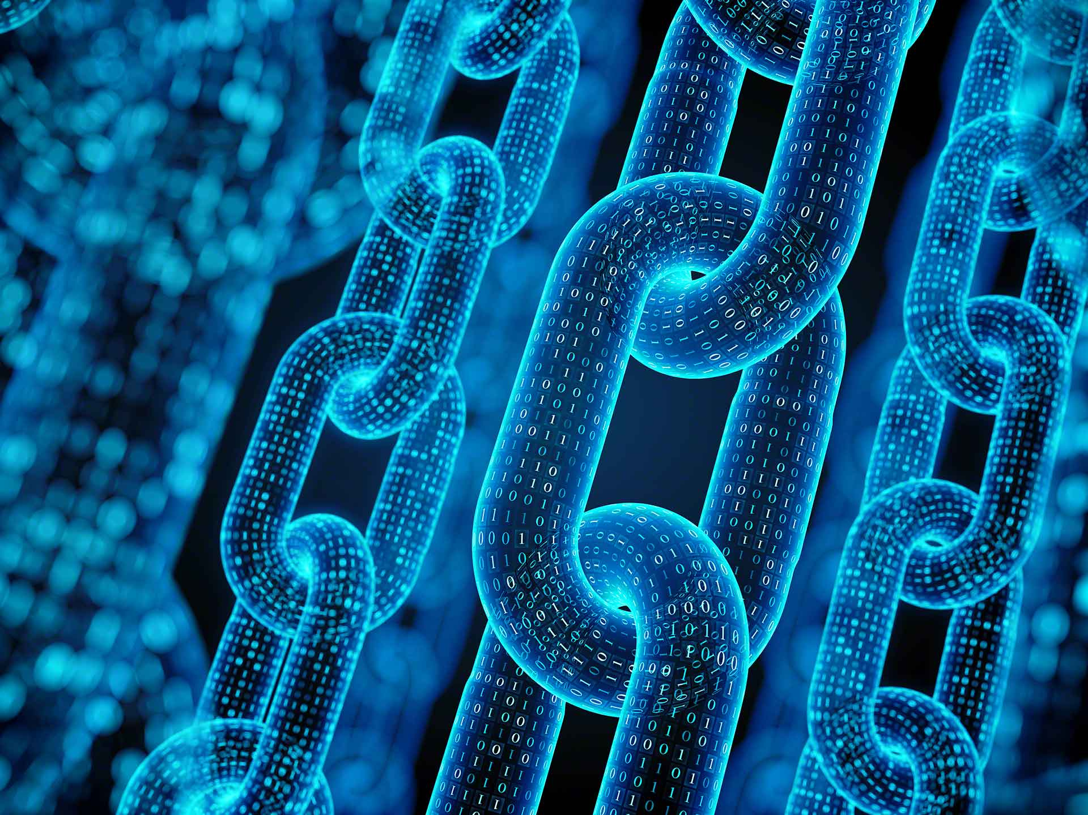

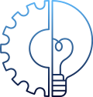



What is
DeCentraSocial
WEB 3.0

Slide 2

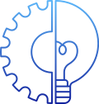



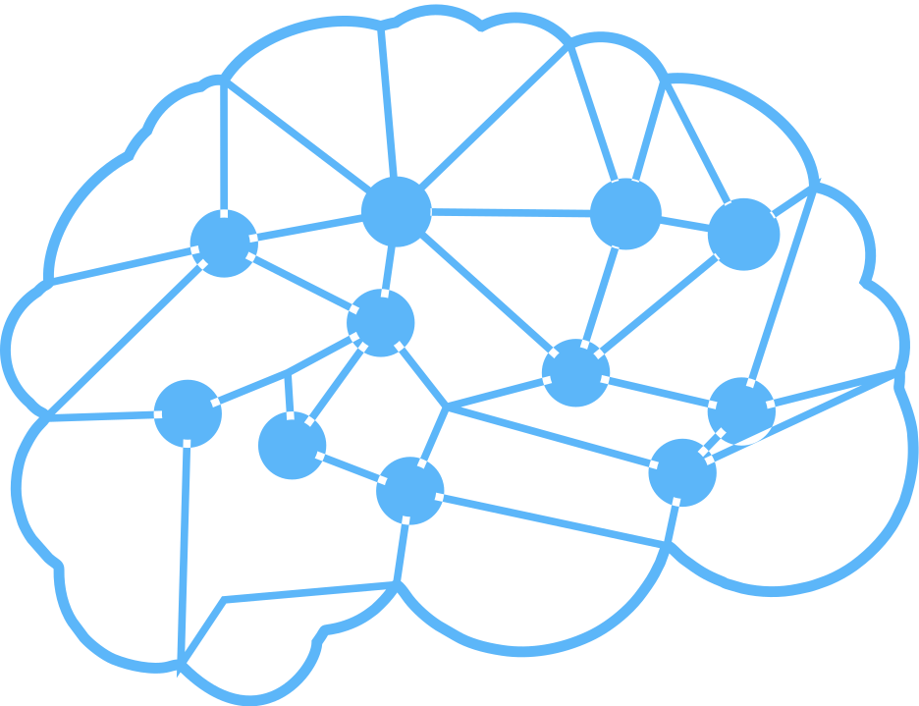
DecentraSocial
It is a Decentralise Version Of Social Media based on Web 3.0 Technology.
Censorship-resistant
Open to everyone.
Users cannot be banned de-platformed, or restricted arbitrarily.
Offer an improved monetization framework for content creators via non-fungible tokens (NFTs), in-app crypto payments, and more.
Decentralized social networks provides users a high level of privacy and anonymity
Decentralized social networks rely on decentralized storage, not centralized databases, which are considerably better for safeguarding user data
Eliminate the "middle-man".
Content creators have direct ownership over their content.
Engage directly with followers, fans, buyers, and other parties, with nothing but a smart contract in between.

Slide 3





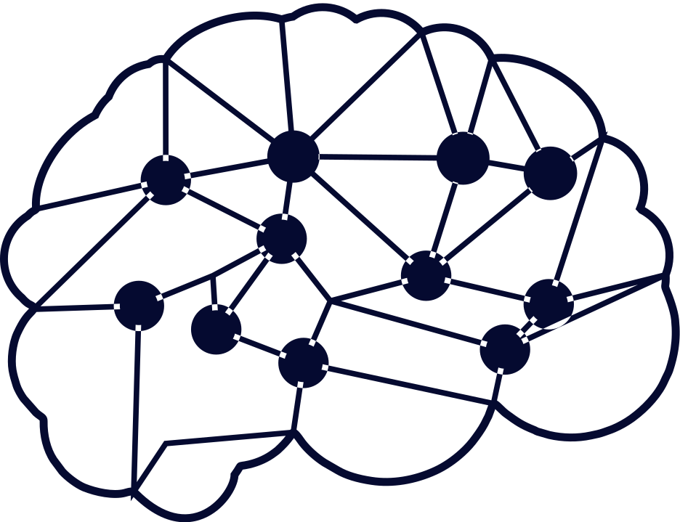
WEB 3.0
01
Decentralization
03
Connectivity and Ubiquity
02
Trust less and Permissionless
04
Semantic Web
It is a collection of ideologies and principles that makes the internet’s data accessible to users and creators. The core concepts driving the 3rd iteration of the web are decentralization, transparency, and user utility.

Slide 4
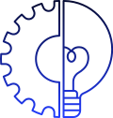
BLOCKCHAIN
DECENTRALIZED
PEER TO PEER
The control/power is not held by a single entity. Instead, it is distributed among multiple participants.
Even if one node is corrupted/fails, the network repair itself and stays functional.
Direct peer to peer transaction of data or finance.
Decentralized nature of blockchain instills trust in the process such that two unknown parties can directly interact/transact with each other.
DISTRIBUTED
Data is distributed among the nodes(computers/hard drives).
Even if one node is tampered, the data does not get compromised.

Slide 5
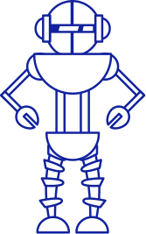

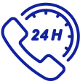

Benefits of Blockchain
Transparency
Accountability
Traceability
Cryptography

Slide 6



NFT(Non-Fungible Token)
A Cryptographic asset on a Blockchain with unique identification codes and metadata that distinguish them from each other.
A non-fungible token (NFT) is a unique digital asset that represents ownership of real-world items like art, video clips, music, and more.
NFTs are often based on the Ethereum blockchain, in the form of ERC-721 tokens.
Digital transformation and adoption of blockchain technology also mean the employment landscape is changing. More people are already working on NFTs, blockchains, and cryptocurrencies than ever before, but it will become increasingly common.

Slide 7
Benefits of NFT
Limited
Indivisible
Benefits
Easily Transferable
Unique
Trustworthy
Maintain Ownership
Rights

Slide 8

How Our Project Works
User will create a profile using metamask.
Then user can sell his NFT'S on the different cryptocurrency and NFT exchange platform.
Now user can upload its post in NFT format.
Hash of the metadata will be used to sell NFT'S on different platform.
Users follower will tip his posts.
All the transactions will be stored on the smart contracts.
Most tipped post will be on top of the feed.

Slide 9
Technology Stacks
React Js
Blockchain
Route Dom Dependency
(Home page to Profile page.)
Some Libraries
Chai Assertion Library
Moca Testing Framework
Ethers Library(Blockchain Interaction)
Transaction Will perform on Metamask
Metadata will be stored on blockchain
NFT(Non- Fungible Token)
Smart Contracts
Solidity
IPFS(Inter Planetry File System) Decentralize file storage system.
Hardhat(Smart Contract development framework for etherium)
Zepplin Smart Contract Library(NFT Standards)
Hash Value of metadata will store on IPFS

Slide 10


Thank You

