Slide 1
Agent-Based RAG Chatbot using MCP
Multi-Document, Multi-Agent Architecture
Presented by: Sahil Suriya
Date: July 5, 2025

Slide 2
Agent-Based Architecture with MCP Integration
- IngestionAgent: Parses and chunks documents
- RetrievalAgent: Searches top-k relevant chunks using vector DB
- LLMResponseAgent: Answers based on retrieved chunks
- CoordinatorAgent: Controls and passes MCP messages
✅ MCP standardizes message flow between agents (traceable communication)

Slide 3

System Flow with MCP Message Passing
1. User uploads document → IngestionAgent
2. Query → RetrievalAgent → relevant chunks
3. Chunks → LLMResponseAgent → answer
4. Final response → UI
📨 MCPMessage (trace_id, sender, receiver, payload) ensures structured flow

Slide 4

Tech Stack Used
- Frontend: Streamlit
- Backend: Python
- Vector Store: FAISS / Chroma
- Embeddings & LLM: HuggingFace Transformers
- Protocol: MCPMessage (custom JSON)
- Supported Files: PDF, DOCX, PPTX, CSV, TXT

Slide 5
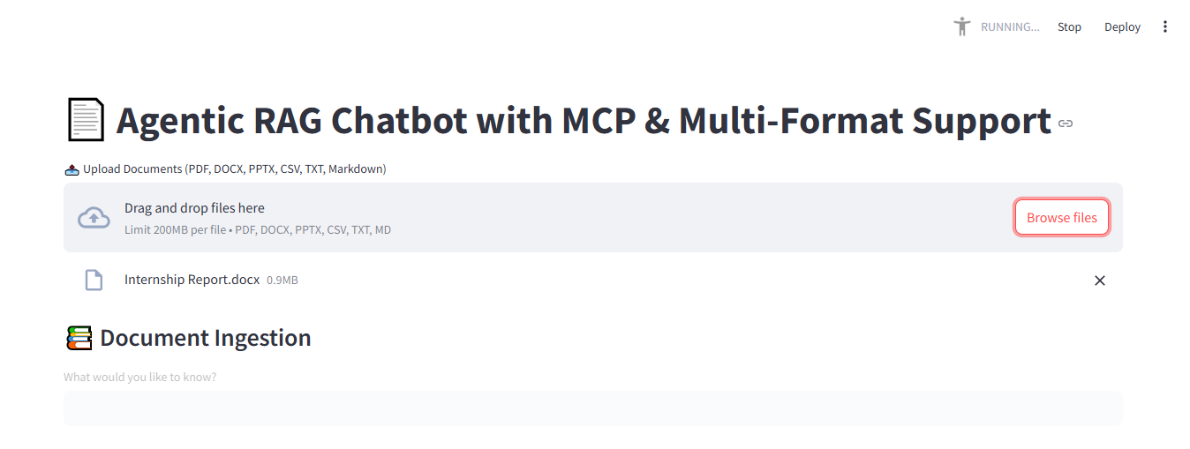
Working Application – UI Screenshots
Fig1 : Document Uploading and Ingestion

Slide 6
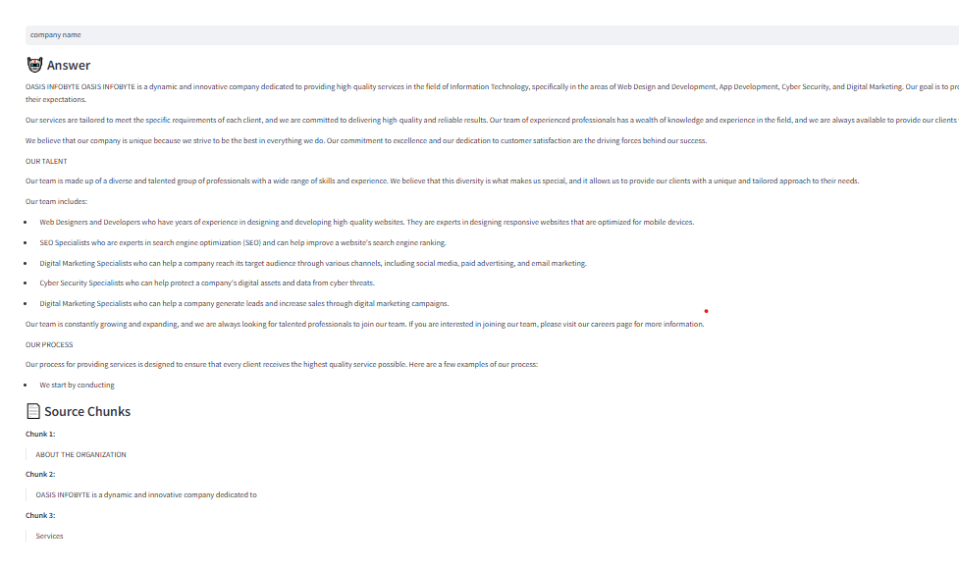
Fig 2: Query and Response

Slide 7
Challenges & Future Scope
File parsing inconsistencies (PDF tables, DOCX formats)
Multi-turn context handling
Latency with large documents and LLMs
Add long-term memory & user profiles
UI upgrade to production frontend (React)
Integrate speech and multimodal support

