Slide 1
Real-Time Stock Market Data Web Application
(Overview of the Project Synopsis)
SAHIL
16 May 2023 Batch
Web developer group
Indian Institute of Technology (Ropar)

Slide 2
AGENDA
Requirement
Introduction
Tools and Techniques
Design of Project
Working of Project
Conclusion
Live Demo
References

Slide 3
Requirements
Display real-time stock market data in an easy-to-understand format.
Responsive design
User authentication system.

Slide 4
Introduction
Real-Time Stock Market Data Web Application that provides real times data about the stocks of any company.
On this platform, users can find the following details about stocks –
Opening and closing price of stocks
The lowest and highest price of stocks
Volume of stocks
Dividend amount
This platform provides all this information with graph visualization.

Slide 5
Tools and Techniques
Frontend – React.js
Backend – Express.js
Authentication – JWT and Nodemailer
Database – MongoDB
API - Vantage API

Slide 6
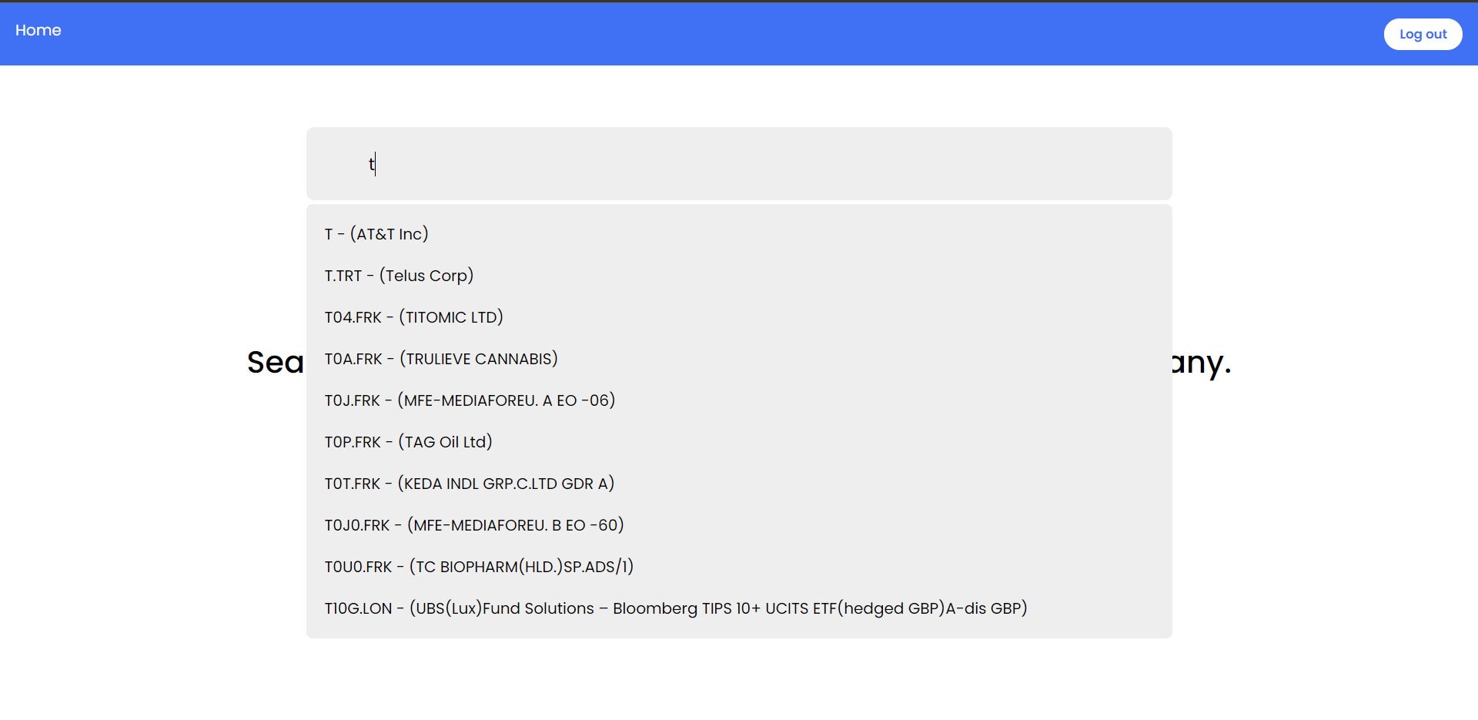
Design
Search for the company name
Search
Results

Slide 7
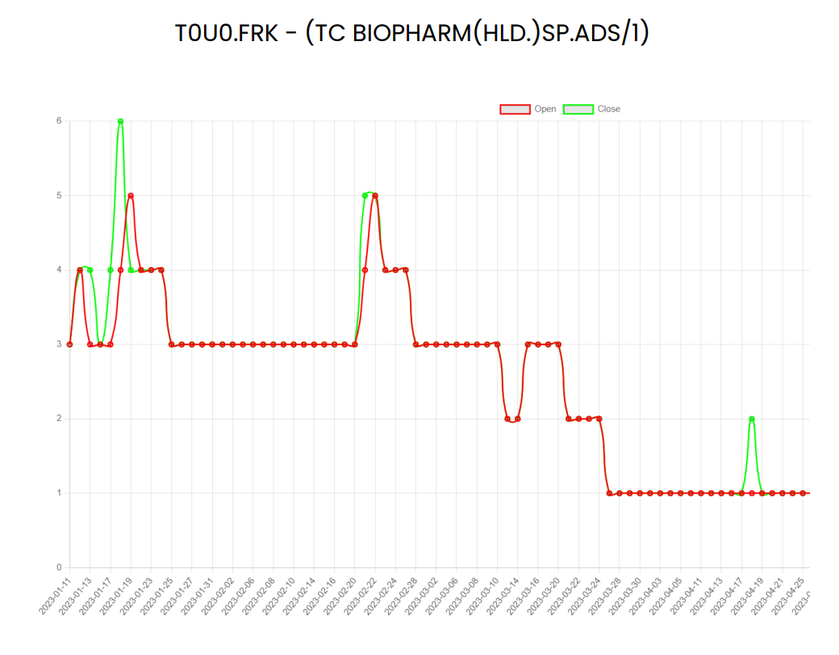

Slide 8
Working of Application
Enter
Authenticated
Not Authenticated
Search for the company name
Login
Sign up
Get graphical visualization of stocks information
Account Verification
End

Slide 9
Conclusion
In this project, We have created a web application to provide information about company stocks in an easy-to-understand format.
We have shown the stock information through graph visualization.
We also implemented the user authentication system.
My main challenge was handling CORS errors and working with cookies used for user authentication.

Slide 10
References
https://blog.webdevsimplified.com/2022-07/react-router/ (to learn about React Router DOM)
https://www.alphavantage.co/documentation/ (Alpha Vantage API)
https://expressjs.com/ (Express.js)

Slide 11
Q&A

