Slide 1
Real-Time Stock Market Data Web Application
(Reading HDFCBANK CSV File Data and Plotting a Graph in Adalo)
Name Sahil
16 May 2023 Batch
Web Developer Group
Indian Institute of Technology (Ropar)

Slide 2
Index
Task Instructions
Introduction
Tools and Technology
Demo
References
The End

Slide 3
Task Instructions
Download the HDFC Bank Data (CSV File).
Create an Adalo project.
Create a Webpage showing low and high prices using the chart.
Apply filters and sorting to the chart.

Slide 4
Introduction
Real-Time Stock Market data web application is a web-based app to provides the user with information about the stocks of the company in easy to understand way.
In this web application users can analyze the data through graph visualization.
On this platform, users can get information about the lowest and highest price of stocks.
Open and close the price of stocks.
Dividend amount and volume.

Slide 5
Tools and Technology
Adalo
Adalo is a no-code platform to create apps and websites in an easy way.
Adalo provides a virtual environment to drag and drop components to create the website.
Adalo provides many types of components like forms, buttons, icons, charts, and many more.
Adalo also integrates with third-party APIs to create functionality like authentication, and data storage.
Adalo also provides a real-time preview of the website.

Slide 6
Line Chart
The line chart is a type of data visualization that shows information by connecting a straight line.
Generally line chart is used to show trends and relations between 2 variables over a continuous time period.
Why line chart?
By using the line chart, we can analyze the data trends, fluctuations, and patterns of prices of stocks of the company.

Slide 7
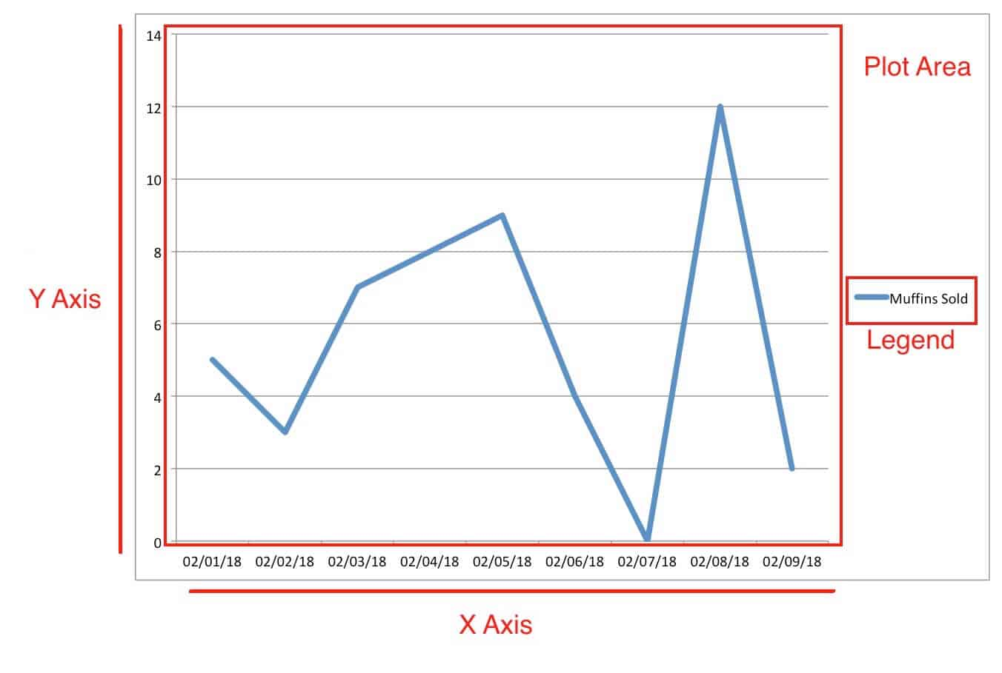


Slide 8
Demo
https://app.adalo.com/apps/12107958-f30f-45a5-a5e4-c561b251f11b/screens

Slide 9
References
https://www.adalo.com/ (Adalo)
https://help.adalo.com/component-basics/marketplace-components/how-to-insert-bar-charts-and-line-graphs (Adalo chart)

Slide 10
Thanks

Slide 11
Q&A
2020mcb1248@iitrpr.ac.in

