Slide 1
Real-Time Stock Market Data Web Application
(Getting Started and Full Walkthrough of Adalo)
SAHIL
16 May 2023 Batch
Web developer group
Indian Institute of Technology (Ropar)

Slide 2
Index
Task Instructions
Introduction
Tools and Technology
Line Chart
Design
Demo
References
The end

Slide 3
Instructions
Explore different functionalities of Adalo
Create a multiple-page responsive website
Functionalities of website –
Navbar
Button
List
Form submission and data storage

Slide 4
Introduction
Real-Time Stock Market Data Web Application that provides real times data about the stocks of any company.
On this platform, users can find the following details about stocks –
Opening and closing price of stocks
The lowest and highest price of stocks
Volume of stocks
Dividend amount
This platform provides all this information with graph visualization.

Slide 5
Tools and Technology
Adalo - Adalo is a no-code platform to create responsive websites and apps with easy drag-and-drop functionality.
React.js – frontend library.
Chart.js – Data visualization using the line chart
Vantage API – to get stock data.
News API – to get stocks related news.
Hosting – Vercel

Slide 6
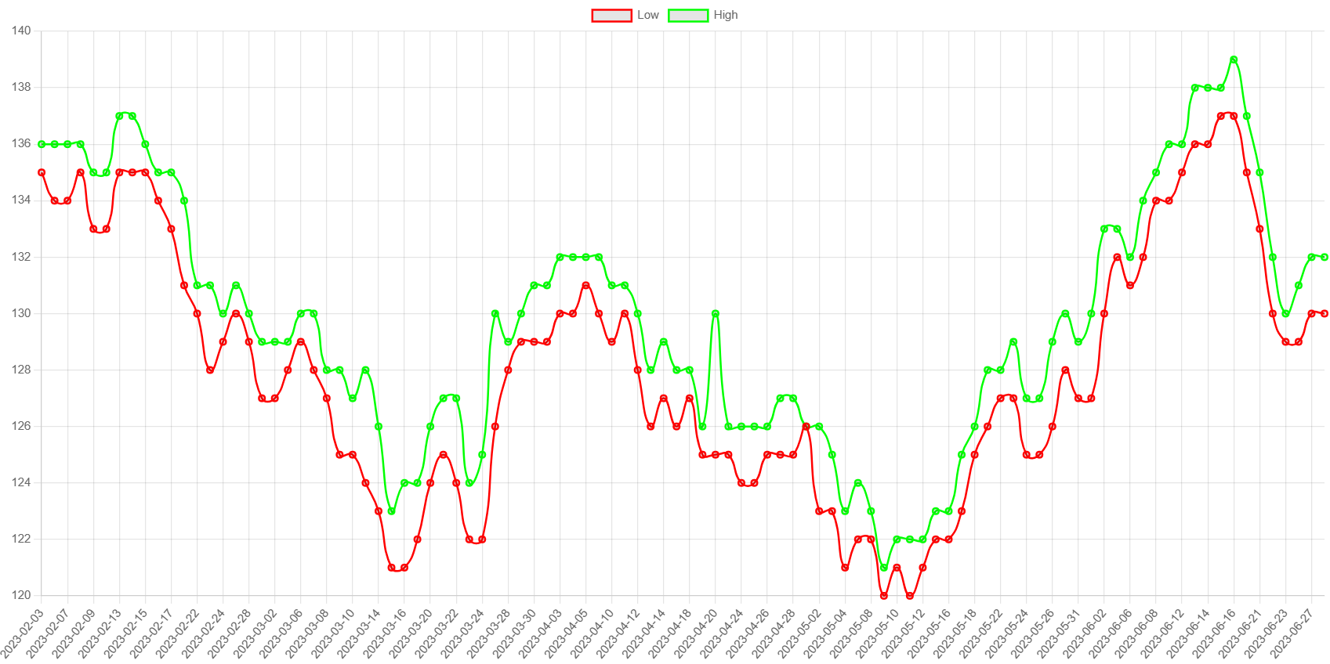
Line Chart of Opening and Closing price of IBM Company

Slide 7
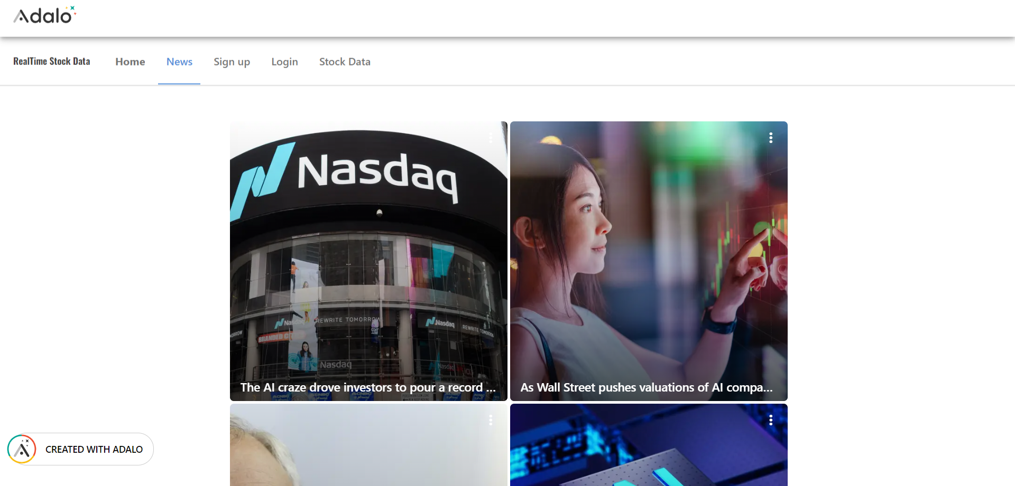
Design

Slide 8
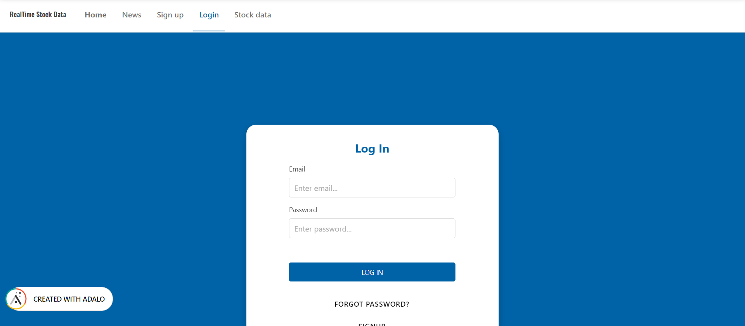
Form

Slide 9
Demo
Project Link
Website link

Slide 10
References
https://blog.webdevsimplified.com/2022-07/react-router/ (to learn about React Router DOM)
https://react.dev/learn (React.js)
https://newsapi.org/docs (News API)
https://www.alphavantage.co/documentation/ (Alpha Vantage API)
https://help.adalo.com/component-basics/marketplace-components/how-to-insert-bar-charts-and-line-graphs
(Adalo resources)

Slide 11
Thank you
2020mcb1248@iitrpr.ac.in

Slide 12
Q&A

