Slide 1

Quandela Challenge
Are Quantum PINNs actually doing anything?
ZombieCats
Zombie1 : Chayma
Zombie2 : Iva
Zombie3 : Sahil

Slide 2
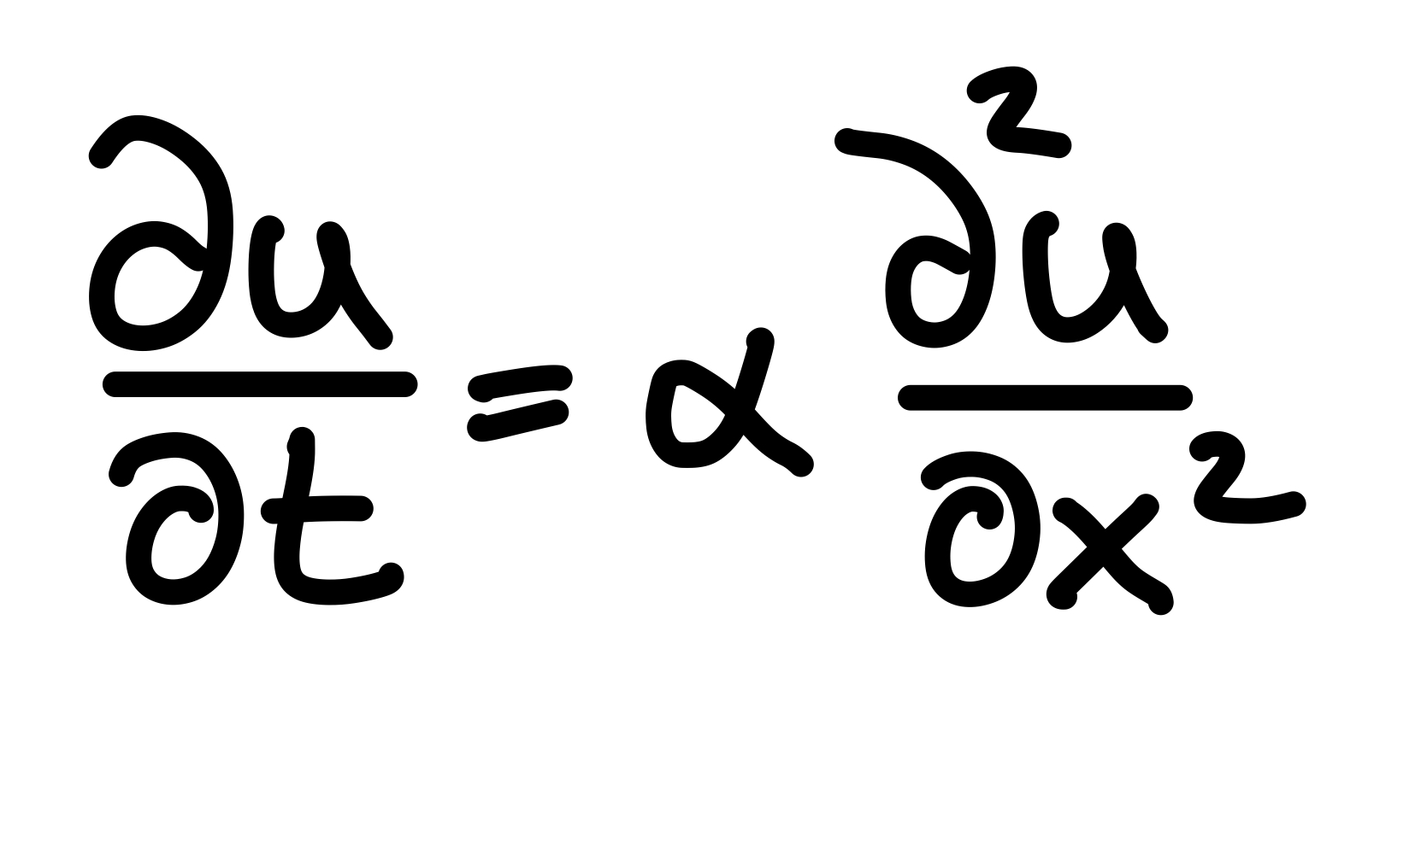
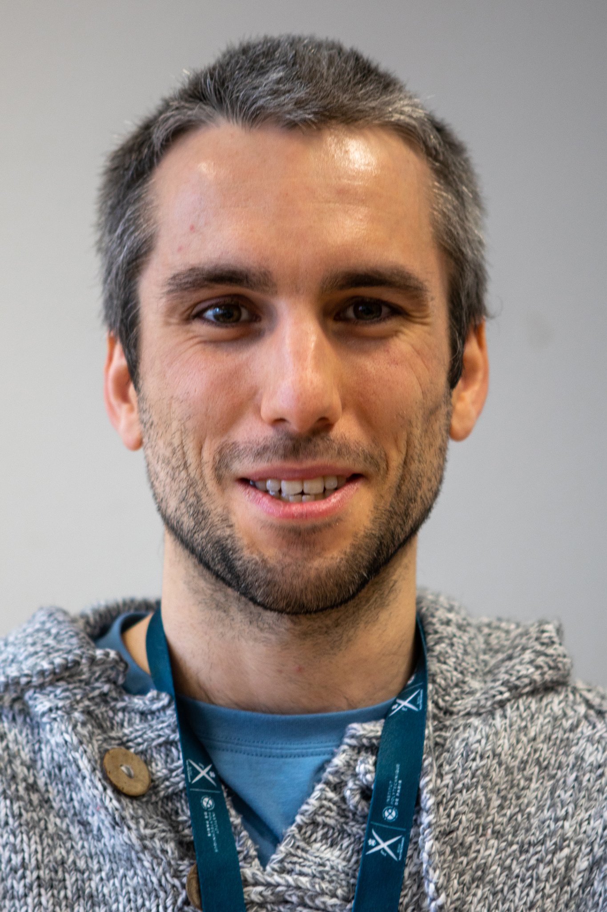

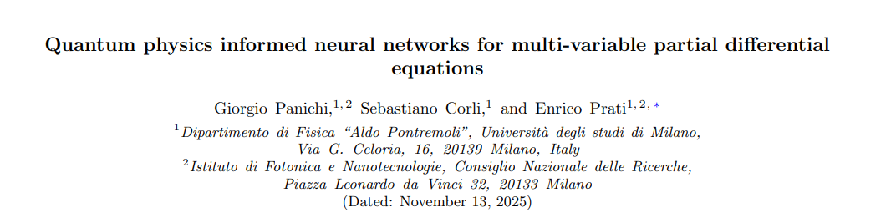
Quantum PINNs vs. PINNs
Why is this interesting?
QPINN:
PINN + quantum model
PINN
NN + physical intuition
MAGIC
Hugo

Slide 3
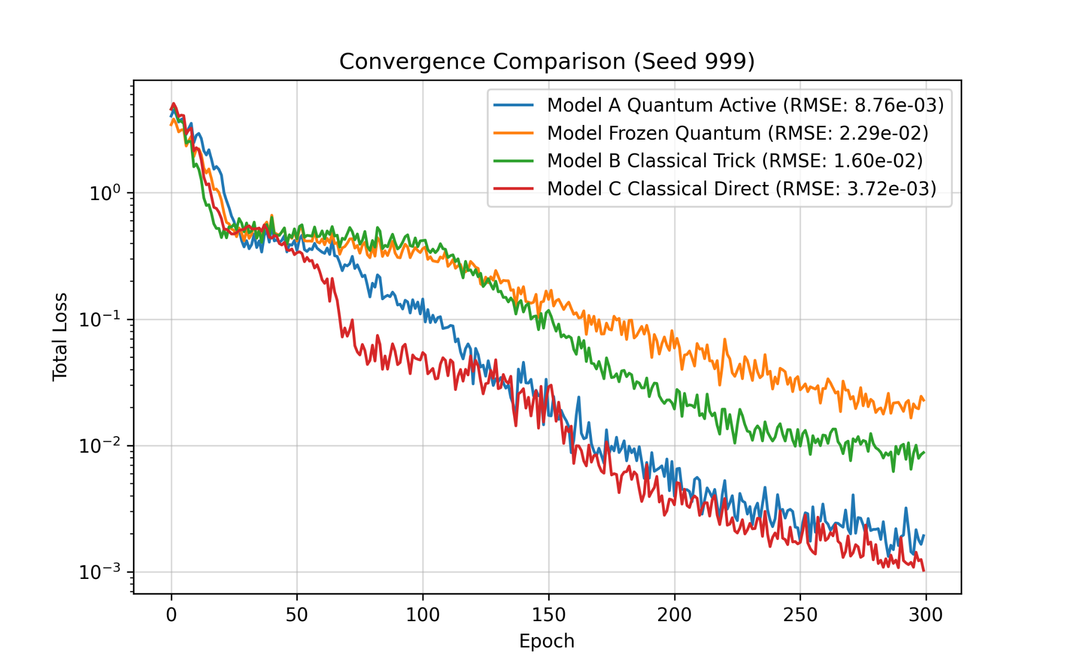
PINNs VS QPINNs: parameter budget
(Q)PINN: ~270 param. : QPINN follows true prediction
PINN no convergence!
(Q)PINN: ~400 parameters
Success!!!
This will be our classical benchmark!
Notes:
Comparing the two started with using the same number of trainable param.
Increase param. both converged. This might be a something. But is the quantum part of thai actually giving us an advantage

Slide 4
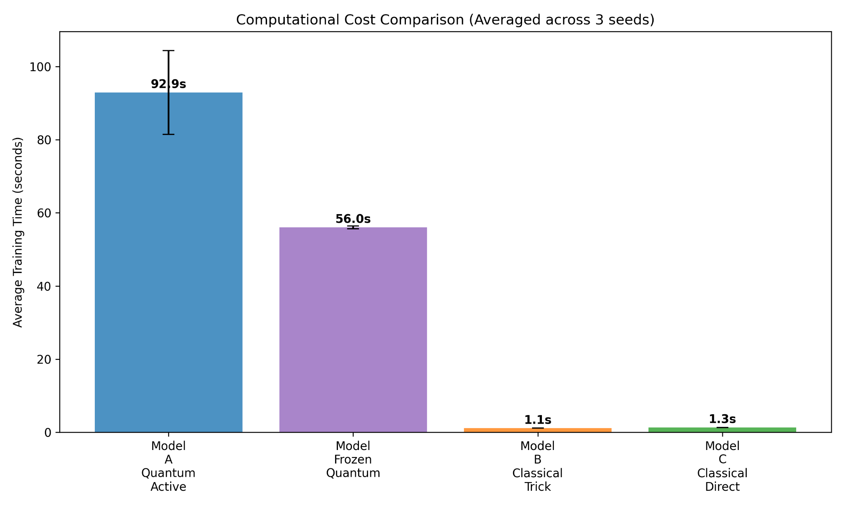
PINNs VS QPINNs: parameter budget with Time
(Q)PINN: ~400 parameters
Still in the regime of
classical simulability
Notes:
This is not a problem that a quantum system will be needed

Slide 5
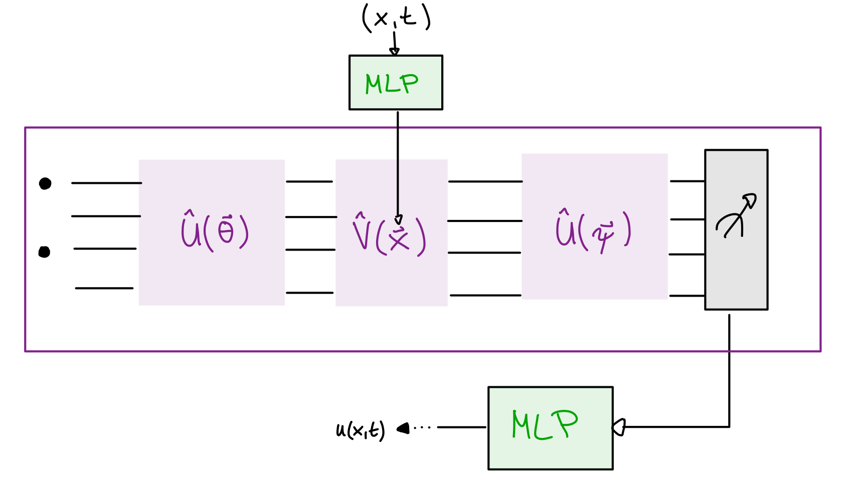
Investigating Quantum Resources
Quantum Resources := # Quantum Parameter

Slide 6
Quantum Resources: circuit ‘depth’
QPINN:
increase # quantum parameters
keep # classical parameters constant

Slide 7
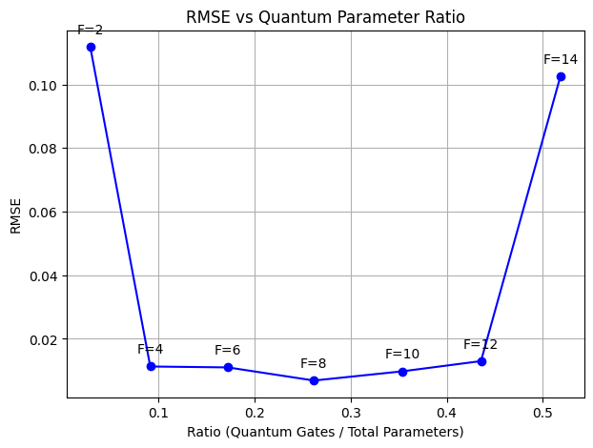
Quantum Resources: circuit ‘depth’
Runtime per seed:
25 - 30 min

Slide 8
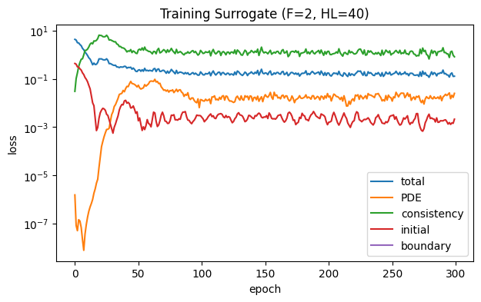
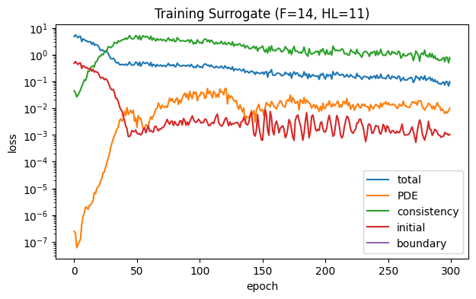
Quantum Resources: circuit ‘depth’
Notes:
plot:
runtime -> how well can we sim. it classically (do we reach interesting regime)
RMSE -> how does accuracy change

Slide 9
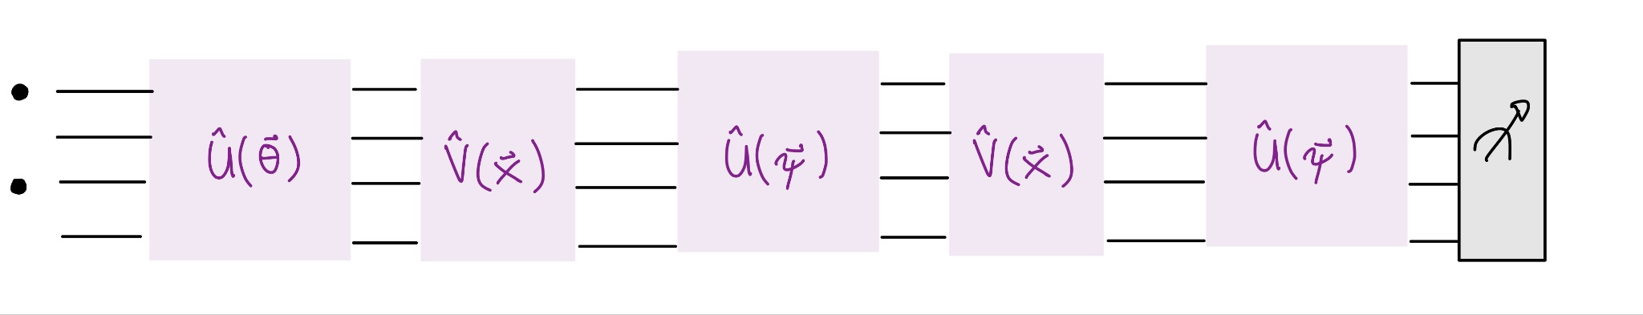
Outlook
Further exploration of ‘Quantum’:
implement ‘layers’, e.g.
change geometry (U)
Look at implementation on real hardware
Look at noise

Slide 10
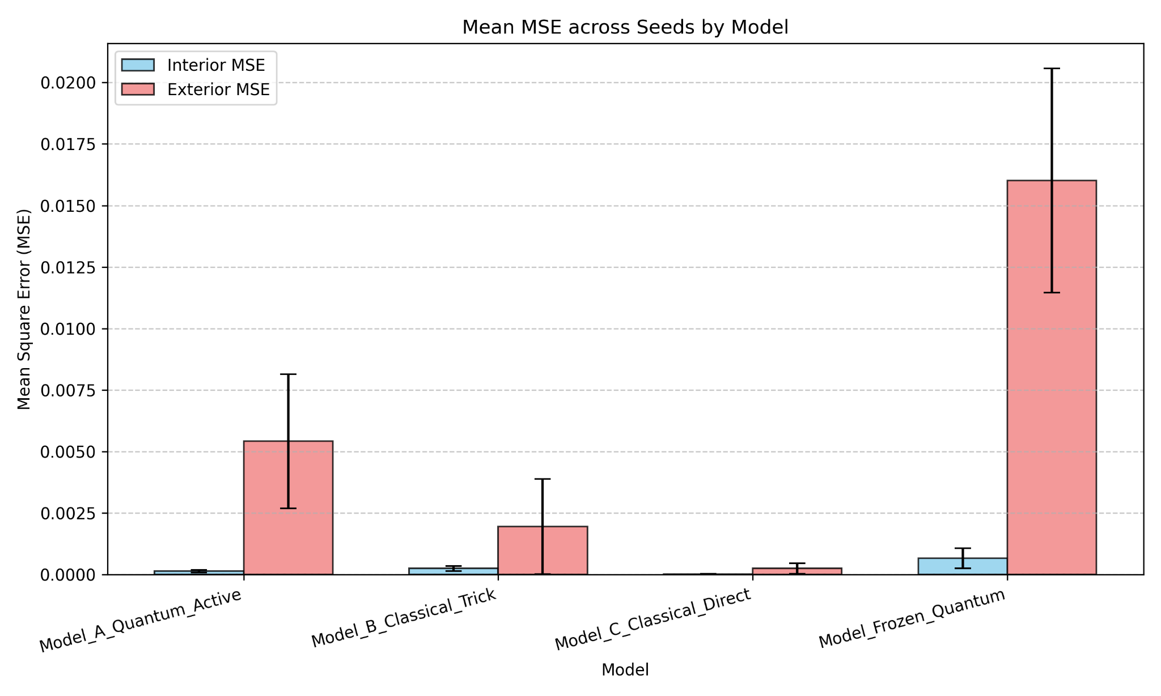
PINNs VS QPINNs: parameter budget
(Q)PINN: ~400 parameters, average across 3 seeds
Notes:
stability:
different seed -> same values (cost function should not change)
not getting the same results for the three seeds some instability

Slide 11
Summary
Tests
Metrics
PINN baseline
MAE
L_inf error
NMSE
Loss convergence
Runtime
Seed stability
Quantum resources:
modify ratio of parameters
increase both # parameter
Freeze Quantum Layer

Slide 12
That’s all Folks!

