Slide 1
Sales Analysis Dashboard
Elevate Labs Internship Task 3 – Power BI
Date : 07/08/2025
By : Sahil Shabbir Wasta (Data Analyst Intern)

Slide 2
Objective of the tASK :
Analyze sales performance, identify top segments, and track profit trends over time using interactive visuals.

Slide 3
Dataset & Tools Overview :
Dataset source : Kaggle – train.csv
(https://www.kaggle.com/datasets/rohitsahoo/sales-forecasting)
Fields used: Sales, Order Date, Category, Segment, Region, etc.
Columns added: Cost, Profit, Profit Margin (by DAX)
Tool Used : Microsoft Power BI

Slide 4
KPI’s Tracked :
Total Sales
Total Orders
Total Profit
Average Margin (Profit)

Slide 5
Dashboard Insights :
Sales: 2.26M Total
Orders: 4,922 Count
Profit: 565K Total
Margin: 25% Average
Peak Sales: Q4 Months
Top Category: Technology
Top Segment: Consumer
Top States: California, New York

Slide 6
Features / Interactivity
Slicers used: Region, Ship Mode, Order Date
Time-series sales trend by Month-Year
Map visualization for geographic insights

Slide 7
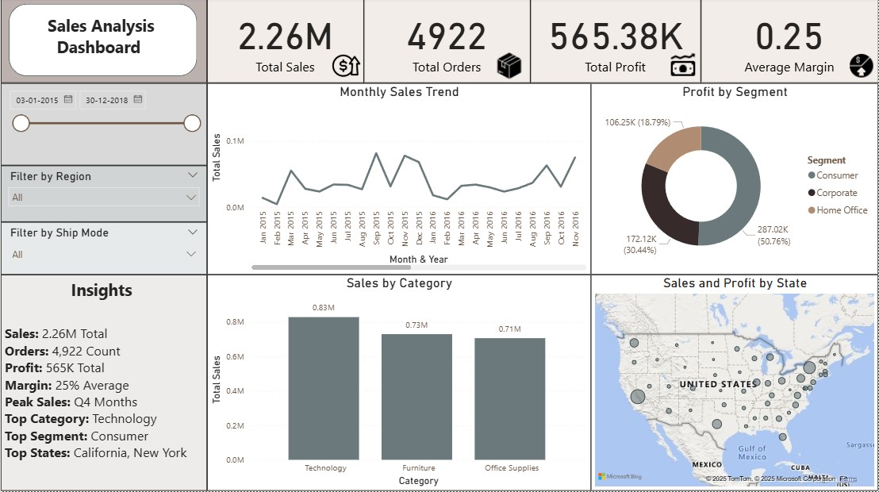
Dashboard Screenshot :

Slide 8
Thank You

