Slide 1

BookBazaar An Online Book Marketplace (Multilingual) with Stripe Payment Integration
Team:- Agile Avengers
Team Members:- Sahil Gujarathi
Saish Thorat
Chintan Tajane
Sanat Tudu

Slide 2
Project Overview
MVPs
Tech Stack
Architecture Diagram
Flowchart Diagram
Use Case Diagram

Slide 3
Project Overview: BookBazaar is an innovative online marketplace for books, offering a multilingual platform for a global audience. It integrates Stripe for seamless and secure payment processing, providing users with an efficient and user-friendly experience.

Slide 4
MVP’s
User Registration and Login
Book Listing (Browse, Search)
Multilingual Support
Book Detail Page
Shopping Cart Functionality
Checkout Process
Stripe Payment Integration

Slide 5
Tech Stack
Frontend: React JS
Backend: Nest JS, Python
Database: MySQL
Payment Gateway: Stripe

Slide 6
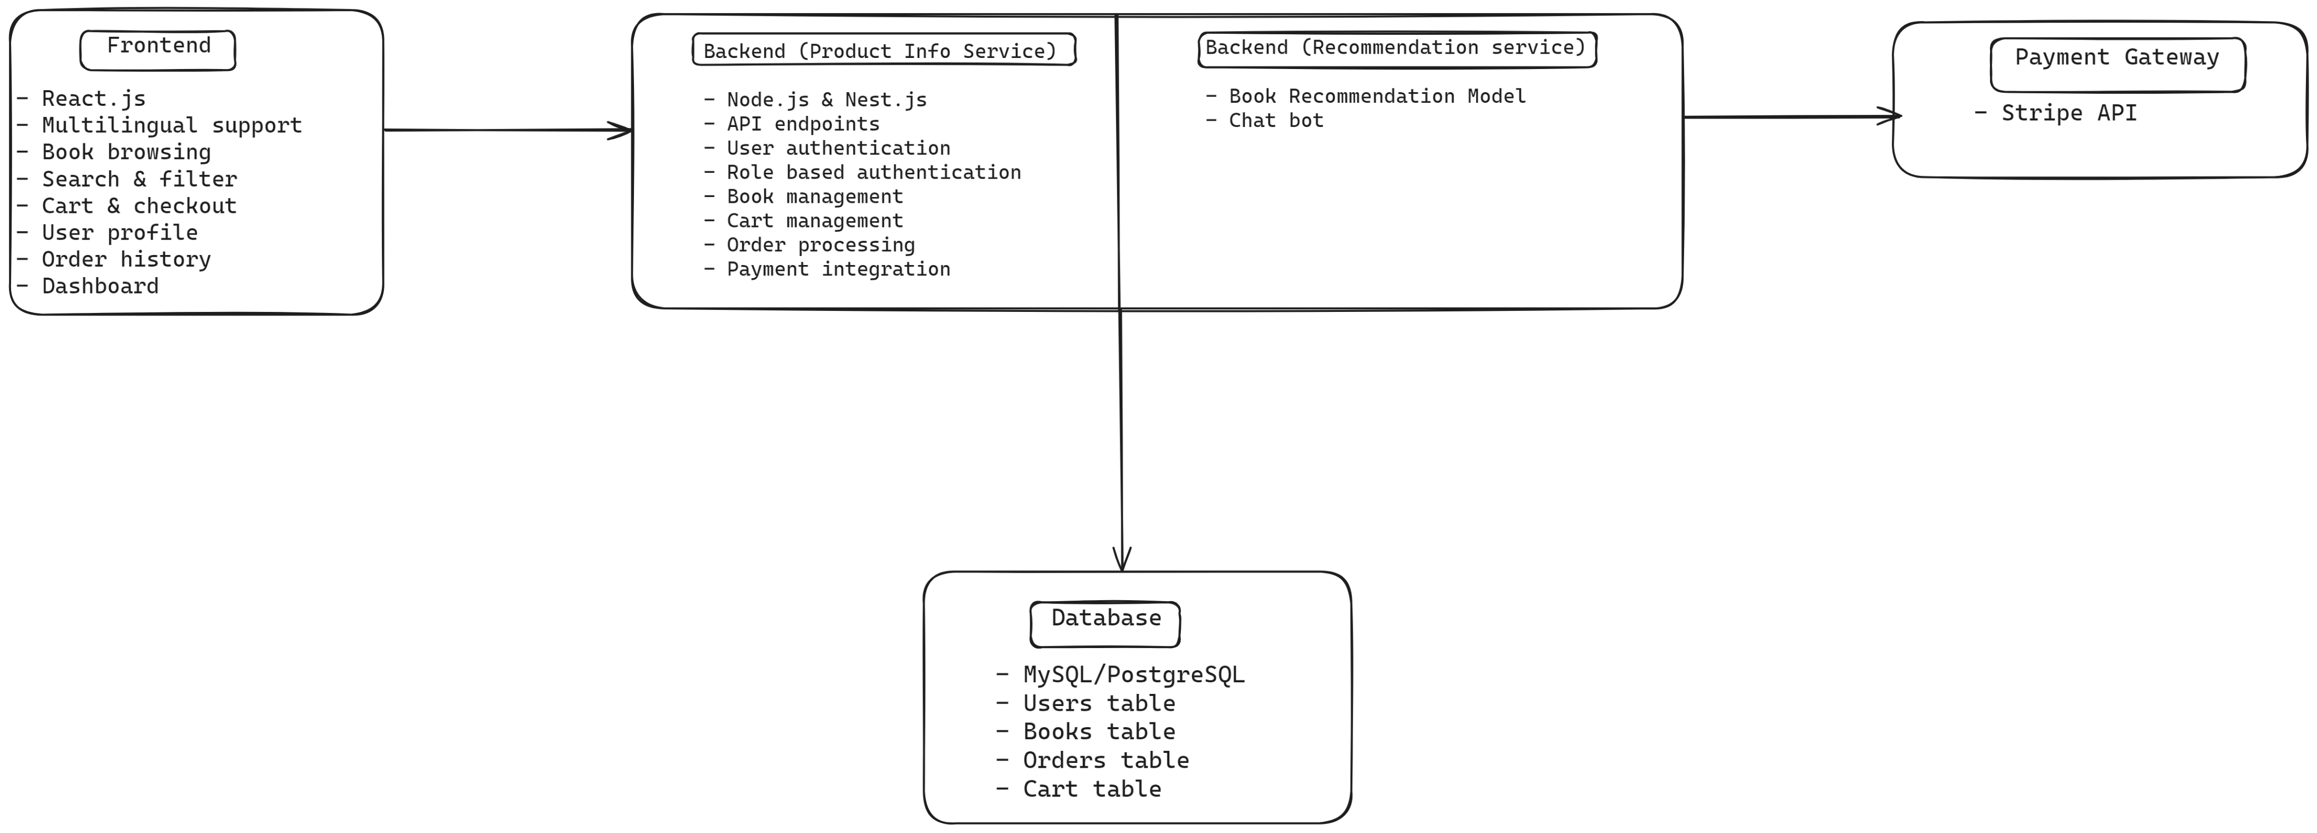
Architecture Diagram

Slide 7
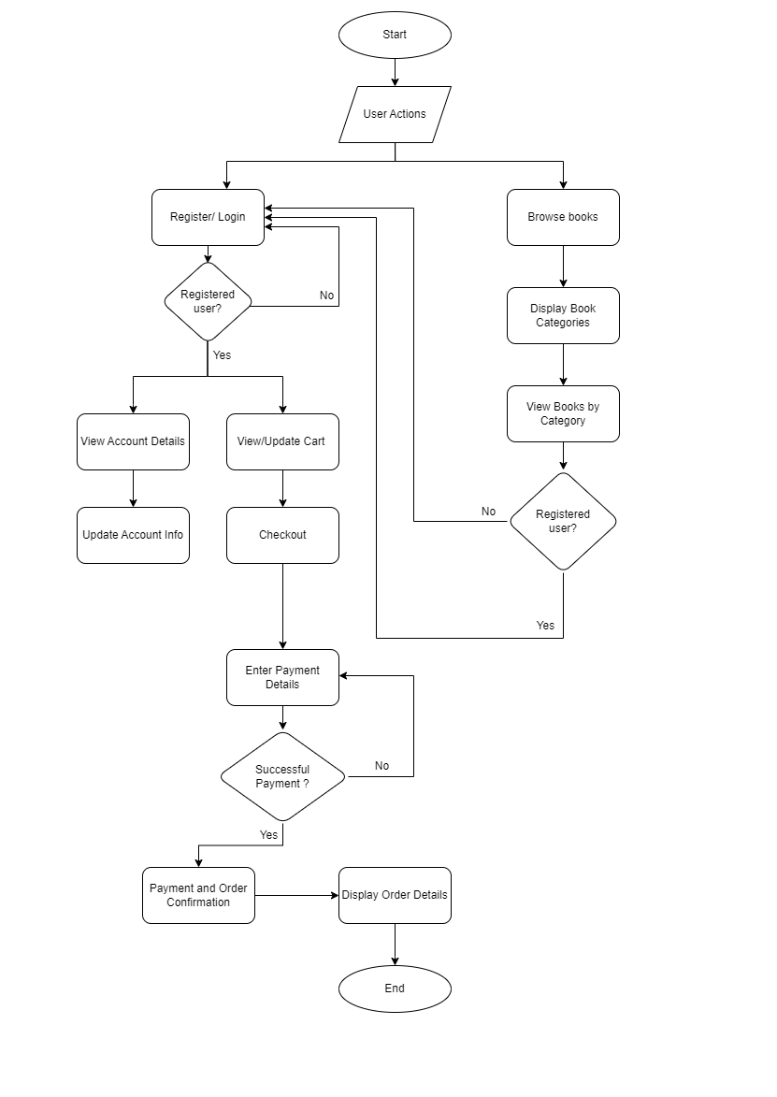
Flowchart Diagram

Slide 8
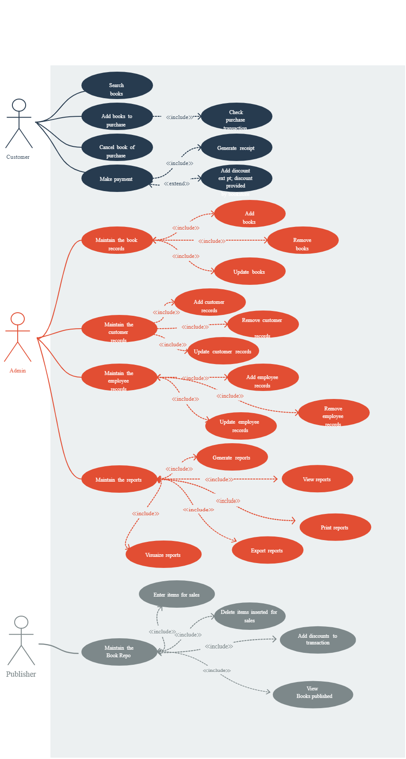
Use Case Diagram

Slide 9
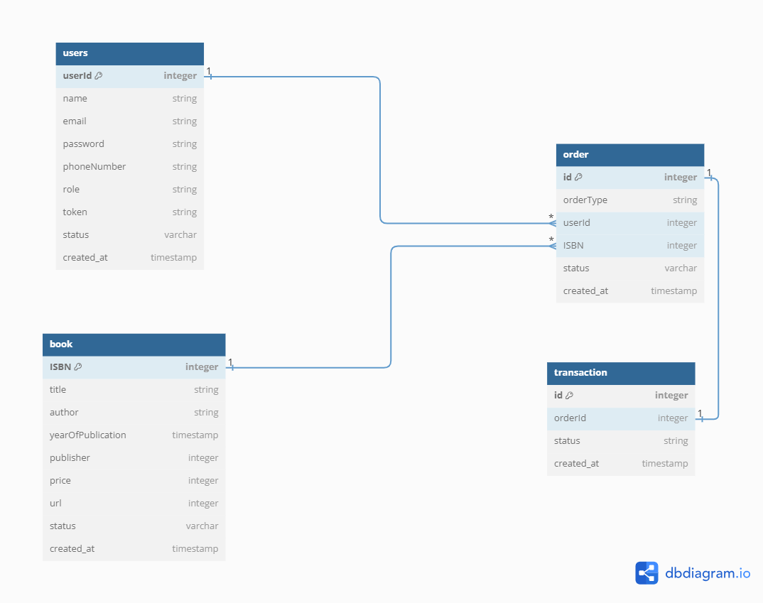
ER Diagram

Slide 10
Thank you

