Slide 1


Modeling Blistering in Metals due to Hydrogen using Phase Field Modeling
Submitted by:
Sahil Mohal (2022MEB1343)
Department of Mechanical Engineering
Indian Institute of Technology, Ropar
Supervised by:
Dr. Dhiraj K. Mahajan
Associate Professor
Department of Mechanical Engineering
Indian Institute of Technology, Ropar

Slide 2
Outline
1. Introduction
2. Literature review
3. Research gap
4. Blistering process
5. Methodology
6. Conclusion
7. Future Scope
8. References

Slide 3
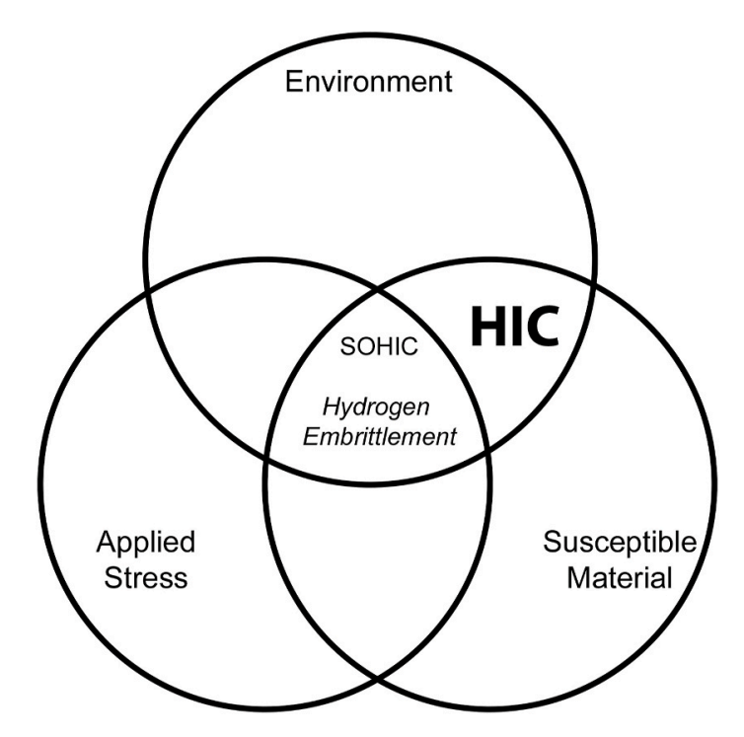
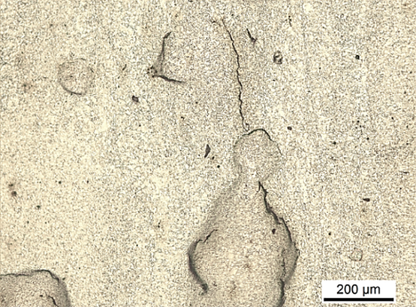
Introduction
Hydrogen Embrittlement (HE) -
Degradation of the mechanical properties such as ductility , due to presence of hydrogen inside metal
σ
Hydrogen Embrittlement (HE)
Hydrogen Induced Cracking (HIC) -
Cracking caused in metals due to presence of hydrogen without any external load
Hydrogen induced cracking (HIC)
(no external load needed)
Crack
Blister
Bechle et al., 2009

Slide 4
Literature Review
Hydrogen effect on mechanical properties
W. H. Johnson (1875) | First time noticed detrimental effect of hydrogen (H) on metals
Zapffe and Sims (1941) | Proposed hydrogen pressure theory for HIC and blister formation
Troiano (1960); Oriani (1970) | Hydrogen-induced reduction in cohesive strength (HEDE or HID)
Beachem, Birnbaum, Robertson, Sofronis (1972, 2015) | Hydrogen-enhanced localized plasticity (HELP)
Phase field for fracture for ductile and brittle fracture
Pañeda et al. (2018-21); Anand et al. (2019); Wu et al. (2020) | Phase field modelling for hydrogen embrittlement
Francfort, Marigo (1998); Bourdin et al. (2000) Ostwald(2009) | Proposed variational formulation of brittle fracture as well as the related regularized formulation
Miehe et al.(2010, 2015; 2016) , Gurtin et al. (1993) | Thermodynamic consistent framework with a local irreversibility constraint on the crack phase field, threshold phase field fracture model
4

Slide 5
Literature Review
Important ingredients for modeling hydrogen effect
Oriani (1970) | Proposed that the Hydrogen at traps and lattice sites is always in equilibrium
Sofronis and McMeeking (1989) | Proposed hydrogen diffusion-deformation coupled framework to simulate the hydrogen distribution in front of crack tip
Barrera et al. (2016) | Implemented the hydrogen transport model by using subroutines
Charles (2017,2019) | Proposed a simple model for blistering in steels

Slide 6
Literature Review
Important Points:
HELP and HEDE are most prominent mechanisms of HE
More than one mechanism can affect simultaneously and/or sequentially
Exact mechanism is still a matter of conjecture
Coupled framework of blistering and phase field fracture model is absent
HELP (Hydrogen Enhanced Localized Plasticity)
Increase dislocation mobility, creating a shielding effect and lowering the stress needed for dislocation movement
HEDE (Hydrogen Enhanced Decohesion)
Hydrogen atoms reduce cohesive strength between metallic bonds.

Slide 7
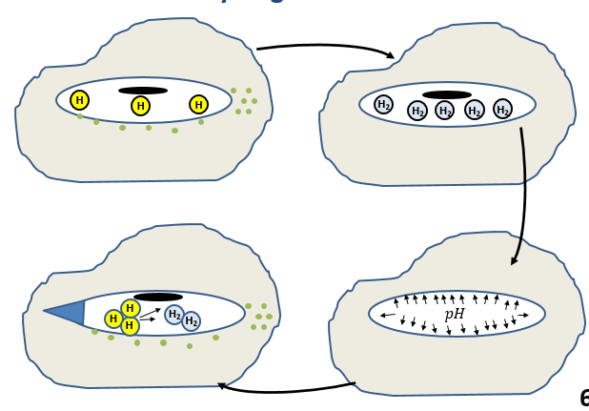

Research Gap
Lack of proper mathematical model to explain blistering phenomena.
Physics for the blister formation due to gaseous hydrogen is absent.
Implementation of phase field to track blister growth contribute to new research and absence of simulation work in publications, leaves a significant research gap to be filled.
Mechanism for HIC (Blistering)

Slide 8



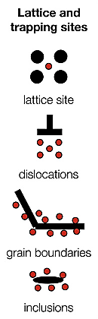
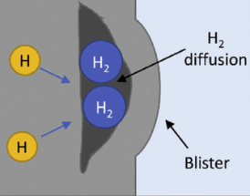
Hydrogen Metal Interaction: Blistering
Hydrogen in metals
Adsorption of hydrogen on metal surface. The metal acts like a catalyst, breaking hydrogen molecules into individual atoms. These atoms then diffuse into metal forming concentration gradient.
This atomic hydrogen sits at locations like lattice sites, dislocation, grain boundaries, inclusions, and other defects.
Precipitation of gaseous hydrogen molecules leads to blister formation, and when blisters reach a critical size, surface bulge out and cracks occur.
Diffusible and trapped hydrogen
Lattice and trapping sites
Ustolin et.al 2020

Slide 9
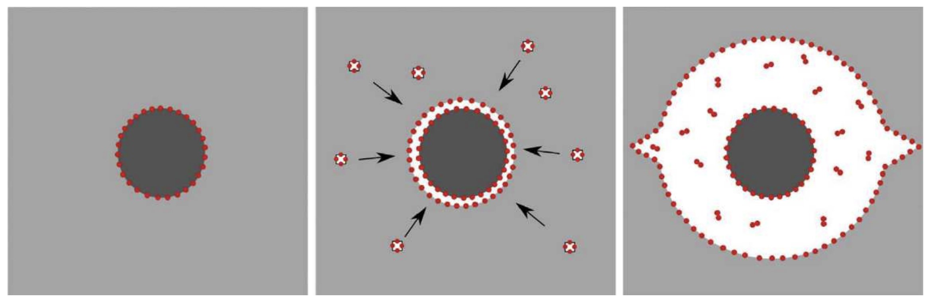
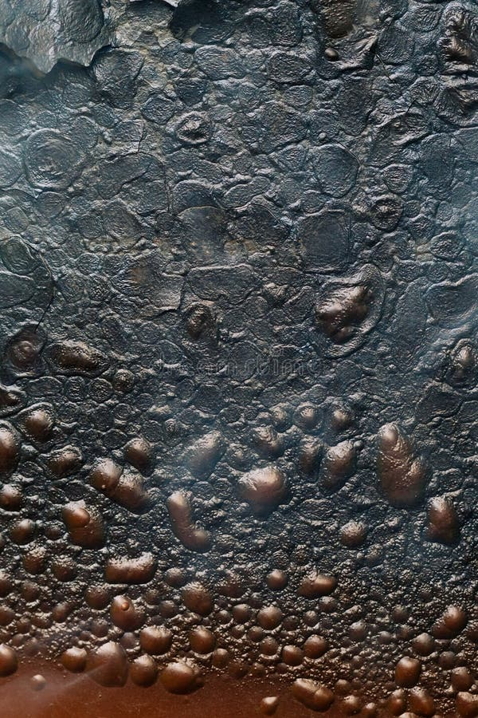
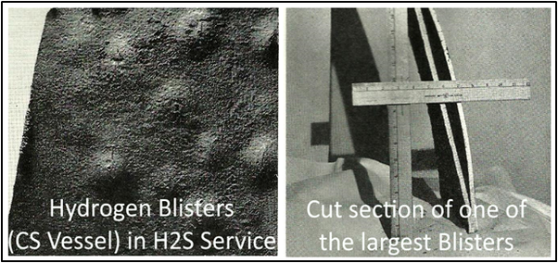
Hydrogen atoms are entrapped along the inclusion.Lattice hydrogen diffuse towards these defects.
Inclusion/ metal matrix interface has opened up , the open volume increases when hydrogen atom-containing vacancies diffuse towards the interface.
A significant volume that has developed, into which hydrogen (H2) molecules have precipitated and crack have started to appear.
Mechanism of Blister Formation
Steel matrix
Inclusion
Hydrogen atom
[16]
Fig: Blisters in metal^{[15]}
Martin and Sofronis 2022

Slide 10
Methodology
Mathematical model formulation
ABAQUS Standard Subroutines
Mathematical model formulation
Phase field fracture model
Thermodynamic treatment
Governing Equations
Hydrogen transport model
Blister model
Writing Subroutine

Slide 11

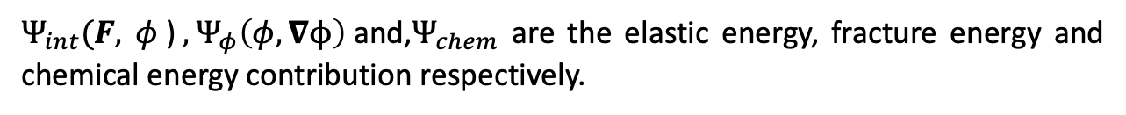

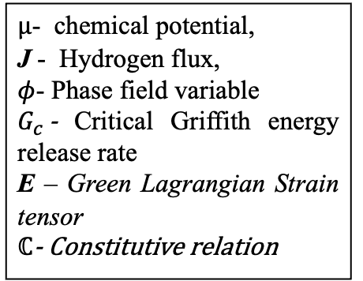
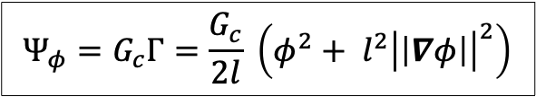
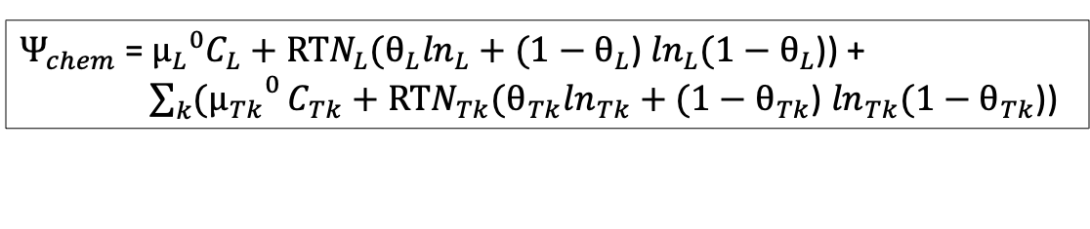
Mathematical modeling
(eq.1)
Mathematical Model
Phase Field Model
Hydrogen Transport model
(eq.2)
Blister model
(eq.3)
Thermo-dynamics
(eq.4)
Governing Equations
Anand et al. (2012)

Slide 12
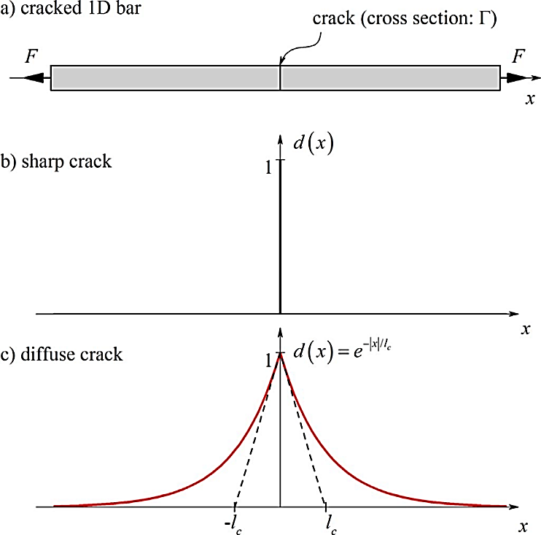


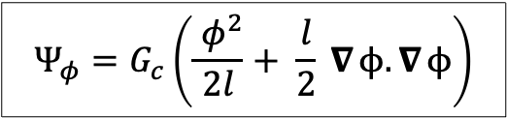

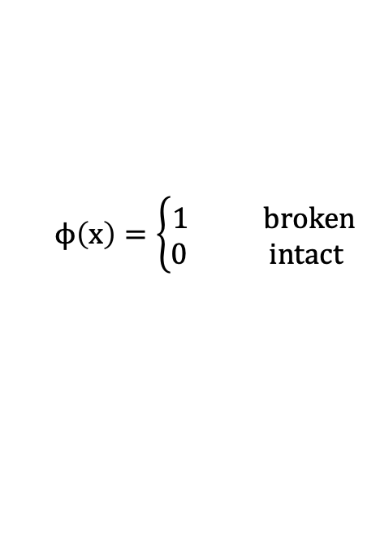
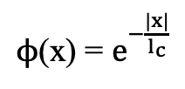
Phase field for fracture model
(eq.5)
Mathematical Model
Phase Field Model
Hydrogen Transport model
Why phase field?
Nucleation and complex topologies of cracks can be tracked.
Allow for efficient and accurate simulations.
Thermodynamically consistent approach to fracture and damage modeling.
Blister model
Thermo-dynamics
Governing Equations
Miehe et.al (2016)

Slide 13

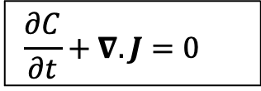
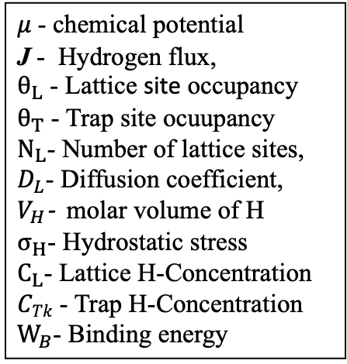
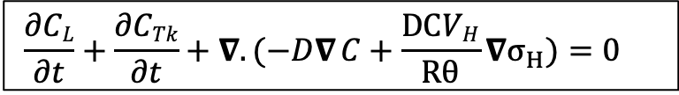
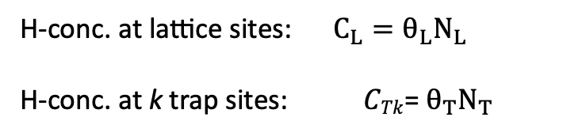
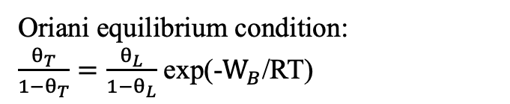
Hydrogen transport model basics
Factors affecting H motion inside metal
Concentration gradients
Stress fields
Mathematical Model
Phase Field Model
Flux equation
Fick’s First Law
Hydrogen Transport model
Diffusion equation
Fick’s Second Law
Blister model
eq (6)
Thermo-dynamics
Governing Equations
Müller 2007

Slide 14
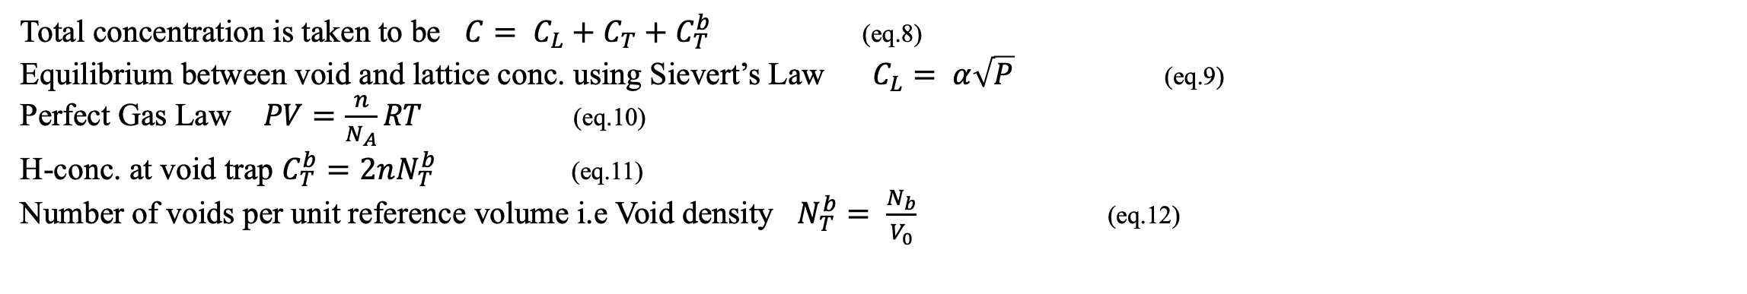
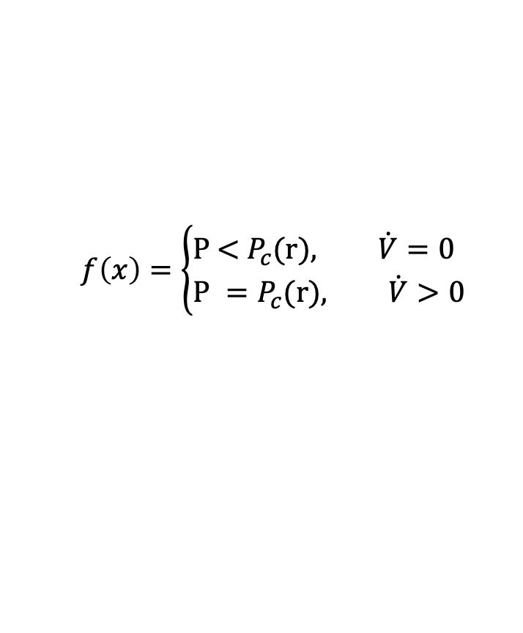
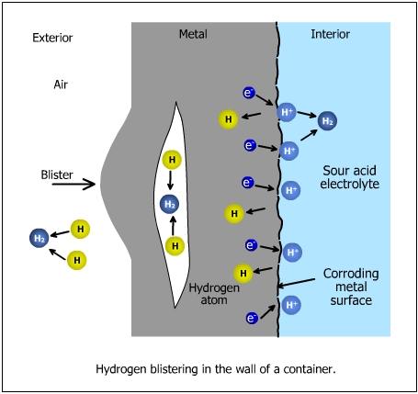
Blister Model
Mathematical Model
Phase Field Model
Hydrogen Transport model
(eq.13)
(eq.14)
Blister model
Strength of surrounding metal
Thermo-dynamics
Pressure of hydrogen gas
Governing Equations
[17]
Krom et al.(1999)

Slide 15
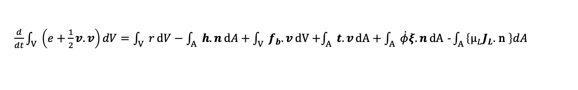
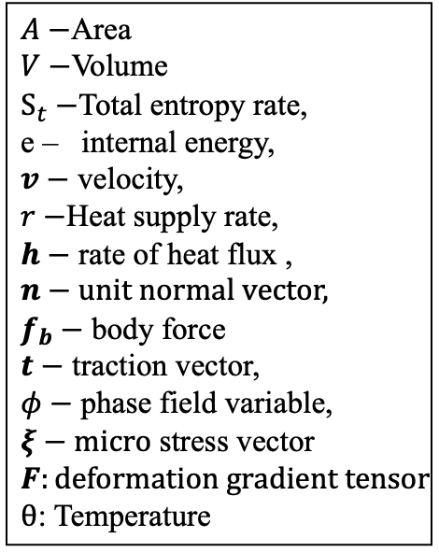
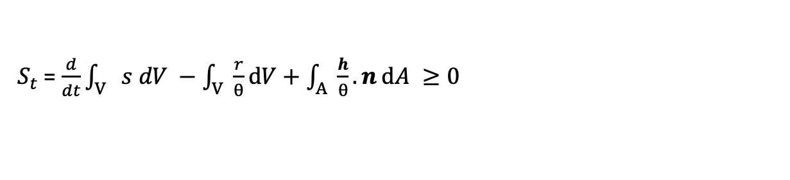
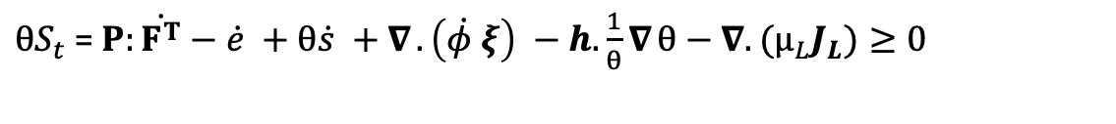

Thermodynamic Treatment
Mathematical Model
First law of thermodynamics
(eq.15)
Phase Field Model
Entropy inequality
(eq.16)
Hydrogen Transport model
Combining both equations
(eq.17)
Blister model
Helmholtz free energy density potential function
Thermo-dynamics
(eq.18)
Governing Equations
(eq.19)
For isothermal conditions final term become zero.
Fried and Gurtin 1993

Slide 16
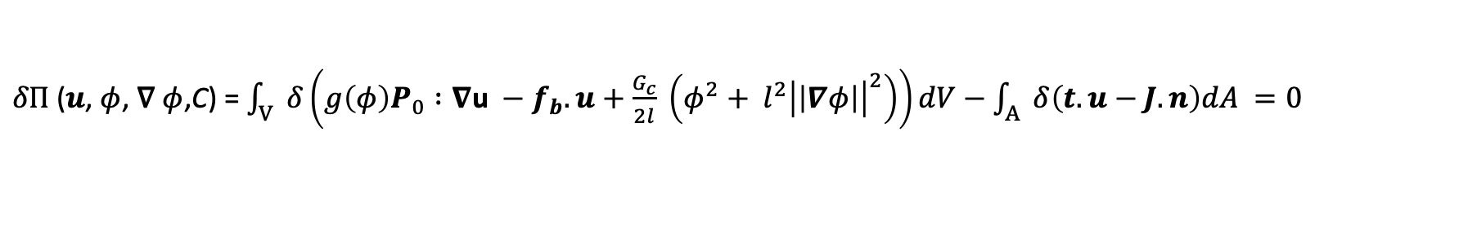
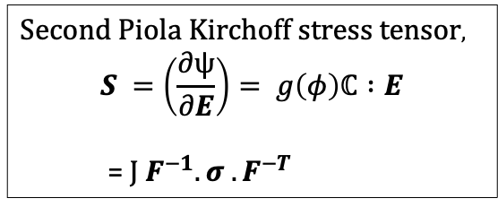

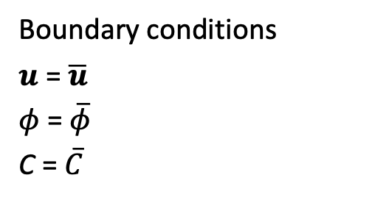
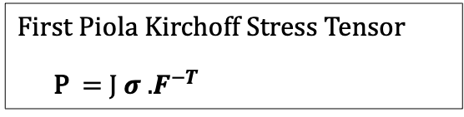
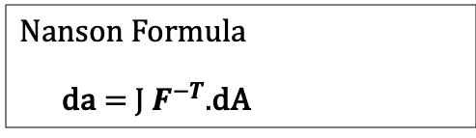
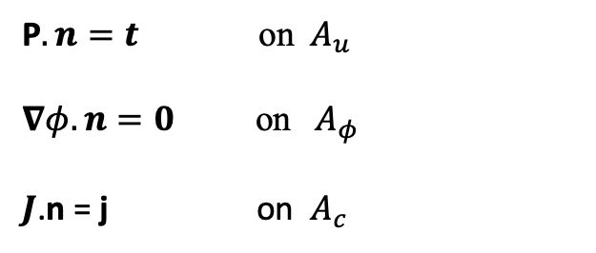
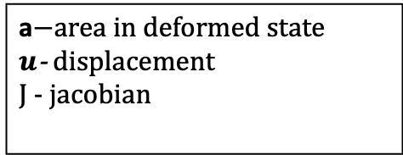
Governing equations
Mathematical Model
(eq.20)
Phase Field Model
Hydrogen Transport model
Blister model
Dirichlet B.C.
Thermo-dynamics
Governing Equations
Neumann B.C.
Subroutines

Slide 17
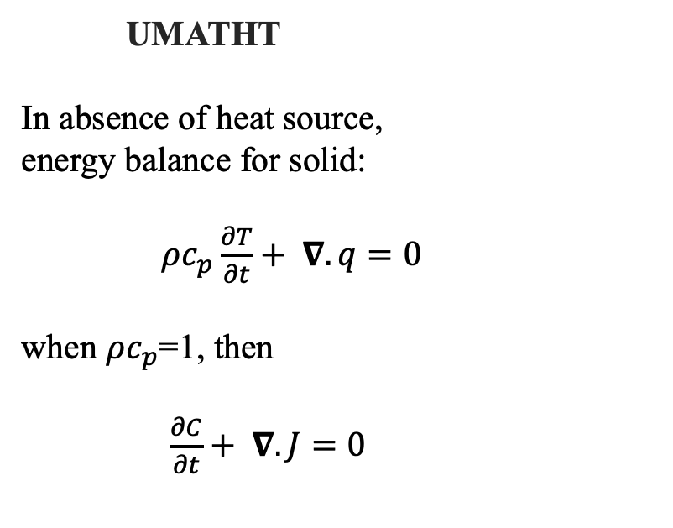
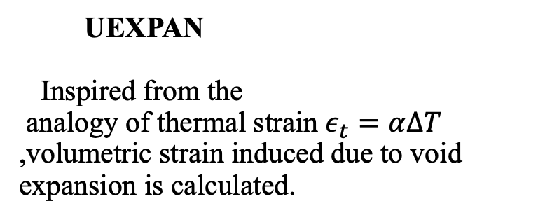

Subroutines
UMAT
Used to calculate elastic and plastic stresses
Mathematical Model
UMAT
Phase Field Model
Hydrogen Transport model
Blister model
UEXPAN
UMATHT
Thermo-dynamics
Governing Equations
Subroutines

Slide 18
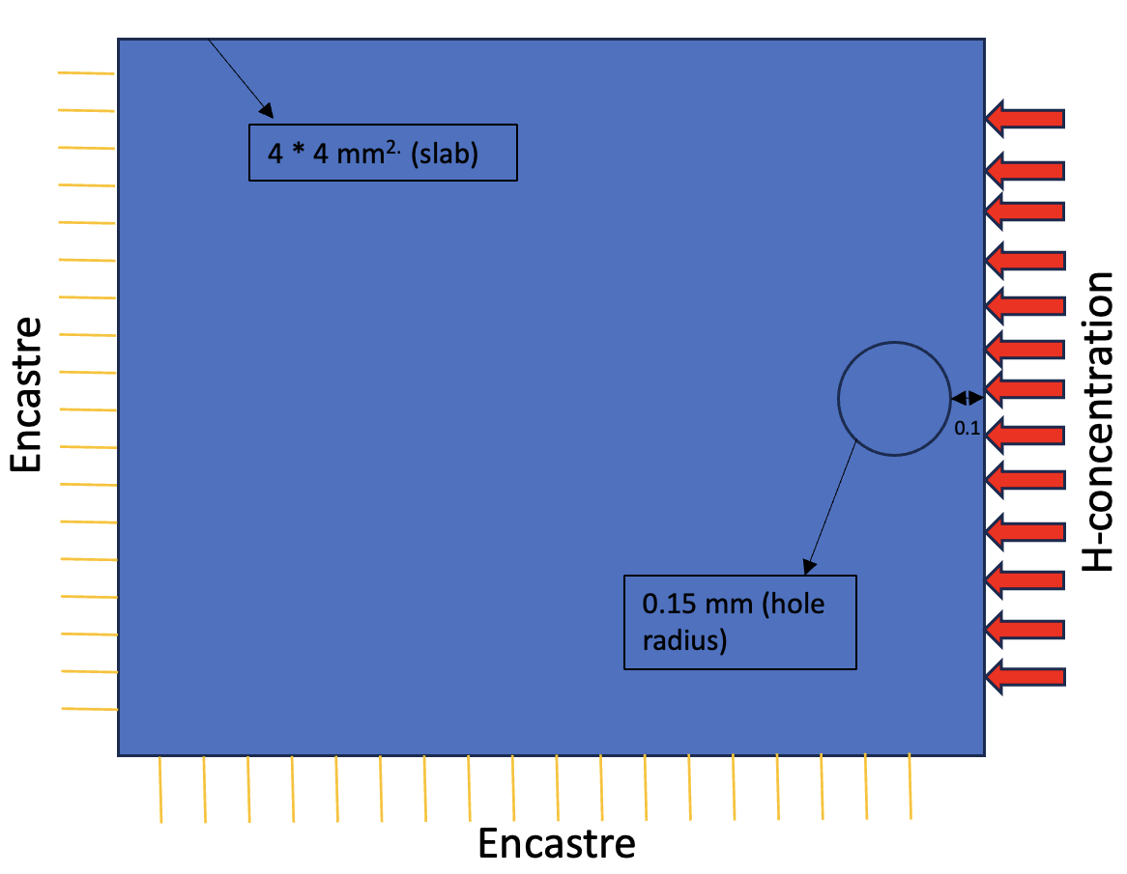
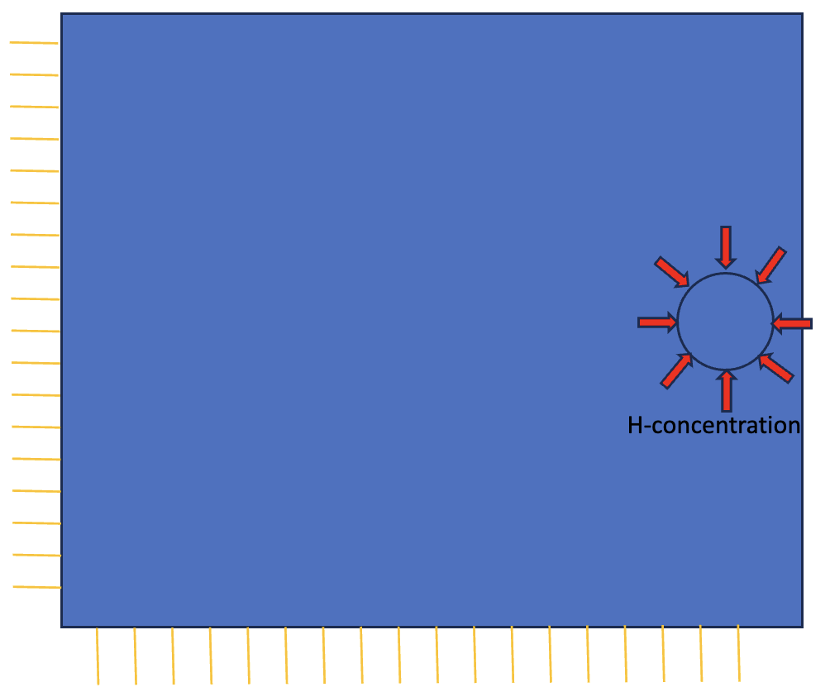
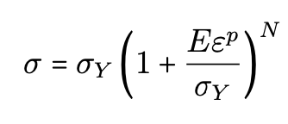
Model Geometry and Properties
Simulation
Assuming linear isotropic material:
(slab) 4*4 mm²
T | 293 (K) | E | 201880(MPa)
D | 0.01271(mm²/s) | 𝜎_{Y} | 595(MPa)
V_{H} | 2000(mm³/mol) | N | 0.059
N_{L} | 5.1 *10²⁹(sites/mm³) | v | 0.3
0.25mm
Encastre
r = 0.15mm (hole)
Total Elements | 10431
Element type | CPE8RT
Encastre
Fig(a): Model geometry
C₀=2.659(mol/mm³)
Isotropic hardening law
C₀=1*10¹⁰(mol/mm³)
Encastre
2.659*10¹³ (mol/s.mm² )
2.695*10⁷ (mol/s.mm² )
Encastre
Fig(b): Case1
Fig(c):Case2
17

Slide 19
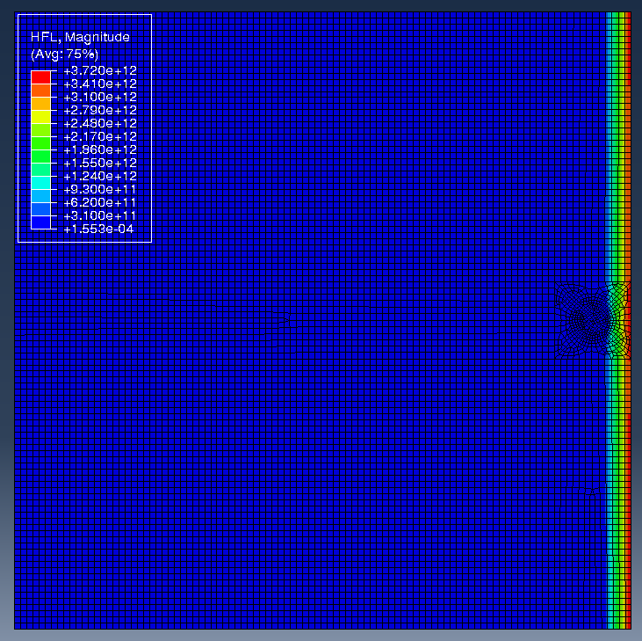
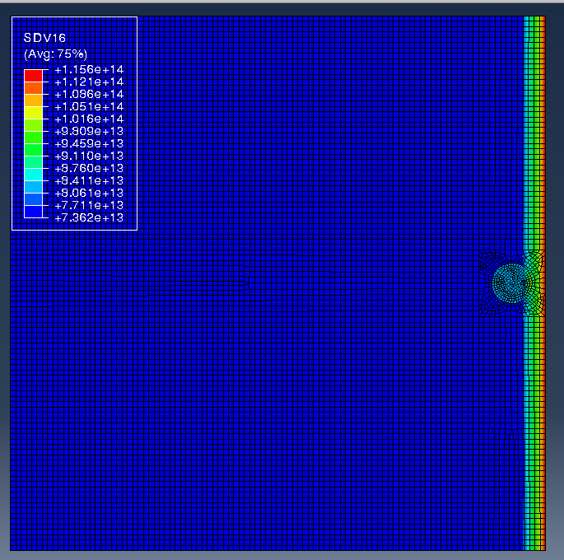
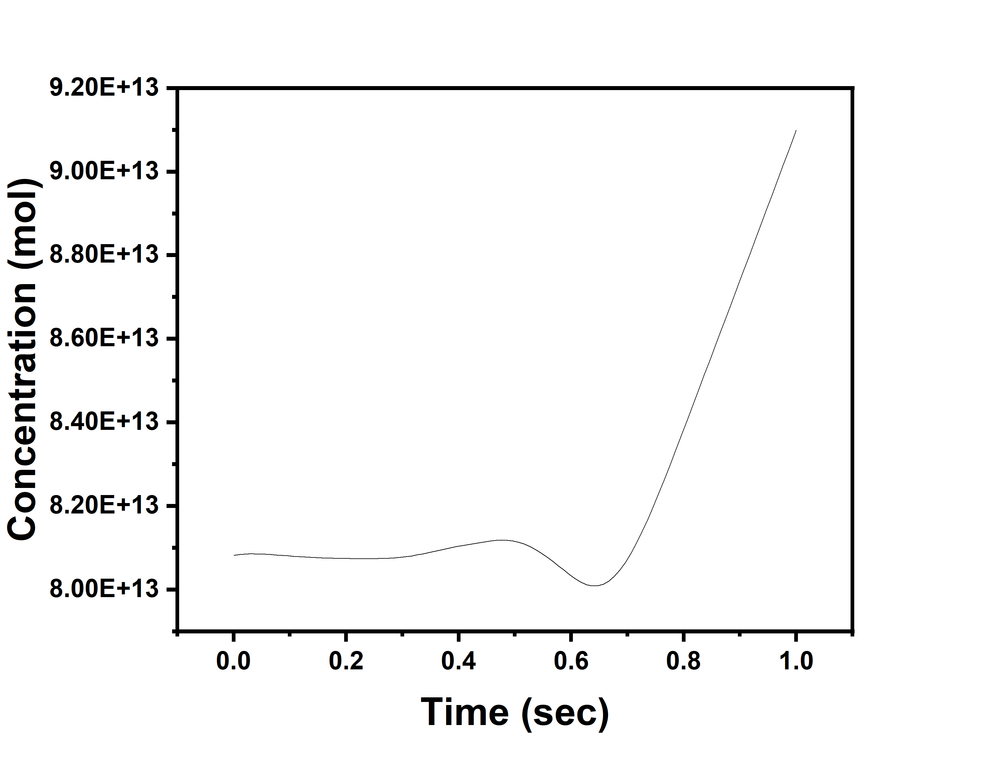
Case1
Simulation
W_{b} | 20*10⁶(kJ/mol)
𝛂 | 1*10⁻²¹(mol⁻¹)
Flux of 2.659*10¹³ mol/s.mm² is given.
Property for hole
/mm³
Fig1: Flux entering inside geometry
Fig2: Total concentration
Fig3: Concentration entering in hole region

Slide 20
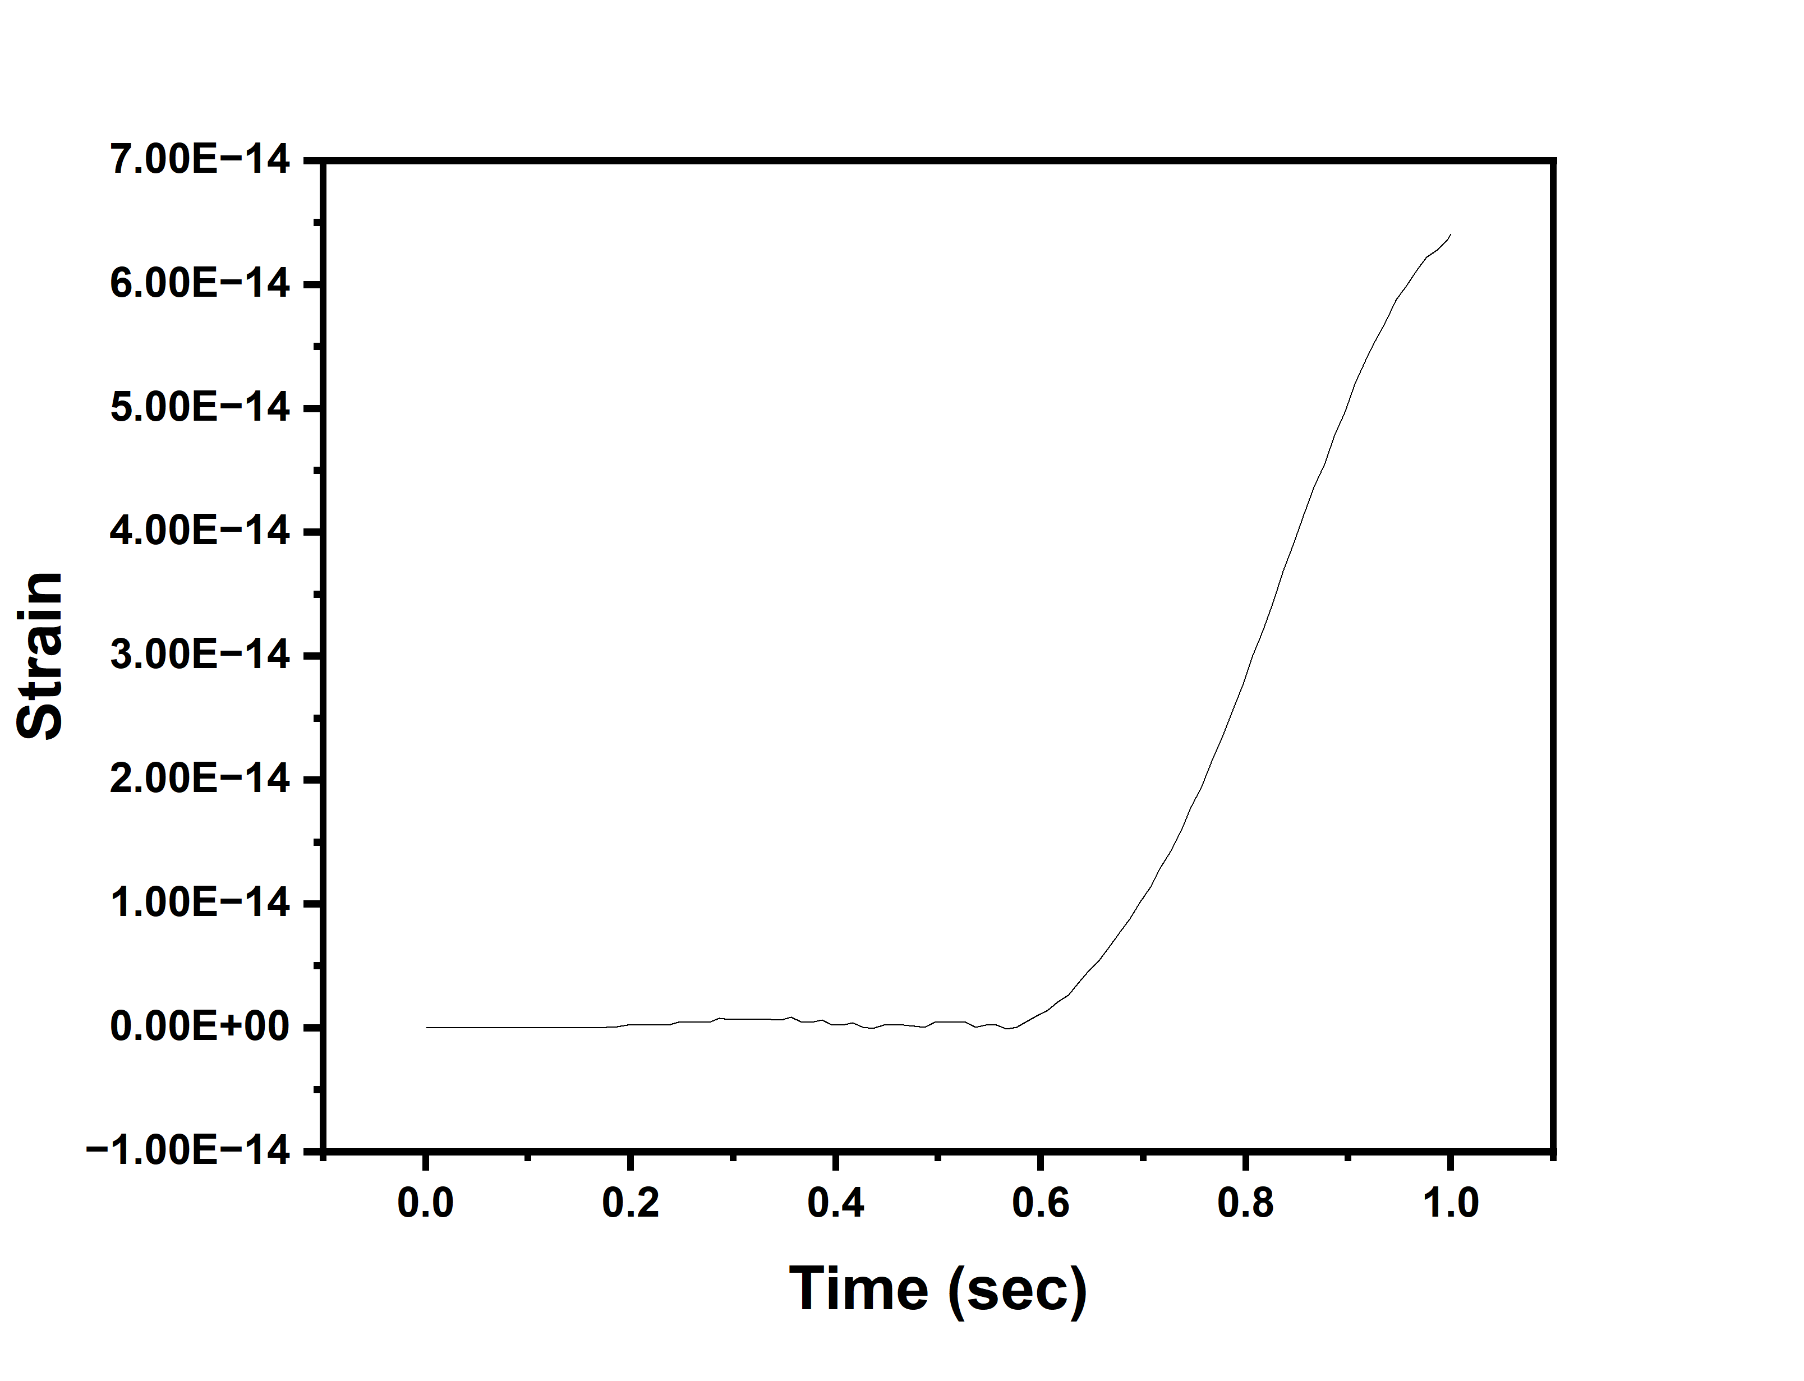
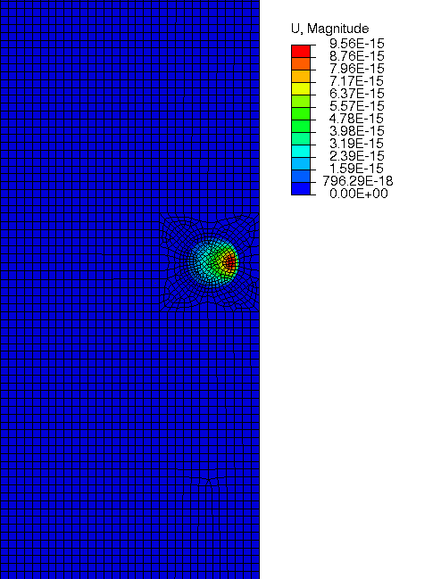
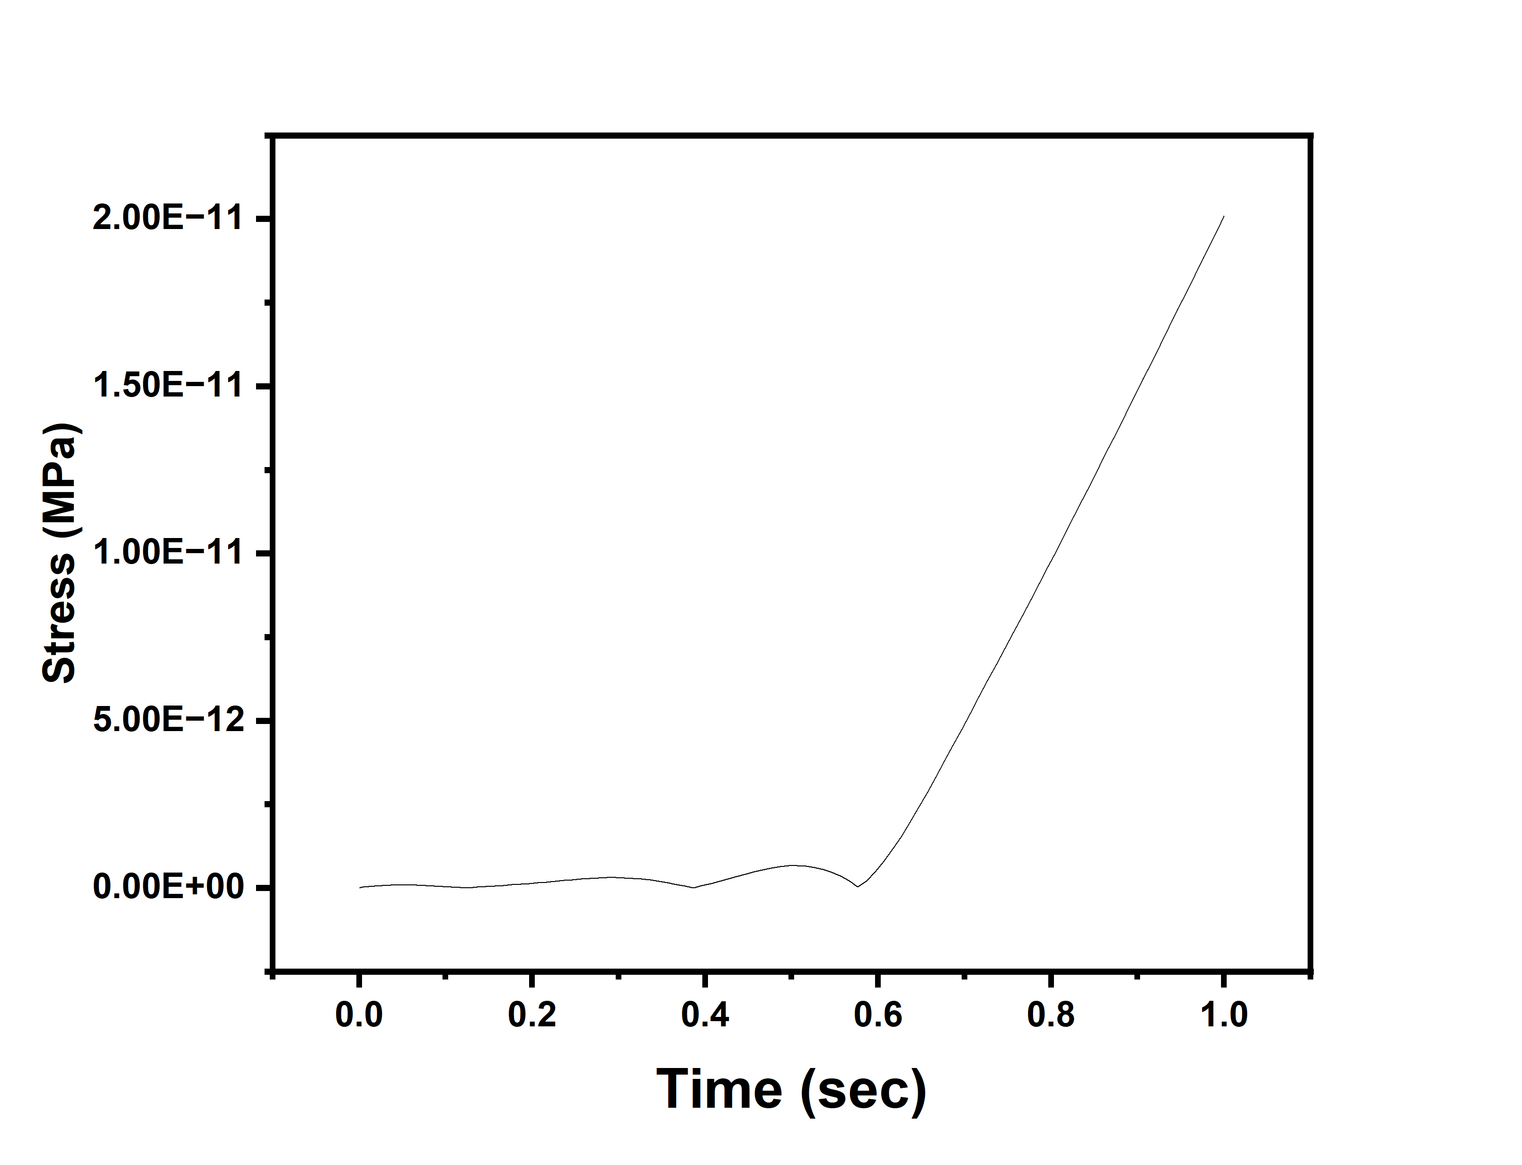
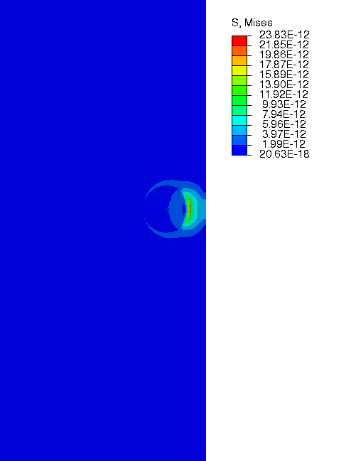
Case 1
Simulation
Fig4: Displacement
Fig6: Strain plot
From displacement and
stress figure it is noted with appropriate parameters , blister can be formed.
Fig7: Stress plot
Fig5:Stress

Slide 21
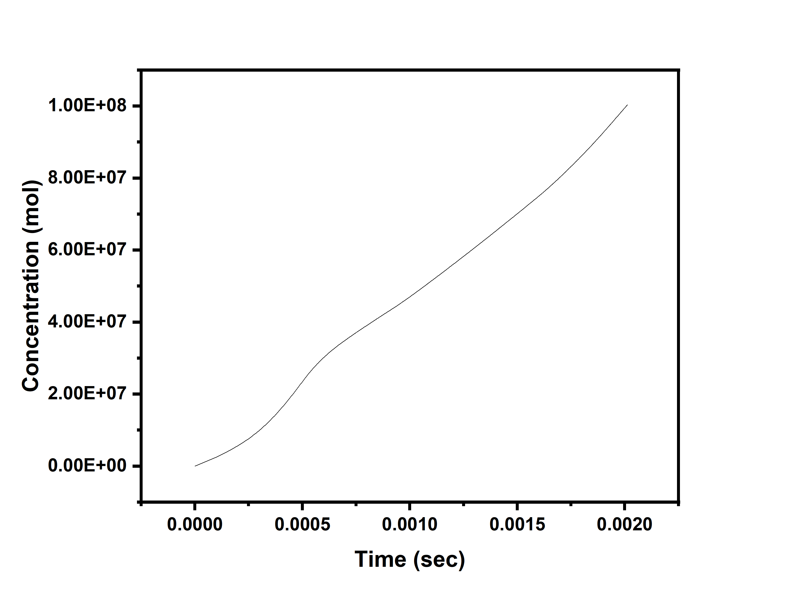

Case 2
Simulation
Property for hole
W_{b} | 20*10⁶(kJ/mol)
𝛂 | 0.000002(mol⁻¹)
Flux of 2.659*10⁷ mol/s.mm² is given.
/mm³
Fig9: Concentration plot
Fig8: Concentration after 0.002s

Slide 22
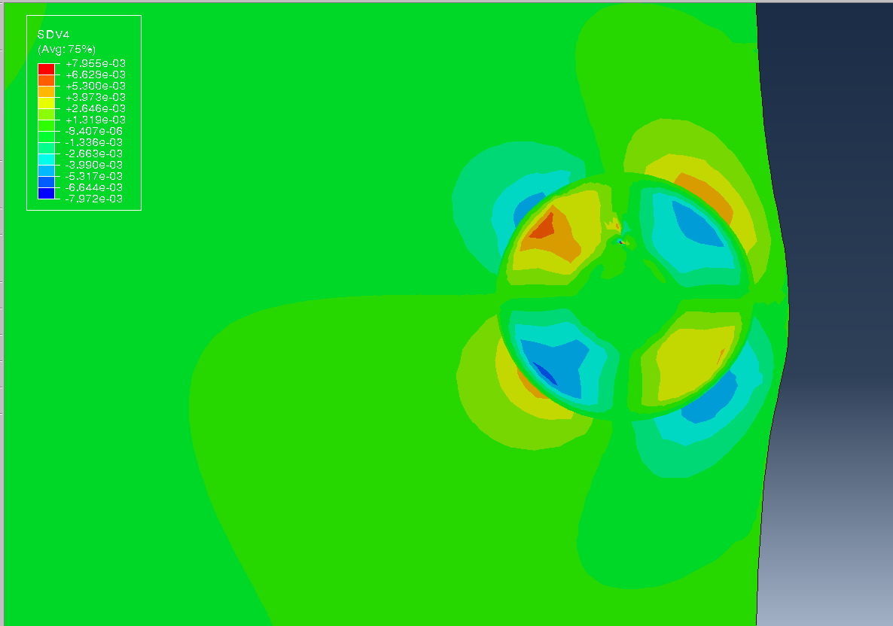
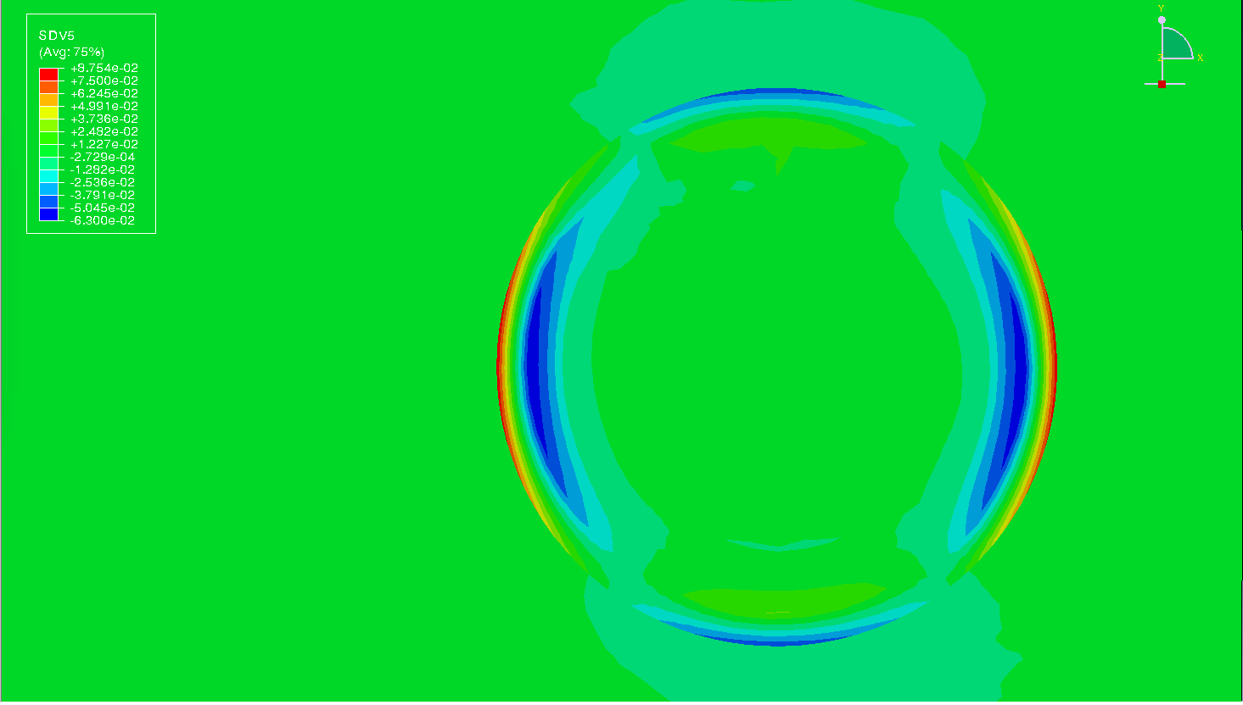




Case 2
Simulation
Fig11: Plastic strain x-direction
Fig9 : Elastic strain x-direction
Fig10: Elastic shear strain
Fig12: Plastic strain y-direction
Fig13: Plastic shear strain
Fig14: Displacement

Slide 23


Simulation
Fig15: Stress contour
Fig16: Stress plot
Plastic bulging can be observed in Fig15
Stress is exceeding yield stress limit
After timestep 0.005seconds stress curve changes its slope (Fig16)

Slide 24
Conclusion
A simple mathematical model was developed to model blister.
A comprehensive mathematical model for blister, coupled with phase-field modeling is developed in present work.
Blistering phenomena was successfully captured during simulations.

Slide 25
Future Scope
Writing UEL subroutine
Coupling phase field part in simulations.

Slide 26
References
[1] May L Martin and Petros Sofronis. Hydrogen-induced cracking and blistering in steels: A review. J. Nat. Gas Sci. Eng., 101(104547):104547, May 2022.
[2] F Larch ́e and J W Cahn. A linear theory of thermochemical equilibrium of solids under stress. Acta Metall., 21(8):1051–1063, August 1973.
[3] Christian Miehe and Steffen Mauthe. Phase field modeling of fracture in multi-physics problems. part III. crack driving forces in hydro-poro-elasticity and hydraulic fracturing of fluid-saturated porous media. Comput. Methods Appl. Mech. Eng., 304:619–655, June 2016.
[4] Vishal Singh, Rajwinder Singh, Amanjot Singh, and Dhiraj K Mahajan. Tracking hydrogen embrittlement using short fatigue crack behavior of metals. Procedia Struct. Integr., 13:1427–1432, 2018.
[5] Rakesh Kumar, Aman Arora, and Dhiraj K Mahajan. Hydrogen-assisted intergranular fatigue crack initiation in metals: Role of grain boundaries and triple junctions. Int. J. Hydrogen Energy, January 2023.
[6] Claudio V. Di Leo and Lallit Anand. Hydrogen in metals: A coupled theory for species diffusion and large elastic-plastic deformations. International Journal of Plasticity, 43: 42–69, 4 2013. ISSN 07496419. doi: 10.1016/j.ijplas.2012.11.005.
[7] Eliot Fried and Morton E Gurtin. Continuum theory of thermally induced phase transitions based on an order parameter, 1993.
[8] Hossein Jafarzadeh, Gholam Hossein Farrahi, Valery I Levitas, and Mahdi Javanbakht. Phase field theory for fracture at large strains including surface stresses. Int. J. Eng. Sci., 178(103732):103732, August 2022.
[9] Richard Ostwald, Ellen Kuhl, and Andreas Menzel. On the implementation of finite deformation gradient-enhanced damage models. Computational Mechanics, 64:847–877, 9 2019. ISSN 14320924. doi: 10.1007/s00466-019-01684-5. 21

Slide 27
[10] Gangloff, R.P., Wei, R.P. Gaseous hydrogen embrittlement of high strength steels. Metall Trans A 8, 1043–1053 (1977). https://doi.org/10.1007/BF02667388
[11] O. Barrera, E. Tarleton, H.W. Tang, and A.C.F. Cocks. Modelling the coupling between hydrogen diffusion and the mechanical behaviour of metals. Computational Materials Science, 122:219–228, 2016. ISSN 0927-0256. doi: https://doi.org/10. 1016/j.commatsci.2016.05.030. URL https://www.sciencedirect.com/science/article/pii/S0927025616302658.21
[12] Margo Cauwels, Robin Depraetere, Wim De Waele, Stijn Hertel ́e, Tom Depover, and Kim Verbeken. Influence of electrochemical hydrogenation parameters on microstructures prone to hydrogen-induced cracking. Journal of Natural Gas Science 21 and Engineering, 101:104533, 2022. ISSN 1875-5100. doi: https://doi.org/10.1016/j. jngse.2022.104533
[13] Anand, L. (2012). A Cahn–Hilliard-type theory for species diffusion coupled with large elastic–plastic deformations. Journal of the Mechanics and Physics of Solids, 60(12), 1983–2002. https://doi.org/10.1016/j.jmps.2012.08.001
[14] Krom, A. H. M., Koers, R. W. J., & Bakker, A. (1999). Hydrogen transport near a blunting crack tip. Journal of the Mechanics and Physics of Solids, 47(4), 971–992. https://doi.org/10.1016/S0022-5096(98)00064-7
[15] https://www.shutterstock.com/image-photo/burning-blister-paint-on-metal-surface-1777015790
[16] https://qr.ae/psVfrk
[17] https://faculty.kfupm.edu.sa/me/hussaini/corrosion%20engineering/04.07.03.html
Images are used only for representation purpose, presenter give credit to copyright owner of images.

Slide 28
Thank You

