Slide 1
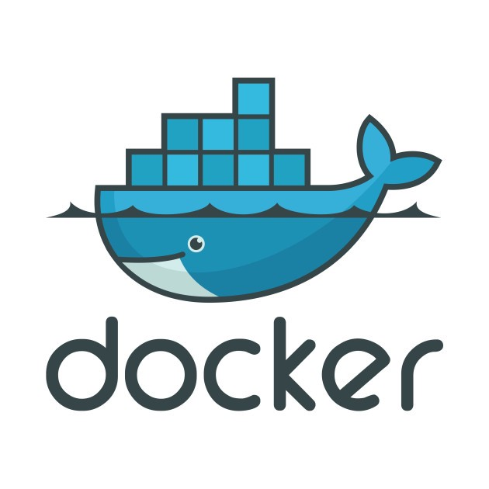
VEENA MARLLA
DNA - C&C

Slide 2
AGENDA – Session 1
Containerization Overview
VMs vs Containers
Docker Overview
Docker Architecture , Components & Installation
Docker Eco system
Docker Objects – Images & Containers
Docker Registry
Basic Docker Commands – Hands-on
Q&A

Slide 3
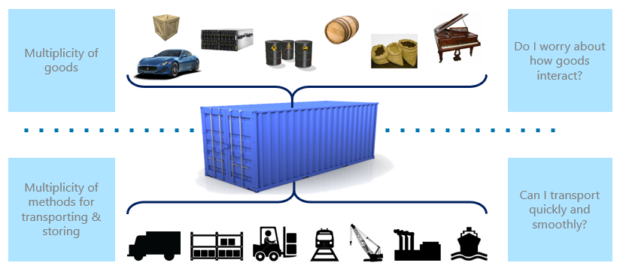
The Shipping Container analogy

Slide 4
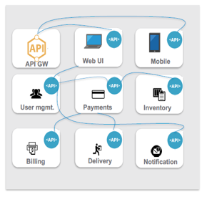
Cloud Native Application
Applications built using Microservices Architecture Pattern
Loosely coupled distributed application
Separate datastore for each service
Packaging – Separate binaries for each microservice
Teams : Owned by smaller teams

Slide 5
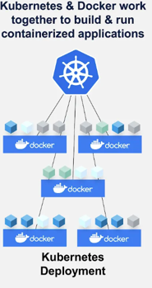
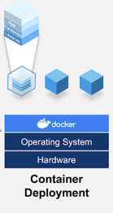
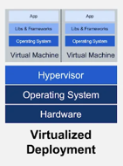
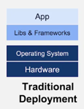
Software Evolution from Traditional ways to Containers

Slide 6
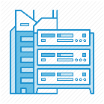
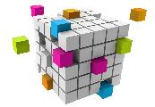





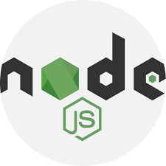
Containerization
Containerization is a technology which involves bundling an application together with all of its related configuration files, libraries and dependencies required for it to run in an efficient and bug-free way across different computing environments.
Containers are more
Any where
Any app
Any language
lightweight
Portable
Efficient
Less Overhead
Java
On-premises
Monolith
.Net
Python
Node
Cloud
Microservice

Slide 7
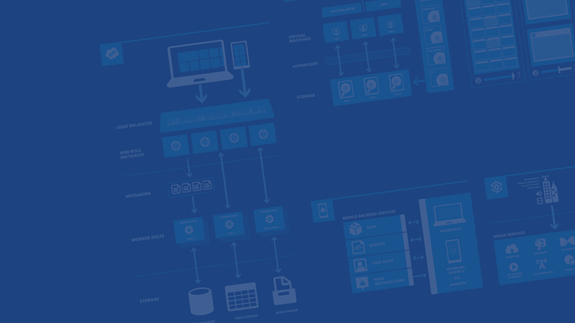
Containers for code
Application code
Dev
PROD
Deployable Unit
Infrastructure code
Test
Staging
Notes:
Explicit infrastructural requirements
Build from new environment instead of reconcile machine states
Version control
Application is consistently deployable
Always deployable
Consistent deployments across environments
Light-weight isolation
Virtual machine-like behavior
Easier distribution and revision

Slide 8
Containers are often compared with VM’s?
Virtualization Technique
Pros
Multiple OS in same machine
Cons
Unstable Performance due to multiple VMs
Hypervisors not as efficient as Host OS
Long Boot-up process
Easy Maintenance and recovery
Lower cost
VM A
Container A
Container B
Container C
VM B
VM C
App A
App B
App C
Libs
Libs
Libs
Guest OS
Guest OS
Guest OS
Hypervisor
Host Operating System
Infrastructure
Server with VMs

Slide 9
What is a Container?
Abstraction at the OS layer rather than at hardware layer
Containerization Technique
Advantages
Container1
Container2
Container3
Containers on same OS kernel are lighter and smaller
Better Resource Utilization
Short Boot-up process
App A
App B
App B
Bins/ Libs
Bins/ Libs
Bins/ Libs
Container Engine
Host Operating System
Infrastructure
Server with containers

Slide 10
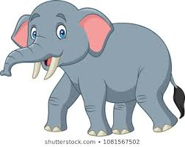

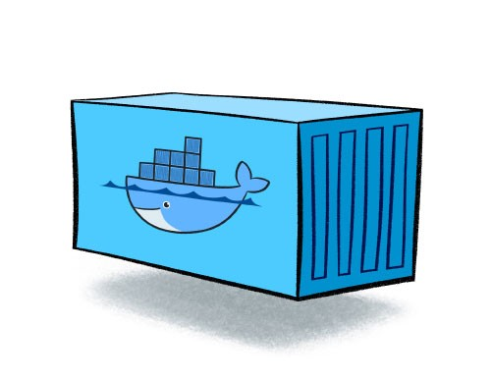
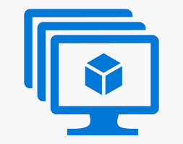

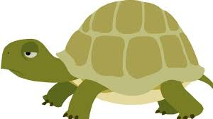


Virtual Machines vs Containers
Size
Start-up
Virtual Machine
Containers
Integration

Slide 11
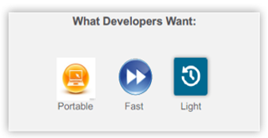
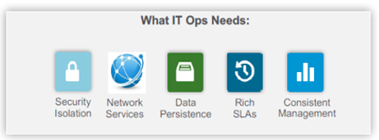
Containers – a glance
A container is a lightweight , stand-alone, executable unit of software
Includes everything needed to run it: code, runtime, system tools, system libraries etc..
Containerized software runs regardless of the environment.
Containers isolates software from its surroundings
“smooth out “ differences between environments.
Helps reduce conflicts between teams.

Slide 12
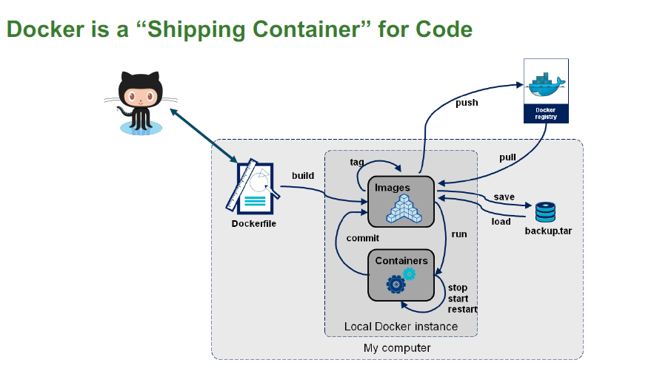
Docker
Docker is an open platform tool from Linux academy to easily build, deploy and execute the applications by using containers.
We can manage our infrastructure in the same ways as we manage our applications.
The advantage of Docker platform is to ship, test, and deploy code quicker so that we can reduce the time between writing code and execute it in production

Slide 13
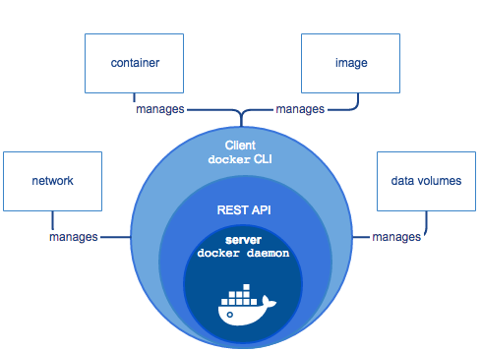
Docker Engine
Docker Engine allows you to develop, assemble, ship, and run applications using the following components:
Docker Daemon
Docker Engine REST API
Docker Client

Slide 14
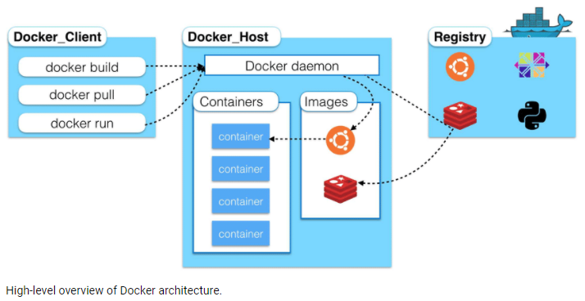
Docker Architecture

Slide 15
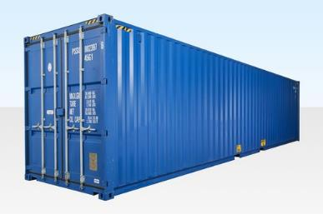
Docker Objects – Images & Containers,
Docker Images
Docker Containers
Read-Only template used to create containers.
Built by docker users
Stored in Docker Hub or on Local registry
Runtime instance of an image
Isolated application platform.
Contains everything needed to run application.
Built from one or more images

Slide 16

Docker Registry
Docker Registry is a storage component for Docker Images
We can store the images in Public or Private Repositories
DockerHub is docker’s very own cloud repository
Stores container images
Images are Pushed into a registry
Images are Pulled from a registry
Images are Searched for within a registry
Build
Push

Slide 17
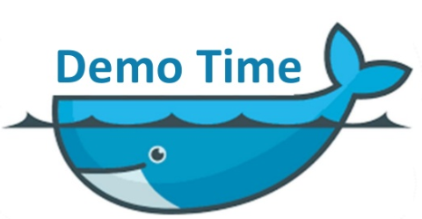

Slide 18
Basic Docker Commands
basic docker commands:
$ docker system df
$ docker info
To pull a Docker Image from the Docker registry, use the command:
$ docker pull <image_name:tag>
To run the image, use the command:
$ docker run <image_name:tag> or docker run <image_id>
To list down all the images in the local registry, use the command:
$ docker images
To login to docker hub , use the command:
$ docker login –u username –p password

Slide 19
Docker Commands
To list down all the running and stopped containers , use:
$ docker ps –a
To start a container, use the command:
$ docker start <container_name>
To stop a container, use the command:
$ docker stop <container_name>
To delete the container, use below command after stopping the container
$ docker rm <Container name>
To delete an image , use:
$ docker rmi <image id>
$ docker rmi <repo:tag>

Slide 20
Docker Commands
Interactive sessions in running docker containers
$ docker exec –it <<container_name>> bash
Container Restart policies
$ docker run –restart always redis
$ docker run –restart unless-stopped redis
Setting Container hostname
$ docker run –h/--hostname myhostname –it ubuntu bash
Port Mapping
$ docker run –p 7070:8080 tomcat

Slide 21
Docker Terminology
Daemons run on host machine. Creates and manages Docker objects: Images, containers, volumes, networks etc. The user doesn’t directly interact with daemon, instead through the docker client.
Docker Daemon
Docker Client
Primary User Interface to Docker. It accepts commands from user and communicates back and forth with a docker daemon
Docker Images
Images are used to create Docker containers. Docker provides a simple way to build new images and update existing images. Docker images are the build component of docker.
Containers are created from Docker Images. They hold everything that is needed to run an application. Each container is an isolated and secure application platform. Docker containers are run component of Docker.
Docker Containers
Docker Registries
Registries store images. These are public or private stores from which you upload/download images. Docker registries are distribution component of Docker

Slide 22
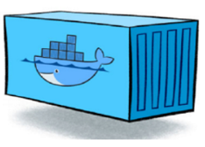
Docker System
Docker
Image
Registry
Push
Pull & Run
Pull & Run
Source
Code
Repository
Run
Dockerfile
build
Docker Engine
container
container
container
Docker
container
Docker
Host Machine
Host OS
Host OS
Staging
Prod

Slide 23
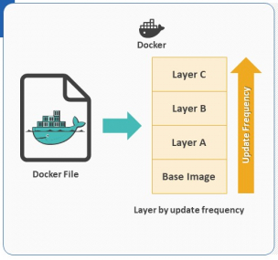
Build Docker Images – Basics
Docker Images are read only templates from which containers are launched from
Each image consists of a series of layers using the union file system
When you change an image a new layer is created.
Dockerfile is a text document, composed of various commands (instructions) and arguments listed successively to automatically perform actions on a base image in order to create (or form) a new one.

Slide 24
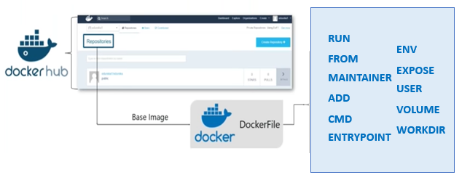
Building Images – Using Dockerfile
Dockerfile is a text document, composed of various commands (instructions) and arguments listed successively to automatically perform actions on a base image in order to create (or form) a new one.

Slide 25
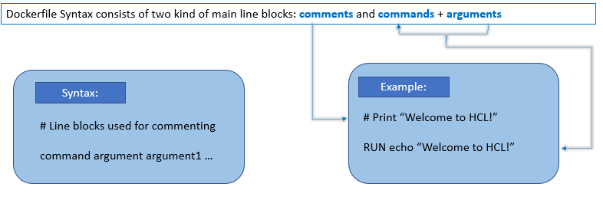
Dockerfile Syntax

Slide 26
Dockerfile – FROM and ENV Instructions
FROM
FROM instruction is the most crucial amongst all for Dockerfiles, It sets the base image required to start the build process. A valid Dockrefile must have FROM as its first instruction.
Staging Server
Example
# Usage: FROM [image name]
FROM ubuntu
ENV
The ENV instruction is also useful for providing required environment variables specific to services you wish to containerize , such as MYSQL_ROOT_PASSWORD
Example
ENV JAVA_HOME /usr/lib/java/jdk1.8
ENV TOMCAT_VERSION 8.0.26

Slide 27
Dockerfile – RUN , ADD and COPY Instructions
RUN
The RUN Instruction will execute any commands in a new layer on top of current image and commits the results. Resulting committed image will be used for the next step in Dockerfile
Example
RUN apt-get update && apt-get install –y \
git \
jdk1.8 \
tomcat
ADD & COPY
The Add and Copy commands can be used to add files to the container
For ADD if source file is a tar file the file will be extracted
ADD allows source file to be a URL
Example
COPY */ /mydir # adds all files from host directory to container /mydir folder
COPY hom* /mydir # adds all files starting with “hom”

Slide 28
Dockerfile – EXPOSE and WORKDIR Instructions
The EXPOSE Instruction informs Docker that the container will listen on the specified network ports at runtime.
Docker uses this information to interconnect containers using links and to determine which ports to expose to the host when using –P flag
Expose
Example
EXPOSE 8080
WORKDIR
The WORKDIR instruction sets the working directory for any RUN, CMD, COPY, ADD, ENTRYPOINT instructions that follow it in Dockerfile.
It can be used multiple times in one Dockerfile
Example
#If a relative path is provided , it will be relative to the path of the previous WORKDIR instruction.
WORKDIR $CATALINA_HOME

Slide 29
Dockerfile – CMD and ENTRYPOINT Instructions
The main purpose of a CMD instruction is to provide defaults for an executing container.
Can be overridden with arguments to docker run.
CMD
Example
CMD [“Catalina.sh, “run”]
ENTRYPOINT
ENTRYPOINT arguments sets the concrete default application that is used every time a container is created using the image
Unlike CMD instruction , ENTRYPOINT cannot be overridden with arguments to docker run.
Example
ENTRYPOINT [“Catalina.sh, “run”]

Slide 30
Dockerfile – Volume , USER and Maintainer Instructions
The VOLUME instruction is used to specify one or more directories that bypass the Union File System. This instruction is how the author of the Dockerfile defines where stateful information should be written
VOLUME
Example
VOLUME [“/data/db/”]
VOLUME /var/log/data
USER
The USER instruction is used to set the UID (or username) which is to run the container based on the image being built.
Example
USER nobody
MAINTAINER
The MAINTAINER instruction is a not-executing command declares the author. It should come nonetheless after FROM command.
Example
MAINTAINER Developer1

Slide 31
Building an Image
A Dockerfile that contains a set of instructions that tell Docker how to build or image.
The Dockerfile can be used to generate an image and store it on your local system.
Docker daemon does the actual build process. Contents of the context is sent to Docker daemon.
Each instruction creates a new layer in the image. The cache from previous builds is used.
$ docker build –t veenam/myapp:v1 .

Slide 32
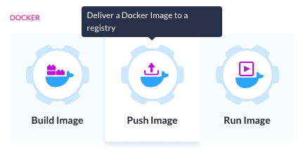
Push Local Images to Registry
In order to share docker images , we can push it to a Docker Registry. Images can then be pulled by other teams for deployment.
Use internal docker registry for private images.
Use DockerHub for public images
$ docker tag myapp:1.0 veenam/myapp:1.0
$ docker push veenam/myapp:1.0
$ docker pull veenam/myapp:1.0

Slide 33
Create Optimized images
1.Remove unnecessary dependencies,
2. deleting package manager cache
3.copying only required content
4. Order from least to most changing content
5. Apt-get update & install in oneline
Using Official images whereever possible
Initial image
FROM debian
COPY . /app
RUN apt-get update
RUN apt-get -y install default-jdk
CMD ["java", "-jar" "/app/target/app.jar"]
FROM openjdk
COPY target/app.jar /app
CMD ["java", "-jar" "/app/app.jar"]
FROM debian
RUN apt-get update && apt-get -y install --no-install-recommends default-jdk && / rm -rf /var/lib/apt/lists/*
COPY target/app.jar /app
CMD ["java", "-jar" "/app/app.jar"]
FROM openjdk:8
COPY target/app.jar /app
CMD ["java", "-jar" "/app/app.jar"]
Using more specific tags, look for minimal flavours

Slide 34
Optimizing Docker Images
Order from least to most frequently changing content – order matters for Caching
Only copy whats needed. Avoid “COPY .” – More specific COPY to limit cache busts
Don’t run apt-update on a single line. This will cause caching issues if the referenced archive gets updated and makes subsequent apt-get install fail without comment. apt-get update & install
Remove unnecessary dependencies - apt-get –y install –no-install-recommends
Remove package manager cache – rm –rf /var/lib/app/lists/*
Use Official images when possible and use more specific tags. The “latest” tag is a rolling tag.
Reduce image size – Faster deploys and smaller attack surface
Use multi-stage builds – drastically reduces the size of the image, improves performance
Minimal Base Images – Example Alpline: 2 MB and Ubuntu: 60 MB

Slide 35
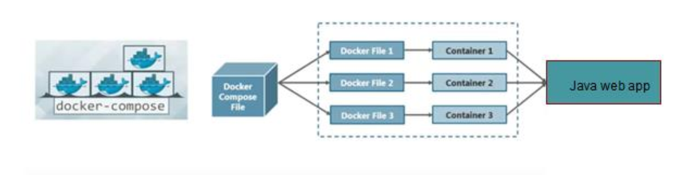
Docker Compose – Why?
PROBLEM:
Our Docker Applications includes to run more than one container.
Building , running and connecting containers from separate Dockerfiles with separate run command is time consuming.
Solution : Docker Compose
Docker Compose is tool used to run multi-container app.
Each container will run a stand-alone application and it can communicate with other containers present in the same host.
Example- App using web component and database component, Microservices app

Slide 36
Docker Compose – Usage & Features
Using Docker Compose is a 3-step process
Define your app’s environment with a Dockerfile, so it can reproduce anywhere.
Define the services that make up your app in a docker-compose, so they can run together in any isolated environment.
Run Docker Compose up and compose starts and run the entire application.
Features
The Features of Compose that make it effective are:
Multiple isolated environments on a single host.
Preserve volume data when container are created.
Only recreate containers that have changed.
Variables and moving a composition between environments.

Slide 37
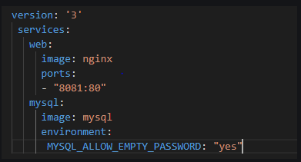
Docker Compose - Commands
In order to manage the whole lifecycle of the application, Docker Compose has several commands:
Start, stop, and rebuild services
View the status of running services
Stream the log output of running services
Run a one-off command on a service
Sample Docker-compose.yaml

Slide 38

Thank You !
Documentation
Docker: https://docs.docker.com/
Try Hands-on
Docker: https://www.katacoda.com/courses/docker

