Slide 1
Jenkins
Veena M

Slide 2

Noticeable Challenges and Trends
AGENDA
Continuous Integration vs Continuous Delivery vs Continuous Deployment
01
02
What & Why Jenkins?
03
Jenkins-Installation
04
Jenkins-Architecture
05
Create and Configure FreeStyle Jobs
08
Jenkins Pipelines for CI-CD
06
07
Jenkinsfile

Slide 3
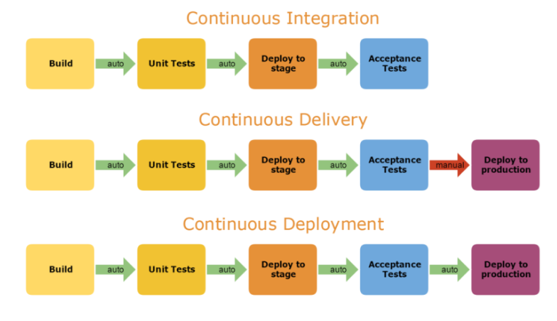

Slide 4
CI – What does it really mean?
At a regular frequency (ideally at every commit), the system is:
Integrated: All changes up until that point are combined into the project
Built: The code is compiled into an executable or package
Tested: Automated test suites are run
Archived: Versioned and stored so it can be distributed as is, if desired
Deployed: Loaded onto a system where the developers can interact with it

Slide 5
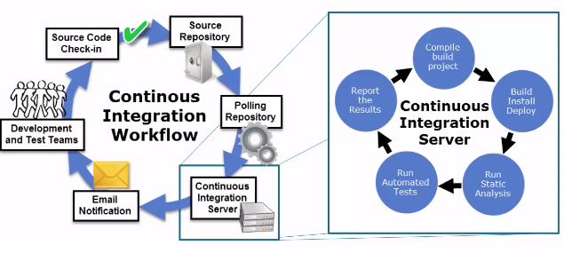
DevOps Tools for this Phase : Jenkins , Teamcity, Bamboo
Continuous Integration

Slide 6
Benefits of CI
Early Bug Detection
Easy Debugging and Change
Quick Feedback Loops
Better Visibility across Development processes
Fast and Reliable Releases
Cost Reduction
Enhanced Flexibility

Slide 7
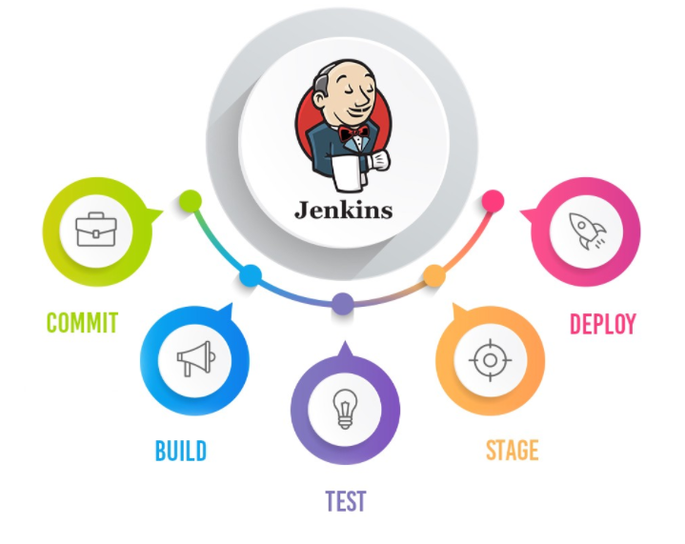
What is Jenkins?
Jenkins is an automation server enabling continuous integration and Continuous Delivery.
It is used to manually, periodically, or automatically build , test and deploy software applications.
It is an opensource Continuous Integration tool written in Java.
Jenkins is used by teams of all different sizes, for projects with various languages.

Slide 8
About Jenkins
Branched from Hudson
Java based Continuous Build System
Runs in servlet container
Glassfish, Tomcat
Supported by over 400 plugins
SCM, Testing, Deployments, Notifications, Reporting,
Artifact Saving, Triggers, External Integration
Under development since 2005
http://jenkins-ci.org/

Slide 9

Why Jenkins?
Jenkins is important for CI/CD pipelines for three key reasons:
Jenkins makes it easier for developers to continuously integrate changes.
Jenkins makes it easier for developers to get the latest build.
Jenkins adds automation to CI/CD pipelines.
It is Opensource
Large support community and thorough documentation
Easily extendable

Slide 10
Jenkins Installation
Jenkins is packaged as a WAR, so you can drop it into whichever servlet container you prefer to use
Jenkins comes pre-packaged with a servlet if you just want a lightweight implementation
Native/Supported packages exist for
Windows, linux, MacOS etc..
There are also cloud based solutions that can provide a Jenkins instance
Cloudbees - http://www.cloudbees.com/

Slide 11
Jenkins - Architecture
Windows
Slave Node(UI)
Master Node:
Schedules build
Dispatches builds to slave nodes for actual execution
Monitors the slave nodes and Records the results.
Jenkins
Master(UI)
MacOS
Slave Node(UI)
Slave Node:
Setup to build projects for Master
Executes the jobs dispatched by Master
Linux
Slave Node(UI)

Slide 12
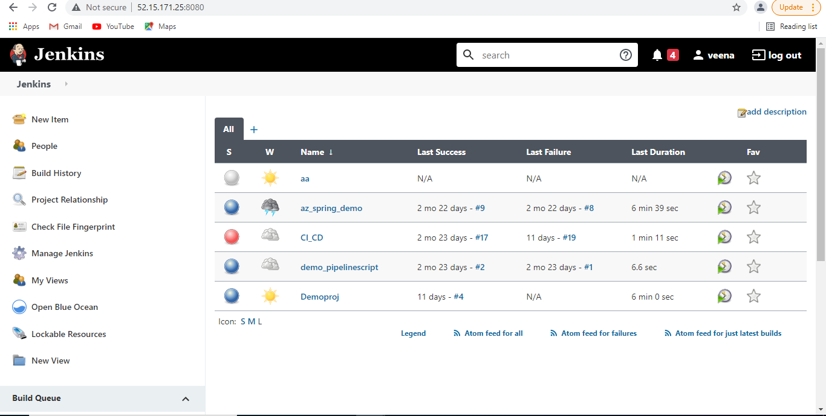
Jenkins UI

Slide 13
Jenkins - Demo
Manage Jenkins
Plugins Installation
User Management
Tools Configurations
Create Free Style Jobs
SCM checkout
Script executions
Maven Project Build
Test-results Publish
Build Triggers

Slide 14
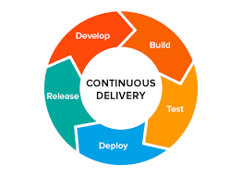
What is a Jenkins Pipeline?
A pipeline is a collection of jobs that brings the software from version control into the hands of the end users by using automation tools. It is a feature used to incorporate continuous delivery in our software development workflow.
Over the years, there have been multiple Jenkins pipeline releases including, Jenkins Build flow, Jenkins Build Pipeline plugin, Jenkins Workflow, etc.
key features of these plugins:
They represent multiple Jenkins jobs as one whole workflow in the form of a pipeline.
What do these pipelines do? These pipelines are a collection of Jenkins jobs which trigger each other in a specified sequence.

Slide 15
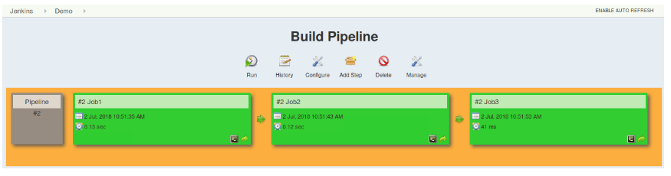
Jenkins Build Pipeline
This approach is effective for deploying small applications.
But what happens when there are complex pipelines with several processes (build, test, unit test, integration test, pre-deploy, deploy, monitor) running 100’s of jobs?
The maintenance cost for such a complex pipeline is huge and increases with the number of processes. It also becomes tedious to build and manage such a vast number of jobs

Slide 16
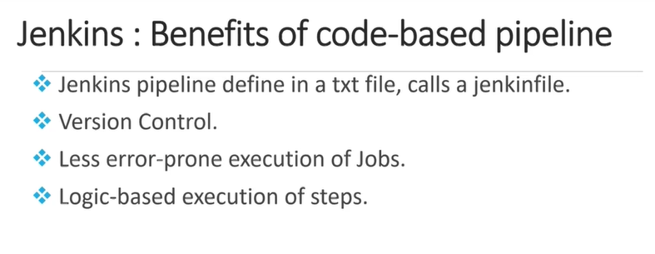
Jenkins Pipeline
Jenkins Pipeline Project is to define the entire deployment flow through code. It basically follows the ‘pipeline as code’ discipline. Instead of building several jobs for each phase, can now code the entire workflow and put it in a Jenkinsfile.

Slide 17
Jenkins Pipeline : Advantages
It models simple to complex pipelines as code by using Groovy DSL (Domain Specific Language)
The code is stored in a text file called the Jenkinsfile which can be checked into a SCM (Source Code Management)
Improves user interface by incorporating user input within the pipeline
It is durable in terms of unplanned restart of the Jenkins master
It supports complex pipelines by incorporating conditional loops, fork or join operations and allowing tasks to be performed in parallel
It can integrate with several other plugins

Slide 18





Static Testing
Static testing is a method of testing the source code without actually executing it. It does so by analyzing the code against the pre-set of coding rules and ensures that it conforms to the guidelines
Informs Dev about errors in the code
Writes the code

Slide 19

Static Code Analysis
Many tools are available which helps in Static testing and provides an analysis got better comprehension
Creates an analysis of the code
Represents it visually
Writes the code

Slide 20

Why use Static Code Analyser
Find errors earlier in the development
Finds security errors & Detects over complexity in code
Enforces best coding practices
Automate & Interate in Jenkins

Slide 21
What is SonarQube?
SonarQube is an Opensource static code analysis software. It is used by developers to manage quality of the source code and maintain consistency.
Architecture & Design
Unit Tests
Duplicated Code
Potential Bugs
Coding Standards
Complex Code
Comments
SonarQube covers the 7 sections of code quality

Slide 22
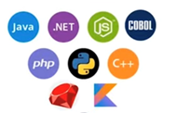
SonarQube - Features
It can work with 25 different languages

Slide 23
SonarQube - Features
Analyses and reports Tricky Issues
Code Smells
Defect Bugs
Vulnerabilities
Execution
Path
Lines of Code
Activate Rules

Slide 24
SonarQube - Features
Ensures better CI-CD. Enhanced workflow.
Automated Code Analysis
Integrate GitHub
Access through web-hooks & API
Analyse Code branches

Slide 25


Slide 26
$7 BILLION | 110,000 EMPLOYEES | 31 COUNTRIES

