Slide 1
Chapter 1: Introduction

Slide 2
Database Management System (DBMS)
DBMS contains information about a particular enterprise
Collection of interrelated data
Set of programs to access the data
An environment that is both convenient and efficient to use
Database Applications:
Banking: transactions
Airlines: reservations, schedules
Universities: registration, grades
Sales: customers, products, purchases
Online retailers: order tracking, customized recommendations
Manufacturing: production, inventory, orders, supply chain
Human resources: employee records, salaries, tax deductions
Databases can be very large.
Databases touch all aspects of our lives
Notes:
2

Slide 3
University Database Example
Application program examples
Add new students, instructors, and courses
Register students for courses, and generate class rosters
Assign grades to students, compute grade point averages (GPA) and generate transcripts
In the early days, database applications were built directly on top of file systems
Notes:
3

Slide 4
Drawbacks of using file systems to store data
Data redundancy and inconsistency
Multiple file formats, duplication of information in different files
Difficulty in accessing data
Need to write a new program to carry out each new task
Data isolation — multiple files and formats
Integrity problems
Integrity constraints (e.g., account balance > 0) become “buried” in program code rather than being stated explicitly
Hard to add new constraints or change existing ones
Notes:
4

Slide 5
Drawbacks of using file systems to store data (Cont.)
Atomicity of updates
Failures may leave database in an inconsistent state with partial updates carried out
Example: Transfer of funds from one account to another should either complete or not happen at all
Concurrent access by multiple users
Concurrent access needed for performance
Uncontrolled concurrent accesses can lead to inconsistencies
Example: Two people reading a balance (say 100) and updating it by withdrawing money (say 50 each) at the same time
Security problems
Hard to provide user access to some, but not all, data
Database systems offer solutions to all the above problems
Notes:
5

Slide 6
Levels of Abstraction
Physical level: describes how a record (e.g., instructor) is stored.
Logical level: describes what data are stored in database, and the relationships among the data.
type instructor = record
ID : string; name : string; dept_name : string; salary : integer;
end;
View level: application programs hide details of data types. Views can also hide information (such as an instructor’s salary) for security purposes.
Notes:
6

Slide 7
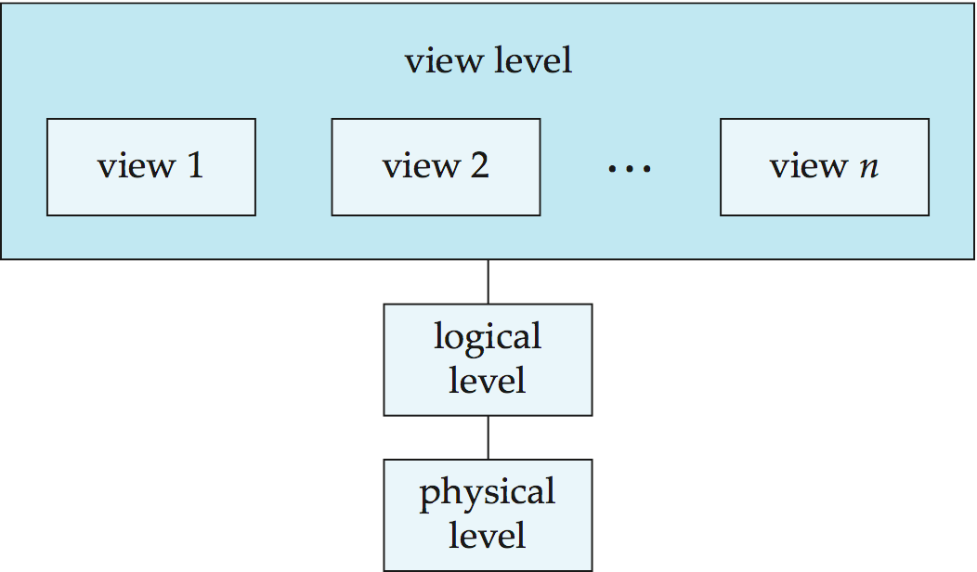
View of Data
An architecture for a database system
Notes:
7

Slide 8
Instances and Schemas
Similar to types and variables in programming languages
Schema – the logical structure of the database
Example: The database consists of information about a set of customers and accounts and the relationship between them
Analogous to type information of a variable in a program
Physical schema: database design at the physical level
Logical schema: database design at the logical level
Instance – the actual content of the database at a particular point in time
Analogous to the value of a variable
Physical Data Independence – the ability to modify the physical schema without changing the logical schema
Applications depend on the logical schema
In general, the interfaces between the various levels and components should be well defined so that changes in some parts do not seriously influence others.
Notes:
8

Slide 9
Data Models
A collection of tools for describing
Data
Data relationships
Data semantics
Data constraints
Relational model
Entity-Relationship data model (mainly for database design)
Object-based data models (Object-oriented and Object-relational)
Semistructured data model (XML)
Other older models:
Network model
Hierarchical model
Notes:
9

Slide 10
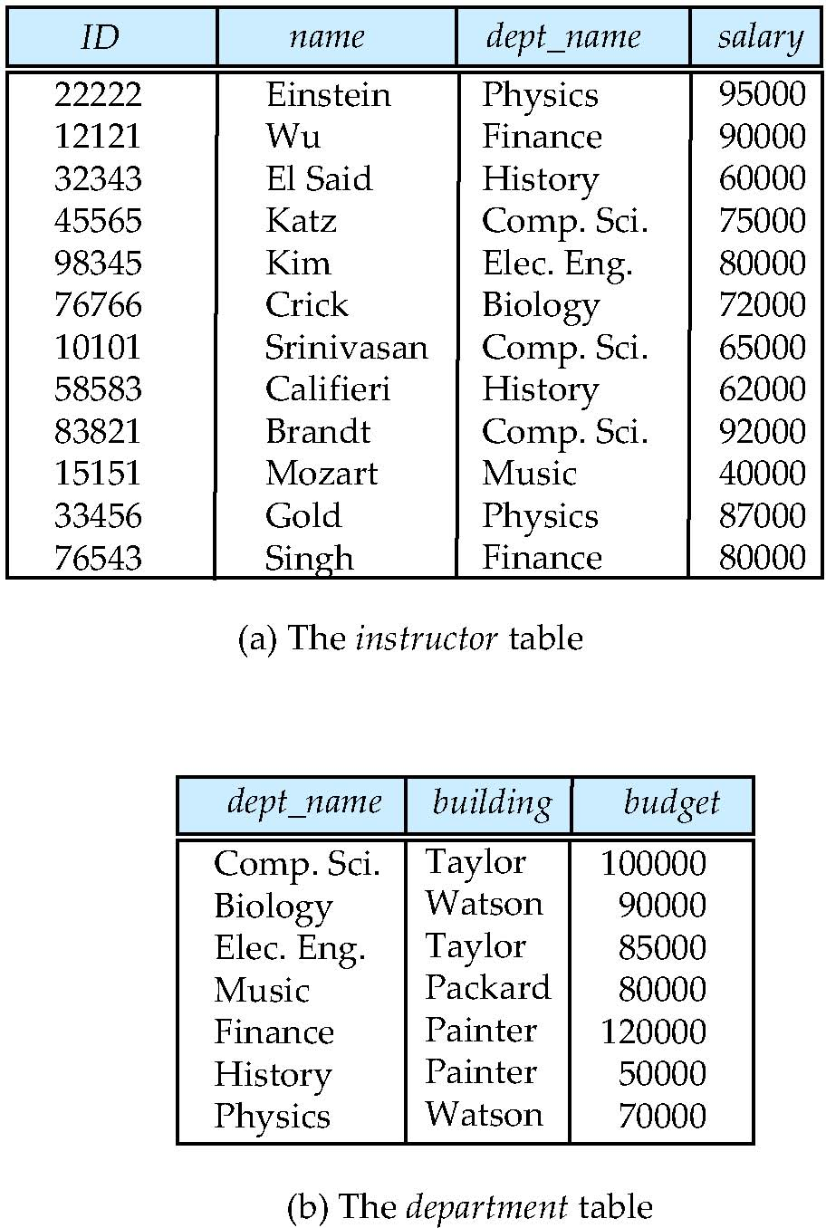
Relational Model
Relational model (Chapter 2)
Example of tabular data in the relational model
Columns
Rows
Notes:
10

Slide 11
A Sample Relational Database
Notes:
11

Slide 12
Data Manipulation Language (DML)
Language for accessing and manipulating the data organized by the appropriate data model
DML also known as query language
Two classes of languages
Procedural – user specifies what data is required and how to get those data
Declarative (nonprocedural) – user specifies what data is required without specifying how to get those data
SQL is the most widely used query language
Notes:
12

Slide 13
Data Definition Language (DDL)
Specification notation for defining the database schema
Example: create table instructor ( ID char(5), name varchar(20), dept_name varchar(20), salary numeric(8,2))
DDL compiler generates a set of table templates stored in a data dictionary
Data dictionary contains metadata (i.e., data about data)
Database schema
Integrity constraints
Primary key (ID uniquely identifies instructors)
Referential integrity (references constraint in SQL)
e.g. dept_name value in any instructor tuple must appear in department relation
Authorization
Notes:
13

Slide 14
SQL
SQL: widely used non-procedural language
Example: Find the name of the instructor with ID 22222 select name from instructor where instructor.ID = ‘22222’
Example: Find the ID and building of instructors in the Physics dept.
select instructor.ID, department.building from instructor, department where instructor.dept_name = department.dept_name and department.dept_name = ‘Physics’
Application programs generally access databases through one of
Language extensions to allow embedded SQL
Application program interface (e.g., ODBC/JDBC) which allow SQL queries to be sent to a database
Chapters 3, 4 and 5
Notes:
14

Slide 15
Database Design
The process of designing the general structure of the database:
Logical Design – Deciding on the database schema. Database design requires that we find a “good” collection of relation schemas.
Business decision – What attributes should we record in the database?
Computer Science decision – What relation schemas should we have and how should the attributes be distributed among the various relation schemas?
Physical Design – Deciding on the physical layout of the database
Notes:
15

Slide 16
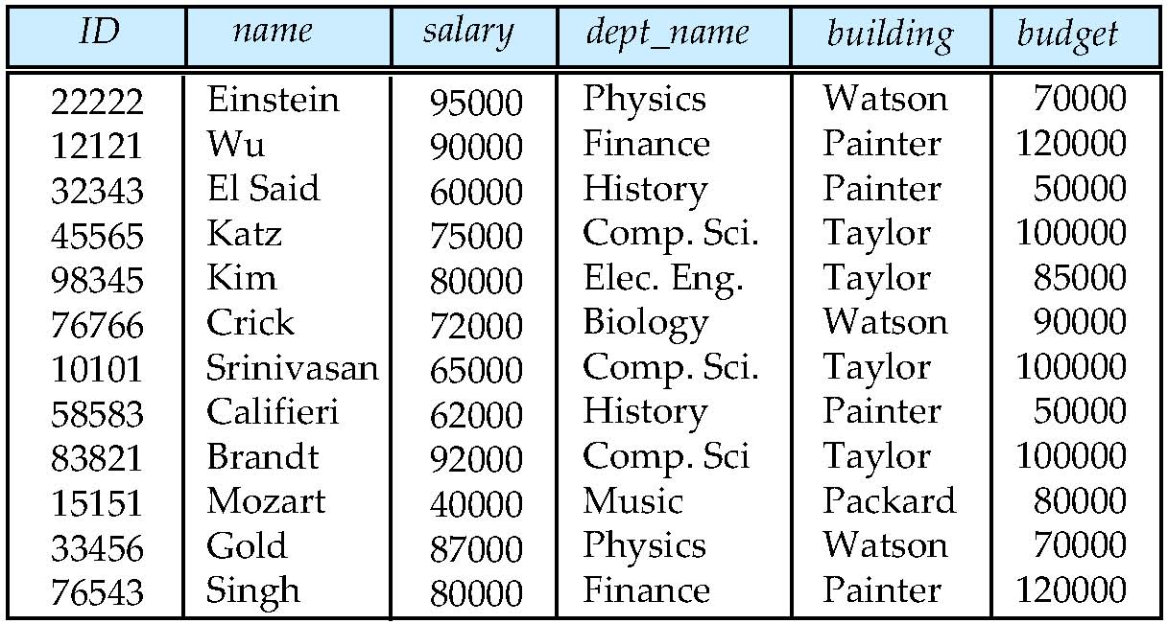
Database Design?
Is there any problem with this design?
Notes:
16

Slide 17
Design Approaches
Normalization Theory (Chapter 8)
Formalize what designs are bad, and test for them
Entity Relationship Model (Chapter 7)
Models an enterprise as a collection of entities and relationships
Entity: a “thing” or “object” in the enterprise that is distinguishable from other objects
Described by a set of attributes
Relationship: an association among several entities
Represented diagrammatically by an entity-relationship diagram:
Notes:
17

Slide 18
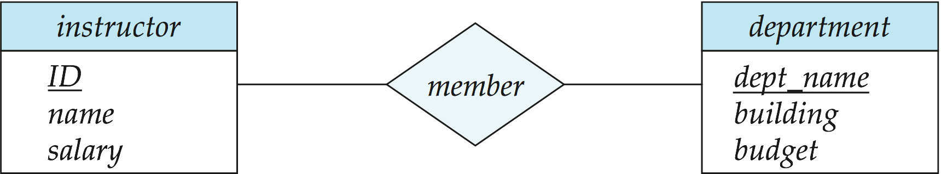
The Entity-Relationship Model
What happened to dept_name of instructor and student?
Models an enterprise as a collection of entities and relationships
Entity: a “thing” or “object” in the enterprise that is distinguishable from other objects
Described by a set of attributes
Relationship: an association among several entities
Represented diagrammatically by an entity-relationship diagram:
Notes:
18

Slide 19
Object-Relational Data Models
Relational model: flat, “atomic” values
Object Relational Data Models
Extend the relational data model by including object orientation and constructs to deal with added data types.
Allow attributes of tuples to have complex types, including non-atomic values such as nested relations.
Preserve relational foundations, in particular the declarative access to data, while extending modeling power.
Provide upward compatibility with existing relational languages.
Notes:
19

Slide 20
XML: Extensible Markup Language
Defined by the WWW Consortium (W3C)
Originally intended as a document markup language not a database language
The ability to specify new tags, and to create nested tag structures made XML a great way to exchange data, not just documents
XML has become the basis for all new generation data interchange formats.
A wide variety of tools is available for parsing, browsing and querying XML documents/data
Notes:
20

Slide 21
Storage Management
Storage manager is a program module that provides the interface between the low-level data stored in the database and the application programs and queries submitted to the system.
The storage manager is responsible to the following tasks:
Interaction with the file manager
Efficient storing, retrieving and updating of data
Issues:
Storage access
File organization
Indexing and hashing
Notes:
21

Slide 22
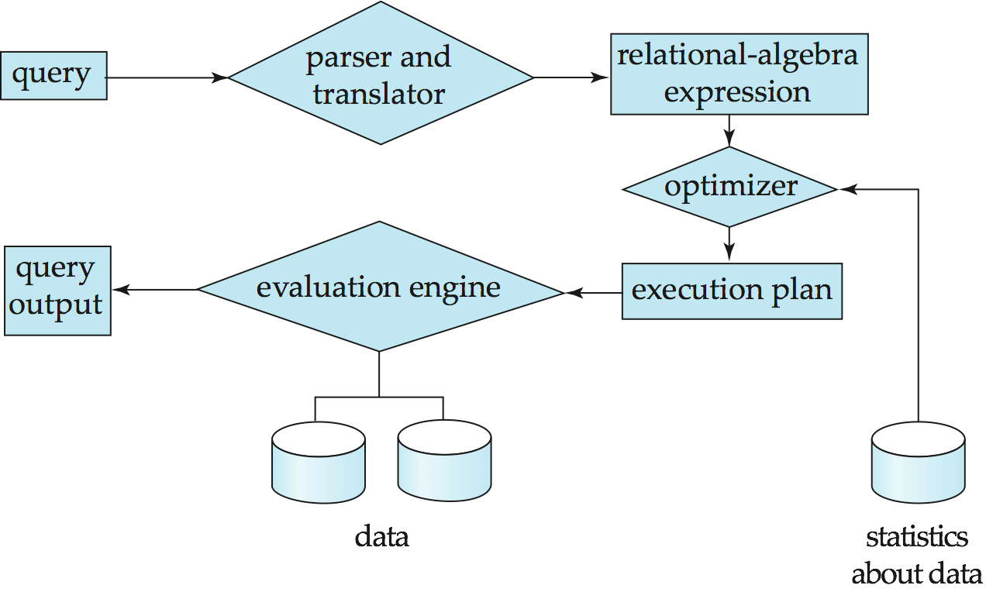
Query Processing
1. Parsing and translation
2. Optimization
3. Evaluation
Notes:
22

Slide 23
Query Processing (Cont.)
Alternative ways of evaluating a given query
Equivalent expressions
Different algorithms for each operation
Cost difference between a good and a bad way of evaluating a query can be enormous
Need to estimate the cost of operations
Depends critically on statistical information about relations which the database must maintain
Need to estimate statistics for intermediate results to compute cost of complex expressions
Notes:
23

Slide 24
Transaction Management
What if the system fails?
What if more than one user is concurrently updating the same data?
A transaction is a collection of operations that performs a single logical function in a database application
Transaction-management component ensures that the database remains in a consistent (correct) state despite system failures (e.g., power failures and operating system crashes) and transaction failures.
Concurrency-control manager controls the interaction among the concurrent transactions, to ensure the consistency of the database.
Notes:
24

Slide 25
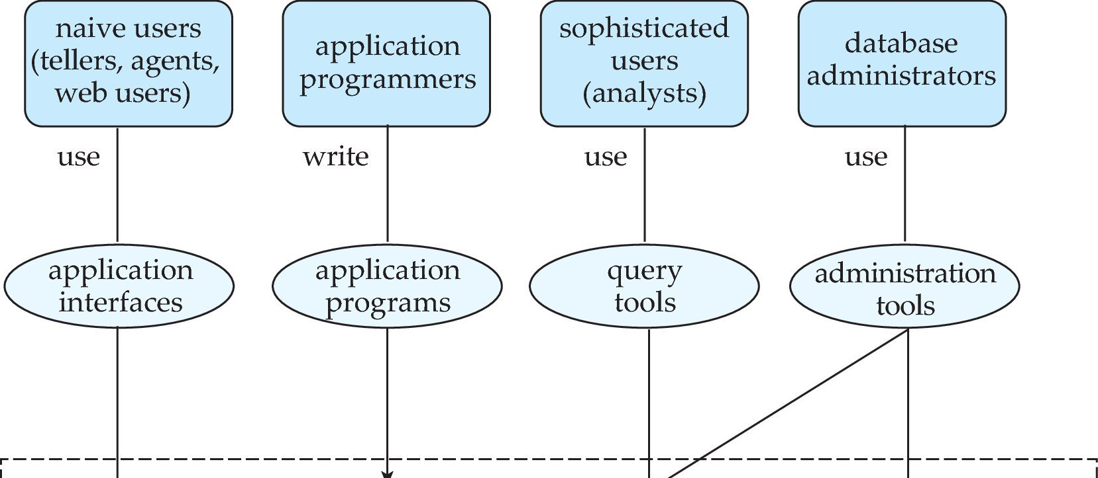
Database Users and Administrators
Database
Notes:
25

Slide 26
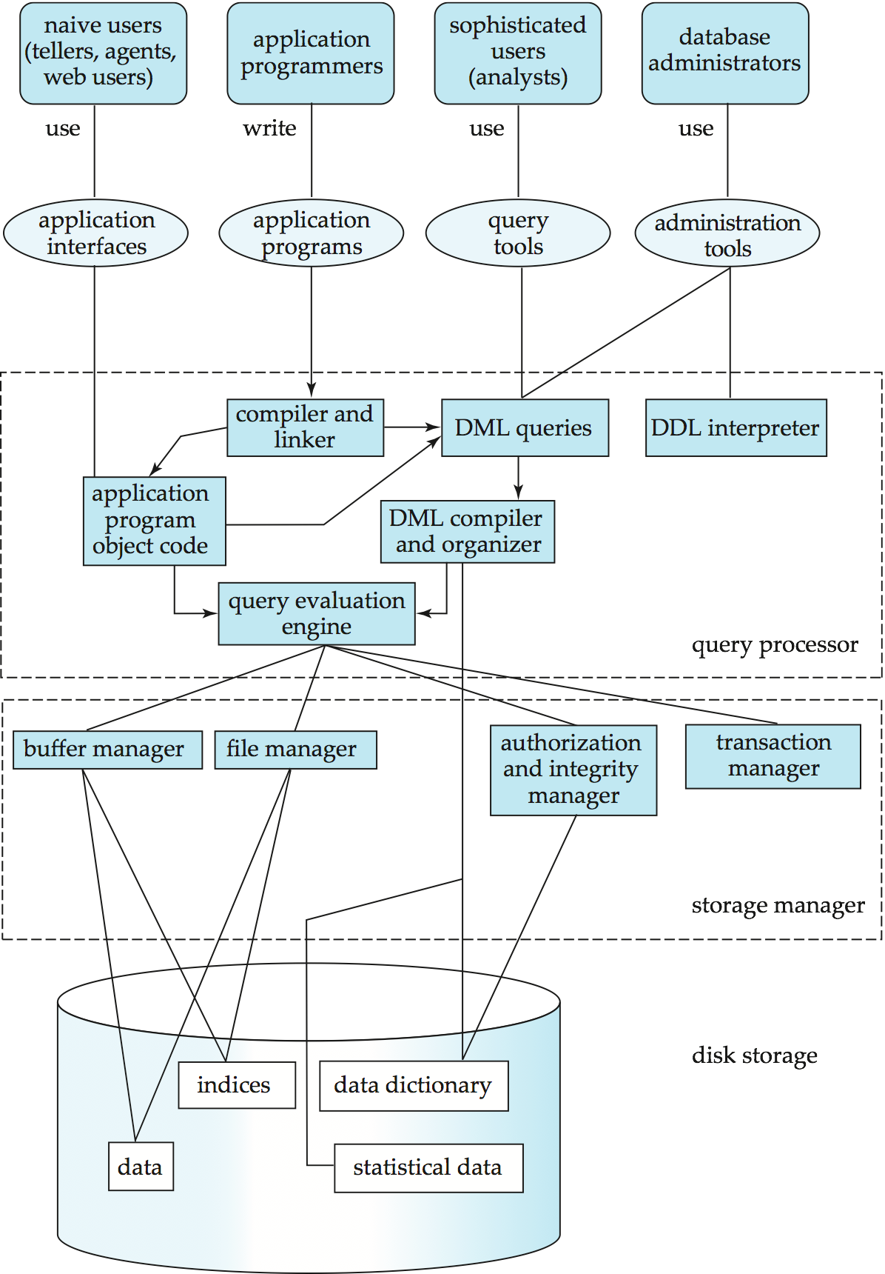
Database System Internals
Notes:
26

Slide 27
Database Architecture
The architecture of a database systems is greatly influenced by
the underlying computer system on which the database is running:
Centralized
Client-server
Parallel (multi-processor)
Distributed
Notes:
27

Slide 28
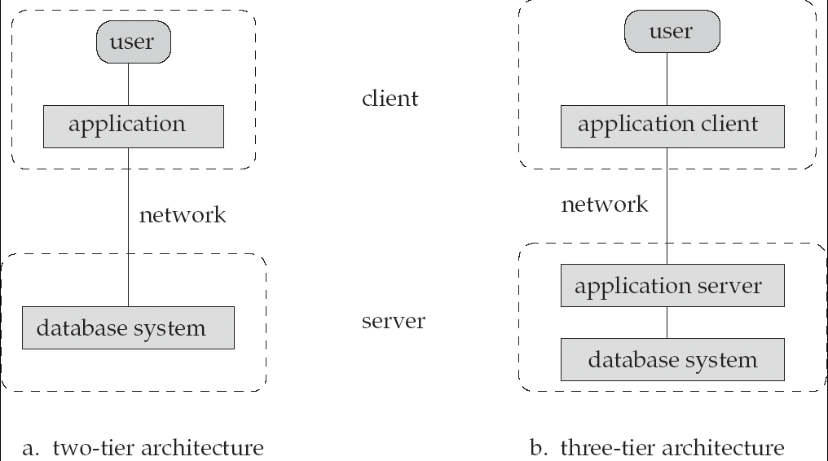
Database Application Architectures
(web browser)
Old
Modern

Slide 29
History of Database Systems
1950s and early 1960s:
Data processing using magnetic tapes for storage
Tapes provided only sequential access
Punched cards for input
Late 1960s and 1970s:
Hard disks allowed direct access to data
Network and hierarchical data models in widespread use
Ted Codd defines the relational data model
Would win the ACM Turing Award for this work
IBM Research begins System R prototype
UC Berkeley begins Ingres prototype
High-performance (for the era) transaction processing
Notes:
29

Slide 30
History (cont.)
1980s:
Research relational prototypes evolve into commercial systems
SQL becomes industrial standard
Parallel and distributed database systems
Object-oriented database systems
1990s:
Large decision support and data-mining applications
Large multi-terabyte data warehouses
Emergence of Web commerce
Early 2000s:
XML and XQuery standards
Automated database administration
Later 2000s:
Giant data storage systems
Google BigTable, Yahoo PNuts, Amazon, ..
Notes:
30

Slide 31
End of Chapter 1
Notes:
31

Slide 32

Figure 1.02
Notes:
32

Slide 33
Figure 1.04
Notes:
33

Slide 34
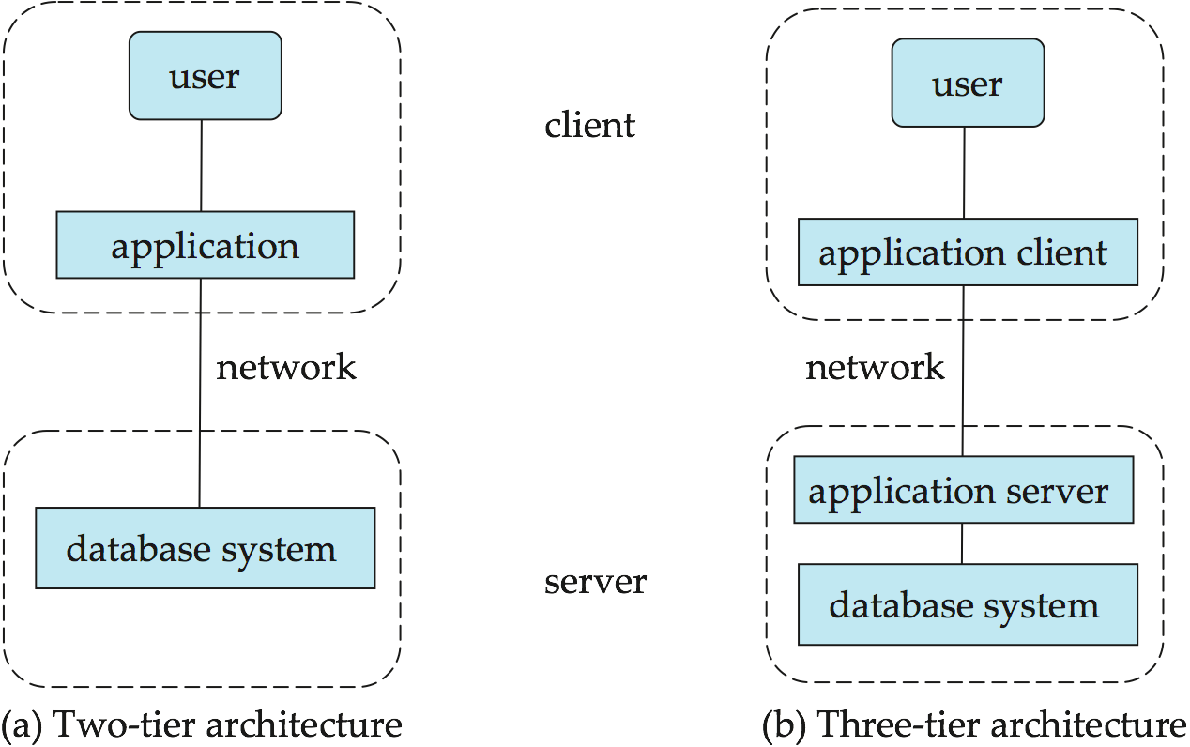
Figure 1.06
Notes:
34

