Slide 1
Chapter 15 : Concurrency Control

Slide 2
Chapter 15: Concurrency Control
Lock-Based Protocols
Timestamp-Based Protocols
Validation-Based Protocols
Multiple Granularity
Multiversion Schemes
Insert and Delete Operations
Concurrency in Index Structures

Slide 3
Lock-Based Protocols
A lock is a mechanism to control concurrent access to a data item
Data items can be locked in two modes:
1. exclusive (X) mode. Data item can be both read as well as
written. X-lock is requested using lock-X instruction.
2. shared (S) mode. Data item can only be read. S-lock is
requested using lock-S instruction.
Lock requests are made to concurrency-control manager. Transaction can proceed only after request is granted.

Slide 4
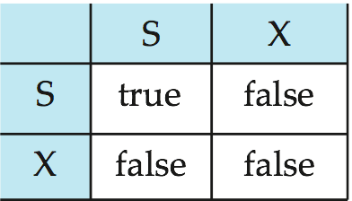
Lock-Based Protocols (Cont.)
Lock-compatibility matrix
A transaction may be granted a lock on an item if the requested lock is compatible with locks already held on the item by other transactions.
Any number of transactions can hold shared locks on an item,
but if any transaction holds an exclusive on the item no other transaction may hold any lock on the item.
If a lock cannot be granted, the requesting transaction is made to wait till all incompatible locks held by other transactions have been released. The lock is then granted.

Slide 5
Lock-Based Protocols (Cont.)
Example of a transaction performing locking:
T₂: lock-S(A);
read (A);
unlock(A);
lock-S(B);
read (B);
unlock(B);
display(A+B)
Locking as above is not sufficient to guarantee serializability — if A and B get updated in-between the read of A and B, the displayed sum would be wrong.
A locking protocol is a set of rules followed by all transactions while requesting and releasing locks. Locking protocols restrict the set of possible schedules.

Slide 6
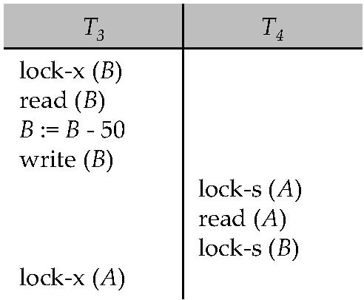
Pitfalls of Lock-Based Protocols
Consider the partial schedule
Neither T₃ nor T₄ can make progress — executing lock-S(B) causes T₄ to wait for T₃ to release its lock on B, while executing lock-X(A) causes T₃ to wait for T₄ to release its lock on A.
Such a situation is called a deadlock.
To handle a deadlock one of T₃ or T₄ must be rolled back and its locks released.

Slide 7
Pitfalls of Lock-Based Protocols (Cont.)
The potential for deadlock exists in most locking protocols. Deadlocks are a necessary evil.
Starvation is also possible if concurrency control manager is badly designed. For example:
A transaction may be waiting for an X-lock on an item, while a sequence of other transactions request and are granted an S-lock on the same item.
The same transaction is repeatedly rolled back due to deadlocks.
Concurrency control manager can be designed to prevent starvation.

Slide 8
The Two-Phase Locking Protocol
This is a protocol which ensures conflict-serializable schedules.
Phase 1: Growing Phase
transaction may obtain locks
transaction may not release locks
Phase 2: Shrinking Phase
transaction may release locks
transaction may not obtain locks
The protocol assures serializability. It can be proved that the transactions can be serialized in the order of their lock points (i.e., the point where a transaction acquired its final lock).

Slide 9
The Two-Phase Locking Protocol (Cont.)
Two-phase locking does not ensure freedom from deadlocks.
Cascading roll-back is possible under two-phase locking. To avoid this, follow a modified protocol called strict two-phase locking. Here a transaction must hold all its exclusive locks till it commits/aborts.
Rigorous two-phase locking is even stricter: here all locks are held till commit/abort. In this protocol transactions can be serialized in the order in which they commit.

Slide 10
The Two-Phase Locking Protocol (Cont.)
There can be conflict serializable schedules that cannot be obtained if two-phase locking is used.
However, in the absence of extra information (e.g., ordering of access to data), two-phase locking is needed for conflict serializability in the following sense:
Given a transaction T_{i} that does not follow two-phase locking, we can find a transaction T_{j} that uses two-phase locking, and a schedule for T_{i} and T_{j} that is not conflict serializable.

Slide 11
Lock Conversions
Two-phase locking with lock conversions:
– First Phase:
can acquire a lock-S on item
can acquire a lock-X on item
can convert a lock-S to a lock-X (upgrade)
– Second Phase:
can release a lock-S
can release a lock-X
can convert a lock-X to a lock-S (downgrade)
This protocol assures serializability. But still relies on the programmer to insert the various locking instructions.

Slide 12
Automatic Acquisition of Locks
A transaction T_{i} issues the standard read/write instruction, without explicit locking calls.
The operation read(D) is processed as:
if T_{i} has a lock on D
then
read(D)
else begin
if necessary wait until no other
transaction has a lock-X on D
grant T_{i} a lock-S on D;
read(D)
end

Slide 13
Automatic Acquisition of Locks (Cont.)
write(D) is processed as:
if T_{i} has a lock-X on D
then
write(D)
else begin
if necessary wait until no other trans. has any lock on D,
if T_{i} has a lock-S on D
then
upgrade lock on D to lock-X
else
grant T_{i} a lock-X on D
write(D)
end;
All locks are released after commit or abort

Slide 14
Implementation of Locking
A lock manager can be implemented as a separate process to which transactions send lock and unlock requests.
The lock manager replies to a lock request by sending a lock grant messages (or a message asking the transaction to roll back, in case of a deadlock).
The requesting transaction waits until its request is answered.
The lock manager maintains a data-structure called a lock table to record granted locks and pending requests.
The lock table is usually implemented as an in-memory hash table indexed on the name of the data item being locked.

Slide 15
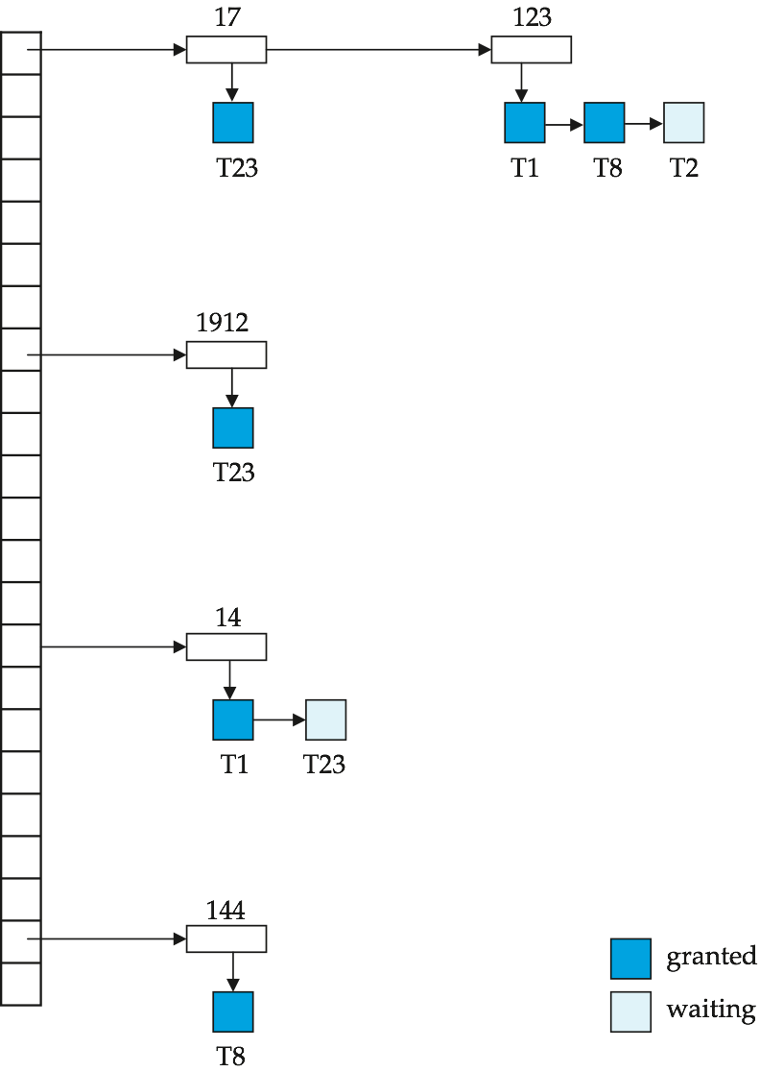
Lock Table
Black rectangles indicate granted locks, white ones indicate waiting requests
Lock table also records the type of lock granted or requested
New request is added to the end of the queue of requests for the data item, and granted if it is compatible with all earlier locks
Unlock requests result in the request being deleted, and later requests are checked to see if they can now be granted
If transaction aborts, all waiting or granted requests of the transaction are deleted
lock manager may keep a list of locks held by each transaction, to implement this efficiently

Slide 16
Graph-Based Protocols
Graph-based protocols are an alternative to two-phase locking.
Impose a partial ordering → on the set D = {d₁, d₂ ,..., d_{h}} of all data items.
If d_{i} → d_{j} then any transaction accessing both d_{i} and d_{j} must access d_{i} before accessing d_{j}.
Implies that the set D may now be viewed as a directed acyclic graph, called a database graph.
The tree-protocol is a simple kind of graph protocol.

Slide 17
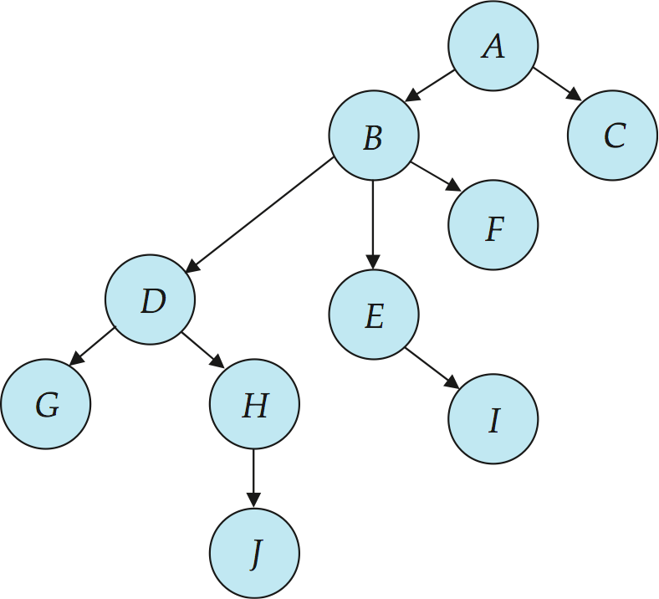
Tree Protocol
Only exclusive locks are allowed.
The first lock by T_{i} may be on any data item. Subsequently, a data Q can be locked by T_{i} only if the parent of Q is currently locked by T_{i}.
Data items may be unlocked at any time.
A data item that has been locked and unlocked by T_{i} cannot subsequently be relocked by T_{i} .

Slide 18
Graph-Based Protocols (Cont.)
The tree protocol ensures conflict serializability as well as freedom from deadlock.
Unlocking may occur earlier in the tree-locking protocol than in the two-phase locking protocol.
shorter waiting times, and increase in concurrency
protocol is deadlock-free, no rollbacks are required
Drawbacks
Protocol does not guarantee recoverability or cascade freedom
Need to introduce commit dependencies to ensure recoverability
Transactions may have to lock data items that they do not access.
increased locking overhead, and additional waiting time
potential decrease in concurrency
Schedules not possible under two-phase locking are possible under tree protocol, and vice versa.

Slide 19
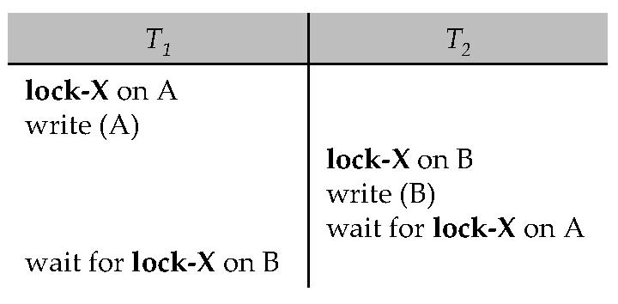
Deadlock Handling
Consider the following two transactions:
T₁: write (X) T₂: write(Y)
write(Y) write(X)
Schedule with deadlock

Slide 20
Deadlock Handling
System is deadlocked if there is a set of transactions such that every transaction in the set is waiting for another transaction in the set.
Deadlock prevention protocols ensure that the system will never enter into a deadlock state. Some prevention strategies:
Require that each transaction locks all its data items before it begins execution (predeclaration).
Impose partial ordering of all data items and require that a transaction can lock data items only in the order specified by the partial order (graph-based protocol).

Slide 21
More Deadlock Prevention Strategies
Following schemes use transaction timestamps for the sake of deadlock prevention alone.
wait-die scheme — non-preemptive
older transaction may wait for younger one to release data item. Younger transactions never wait for older ones; they are rolled back instead.
a transaction may die several times before acquiring needed data item
wound-wait scheme — preemptive
older transaction wounds (forces rollback) of younger transaction instead of waiting for it. Younger transactions may wait for older ones.
may be fewer rollbacks than wait-die scheme

Slide 22
Deadlock prevention (Cont.)
Both in wait-die and in wound-wait schemes, a rolled back transactions is restarted with its original timestamp. Older transactions thus have precedence over newer ones, and starvation is hence avoided.
Timeout-Based Schemes:
a transaction waits for a lock only for a specified amount of time. After that, the wait times out and the transaction is rolled back.
thus deadlocks are not possible
simple to implement; but starvation is possible. Also difficult to determine good value of the timeout interval.

Slide 23
Deadlock Detection
Deadlocks can be described as a wait-for graph, which consists of a pair G = (V,E),
V is a set of vertices (all the transactions in the system)
E is a set of edges; each element is an ordered pair T_{i} →T_{j}.
If T_{i} → T_{j} is in E, then there is a directed edge from T_{i} to T_{j}, implying that T_{i} is waiting for T_{j} to release a data item.
When T_{i} requests a data item currently being held by T_{j}, then the edge T_{i} T_{j} is inserted in the wait-for graph. This edge is removed only when T_{j} is no longer holding a data item needed by T_{i}.
The system is in a deadlock state if and only if the wait-for graph has a cycle. Must invoke a deadlock-detection algorithm periodically to look for cycles.

Slide 24
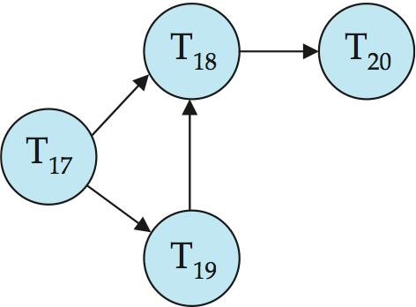
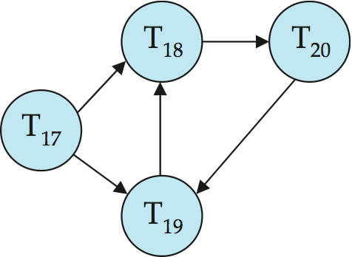
Deadlock Detection (Cont.)
Wait-for graph without a cycle
Wait-for graph with a cycle

Slide 25
Deadlock Recovery
When deadlock is detected:
Some transaction will have to rolled back (made a victim) to break deadlock. Select that transaction as victim that will incur minimum cost.
Rollback -- determine how far to roll back transaction
Total rollback: Abort the transaction and then restart it.
More effective to roll back transaction only as far as necessary to break deadlock.
Starvation happens if same transaction is always chosen as victim. Include the number of rollbacks in the cost factor to avoid starvation

Slide 26
Multiple Granularity
Allow data items to be of various sizes and define a hierarchy of data granularities, where the small granularities are nested within larger ones.
Can be represented graphically as a tree (but don't confuse with tree-locking protocol)
When a transaction locks a node in the tree explicitly, it implicitly locks all the node's descendents in the same mode.
Granularity of locking (level in tree where locking is done):
fine granularity (lower in tree): high concurrency, high locking overhead
coarse granularity (higher in tree): low locking overhead, low concurrency

Slide 27
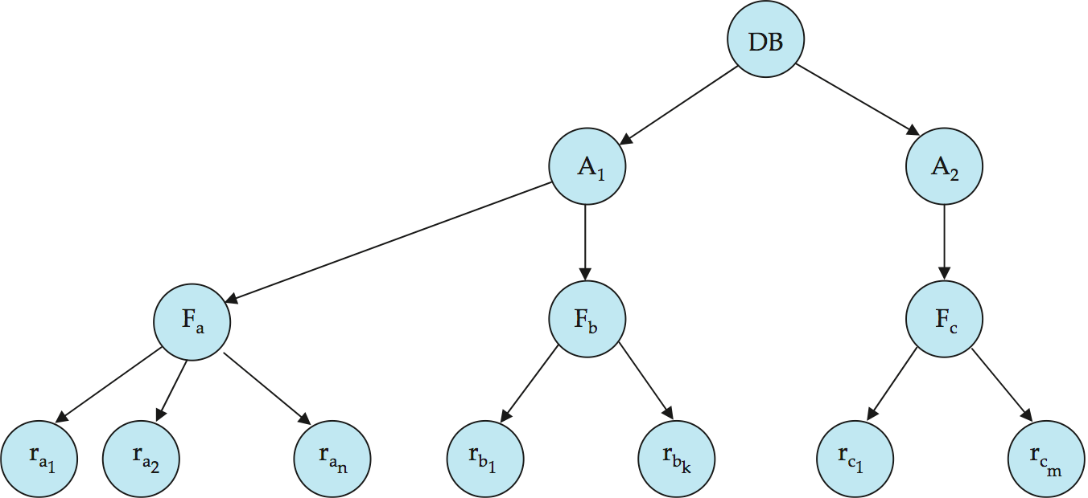
Example of Granularity Hierarchy
The levels, starting from the coarsest (top) level are:
database
area
file
record

Slide 28
Intention Lock Modes
In addition to S and X lock modes, there are three additional lock modes with multiple granularity:
intention-shared (IS): indicates explicit locking at a lower level of the tree but only with shared locks.
intention-exclusive (IX): indicates explicit locking at a lower level with exclusive or shared locks
shared and intention-exclusive (SIX): the subtree rooted by that node is locked explicitly in shared mode and explicit locking is being done at a lower level with exclusive-mode locks.
Intention locks allow a higher level node to be locked in S or X mode without having to check all descendent nodes.

Slide 29
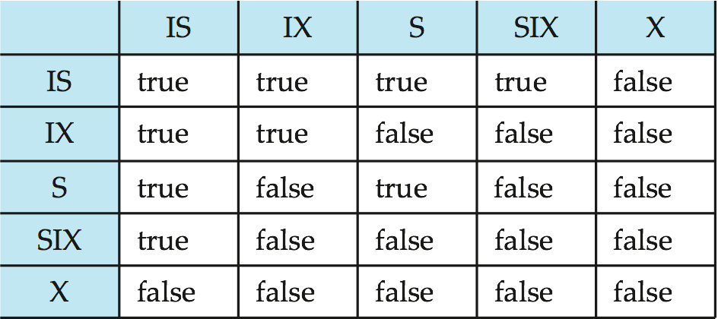
Compatibility Matrix with Intention Lock Modes
The compatibility matrix for all lock modes is:

Slide 30
Multiple Granularity Locking Scheme
Transaction T_{i} can lock a node Q, using the following rules:
The lock compatibility matrix must be observed.
The root of the tree must be locked first, and may be locked in any mode.
A node Q can be locked by T_{i} in S or IS mode only if the parent of Q is currently locked by T_{i} in either IX or IS mode.
A node Q can be locked by T_{i} in X, SIX, or IX mode only if the parent of Q is currently locked by T_{i} in either IX or SIX mode.
T_{i} can lock a node only if it has not previously unlocked any node (that is, T_{i} is two-phase).
T_{i} can unlock a node Q only if none of the children of Q are currently locked by T_{i}.
Observe that locks are acquired in root-to-leaf order, whereas they are released in leaf-to-root order.

Slide 31
Timestamp-Based Protocols
Each transaction is issued a timestamp when it enters the system. If an old transaction T_{i} has time-stamp TS(T_{i}), a new transaction T_{j} is assigned time-stamp TS(T_{j}) such that TS(T_{i}) <TS(T_{j}).
The protocol manages concurrent execution such that the time-stamps determine the serializability order.
In order to assure such behavior, the protocol maintains for each data Q two timestamp values:
W-timestamp(Q) is the largest time-stamp of any transaction that executed write(Q) successfully.
R-timestamp(Q) is the largest time-stamp of any transaction that executed read(Q) successfully.

Slide 32
Timestamp-Based Protocols (Cont.)
The timestamp ordering protocol ensures that any conflicting read and write operations are executed in timestamp order.
Suppose a transaction T_{i} issues a read(Q):
If TS(T_{i}) ≤ W-timestamp(Q), then T_{i} needs to read a value of Q that was already overwritten.
Hence, the read operation is rejected, and T_{i} is rolled back.
If TS(T_{i})≥ W-timestamp(Q), then the read operation is executed, and R-timestamp(Q) is set to max(R-timestamp(Q), TS(T_{i})).

Slide 33
Timestamp-Based Protocols (Cont.)
Suppose that transaction T_{i} issues write(Q).
If TS(T_{i}) < R-timestamp(Q), then the value of Q that T_{i} is producing was needed previously, and the system assumed that that value would never be produced.
Hence, the write operation is rejected, and T_{i} is rolled back.
If TS(T_{i}) < W-timestamp(Q), then T_{i} is attempting to write an obsolete value of Q.
Hence, this write operation is rejected, and T_{i} is rolled back.
Otherwise, the write operation is executed, and W-timestamp(Q) is set to TS(T_{i}).

Slide 34
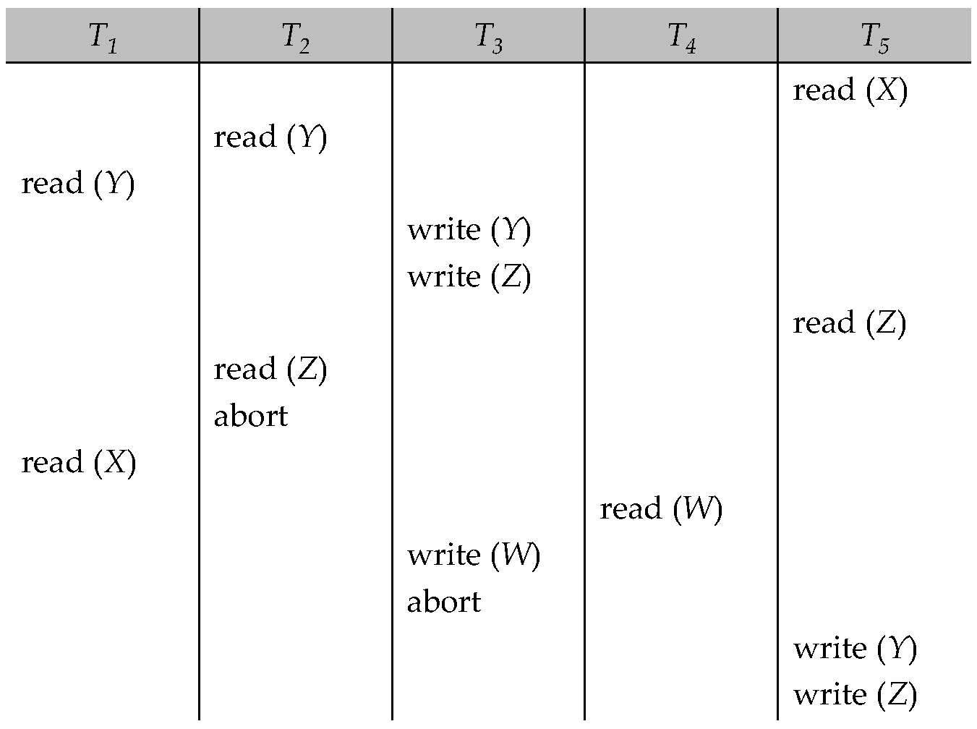
Example Use of the Protocol
A partial schedule for several data items for transactions with
timestamps 1, 2, 3, 4, 5

Slide 35
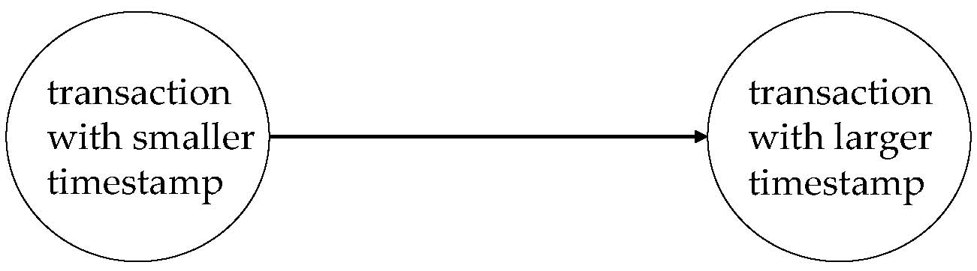
Correctness of Timestamp-Ordering Protocol
The timestamp-ordering protocol guarantees serializability since all the arcs in the precedence graph are of the form:
Thus, there will be no cycles in the precedence graph.
Timestamp protocol ensures freedom from deadlock as no transaction ever waits.
But the schedule may not be cascade-free, and may not even be recoverable.

Slide 36
Recoverability and Cascade Freedom
Problem with timestamp-ordering protocol:
Suppose T_{i} aborts, but T_{j} has read a data item written by T_{i}
Then T_{j} must abort; if T_{j} had been allowed to commit earlier, the schedule is not recoverable.
Further, any transaction that has read a data item written by T_{j} must abort
This can lead to cascading rollback --- that is, a chain of rollbacks
Solution 1:
A transaction is structured such that its writes are all performed at the end of its processing
All writes of a transaction form an atomic action; no transaction may execute while a transaction is being written
A transaction that aborts is restarted with a new timestamp
Solution 2: Limited form of locking: wait for data to be committed before reading it
Solution 3: Use commit dependencies to ensure recoverability

Slide 37
Thomas’ Write Rule
Modified version of the timestamp-ordering protocol in which obsolete write operations may be ignored under certain circumstances.
When T_{i} attempts to write data item Q, if TS(T_{i}) < W-timestamp(Q), then T_{i} is attempting to write an obsolete value of {Q}.
Rather than rolling back T_{i} as the timestamp ordering protocol would have done, this {write} operation can be ignored.
Otherwise this protocol is the same as the timestamp ordering protocol.
Thomas' Write Rule allows greater potential concurrency.
Allows some view-serializable schedules that are not conflict-serializable.

Slide 38
View Serializability
Let S and S´ be two schedules with the same set of transactions. S and S´ are view equivalent if the following three conditions are met, for each data item Q,
If in schedule S, transaction T_{i} reads the initial value of Q, then in schedule S´ also transaction T_{i} must read the initial value of Q.
If in schedule S transaction T_{i} executes read(Q), and that value was produced by transaction T_{j} (if any), then in schedule S´ also transaction T_{i} must read the value of Q that was produced by the same write(Q) operation of transaction T_{j} .
The transaction (if any) that performs the final write(Q) operation in schedule S must also perform the final write(Q) operation in schedule S´.
As can be seen, view equivalence is also based purely on reads and writes alone.

Slide 39
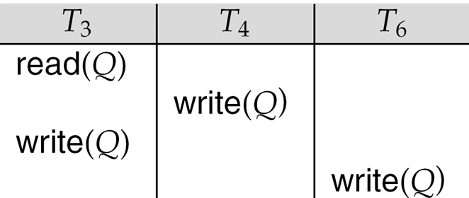
View Serializability (Cont.)
A schedule S is view serializable if it is view equivalent to a serial schedule.
Every conflict serializable schedule is also view serializable.
Below is a schedule which is view-serializable but not conflict serializable.
What serial schedule is above equivalent to?
Every view serializable schedule that is not conflict serializable has blind writes.

Slide 40
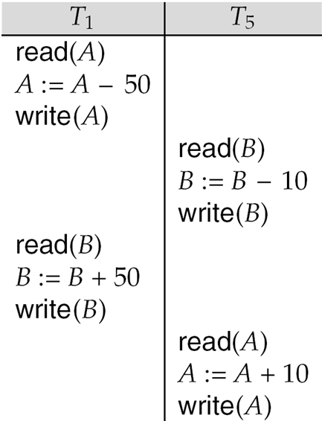
Other Notions of Serializability
The schedule below produces same outcome as the serial schedule < T₁, T₅ >, yet is not conflict equivalent or view equivalent to it.
Determining such equivalence requires analysis of operations other than read and write.

Slide 41
Test for View Serializability
The precedence graph test for conflict serializability cannot be used directly to test for view serializability.
Extension to test for view serializability has cost exponential in the size of the precedence graph.
The problem of checking if a schedule is view serializable falls in the class of NP-complete problems.
Thus, the existence of an efficient algorithm is extremely unlikely.
However, practical algorithms that just check some sufficient conditions for view serializability can still be used.

Slide 42
Validation-Based Protocol
Execution of transaction T_{i} is done in three phases.
1. Read and execution phase: Transaction T_{i} writes only to
temporary local variables
2. Validation phase: Transaction T_{i} performs a ``validation test''
to determine if local variables can be written without violating
serializability.
3. Write phase: If T_{i} is validated, the updates are applied to the
database; otherwise, T_{i} is rolled back.
The three phases of concurrently executing transactions can be interleaved, but each transaction must go through the three phases in that order.
Assume for simplicity that the validation and write phase occur together, atomically and serially
i.e., only one transaction executes validation/write at a time.
Also called as optimistic concurrency control since transaction executes fully in the hope that all will go well during validation

Slide 43
Validation-Based Protocol (Cont.)
Each transaction T_{i} has 3 timestamps:
Start(T_{i}) : the time when T_{i} started its execution
Validation(T_{i}): the time when T_{i} entered its validation phase
Finish(T_{i}) : the time when T_{i} finished its write phase
Serializability order is determined by timestamp given at validation time, to increase concurrency.
Thus TS(T_{i}) is given the value of Validation(T_{i}).
This protocol is useful and gives greater degree of concurrency if probability of conflicts is low.
because the serializability order is not pre-decided, and
relatively few transactions will have to be rolled back.

Slide 44
Validation Test for Transaction T_{j}
If for all T_{i} with TS (T_{i}) < TS (T_{j}) either one of the following condition holds:
finish(T_{i}) < start(T_{j})
start(T_{j}) < finish(T_{i}) < validation(T_{j}) and the set of data items written by T_{i} does not intersect with the set of data items read by T_{j}.
then validation succeeds and T_{j} can be committed. Otherwise, validation fails and T_{j} is aborted.
Justification: Either the first condition is satisfied, and there is no overlapped execution, or the second condition is satisfied and
the writes of T_{j} do not affect reads of T_{i} since they occur after T_{i} has finished its reads.
the writes of T_{i} do not affect reads of T_{j} since T_{j} does not read any item written by T_{i}.

Slide 45
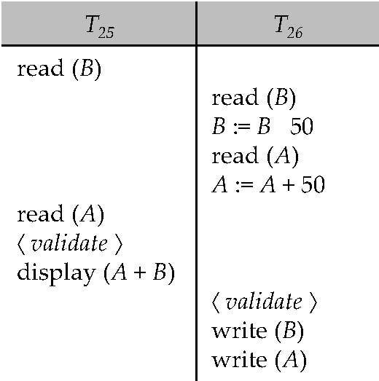
Schedule Produced by Validation
Example of schedule produced using validation

Slide 46
Multiversion Schemes
Multiversion schemes keep old versions of data item to increase concurrency.
Multiversion Timestamp Ordering
Multiversion Two-Phase Locking
Each successful write results in the creation of a new version of the data item written.
Use timestamps to label versions.
When a read(Q) operation is issued, select an appropriate version of Q based on the timestamp of the transaction, and return the value of the selected version.
reads never have to wait as an appropriate version is returned immediately.

Slide 47
Multiversion Timestamp Ordering
Each data item Q has a sequence of versions <Q₁, Q₂,...., Q_{m}>. Each version Q_{k} contains three data fields:
Content -- the value of version Q_{k}.
W-timestamp(Q_{k}) -- timestamp of the transaction that created (wrote) version Q_{k}
R-timestamp(Q_{k}) -- largest timestamp of a transaction that successfully read version Q_{k}
when a transaction T_{i} creates a new version Q_{k} of Q, Q_{k}'s W-timestamp and R-timestamp are initialized to TS(T_{i}).
R-timestamp of Q_{k} is updated whenever a transaction T_{j} reads Q_{k}, and TS(T_{j}) > R-timestamp(Q_{k}).

Slide 48
Multiversion Timestamp Ordering (Cont)
Suppose that transaction T_{i} issues a read(Q) or write(Q) operation. Let Q_{k} denote the version of Q whose write timestamp is the largest write timestamp less than or equal to TS(T_{i}).
If transaction T_{i} issues a read(Q), then the value returned is the content of version Q_{k}.
If transaction T_{i} issues a write(Q)
if TS(T_{i}) < R-timestamp(Q_{k}), then transaction T_{i} is rolled back.
if TS(T_{i}) = W-timestamp(Q_{k}), the contents of Q_{k} are overwritten
else a new version of Q is created.
Observe that
Reads always succeed.
A write by T_{i} is rejected if some other transaction T_{j} that (in the serialization order defined by the timestamp values) should read T_{i}'s write, has already read a version created by a transaction older than T_{i}.
Protocol guarantees serializability.

Slide 49
Multiversion Two-Phase Locking
Differentiates between read-only transactions and update transactions
Update transactions acquire read and write locks, and hold all locks up to the end of the transaction. That is, update transactions follow rigorous two-phase locking.
Each successful write results in the creation of a new version of the data item written.
each version of a data item has a single timestamp whose value is obtained from a counter ts-counter that is incremented during commit processing.
Read-only transactions are assigned a timestamp by reading the current value of ts-counter before they start execution; they follow the multiversion timestamp-ordering protocol for performing reads.

Slide 50
Multiversion Two-Phase Locking (Cont.)
When an update transaction wants to read a data item:
it obtains a shared lock on it, and reads the latest version.
When it wants to write an item
it obtains X lock on; it then creates a new version of the item and sets this version's timestamp to ∞.
When update transaction T_{i} completes, commit processing occurs:
T_{i} sets timestamp on the versions it has created to ts-counter + 1
T_{i} increments ts-counter by 1
Read-only transactions that start after T_{i} increments ts-counter will see the values updated by T_{i}.
Read-only transactions that start before T_{i} increments the ts-counter will see the value before the updates by T_{i}.
Only serializable schedules are produced.

Slide 51
MVCC: Implementation Issues
Creation of multiple versions increases storage overhead
Extra tuples
Extra space in each tuple for storing version information
Versions can, however, be garbage collected
E.g., if Q has two versions Q5 and Q9, and the oldest active transaction has timestamp > 9, than Q5 will never be required again

Slide 52
Snapshot Isolation
Motivation: Decision support queries that read large amounts of data have concurrency conflicts with OLTP transactions that update a few rows
Poor performance results
Solution 1: Give logical “snapshot” of database state to read only transactions, read-write transactions use normal locking
Multiversion 2-phase locking
Works well, but how does system know a transaction is read only?
Solution 2: Give snapshot of database state to every transaction, updates alone use 2-phase locking to guard against concurrent updates
Problem: variety of anomalies such as lost update can result
Partial solution: snapshot isolation level (next slide)
Proposed by Berenson et al, SIGMOD 1995
Variants implemented in many database systems
E.g., Oracle, PostgreSQL, SQL Server 2005

Slide 53
Snapshot Isolation
A transaction T1 executing with Snapshot Isolation
takes snapshot of committed data at start
always reads/modifies data in its own snapshot
updates of concurrent transactions are not visible to T1
writes of T1 complete when it commits
First-committer-wins rule:
Commits only if no other concurrent transaction has already written data that T1 intends to write.
T1 | T2 | T3
W(Y := 1) Commit
 | Start R(X) → 0 R(Y)→ 1
 |  | W(X:=2) W(Z:=3) Commit
 | R(Z) → 0 R(Y) → 1 W(X:=3) Commit-Req Abort
Concurrent updates not visible
Own updates are visible
Not first-committer of X
Serialization error, T2 is rolled back

Slide 54
Benefits of SI
Reading is never blocked
and also doesn’t block other txns activities
Performance similar to Read Committed
Avoids the usual anomalies
No dirty read
No lost update
No non-repeatable read
Predicate based selects are repeatable (no phantoms)
Problems with SI
SI does not always give serializable executions
Serializable: among two concurrent txns, one sees the effects of the other
In SI: neither sees the effects of the other
Result: Integrity constraints can be violated

Slide 55
Snapshot Isolation
E.g., of problem with SI
T1: x:=y
T2: y:= x
Initially x = 3 and y = 17
Serial execution: x = ??, y = ??
if both transactions start at the same time, with snapshot isolation: x = ?? , y = ??
Called skew write
Skew also occurs with inserts
E.g.,:
Find max order number among all orders
Create a new order with order number = previous max + 1

Slide 56
Snapshot Isolation Anomalies
SI breaks serializability when txns modify different items, each based on a previous state of the item the other modified
Not very common in practice
E.g., the TPC-C benchmark runs correctly under SI
when txns conflict due to modifying different data, there is usually also a shared item they both modify too (like a total quantity) so SI will abort one of them
But does occur
Application developers should be careful about write skew
SI can also cause a read-only transaction anomaly, where read-only transaction may see an inconsistent state even if updaters are serializable
We omit details

Slide 57
SI In Oracle and PostgreSQL
Warning: SI used when isolation level is set to serializable, by Oracle and PostgreSQL
PostgreSQL’s implementation of SI described in Section 26.4.1.3
Oracle implements “first updater wins” rule (variant of “first committer wins”)
concurrent writer check is done at time of write, not at commit time
Allows transactions to be rolled back earlier
Neither supports true serializable execution
Can sidestep for specific queries by using select .. for update in Oracle and PostgreSQL
Locks the data which is read, preventing concurrent updates
E.g.,
select max(orderno) from orders for update
read value into local variable maxorder
insert into orders (maxorder+1, …)

Slide 58
Insert and Delete Operations
If two-phase locking is used :
A delete operation may be performed only if the transaction deleting the tuple has an exclusive lock on the tuple to be deleted.
A transaction that inserts a new tuple into the database is given an X-mode lock on the tuple
Insertions and deletions can lead to the phantom phenomenon.
A transaction that scans a relation
(e.g., find sum of balances of all accounts in Perryridge)
and a transaction that inserts a tuple in the relation
(e.g., insert a new account at Perryridge)
(conceptually) conflict in spite of not accessing any tuple in common.
If only tuple locks are used, non-serializable schedules can result
E.g., the scan transaction does not see the new account, but reads some other tuple written by the update transaction

Slide 59
Insert and Delete Operations (Cont.)
The transaction scanning the relation is reading information that indicates what tuples the relation contains, while a transaction inserting a tuple updates the same information.
The information should be locked.
One solution:
Associate a data item with the relation, to represent the information about what tuples the relation contains.
Transactions scanning the relation acquire a shared lock in the data item.
Transactions inserting or deleting a tuple acquire an exclusive lock on the data item. (Note: locks on the data item do not conflict with locks on individual tuples.)
Above protocol provides very low concurrency for insertions/ deletions.
Index locking protocols provide higher concurrency while preventing the phantom phenomenon, by requiring locks on certain index buckets.

Slide 60
Weak Levels of Consistency
Degree-two consistency: differs from two-phase locking in that S-locks may be released at any time, and locks may be acquired at any time
X-locks must be held till end of transaction
Serializability is not guaranteed, programmer must ensure that no erroneous database state will occur]
Cursor stability:
For reads, each tuple is locked, read, and lock is immediately released
X-locks are held till end of transaction
Special case of degree-two consistency

Slide 61
Weak Levels of Consistency in SQL
SQL allows non-serializable executions
Serializable: is the default
Repeatable read: allows only committed records to be read, and repeating a read should return the same value (so read locks should be retained)
However, the phantom phenomenon need not be prevented
T1 may see some records inserted by T2, but may not see others inserted by T2
Read committed: same as degree two consistency, but most systems implement it as cursor-stability
Read uncommitted: allows even uncommitted data to be read
In many database systems, read committed is the default consistency level
has to be explicitly changed to serializable when required
set isolation level serializable

Slide 62
Index Locking Protocol
Index locking protocol:
Every relation must have at least one index.
A transaction can access tuples only after finding them through one or more indices on the relation
A transaction T_{i} that performs a lookup must lock all the index leaf nodes that it accesses, in S-mode
Even if the leaf node does not contain any tuple satisfying the index lookup (e.g., for a range query, no tuple in a leaf is in the range)
A transaction T_{i} that inserts, updates or deletes a tuple t_{i} in a relation r
must update all indices to r
must obtain exclusive locks on all index leaf nodes affected by the insert/update/delete
The rules of the two-phase locking protocol must be observed
Guarantees that phantom phenomenon won’t occur

Slide 63
Concurrency in Index Structures
Indices are unlike other database items in that their only job is to help in accessing data.
Index-structures are typically accessed very often, much more than other database items.
Treating index-structures like other database items, e.g., by 2-phase locking of index nodes can lead to low concurrency.
There are several index concurrency protocols where locks on internal nodes are released early, and not in a two-phase fashion.
It is acceptable to have nonserializable concurrent access to an index as long as the accuracy of the index is maintained.
In particular, the exact values read in an internal node of a B⁺-tree are irrelevant so long as we land up in the correct leaf node.

Slide 64
Concurrency in Index Structures (Cont.)
Example of index concurrency protocol:
Use crabbing instead of two-phase locking on the nodes of the B⁺-tree, as follows. During search/insertion/deletion:
First lock the root node in shared mode.
After locking all required children of a node in shared mode, release the lock on the node.
During insertion/deletion, upgrade leaf node locks to exclusive mode.
When splitting or coalescing requires changes to a parent, lock the parent in exclusive mode.
Above protocol can cause excessive deadlocks
Searches coming down the tree deadlock with updates going up the tree
Can abort and restart search, without affecting transaction
Better protocols are available; see Section 16.9 for one such protocol, the B-link tree protocol
Intuition: release lock on parent before acquiring lock on child
And deal with changes that may have happened between lock release and acquire

Slide 65
Next-Key Locking
Index-locking protocol to prevent phantoms required locking entire leaf
Can result in poor concurrency if there are many inserts
Alternative: for an index lookup
Lock all values that satisfy index lookup (match lookup value, or fall in lookup range)
Also lock next key value in index
Lock mode: S for lookups, X for insert/delete/update
Ensures that range queries will conflict with inserts/deletes/updates
Regardless of which happens first, as long as both are concurrent

Slide 66
End of Chapter
Thanks to Alan Fekete and Sudhir Jorwekar for Snapshot Isolation examples

Slide 67
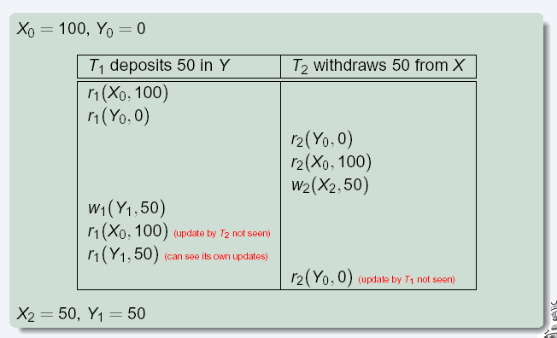
Snapshot Read
Concurrent updates invisible to snapshot read

Slide 68
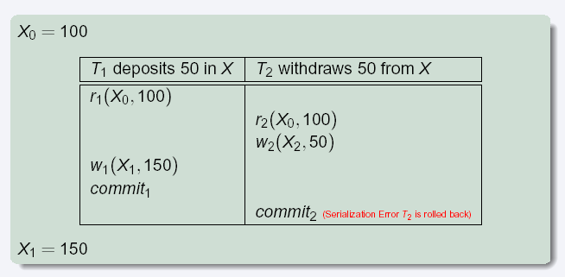
Snapshot Write: First Committer Wins
Variant: “First-updater-wins”
Check for concurrent updates when write occurs
(Oracle uses this plus some extra features)
Differs only in when abort occurs, otherwise equivalent

Slide 69

Figure 15.01

Slide 70
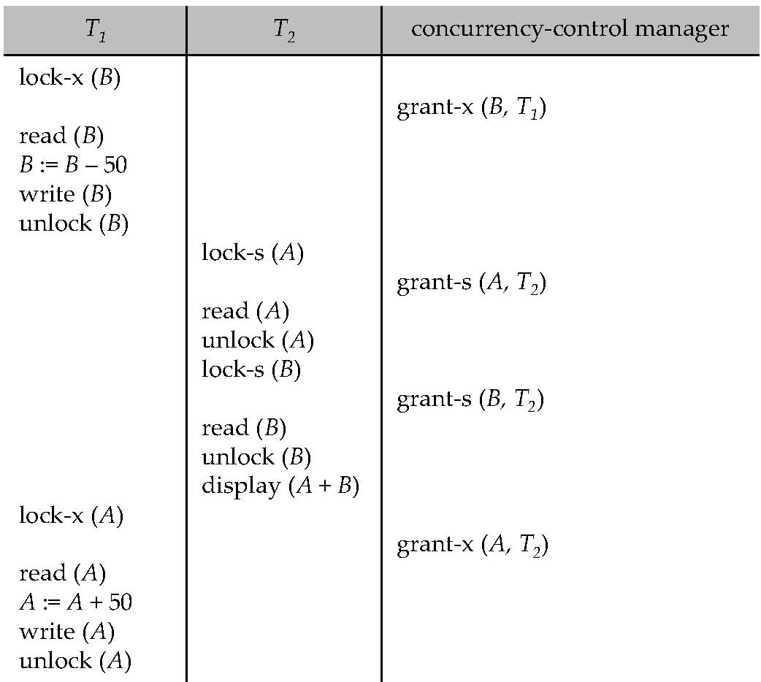
Figure 15.04

Slide 71
Figure 15.07

Slide 72
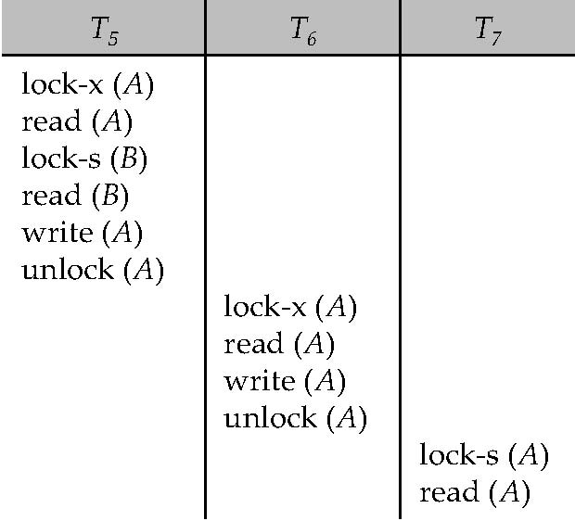
Figure 15.08

Slide 73
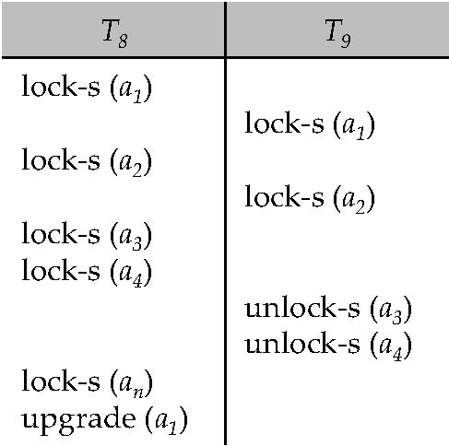
Figure 15.09

Slide 74

Figure 15.10

Slide 75

Figure 15.11

Slide 76
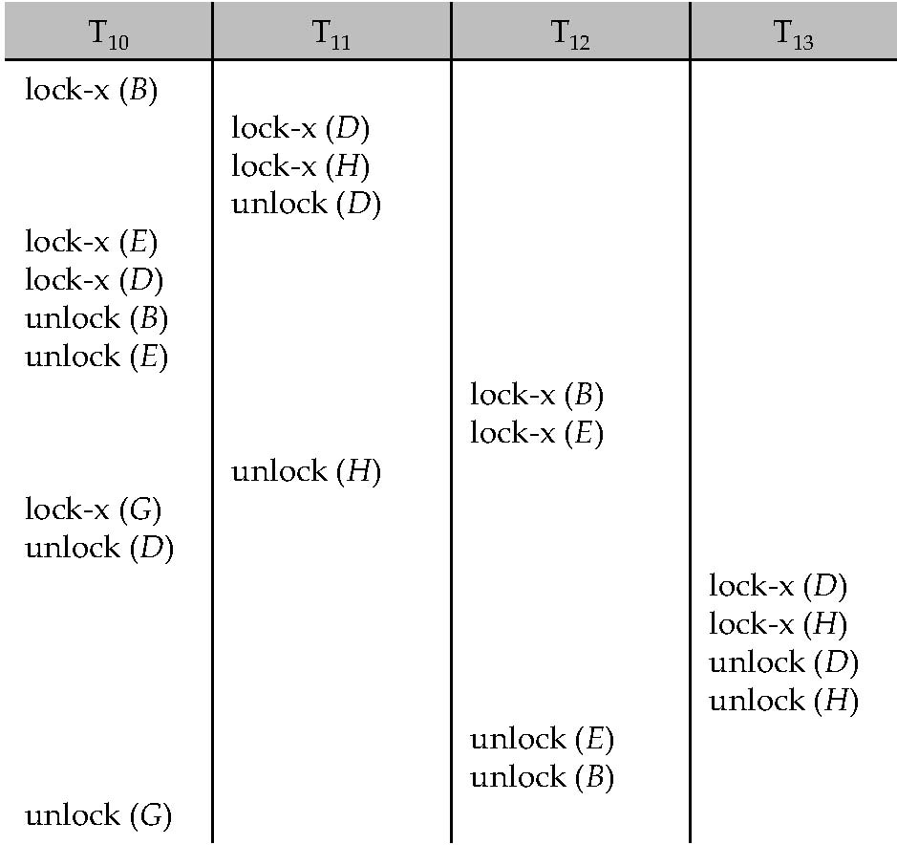
Figure 15.12

Slide 77

Figure 15.13

Slide 78

Figure 15.14

Slide 79

Figure 15.15

Slide 80

Figure 15.16

Slide 81
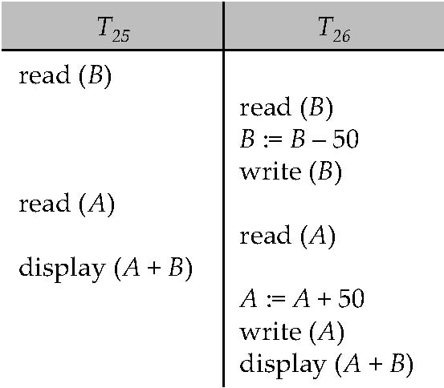
Figure 15.17

Slide 82
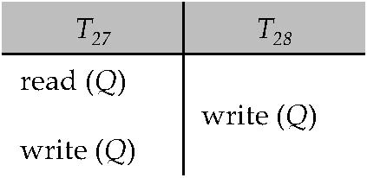
Figure 15.18

Slide 83
Figure 15.19

Slide 84
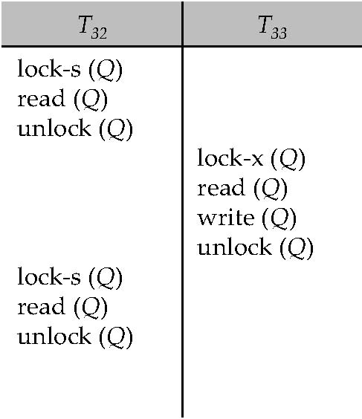
Figure 15.20

Slide 85
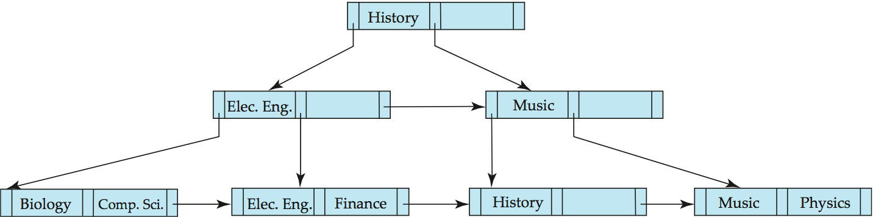
Figure 15.21

Slide 86
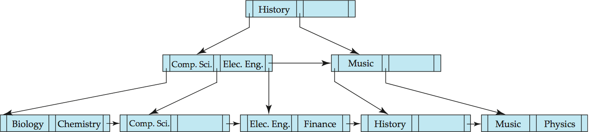
Figure 15.22

Slide 87
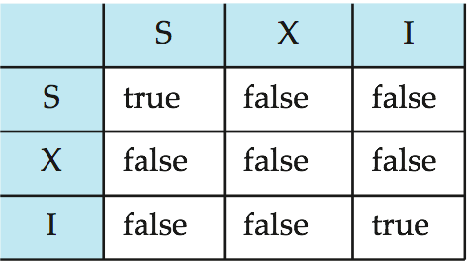
Figure 15.23

Slide 88
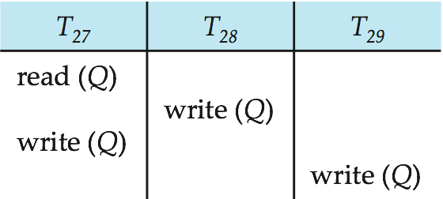
Figure in-15.1

