Slide 1
Chapter 2: Intro to Relational Model

Slide 2
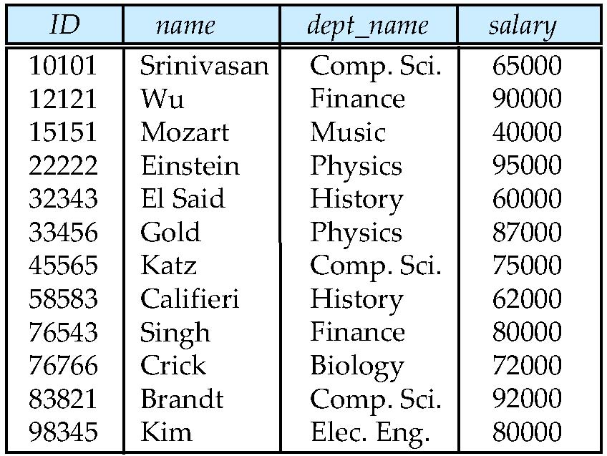
Example of a Relation
attributes
(or columns)
tuples
(or rows)

Slide 3
Attribute Types
The set of allowed values for each attribute is called the domain of the attribute
Attribute values are (normally) required to be atomic; that is, indivisible
The special value null is a member of every domain
The null value causes complications in the definition of many operations

Slide 4
Relation Schema and Instance
A₁, A₂, …, A_{n} are attributes
R = (A₁, A₂, …, A_{n} ) is a relation schema
Example:
instructor = (ID, name, dept_name, salary)
Formally, given sets D₁, D₂, …. D_{n} a relation r is a subset of D₁ x D₂ x … x D_{n} Thus, a relation is a set of n-tuples (a₁, a₂, …, a_{n}) where each a_{i} ∈ D_{i}
The current values (relation instance) of a relation are specified by a table
An element t of r is a tuple, represented by a row in a table

Slide 5
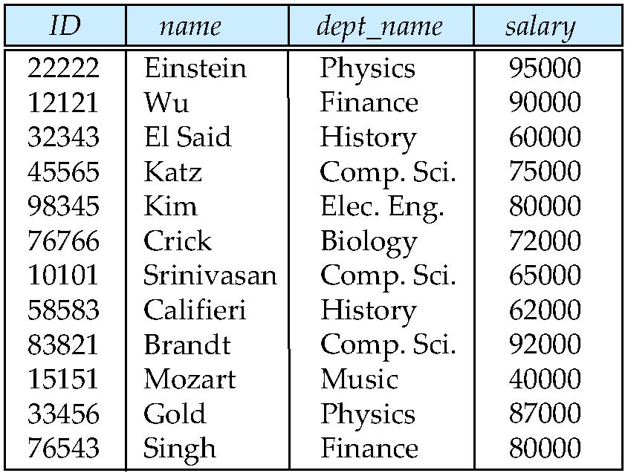
Relations are Unordered
Order of tuples is irrelevant (tuples may be stored in an arbitrary order)
Example: instructor relation with unordered tuples

Slide 6
Database
A database consists of multiple relations
Information about an enterprise is broken up into parts
instructor student advisor
Bad design: univ (instructor -ID, name, dept_name, salary, student_Id, ..) results in
repetition of information (e.g., two students have the same instructor)
the need for null values (e.g., represent an student with no advisor)
Normalization theory (Chapter 7) deals with how to design “good” relational schemas

Slide 7
Keys
Let K ⊆ R
K is a superkey of R if values for K are sufficient to identify a unique tuple of each possible relation r(R)
Example: {ID} and {ID,name} are both superkeys of instructor.
Superkey K is a candidate key if K is minimal Example: {ID} is a candidate key for Instructor
One of the candidate keys is selected to be the primary key.
which one?
Foreign key constraint: Value in one relation must appear in another
Referencing relation
Referenced relation

Slide 8
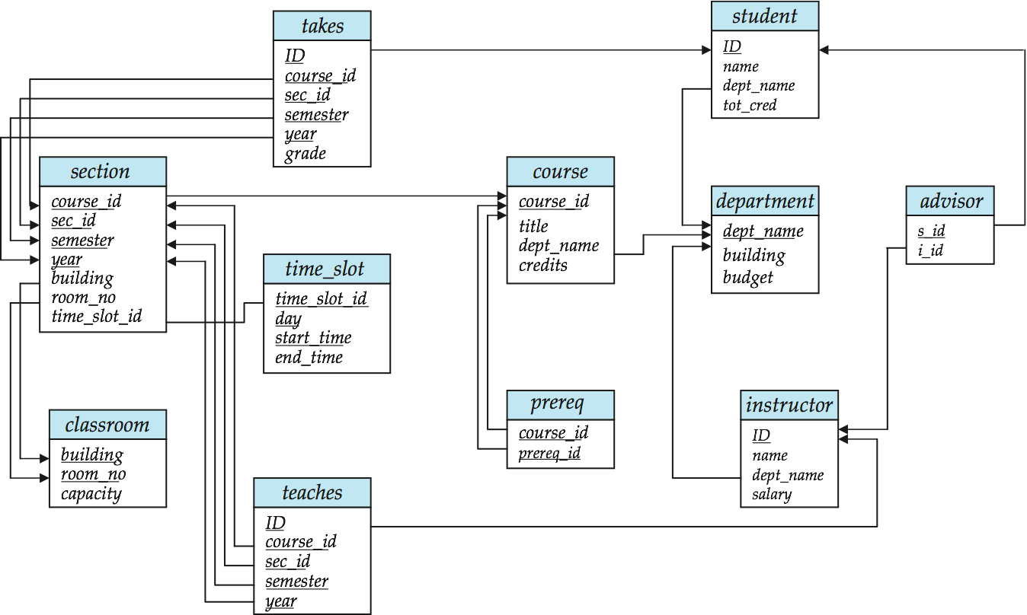
Schema Diagram for University Database

Slide 9
Relational Query Languages
Procedural vs.non-procedural, or declarative
“Pure” languages:
Relational algebra
Tuple relational calculus
Domain relational calculus
Relational operators

Slide 10
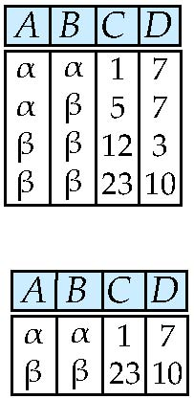
Selection of tuples
Relation r
Select tuples with A=B and D > 5
σ _{A=B and D > 5} (r)

Slide 11
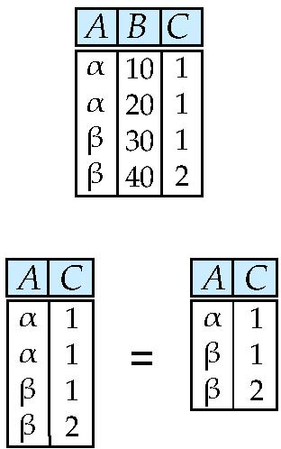
Selection of Columns (Attributes)
Relation r:
Select A and C
Projection
Π _{A, C} (r)

Slide 12
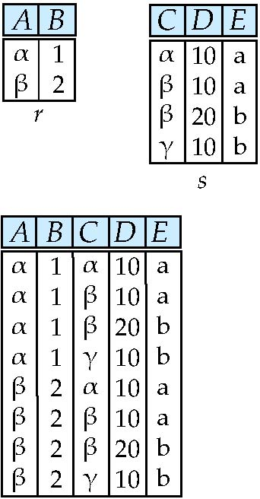
Joining two relations – Cartesian Product
Relations r, s:
r x s:

Slide 13
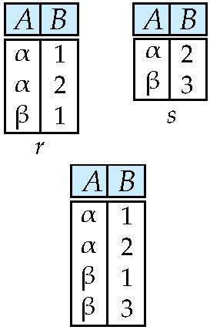
Union of two relations
Relations r, s:
r ∪ s:

Slide 14
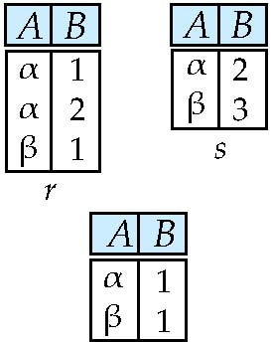
Set difference of two relations
Relations r, s:
r – s:

Slide 15
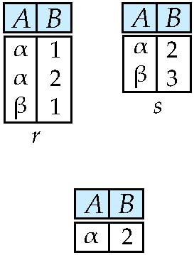
Set Intersection of two relations
Relation r, s:
r ∩ s

Slide 16
Joining two relations – Natural Join
Let r and s be relations on schemas R and S respectively. Then, the “natural join” of relations R and S is a relation on schema R ∪ S obtained as follows:
Consider each pair of tuples t_{r} from r and t_{s} from s.
If t_{r} and t_{s} have the same value on each of the attributes in R ∩ S, add a tuple t to the result, where
t has the same value as t_{r} on r
t has the same value as t_{s} on s

Slide 17
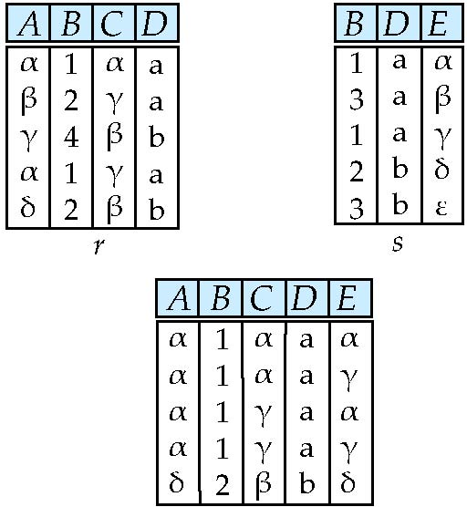
Natural Join Example
Relations r, s:
Natural Join
r s

Slide 18
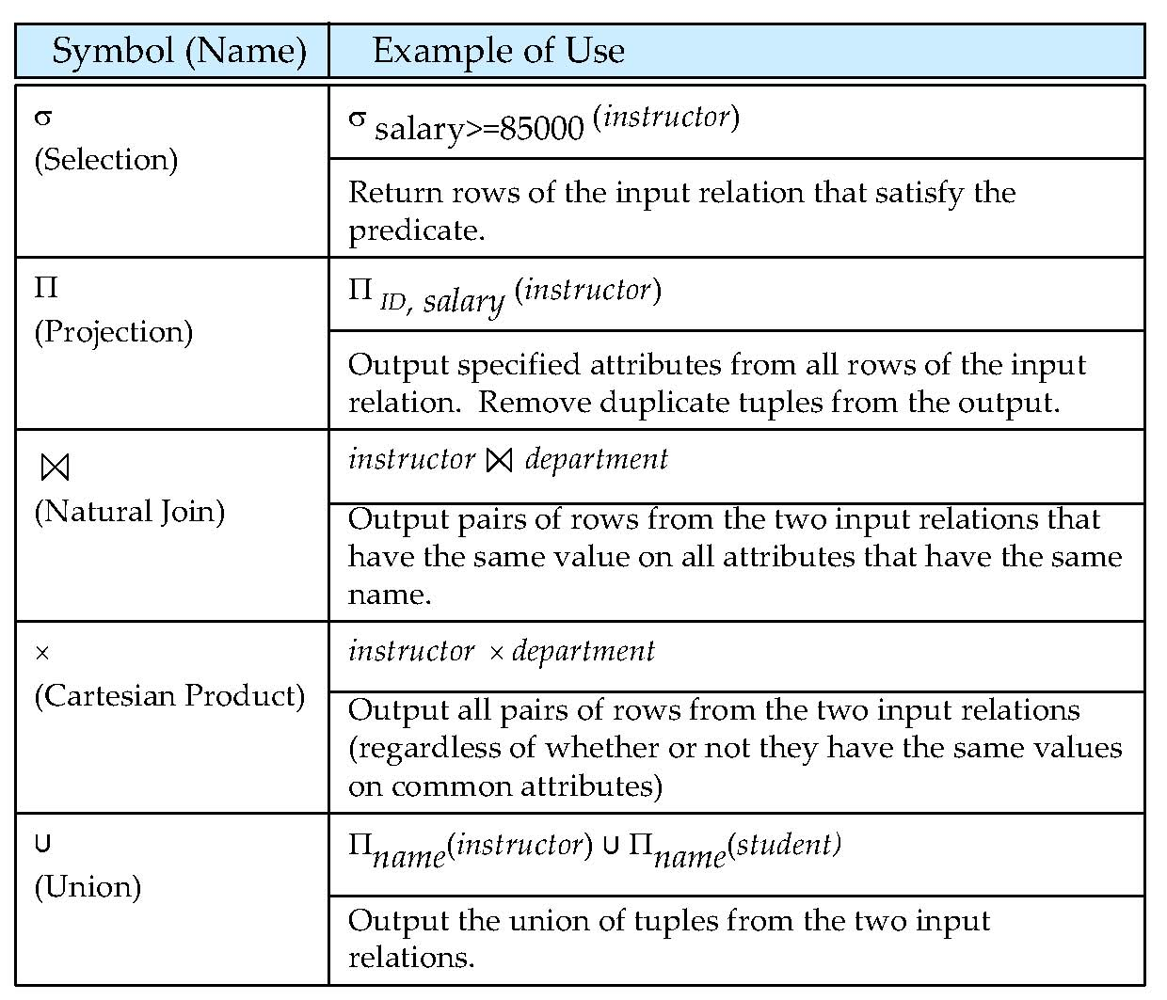
Figure in-2.1

Slide 19
End of Chapter 2

Slide 20
Figure 2.01

Slide 21
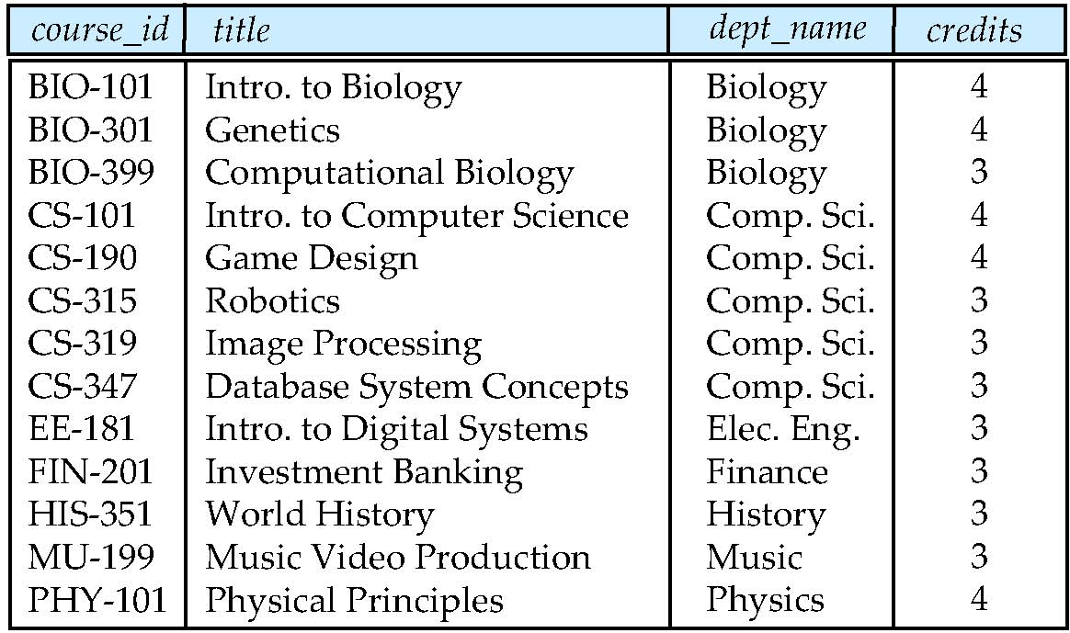
Figure 2.02

Slide 22
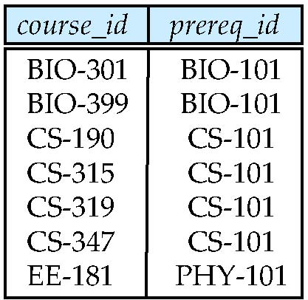
Figure 2.03

Slide 23
Figure 2.04

Slide 24
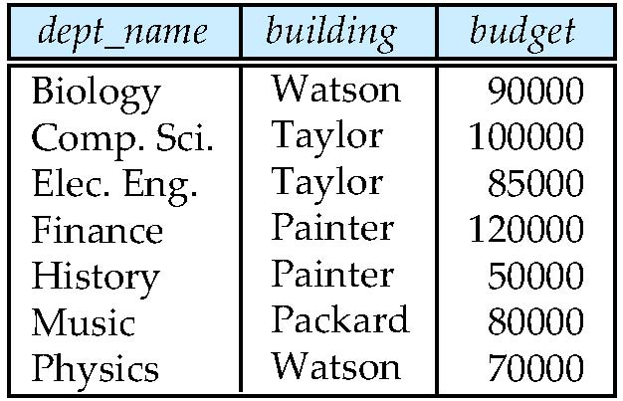
Figure 2.05

Slide 25
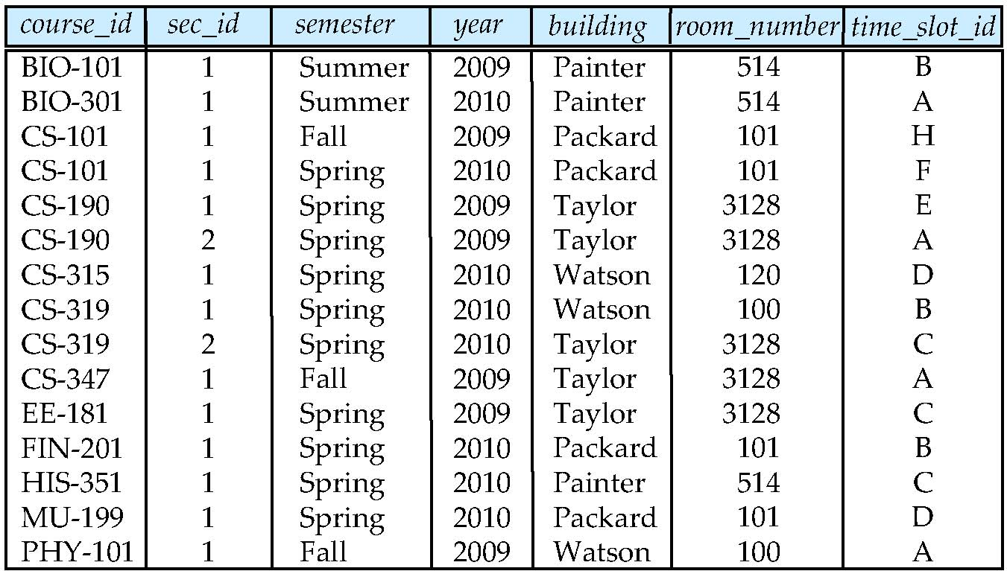
Figure 2.06

Slide 26
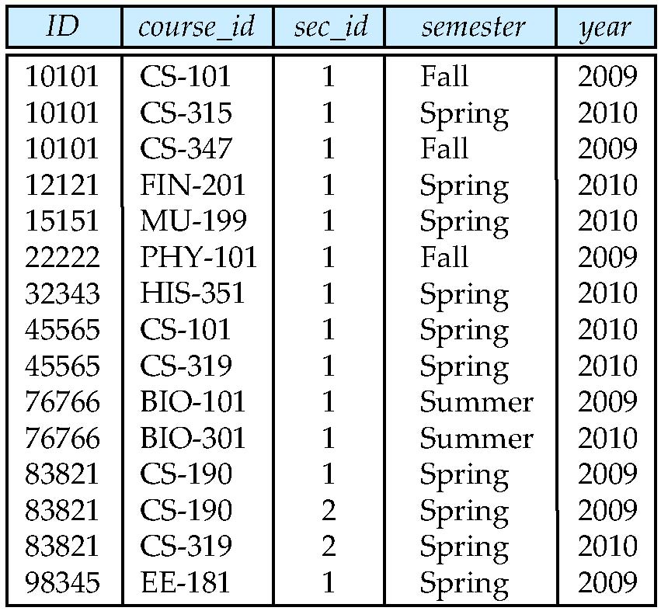
Figure 2.07

Slide 27
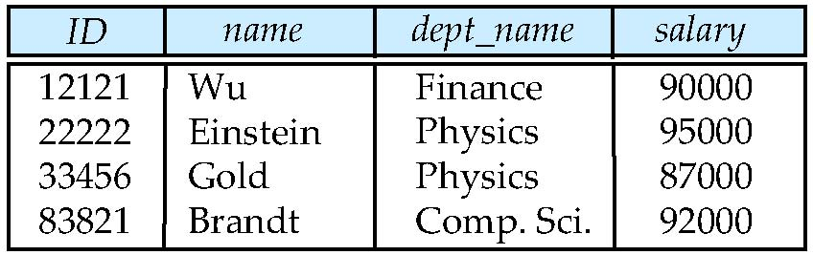
Figure 2.10

Slide 28
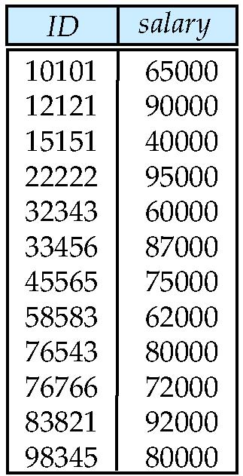
Figure 2.11

Slide 29
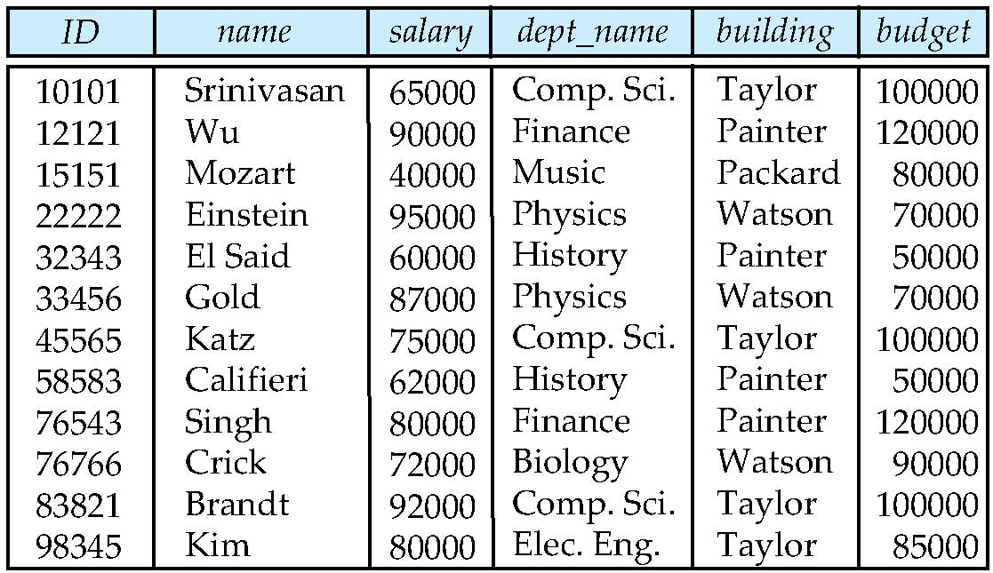
Figure 2.12

Slide 30
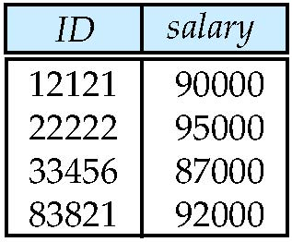
Figure 2.13

