Slide 1
Longest Common Subsequence

Slide 2
What is subsequence
A subsequence of a string is a new string that is formed from the original string by deleting some (can be none) of the characters without disturbing the relative positions of the remaining characters. (i.e., "ace" is a subsequence of "abcde" while "aec" is not).

Slide 3
What is common subsequence
Given two strings X of length m and Y of length n.
Finding common subsequence of X and Y.
Let Z is common subsequence of X and Y.
Then,
Z is subsequence of X.
Z is subsequence of Y.

Slide 4
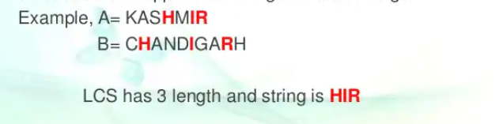
Longest common subsequence
The longest common subsequence (LCS) is defined as the longest subsequence that is common to all the given sequences, provided that the elements of the subsequence are not required to occupy consecutive positions within the original sequences.

Slide 5
Naive method
Given two strings X of length m and Y of length n.
Finding largest common subsequence of X and Y.
Find all subsequence of X.
For each subsequence , find whether it is subsequence of Y.
Find longest comment subsequence from available subsequence.

Slide 6
Recursive method
Let the input sequences be X[0..m-1] and Y[0..n-1] of lengths m and n respectively. And let L(X[0..m-1], Y[0..n-1]) be the length of LCS of the two sequences X and Y. Following is the recursive definition of L(X[0..m-1], Y[0..n-1]).
If last characters of both sequences match (or X[m-1] == Y[n-1]) then L(X[0..m-1], Y[0..n-1]) = 1 + L(X[0..m-2], Y[0..n-2])
If last characters of both sequences do not match (or X[m-1] != Y[n-1]) then L(X[0..m-1], Y[0..n-1]) = MAX ( L(X[0..m-2], Y[0..n-1]), L(X[0..m-1], Y[0..n-2]) )

Slide 7
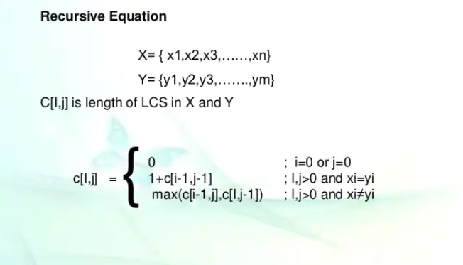
Recursive method

Slide 8
Dynamic method
If we draw the complete recursion tree, then we can see that there are many subproblems which are solved again and again. So this problem has Overlapping Substructure property and recomputation of same subproblems can be avoided by either using Memoization or Tabulation.

Slide 9
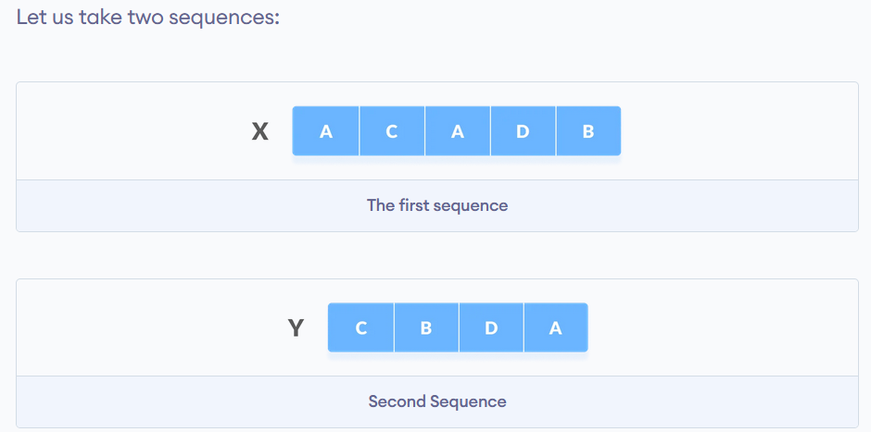
Dynamic method

Slide 10
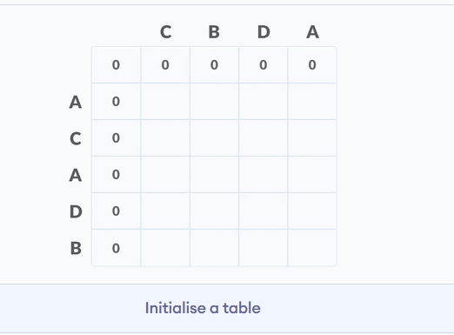
Dynamic method
The following steps are followed for finding the longest common subsequence.
Create a table of dimension n+1*m+1 where n and m are the lengths of X and Y respectively.
The first row and the first column are filled with zeros.

Slide 11
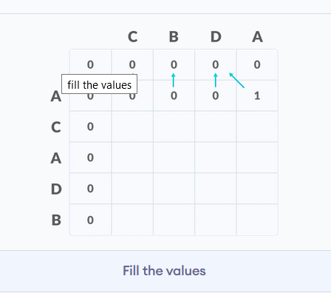
Dynamic method
3.If the character correspoding to the current row and current column are matching,
then fill the current cell by adding one to the diagonal element. Point an arrow to the diagonal cell.
4.Else take the maximum value from the previous column and previous row element for filling
the current cell. Point an arrow to the cell with maximum value. If they are equal, point to any of them.

Slide 12
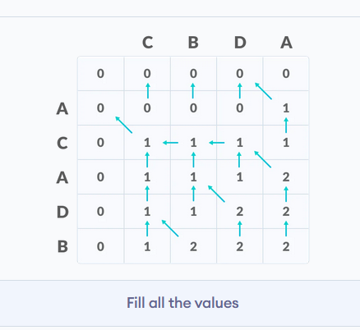
Dynamic method
5.Step 2 is repeated until the table is filled.

Slide 13
Dynamic method
6.The value in the last row and the last column is the length of the longest common subsequence.
7.In order to find the longest common subsequence, start from the last element and follow the direction of the arrow. The elements corresponding to () symbol form the longest common subsequence.ommon subsequence.

Slide 14
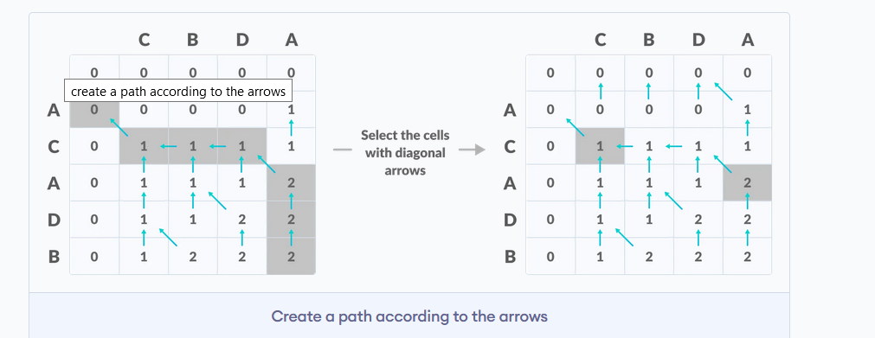
Dynamic method

Slide 15
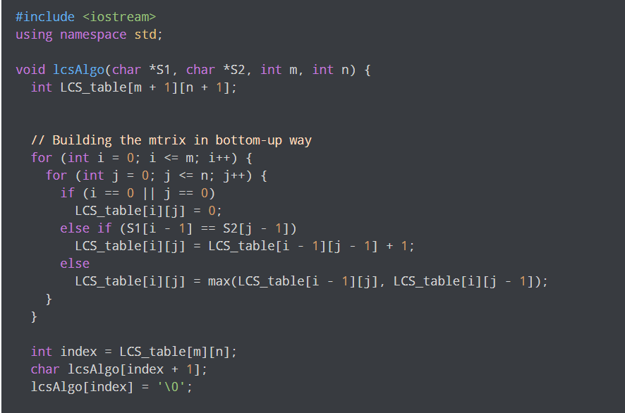
C++ code for LCS

Slide 16
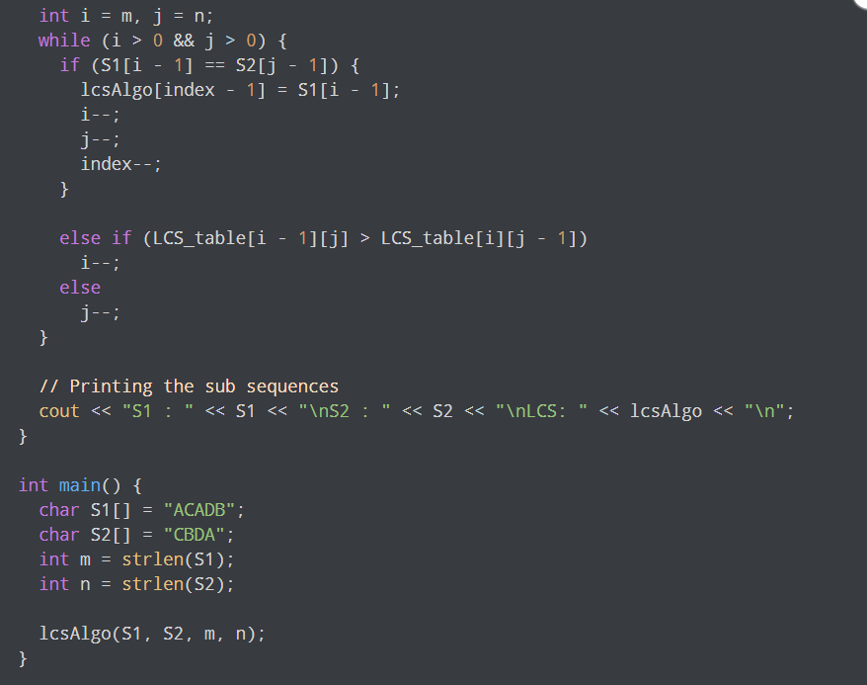
C++ code for LCS

Slide 17
ThanKs all

