Slide 1
Methods for Solving Recurrences
Iteration method
Substitution method
Recursion tree method
Master method

Slide 2
The Iteration Method
Convert the recurrence into a summation and try to bound it using known series
  Iterate the recurrence until the initial condition is reached.
  Use back-substitution to express the recurrence in terms of n and the initial (boundary) condition.

Slide 3
The Iteration Method
T(n) = c + T(n/2)
T(n) = c + T(n/2)
= c + c + T(n/4)
= c + c + c + T(n/8)
Assume n = 2^{k}
T(n) = c + c + … + c + T(1)
= clgn + T(1)
= Θ(lgn)
T(n/2) = c + T(n/4)
T(n/4) = c + T(n/8)
k times

Slide 4
Iteration Method – Example
T(n) = n + 2T(n/2)
T(n) = n + 2T(n/2)
= n + 2(n/2 + 2T(n/4))
= n + n + 4T(n/4)
= n + n + 4(n/4 + 2T(n/8))
= n + n + n + 8T(n/8)
… = in + 2^{i}T(n/2^{i})
= kn + 2^{k}T(1)
= nlgn + nT(1) = Θ(nlgn)
Assume: n = 2^{k}
T(n/2) = n/2 + 2T(n/4)

Slide 5
The substitution method
Guess a solution
Use induction to prove that the solution works

Slide 6
Substitution method
Guess a solution
  T(n) = O(g(n))
  Induction goal: apply the definition of the asymptotic notation
    T(n) ≤ d g(n), for some d > 0 and n ≥ n₀
  Induction hypothesis: T(k) ≤ d g(k) for all k < n
Prove the induction goal
  Use the induction hypothesis to find some values of the constants d and n₀ for which the induction goal holds
(strong induction)

Slide 7


Slide 8
Example: Binary Search
T(n) = c + T(n/2)
Guess: T(n) = O(lgn)
  Induction goal: T(n) ≤ d lgn, for some d and n ≥ n₀
  Induction hypothesis: T(n/2) ≤ d lg(n/2)
Proof of induction goal:
T(n) = T(n/2) + c ≤ d lg(n/2) + c
= d lgn – d + c ≤ d lgn
if: – d + c ≤ 0, d ≥ c
Base case?

Slide 9
Example 2
T(n) = T(n-1) + n
Guess: T(n) = O(n²)
  Induction goal: T(n) ≤ c n², for some c and n ≥ n₀
  Induction hypothesis: T(n-1) ≤ c(n-1)² for all k < n
Proof of induction goal:
T(n) = T(n-1) + n ≤ c (n-1)² + n
= cn² – (2cn – c - n) ≤ cn²
if: 2cn – c – n ≥ 0 ⇔ c ≥ n/(2n-1) ⇔ c ≥ 1/(2 – 1/n)
  For n ≥ 1 ⇒ 2 – 1/n ≥ 1 ⇒ any c ≥ 1 will work

Slide 10
Example 3
T(n) = 2T(n/2) + n
Guess: T(n) = O(nlgn)
  Induction goal: T(n) ≤ cn lgn, for some c and n ≥ n₀
  Induction hypothesis: T(n/2) ≤ cn/2 lg(n/2)
Proof of induction goal:
T(n) = 2T(n/2) + n ≤ 2c (n/2)lg(n/2) + n
= cn lgn – cn + n ≤ cn lgn
if: - cn + n ≤ 0 ⇒ c ≥ 1
Base case?

Slide 11
The recursion-tree method
Convert the recurrence into a tree:
  Each node represents the cost incurred at various levels of recursion
  Sum up the costs of all levels
Used to “guess” a solution for the recurrence

Slide 12
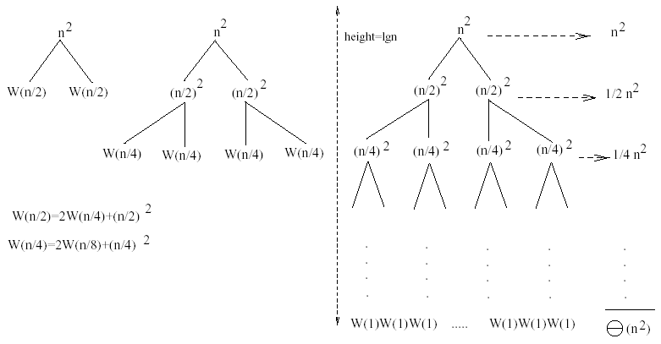
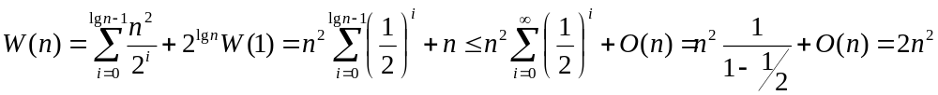
Example 1
W(n) = 2W(n/2) + n²
Subproblem size at level i is: n/2^{i}
Subproblem size hits 1 when 1 = n/2^{i} ⇒ i = lgn
Cost of the problem at level i = (n/2^{i})² No. of nodes at level i = 2^{i}
Total cost:
⇒ W(n) = O(n²)

Slide 13
Example 2 - Substitution
T(n) = 3T(n/4) + cn²
Guess: T(n) = O(n²)
  Induction goal: T(n) ≤ dn², for some d and n ≥ n₀
  Induction hypothesis: T(n/4) ≤ d (n/4)²
Proof of induction goal:
T(n) = 3T(n/4) + cn²
≤ 3d (n/4)² + cn²
= (3/16) d n² + cn²
≤ d n² if: d ≥ (16/13)c
Therefore: T(n) = O(n²)

Slide 14
Example 3 - Substitution
W(n) = W(n/3) + W(2n/3) + O(n)
Guess: W(n) = O(nlgn)
  Induction goal: W(n) ≤ dnlgn, for some d and n ≥ n₀
  Induction hypothesis: W(k) ≤ d klgk for any K < n (n/3, 2n/3)
Proof of induction goal:
Try it out as an exercise!!
T(n) = O(nlgn)

Slide 15
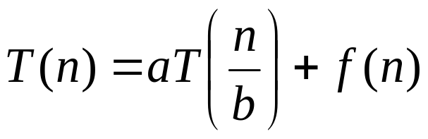
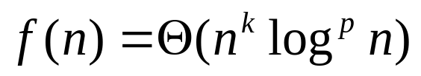
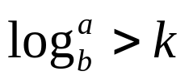
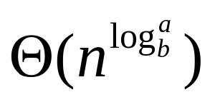
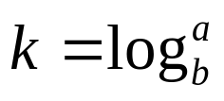
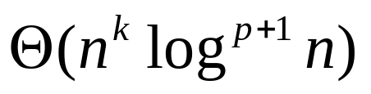
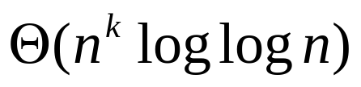
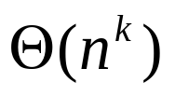
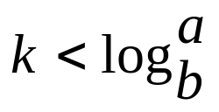


Master’s method
“Cookbook” for solving recurrences of the form:
where, a ≥ 1, b > 1, and
case 1: if then T(n) =
case 2: if then
(i) if p > -1 then T(n) =
(ii) if p = -1 then T(n) =
(iii) if p < -1 then T(n) =
case 3: if then
i) if p >= 0 then ii) if p < 0 then

Slide 16
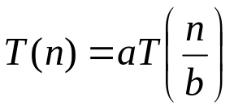
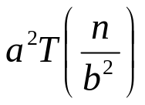
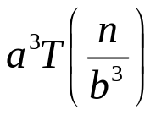
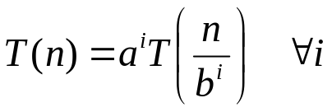
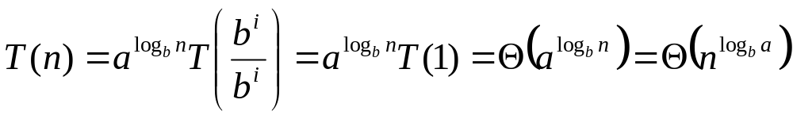
Why n^{log}_{b}ª?
Case 1:
  If f(n) is dominated by n^{log}_{b}ª:
    T(n) = Θ(n^{log}_{b}^{n})
Case 3:
  If f(n) dominates n^{log}_{b}ª:
    T(n) = Θ(f(n))
Case 2:
  If f(n) = Θ(n^{log}_{b}ª):
    T(n) = Θ(n^{log}_{b}ª logn)
Assume n = b^{k} ⇒ k = log_{b}n
At the end of iteration i = k:

Slide 17
Examples
T(n) = 2T(n/2) + n
a = 2, b = 2, log₂2 = 1
Compare n^{log}₂² with f(n) = n
⇒ f(n) = Θ(n) ⇒ Case 2
⇒ T(n) = Θ(nlgn)

Slide 18
Examples
T(n) = 2T(n/2) + n²
a = 2, b = 2, log₂2 = 1
Compare n with f(n) = n²
⇒ f(n) Case 3 ⇒ verify regularity cond.
a f(n/b) ≤ c f(n)
⇔ 2 n²/4 ≤ c n² ⇒ c = ½ is a solution (c<1)
⇒ T(n) = Θ(n²)

Slide 19

Examples (cont.)
T(n) = 2T(n/2) +
a = 2, b = 2, log₂2 = 1
Compare n with f(n) = n^{1/2}
⇒ f(n) = O(n^{1-ε}) Case 1
⇒ T(n) = Θ(n)

Slide 20
Examples
T(n) = 3T(n/4) + nlgn
a = 3, b = 4, log₄3 = 0.793
Compare n^{0.793} with f(n) = nlgn
f(n) = Case 3
Check regularity condition:
3∗(n/4)lg(n/4) ≤ (3/4)nlgn = c ∗f(n), c=3/4
⇒T(n) = Θ(nlgn)

Slide 21
Examples
T(n) = 2T(n/2) + nlgn
a = 2, b = 2, log₂2 = 1
Compare n with f(n) = nlgn
  seems like case 3 should apply

