Slide 1
Mango Bazar
Submitted By:
Md Sahin Alom
Student ID: 18CSE051
Department of CSE, BSMRSTU
Gopalganj-8100.
Supervised By:
Md. Monowar Hossain
Assistant Professor
Department of CSE, BSMRSTU
Gopalganj-8100.

Slide 2
OUTLINE
Introduction
Objective
Project Category
Tools and Platform
Features and Result
Implementation
Future scope of the program
Conclusions

Slide 3
Introduction
Mango Bazar is an e-commerce website.
Mango Bazar is an automated system of manual Mango Bazar .
An online store is a virtual store on the Internet where customers can browse the catalog and select products of interest.

Slide 4
Objective
Create a set of requirements for a Website for small businesses based on research
Knowing when an item was saved or not saved in the shopping cart.
Easy scanning and selecting items in a list.

Slide 5
Project Category
It is a web based application.
Unlike traditional applications, It is accessible anytime, anywhere, via a PC with an Internet connection.
It need lower requirements on the end user system and simplified architecture.

Slide 6
Tools and Platform
For saving the data we have used mssql database.
Language: C#
Front end: html5,css,javascript.
Framework ASP.net
To access the application we can any type of pc using visual studio.

Slide 7
Features of Application
Register New User
Login
Mango Bazar for user
Mango Bazar for admin
Add new mango
Add new type
Showing all order list
List of mango
Mango details
Add to cart
Process to checkout
Show order list

Slide 8
Implementation

Slide 9
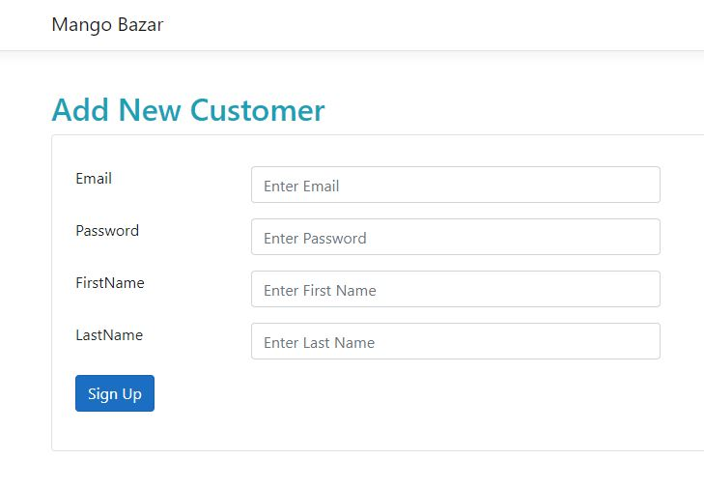
Register as a New User

Slide 10
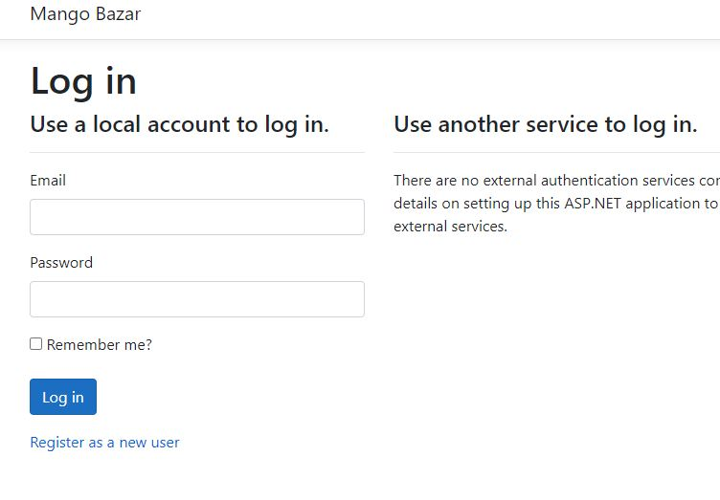
Login

Slide 11
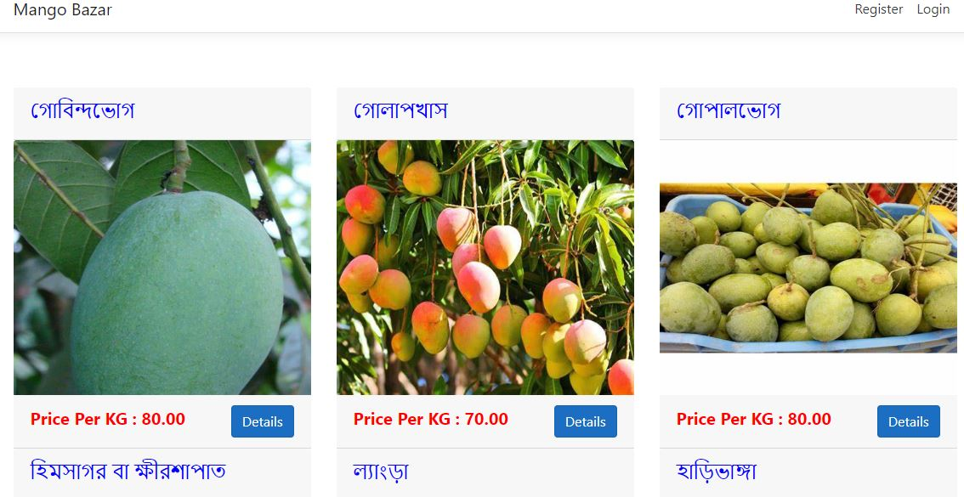
Main page

Slide 12
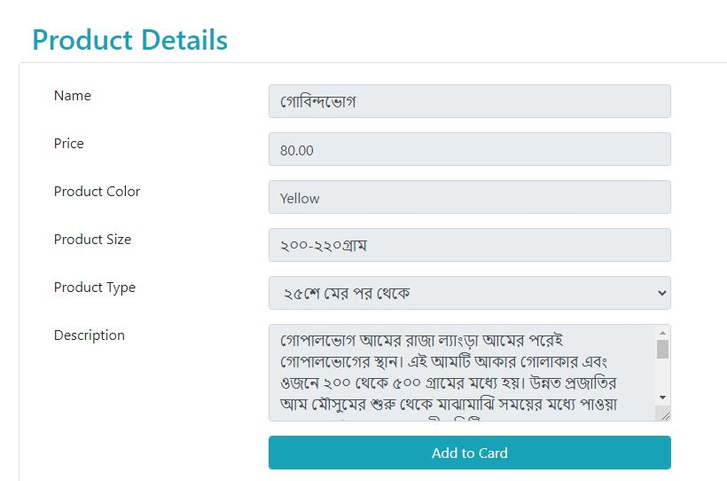
Mango details

Slide 13
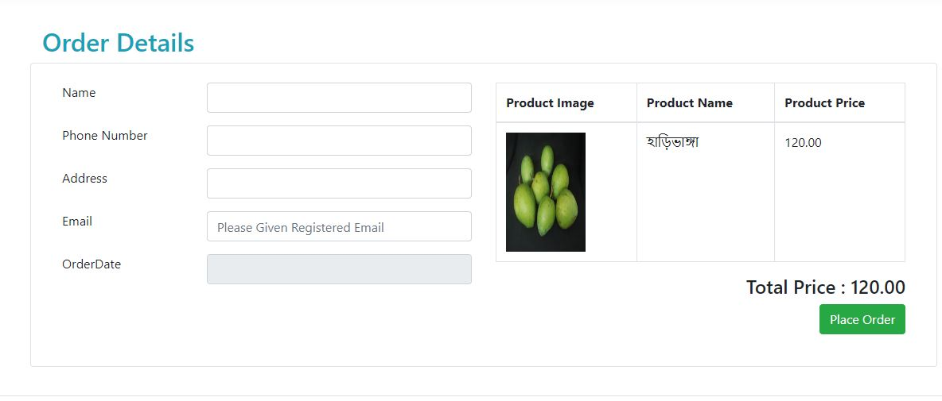
Process to checkout

Slide 14
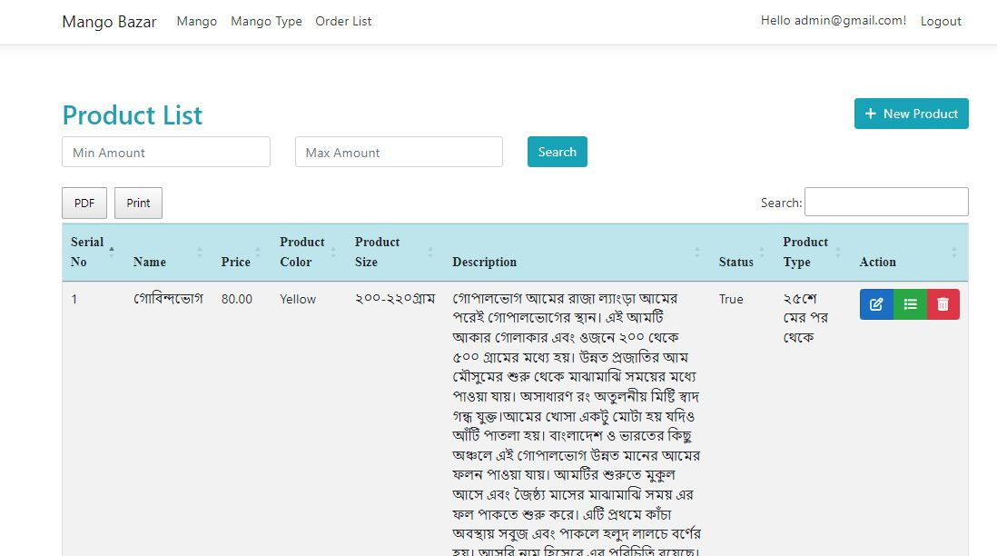
Mango list

Slide 15
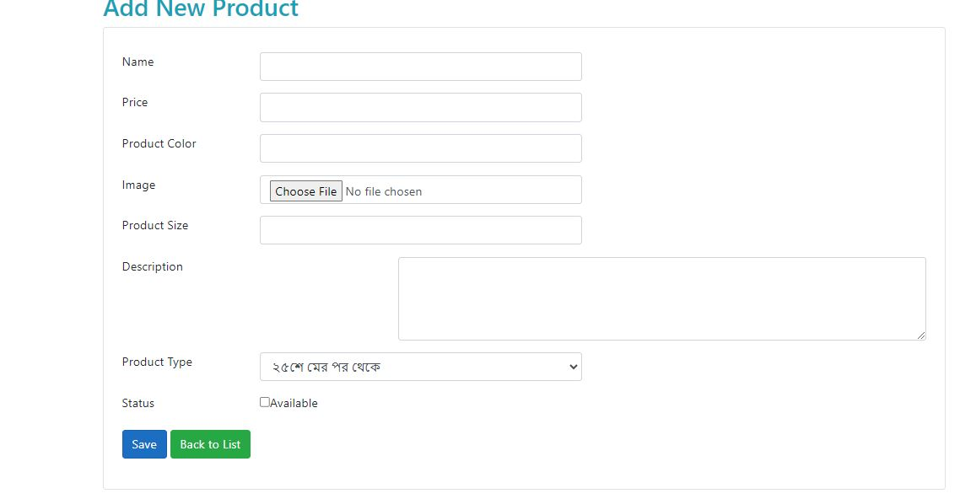
Add new Mango:

Slide 16
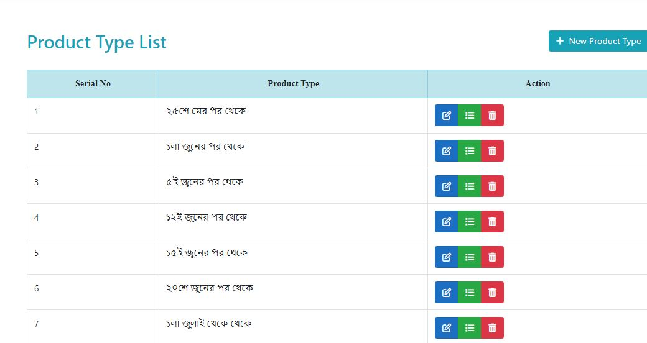
Mango type:

Slide 17
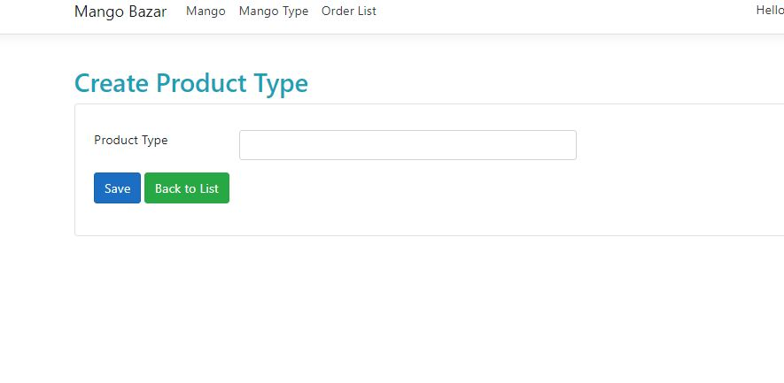
Add new Mango type

Slide 18
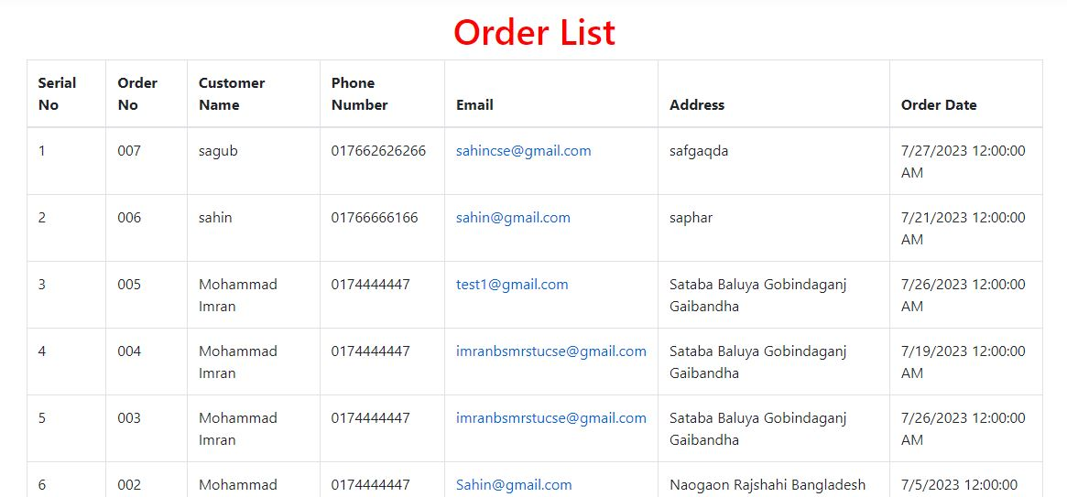
Order list

Slide 19
Future scope of the program
In the future add online payment method
Gui modification, users can sell their products.
We can run the entire system in any operating system and also we have an android application of this entire system.

Slide 20
Conclusions
Easy to manage and start a business.
No need physical company set up.
Low operation cost and better quality service.
Faster buying and selling procedure.

Slide 21
Thanks For Your Attention

