Slide 1


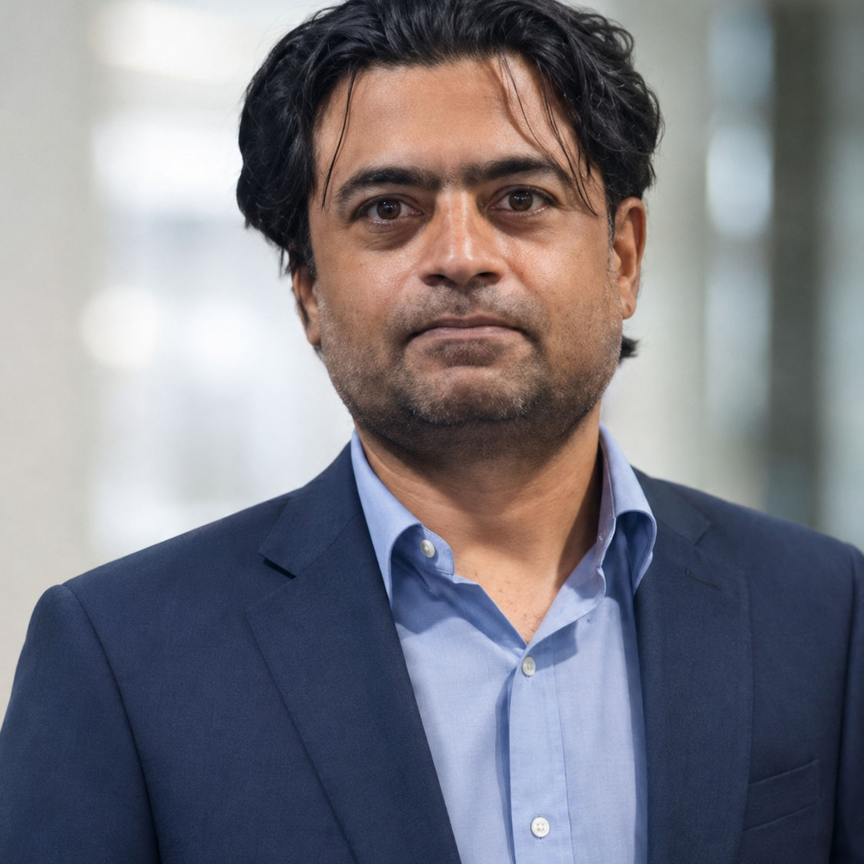

Galaxefi
R D T I I E X T R A C T I O N E N G I N E • L I V E P I T C H
P R E S E N T E R
Haris Mumtaz (Lead)
Muhammad Mujtaba
Asif Pervez
Notes:
Opening: introduce Galaxefi, then present Haris Mumtaz as lead presenter and Muhammad Mujtaba and Asif Pervez as the supporting team.
[Sources]
- User-provided screenshot visual reference
- User-provided local headshots: docs/members/lead.jpeg, docs/members/mujtaba.png, docs/members/ap.jpeg

Slide 2
RDTII EXTRACTION ENGINE · LIVE PITCH
27 / 27
known indicator checks recovered
Across six Singapore, Australia, and Malaysia runs against the Round 1 reference set.
$0.43 recorded Singapore P7 model cost
Source → provision → RDTII output
Galaxefi | 3 August 2026
Notes:
0:00-0:50. Open with the manual research bottleneck, then state the evidence: 27 of 27 known indicator checks recovered. Say 'known-indicator coverage', not '100% legal accuracy'.
[Sources]
- evaluate.py run against outputs/*_2026-07-17*.csv
- logs/cost_report.json
- Pitching Rules.pdf, presentation timing

Slide 3
ARCHITECTURE IN 30 SECONDS
Two zones turn scattered laws into auditable evidence
The architecture separates evidence discovery from legal mapping and output validation.
ZONE 1
ZONE 2
Evidence discovery
Intelligent mapping
Economy + pillar
→
→
→
CSV / JSON
Official portals
Rank + exclude
KNOWN / NEW
Fetch + OCR / translate
Hybrid retrieval + mapping
Validate + write
Exact source · exact provision · indicator · confidence · reviewer notes
Galaxefi · UN Global Hackathon · 3 August 2026
02
Notes:
0:50-1:20. Spend no more than 30 seconds: Zone 1 discovers and tags evidence; Zone 2 reads, retrieves, maps, validates, and writes. Do not explain modules.
[Sources]
- README.md
- CONTEXT.md
- docs/RDTII_Pipeline_Architecture.md

Slide 4
WHY THIS ENGINE IS DIFFERENT
Four design choices make the engine reusable
Each differentiator addresses a scoring, reliability, cost, or scalability constraint.
NEW provision detection
Eight provider tiers
01
02
Independent discoveries are separated from Round 1 examples.
Cloud and local choices; one provider pinned for each run.
Measured cost reporting
YAML economy configs
03
04
Token, OCR, latency, and total run cost are logged.
Singapore, Australia, and Malaysia share one pipeline.
Galaxefi · UN Global Hackathon · 3 August 2026
03
Notes:
1:20-3:10. Spend about 25 seconds per differentiator. Clarify that eight tiers are supported, while one provider is pinned per run for consistency and auditability.
[Sources]
- CONTEXT.md, ADR-021 and LLM providers
- logs/cost_report.json
- economies/*.yaml
- evaluate.py NEW-provision evaluation

Slide 5
SINGAPORE P7 EVIDENCE DEMO
One official Act, two traceable RDTII results
Selected PDPA provisions demonstrate exact-source NEW and KNOWN results from the completed run.
OFFICIAL SOURCE
NEW
P7-I3 · Section 50(4)
Personal Data
Protection Act 2012
Singapore Statutes Online
One-year investigation-record retention
Confidence 0.92 · Exact snippet retained
→
KNOWN
P7-I4 · Section 11(3)
Designated data-protection function
Confidence 0.98 · Exact snippet retained
sso.agc.gov.sg · Exact source text retained
Galaxefi · UN Global Hackathon · 3 August 2026
04
Notes:
3:10-5:30. Show the archived official PDPA text and the two selected output rows: NEW P7-I3 Section 50(4), confidence 0.92; KNOWN P7-I4 Section 11(3), confidence 0.98. The completed online run took 9:37, so show its prepared CSV/JSON rather than starting a full run during the pitch.
[Sources]
- outputs/Singapore_P7_2026-08-01T102134.csv
- outputs/Singapore_P7_2026-08-01T102134.json
- outputs/archive/Act_PDPA2012_WholeDoc_1.html

Slide 6
MEASURED PROOF
Known checks recovered - and more evidence found
Repository evaluator and cost-log results from the six completed runs.
27/27
73
$0.43
3 × 2
known indicator checks
NEW candidates
Singapore P7 model cost
economies × pillars
What the numbers mean
27/27 measures known-indicator coverage - not universal legal accuracy. NEW results are candidates for policy review, with source text, confidence, and notes kept visible.
Galaxefi · UN Global Hackathon · 3 August 2026
05
Notes:
5:30-6:40. State the measured results and define them carefully. The six current evaluator runs report 27/27 known indicator checks and 73 NEW candidates. The latest Singapore P7 cost report records $0.430863 in model usage.
[Sources]
- evaluate.py outputs for SG/AU/MY P6/P7
- logs/cost_report.json
- outputs/Singapore_P7_2026-08-01T102134.csv

Slide 7
THE NEXT FRONTIER
What if a trader could ask:
'Can I ship this from A to B?'
The same evidence engine can grow into a trade-intelligence layer.
NOW
NEXT
THEN
NOW
NEXT
THEN
Multiple pillars
Multiple economies
HS code
Origin + destination
Official laws, regulations
and trader steps
One engine → broader coverage → actionable trade guidance
Built on official sources.
Notes:
Future vision: extend the evidence engine from regulatory coverage into practical trade-intelligence guidance for traders. Keep this framed as a direction built on official sources, not as a current product capability.
[Sources]
- User-provided screenshot visual reference
- Existing RDTII extraction engine deck

Slide 8
THE TAKEAWAY
We automate evidence preparation,
not legal judgment.
Official source → exact provision → RDTII indicator → reviewer-ready output
FASTER
AUDITABLE
SCALABLE
Less manual discovery
Evidence stays visible
More economies via config
27/27 known checks · $0.43 recorded run cost
Questions
Galaxefi · 3 August 2026
Notes:
6:40-7:25. Deliver the final line: the engine removes the expensive evidence-preparation bottleneck while keeping legal judgment and evidence review visible. Stop by 7:25-7:30.
[Sources]
- Pitching Rules.pdf, seven-minute warning and eight-minute mute
- evaluate.py evaluator outputs
- logs/cost_report.json

