Slide 1




PARTICIPANT PRESENTATION
Participant Details
Qiskit
Fall Fest
2026
PROJECT TITLE
QuantVault: Quantum-Aware Cryptographic Risk & Migration Framework
TRACK
Track 1 · Quantum Crypto & Security
TEAM NAME
HackersLobby · VTU-QFF-HC-0108
TEAM LEADER
Sahinur Rahman
EMAIL / CONTACT
sahinurrahman1847@gmail.com
Hackathon · Team Details
TEAM MEMBERS
Sahinur Rahman (Lead) · Subhraditya Ghosh · Archisman Halder
INSTITUTION / ORGANISATION
Kalyani Government Engineering College
COUNTRY
India
Notes:
Hi, we're HackersLobby. QuantVault started from one simple question: if a quantum computer shows up in fifteen years, which of today's systems are already in trouble? We'll show you how we answer that, and where quantum security actually helps, without overselling it.

Slide 2




Problem Statement
Harvest now, decrypt later
In our sample hospital
11 / 13
Systems rely on quantum-vulnerable cryptography
TODAY
STORED
LATER
25 yrs
Traffic is recorded
while encrypted
It waits, unread,
for years
A quantum computer
breaks RSA / ECC
Health records must stay confidential
A patient record sent today must stay private until 2051. The encryption protecting it may not last that long.
2
Systems where nobody can say what crypto runs
Notes:
Here's the uncomfortable part. Someone can record encrypted hospital traffic today and simply wait. When a capable quantum computer exists, RSA and elliptic-curve keys fall, and that old traffic opens up. Health records need to stay private for decades, so the deadline isn't the day the quantum computer arrives; it's much earlier. And most organisations can't even list where RSA lives. In our sample hospital, 11 of 13 systems are exposed and two run cryptography nobody has documented.

Slide 3





Objectives & Novelty
One test every system has to pass
Map every algorithm
Rank by real risk
X
+
Y
>
Z
Show Eve being caught
Plan a 5-phase roadmap
Years the Data
must stay secret
Years Migration
will take
Years until a
Quantum Threat
What's different
Health records: 25 + 5 > 15
Already 15 years late. Start now.
Unknown crypto is never scored as safe
Forward secrecy ≠ quantum-safe
Z is a slider, never a prediction
Notes:
Our whole approach rests on Mosca's inequality. If the years your data must stay secret plus the years it takes you to migrate exceed the years until a quantum threat, you're already late. For the health-record system that's 25 plus 5 against 15: fifteen years behind. We set ourselves four jobs: map, rank, show, plan. And three honesty rules: unknown never means safe, forward secrecy isn't quantum safety, and the threat date is your assumption to move, not ours to predict.

Slide 4


Solution & Quantum Advantage
01 DISCOVER
02 DECIDE
03 DEMONSTRATE
Crypto inventory,
Classified by role
Mosca + Risk Score
with a live Z Slider
BB84 on Qiskit Aer
with an Eavesdropper
Where quantum genuinely helps
Where it doesn't
0%
~25%
1 / 13
Measuring disturbs the photon: Physics exposes Eve.
Assets justify QKD: one dedicated fibre link. The rest need Post-Quantum Crypto first.
Error rate,
No spy
Error rate,
Spy on the line
Notes:
QuantVault works in three layers: discover what you have, decide what moves first, and demonstrate why quantum key distribution is interesting. The quantum part is real: in BB84, measuring a photon disturbs it, so a spy pushes the error rate from zero to about 25 percent and gets caught. But we're honest about the limits: in our hospital only one link, a dedicated fibre between data centres, is a QKD candidate. Everything else should move to post-quantum cryptography first.

Slide 5
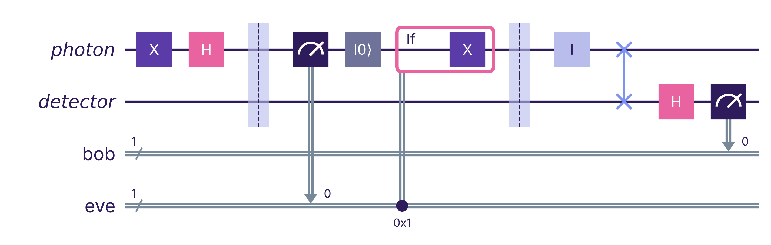
Algorithm & Circuit Design
ALICE
EVE intercepts & resends
CHANNEL
BOB
From photons to a key
Sent
2,048
Sifted (bases match)
1,024
After error sample
768
Final secret key
443
One qubit, built by bb84_circuit(): Alice sends |1⟩ in the X basis; Eve measures in Z and resends. Run 2,048× per experiment on Aer.
Abort if QBER upper bound > 11%
Notes:
This is the actual circuit from our code, not a textbook drawing. Alice encodes a bit with X and H gates, Eve optionally measures and resends, the channel can add noise, and Bob measures in his own random basis. On the right is what happens to an ideal 2,048-qubit run: half survive sifting, we spend a sample checking errors, and after reconciliation and privacy amplification 443 secret bits remain. If the error rate's upper bound crosses 11 percent, we refuse to produce a key at all.

Slide 6
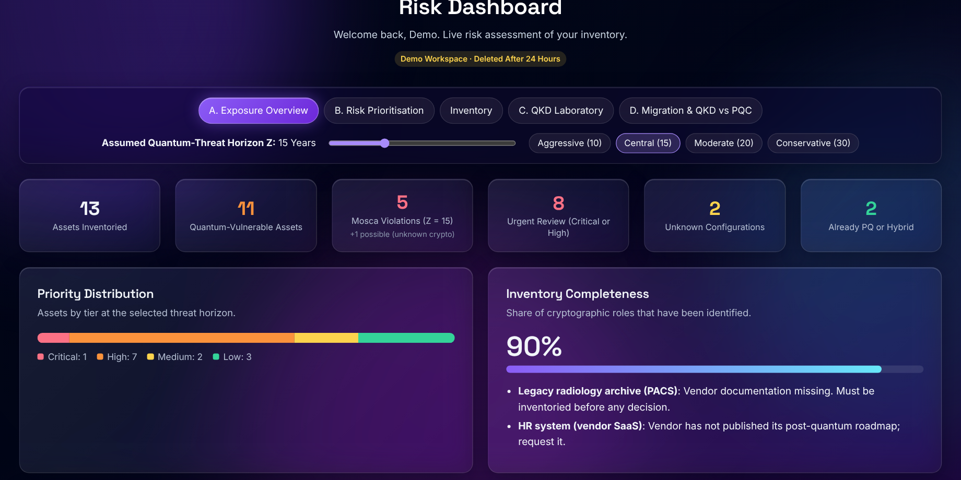


Implementation & Tech Stack
React 19
Express API
Python engines
Vite · Tailwind
Recharts
Auth · rate limits
Qiskit 1.x · Aer
NumPy · SciPy
Scoring logic lives once, in Python, so CLI and dashboard never disagree
MongoDB
Atlas
Live: quantvault-n8cp.onrender.com
Built-in demo account, no sign-up needed
Docker on Render
14 test files
CI on every push
Notes:
Under the hood it's a MERN app in front of Python. React draws the dashboard, Express handles accounts and rate limits, and every score and every BB84 run comes from the same Python code, so the dashboard and the command line can never tell different stories. It ships as one Docker image on Render, with 14 test files running in CI. Judges can log in with the demo account in about ten seconds.

Slide 7


Results & Analysis
Three runs, 2,048 qubits
0.0%
Clean channel
443-bit key
24.0%
Eve on every qubit
Aborted, 0 bits
2.4%
Noise p = 0.05
170-bit key
Eve's error rate tracks theory: ≈ 25% × share of qubits she touches.
Notes:
Here's the evidence. Without Eve, errors grow gently with noise. With Eve, they jump to about 25 percent immediately and never come back down, well above our 11 percent abort line. On the right are three single runs from the live dashboard: a clean channel gives a 443-bit key, Eve on every qubit gets the run aborted, and moderate noise still yields a shorter 170-bit key. One honest caveat: these are three repetitions per setting, so a few points are noisy.

Slide 8



Impact & Real-World Applications
Same problem, everywhere
Hospitals
Records kept 25+ yrs
Banks
Loan & KYC archives
Government
Decades-long secrets
Device makers
Firmware, 15+ yrs
Gives a security lead a ranked, defensible answer to "what do we fix first?"
Critical
High
Medium
Notes:
This is what a hospital security lead walks into the board meeting with: a ranked list, not a vague worry. Health records come first at 80.4, then the firmware that signs infusion pumps. A nurse never sees this dashboard, but she relies on that pump's signature being trustworthy for fifteen years. The same logic applies to banks, government archives and any device maker whose firmware has to be trusted for years.

Slide 9

Challenges & Future Scope
Honest limits, and how we handle them
What we'd build next
Nobody knows Z
→ Made it a slider (5–40 years)
1
Auto-discovery
Scan TLS endpoints & certificates
Score weights are judgement
2
Real hardware
BB84 on IBM Quantum via Qiskit Runtime
→ Exposed and Editable
Simulated channel only
→ Limits reported, not hidden
3
Stronger proofs
Finite-key & decoy-state analysis
Vendors hide their crypto
→ Flagged, never assumed safe
4
Standard input
Import CycloneDX crypto BOMs
Notes:
We want to be upfront about what this isn't. Nobody knows when a capable quantum computer arrives, so we made that a slider instead of pretending. Our score weights are expert defaults you can change. The BB84 lab is a simulation, and it says so. Next, we'd like the inventory to fill itself by scanning certificates, run BB84 on real IBM hardware through Qiskit Runtime, add finite-key analysis, and accept standard crypto bills of materials so teams don't retype what they already have.

Slide 10
CLOSING
Thank You
Questions?
Inspiring Minds. Shaping Tomorrow.
GITHUB REPOSITORY
https://github.com/vtu-qiskit-fall-fest-2026/vtu-hc-hackerslobby
LIVE DEMO
https://quantvault-n8cp.onrender.com/
Notes:
Thank you. If you'd like to try it, the demo account is on the sign-in page and the code is on GitHub. We'd love your questions, especially the hard ones about where QKD really fits.

