Slide 1
Operation | List | Dictionary
Mutable | Yes | Yes
Insert | list1 = [100, 200, 300], initiates a list list1.insert(pos, ‘xyz’) : Inserts the element at specified location | dict1 = {} : Initiate an empty dictionary dict1 = dict([(‘John’, ‘NewYork’), (‘Mark’, ‘California’)]) dict1[‘John’] = ‘NewYork’ : Post initiation, inserts an entry dict2 = dict1.copy() : Creates a copy of dict1 onto dict2
Update | list1[index] = ‘xyz’, where index is referring to an existing value: Overwrites current value with new value. list1.append(list2) : Append an object to the current list list1.extend([100,200]) : Appends the new items to existing list from the iterable | dict1[‘John’] = ‘California’ : Overwrites the existing value, of any else inserts Dict1.update({Mark’: ‘NorthCarolina’}) – Updates the element
Delete | list1.pop() : Deletes the last element of the list list1.remove(‘xyz’) : Deletes the element with a specified value list1.clear() : Removes all elements of the list (Empty list) del list1 : Deletes the list1 | dict1.pop(‘John’) : Removes the element from dict1 dict1.popitem(‘John’) : Removes the last item from dict1 dict1.clear() : Results in empty dictionary del dict1 : Deletes dict1

Slide 2
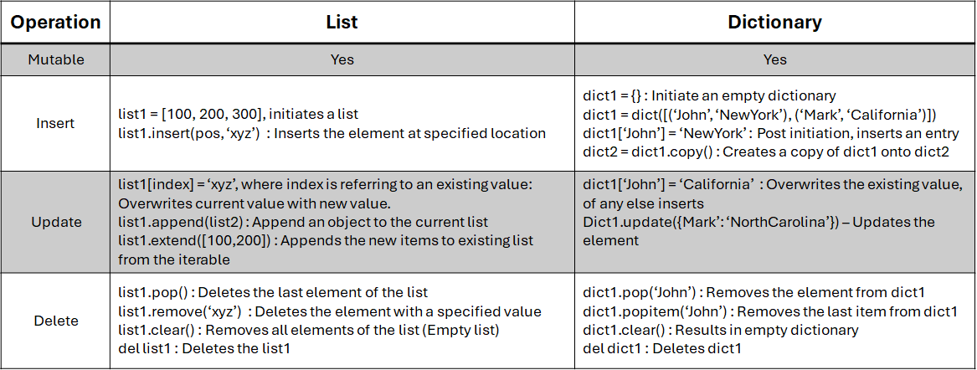

Slide 3
Scenario | List | Dictionary
Access Data in Sequence/Ordered | Yes | No
Query/Operational Performance | Low | High
Readability | Low | High
Allow Duplicates | Yes | No

