Slide 1
RecruitFlow AI
AI-Assisted Resume Screening, Ranking & Candidate Intelligence Platform
Architecture: Python 3.12 Flask Application Factory + MySQL 8 + SQLAlchemy 2.0
AI / ML Engine: 100% Deterministic Explainable Scoring (Zero external paid APIs, Zero Hallucinations)
Validation & Quality: 85/85 Automated Pytest Test Suite Passing (100% Pass Rate in ~27s)
Complete Phases: All 7 Phases Implemented End-to-End (Auth, Jobs, Resumes, Matching, Pipeline, Analytics)
Presented by: Full Stack & Generative AI Software Engineering Portfolio

Slide 2
MARKET CHALLENGE & SOLUTION
Problem Statement & Product Vision
1. Current ATS Flaws
★ Industry Challenges
• Black-box algorithmic rejection without explaining reasons to candidates.
• Naïve keyword matching confuses skills (e.g., 'Java' vs 'JavaScript').
• Malicious file upload risks (lack of magic-byte verification).
• High costs & non-deterministic drift of external LLM APIs.
2. The RecruitFlow AI Vision
★ The Solution
• 100% Explainable & Transparent candidate evaluation.
• Dual-score separation: ATS readability vs. Job suitability.
• Dignified feedback: Evidence-based 'Why Was My Resume Not Shortlisted?'.
• Ethical AI: Suggestions never hallucinate unearned skills or credentials.
3. Business & Technical Impact
★ Key Advantages
• Zero external API dependency saves cloud budget & guarantees 0ms latency.
• Strict tenant isolation keeps corporate client data segregated.
• Human-in-the-loop guarantee: AI never rejects or hires autonomously.
• OWASP hardened: CSRF protection, magic-byte checks & CSV sanitization.

Slide 3
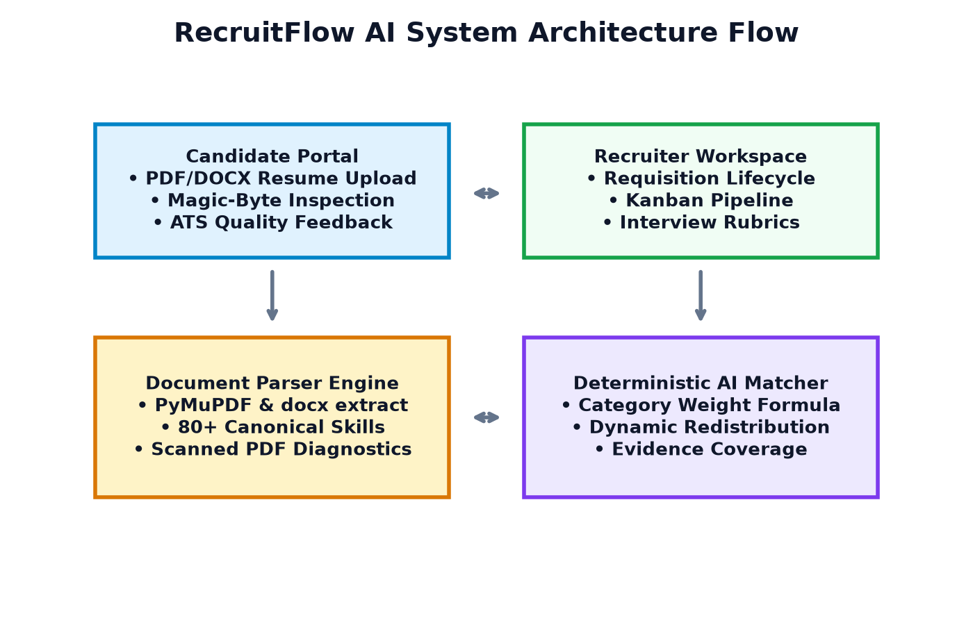
ENTERPRISE ARCHITECTURE
System Architecture & Engineering Workflow
Full-Stack Foundation
★ Core Technical Stack
• Flask Application Factory Pattern with 10 modular Blueprints.
• SQLAlchemy 2.0 ORM with MySQL 8 production database.
• SQLite in-memory test isolation for sub-30s CI/CD runs.
• Alembic / Flask-Migrate schema version control.
• Server-side RBAC decorators (@candidate_required, @recruiter_required, @org_membership_required).
• Werkzeug scrypt password hashing & single-use SHA-256 reset tokens.
• Flask-WTF CSRF protection on 100% of mutation forms.

Slide 4
FEATURE ROADMAP & SCOPE
Complete 7-Phase Milestone Execution
Phases 1 & 2: Core & Auth
★ Phase 1 & 2
• App factory & Blueprints.
• RBAC user roles.
• Multi-tenant company accounts.
• Secure signup, login, password reset.
Phases 3 & 4: Jobs & Ingestion
★ Phase 3 & 4
• Job requisition lifecycle.
• Candidate application submission.
• Magic-byte inspection (PDF/DOCX).
• PyMuPDF + docx text extraction.
• Canonical taxonomy: 80+ skills.
Phases 5 & 6: AI & Pipeline
★ Phase 5 & 6
• Deterministic AI scoring.
• Dynamic weight redistribution.
• Multi-round interview scheduler.
• 1-5 interviewer rubrics.
• Confidential internal feedback.
• Kanban hiring pipeline.
Phase 7: ATS & Analytics
★ Phase 7
• 7-Category ATS Quality Scorer.
• Dual-score separation.
• 10-criteria comparison engine.
• 3-tier prioritized writing checklist.
• Why Not Shortlisted diagnostics.
• Hiring funnel & CSV export.

Slide 5
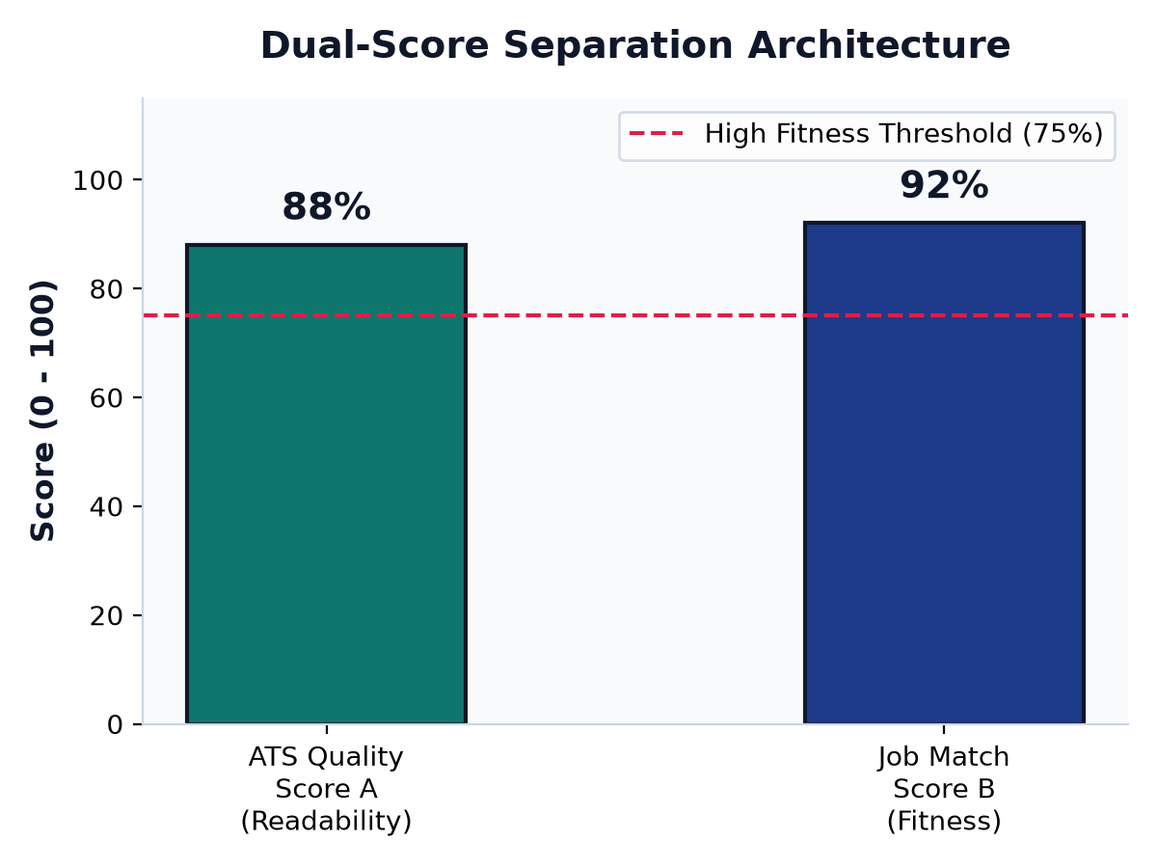
CORE INNOVATION
Dual-Score Separation Architecture
Separating Readability from Qualification
★ Dual-Metric Model
• Score A: ATS Quality & Readability (0–100)
• • Evaluates formatting, contact links, action verbs, measurable metrics, and layout health independently of any job.
• Score B: Job-Specific Match (0–100)
• • Evaluates qualification, skills, and experience fit against a target job opening using the Phase 5 engine.
• Architectural Benefit:
• • Prevents penalizing a brilliant candidate for a simple layout issue.
• • Helps candidates fix their resume formatting before applying to roles.

Slide 6
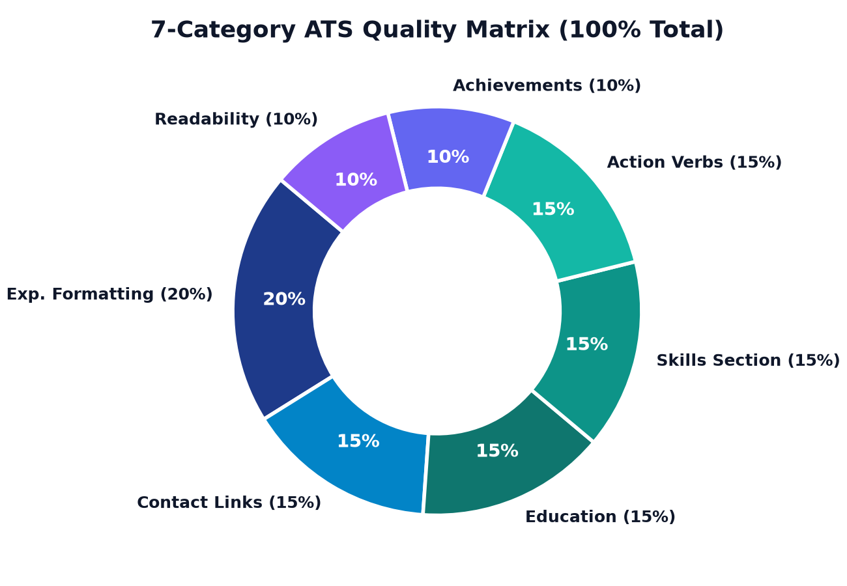
DOCUMENT READABILITY
ATS Resume Quality Analysis Matrix
7 Configurable Categories (100% Total)
★ Weighted Categories
• 1. Experience Section Structure: 20%
• 2. Contact & Online Profiles (LinkedIn, GitHub): 15%
• 3. Education Formatting: 15%
• 4. Skills Formatting & Canonical Taxonomy: 15%
• 5. Strong Action Verbs: 15%
• 6. Measurable Achievements (% / $ metrics): 10%
• 7. File Readability & Clean Layout: 10%
• Diagnostic Warnings:
• • Automatically flags scanned/image-only PDFs (<50 characters) to prevent unparsed application rejections.

Slide 7
AI MATCHING ENGINE
Explainable Candidate Matching & Fairness
Core Match Weights
★ Deterministic Formula
• Required Skills: 50%
• Preferred Skills: 20%
• Experience Alignment: 20%
• Education Level: 10%
• Strict Total: 100% (1.00) mathematically verified.
Dynamic Redistribution
★ Fairness Engine
• No penalty for omitted job criteria.
• If a job specifies no preferred skills, that 20% is proportionally redistributed across active categories.
• Candidates are never penalized for unrequested attributes.
• Pure Python deterministic engine — zero LLM hallucination or drift.
Token Boundary Precision
★ Audit Safeguards
• Word boundaries prevent substring confusion:
• • 'Java' != 'JavaScript'
• • 'C' != 'C++' or 'C#'
• Evidence Coverage Tracking: If evidence is missing, reports 'Unavailable' instead of 0% or 100%.
• SHA-256 Input Hash flags stale scores automatically.

Slide 8
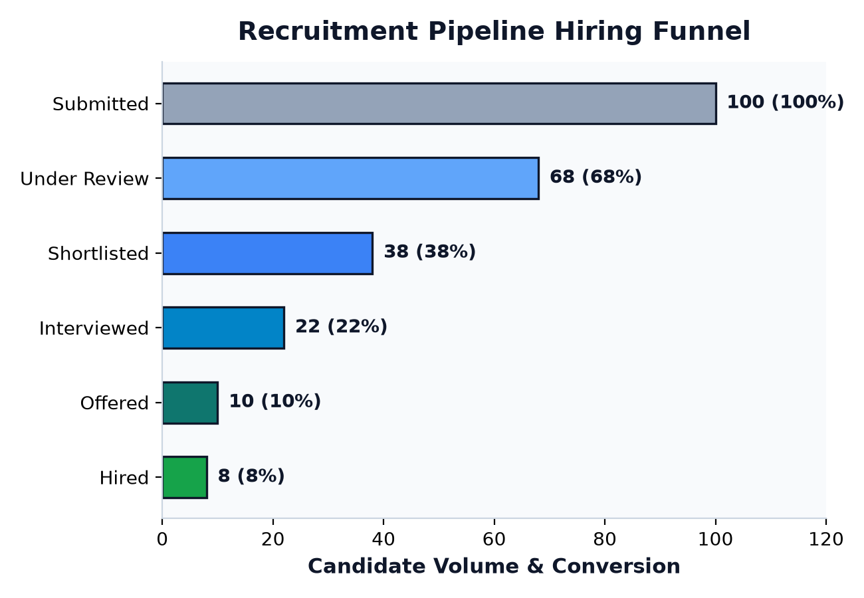
PIPELINE & ANALYTICS
Candidate Dignity & Recruiter Funnel Analytics
Dignified Candidate Experience
★ Candidate Dignity
• 'Why Was My Resume Not Shortlisted?':
• • Evidence-based gap diagnosis shows exact missing requirements.
• • Side-by-side criteria breakdown (Skills, Experience, Degrees).
• • Honest Disclaimer: 'Decisions reflect the competitive applicant pool for this role.'
• • Structured Rejection Codes: Qualifications mismatch, experience gap, position filled.
• • Candidate Privacy: Recruiter internal notes and scoring cards are strictly hidden from candidates.

Slide 9
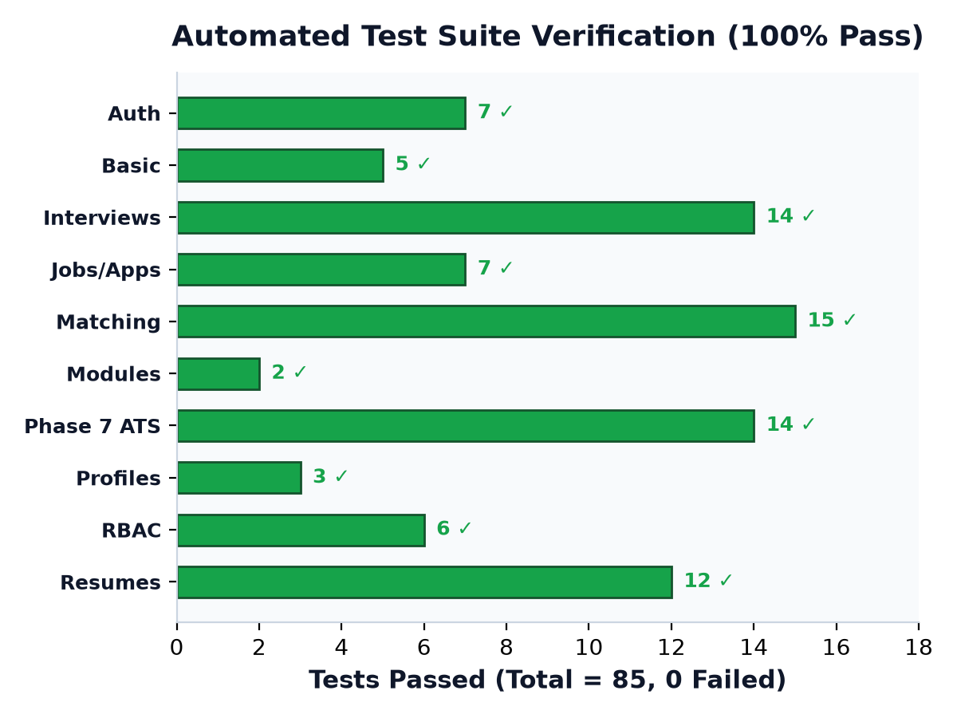
QUALITY ASSURANCE
Automated Verification & 100% Test Pass Rate
Verification Across 10 Modules
★ Pytest Metrics
• Total Tests: 85 automated tests.
• Pass Rate: 100% (85 passed, 0 failed).
• Execution Time: 27.31 seconds in Pytest.
• Database: SQLite in-memory isolation for fast deterministic test runs.
• Hardened Security:
• • Multi-tenant cross-organization isolation verified.
• • CSRF protection & password hashing tested.
• • Malicious disguised file uploads rejected.
• • CSV formula injection defense (' prepended).

Slide 10
LIVE DEMONSTRATION & REPOSITORY
How to Run RecruitFlow AI Live for Evaluation
Quick Launch Commands
1. Open Windows PowerShell:
cd C:\Users\sahit\.gemini\antigravity\scratch\recruitflow-ai
2. Run automated tests (85 passed in ~27s):
pytest
3. Start application:
python run.py
4. Open in browser:
http://127.0.0.1:5000
5. Health API Check:
http://127.0.0.1:5000/health
Key Demonstration Highlights
• Resume Upload & Parsing: Upload a PDF/DOCX resume; observe instant metadata extraction & skills normalization.
• ATS Quality Gauge: View 7-category breakdown and proactive suggestions.
• Side-by-Side Comparison: Compare resume against job description criteria.
• AI Matching & Leaderboard: See match scores calculated deterministically with explainable breakdowns.
• Kanban Pipeline: Move candidate across hiring stages with human-in-the-loop audit logs.
• Recruiter Reports: Inspect Chart.js hiring funnel and export sanitized CSV.

