Slide 1
CSE101-Lec#15
Types of Arrays
Application of arrays

Slide 2
Outline
Defining and processing array types
  1D array
  2D array
Applications of arrays

Slide 3
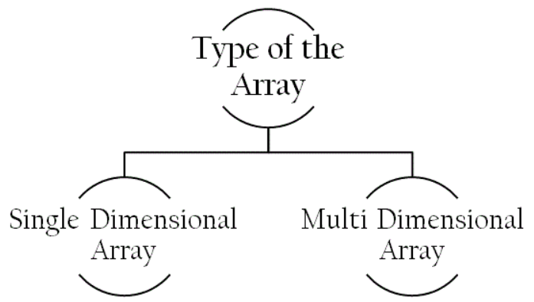
Array Types

Slide 4
Single Dimensional array
Used to represent and store data in a linear form.
Array having only one subscript variable is called One-Dimensional array.
It is also called as Linear Array or 1- D Array.
Example: int a[n];
char arr1[20] = “C Programming" ;
float arr2[3] = {12.5,13.5,14.5};

Slide 5
Program to display the average of elements in 1D array
#include<stdio.h>
int main()
{
int avg, sum=0, i;
int marks[30]; /*array declaration*/
for(i=0;i<=29;i++)
{
printf("enter numbers");
scanf("%d",&marks[i]); /*store data in array*/
}
for(i=0;i<=29;i++)
{
sum = sum + marks[i];/*read data from an array*/
}
avg = sum/30;
printf("Average marks= %d", avg);
}
Notes:
To find aveage marks obtained by 30 students of a class

Slide 6
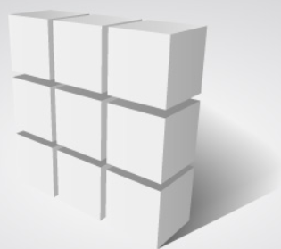
Multi-Dimensional Arrays
Array having more than one subscript variable is called Multi- Dimensional array.
Multi Dimensional Array is also called as Matrix.
Most popular and commonly used multi dimensional array is two dimensional array.
The 2-D arrays are used to store data in the form of table.
Syntax for declaring a two dimensional array:
datatype arrayName [ rowSize ] [ columnSize ] ;
Example:
int matrix_A [2][3] = { {1, 2, 3},{4, 5, 6} } ;
It reserves 6 continuous memory locations of 2 bytes each in the form of 2 rows and 3 columns. And the first row is initialized with values 1, 2 & 3 and second row is initialized with values 4, 5 & 6.
It can also initialize as :
int matrix_A [2][3] = { {1, 2, 3},
{4, 5, 6} } ;

Slide 7
Multi-Dimensional Arrays
Column 0 0
Column 1
Column 2
Column 3
Row 0
a[ 0 ][ 0 ]
a[ 0 ][ 1 ]
a[ 0 ][ 2 ]
a[ 0 ][ 3 ]
Row 1
a[ 1 ][ 0 ]
a[ 1 ][ 1 ]
a[ 1 ][ 2 ]
a[ 1 ][ 3 ]
Row 2
a[ 2 ][ 0 ]
a[ 2 ][ 1 ]
a[ 2 ][ 2 ]
a[ 2 ][ 3 ]
Column subscript
Array name
Row subscript

Slide 8
Multiple-Subscripted Arrays
1 2
3 4
Initialization
  int a[ 2 ][ 2 ] = { { 1, 2 }, { 3, 4 } };
  Initializers grouped by row in braces .
  If not enough, unspecified elements set to zero
    int a[ 2 ][ 2 ] = { { 1 }, { 3, 4 } };
Referencing elements: via 2 subscripts, i.e. one for row
2nd for column.
  Specify row, then column
    printf( "%d", a[ 0 ][ 1 ] );
1 0
3 4

Slide 9
Program to display 2D array
#include<stdio.h>
void main()
{
int a[3][3], i, j;
for(i=0; i<3; i++) //for loop for rows
{
for(j=0; j<3;j++) // for loop for columns
{
printf("enter the value of a[%d][%d]: ", i, j);
scanf("%d", &a[i][j]);
} //end for columns
} //end for rows
printf("elements of 2D matrix are\n");
for(i=0; i<3; i++)
{
for(j=0;j<3;j++)
{
printf("%d\t", a[i][j]);
} //end for
printf("\n");
} //end for
} //end main

Slide 10
enter the value of a[0][0] :1
enter the value of a[0][1] :2
enter the value of a[0][2] :3
enter the value of a[1][0] :4
enter the value of a[1][1] :5
enter the value of a[1][2] :6
enter the value of a[2][0] :7
enter the value of a[2][1] :8
enter the value of a[2][2] :9
Element of 2D matrix are:
2 3
5 6
7 8 9

Slide 11
Operations on arrays
Insertion of element into an array
Deletion of element from an array

Slide 12
Program to insert an element into an array
#include<stdio.h>
#include<conio.h>
int main()
{
int array[100], position, c, n, value;
printf("Enter number of elements in array:\n");
scanf("%d", &n);
printf("Enter %d elements:\n", n);
for (c = 0; c < n; c++)
{ scanf("%d", &array[c]); }
printf("Enter the location where to insert an element:\n");
scanf("%d", &position);
printf("Enter the value to insert:\n");
scanf("%d", &value);
for (c = n - 1; c >= position - 1; c--)
{ array[c+1] = array[c]; }
array[position-1] = value;
printf("Resultant array is:\n");
for (c = 0; c <= n; c++)
{
printf("%d\n", array[c]);
}
}

Slide 13
Enter number of elements in array: 4
Enter 4 elements
2
45
66
33
Enter the location where you wish to insert an element : 2
Enter the value to insert : 99
Resultant array is :
2
99
45
66
33

Slide 14
Program to delete an element from an array
#include <stdio.h>
int main()
{
int array[100], position, c, n;
printf("Enter number of elements in array\n");
scanf("%d", &n);
printf("Enter %d elements\n", n);
for (c = 0; c < n; c++)
{ scanf("%d", &array[c]); }
printf("Enter the location where you wish to delete from an array\n");
scanf("%d", &position);
for (c = position-1; c < n; c++)
{ array[c] = array[c+1]; }
printf("Resultant array is\n");
for (c = 0; c < n-1; c++)
{ printf("%d\n", array[c]); }
}

Slide 15
Enter number of elements in array: 4
Enter 4 elements
2
45
66
33
Enter the location where you wish to delete from an array : 2
Resultant array is :
2
66
33

Slide 16
Applications of Array
1. Stores Elements of Same Data Type
Array is used to store the number of elements that are of same data type.
Eg: int students[30];
Array of marks of five subjects for single student.
float marks[5];
Array of marks of five subjects for 30 students.
float marks[30][5]
Similarly, if we declare the character array then it can hold only character.
So, in short character array can store character variables while floating array stores only floating numbers.

Slide 17
2. Array Used for Maintaining multiple variable names using single name
Suppose we need to store 5 roll numbers of students, then without declaration of array we need to declare following -
int roll1,roll2,roll3,roll4,roll5;
Now in order to get roll number of first student we need to access roll1.
Guess if we need to store roll numbers of 100 students, then what will be the procedure.
Maintaining all the variables and remembering all these things is very difficult.
So we are using array which can store multiple values and we have to remember just single variable name.

Slide 18
3. Array Can be Used for Sorting Elements
We can store elements to be sorted in an array and then by using different sorting technique we can sort the elements.
Different Sorting Techniques are :
1. Bubble Sort
2. Insertion Sort
3. Selection Sort
Notes:
To sort the elements without using array we have to compare each and every variable individually without using loops.

Slide 19
4. Array Can Perform Matrix Operation
Matrix operations can be performed using the array. We can use 2-D array
To store the matrix.
To perform all mathematical manipulations on matrix.
Matrix can be multi-dimensional.

Slide 20
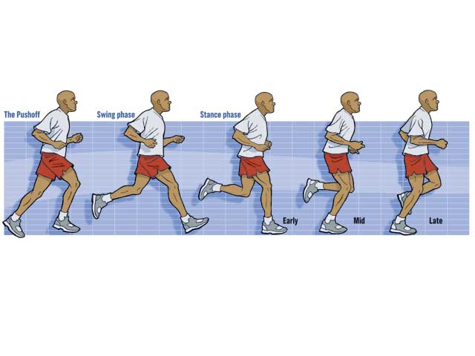


Some classic daily examples…
1D
Running
  Distance [D]
2D
Long Jump
  Distance, Height [D,H]
3D
High Jump
  Distance, Height, Roll [D,H,R]

Slide 21

Next Lecture
Finding my stuffs from a mess …??
Searching Technique

