Slide 1
CSE101-Lec#14
Arrays
(Arrays and Functions)

Slide 2
Outline
To declare an array
To initialize an array
To pass an array to a function

Slide 3
Introduction
Arrays :
  Collection of related data items of same data type.
  Static entity – i.e. they remain the same size throughout program execution.
Example where arrays are used:
to store list of Employee or Student names,
to store marks of students,
or to store list of numbers or characters etc.

Slide 4
Arrays
Name of array (Note that all elements of this array have the same name, c)
Array
  Group of consecutive memory locations
  Same name and data type
To refer to an element, specify:
  Array name
  Position number in square brackets([])
Format/Syntax:
    arrayname[position_number]
  First element is always at position 0
  Eg. n element array named c:
    c[0], c[1]...c[n – 1]
c[0]
-45
c[1]
6
c[2]
0
c[3]
72
c[4]
3
c[5]
-89
c[6]
0
c[7]
62
c[8]
-3
c[9]
1
c[10]
6453
c[11]
78
Position number of the element within array c

Slide 5
Important points about Array
Array data type: any
Array size: constant value.
Array Storage: Contiguous (adjacent) memory locations are used to store array elements in memory.
It is a best practice to initialize an array to zero or null while declaring, if we don’t assign any values to array.

Slide 6
Array Examples
Array elements are like normal variables
    c[0] = 3; //stores 3 to c[0] element
    scanf (“%d”, &c[1]); //reads c[1] element
    printf (“%d, %d”, c[0], c[1]); //displays c[0] & c[1] element
The position number inside square brackets is called subscript/index.
Subscript must be integer or an integer expression
    c[5 + 2] = 7; (i.e. c[3] = 7)

Slide 7
Array Definition
When defining arrays, specify:
  Name
  Data Type of array
  Number of elements
    datatype array_Name[number_of_elements];
  Examples:
    int students[10];
    float myArray[3284];
Defining multiple arrays of same data type
  Format is similar to regular variables
  Example:
    int b[100], x[27];

Slide 8
Array Initialization
Initializers
    int n[5] = { 1, 2, 3, 4, 5 };
  If not enough initializers given, then rightmost elements become 0.
  int n[5] = { 0 }; // initialize all elements to 0
  C arrays have no bounds checking.
If size is not mentioned, initializers determine it.
    int n[ ] = { 1, 2, 3, 4, 5 };
  5 initializers, therefore 5 element array.

Slide 9
Array Initialization
Array is same as the variable can take value from the user at run time.
Array is a group of elements, so for loop is used to get the values of every element instead of getting single value at a time.
Example: int array[5], i; // array of size 5
for(i=0; i<5; i++)
{ // loop begins from 0 to 4
scanf(“%d”, &array[i]);
} //for loop ends

Slide 10
//PROGRAM TO INITIALIZE ARRAY ELEMENTS TO ZERO
#include <stdio.h>
#define MAX_SIZE 10
int main()
{
int n[ 10 ]; //array declaration
int i;
for ( i = 0; i < 10; i++ )
{
n[ i ] = 0; // initialize elements of array n to 0
}
printf( "%s, %s \n", "Element", "Value" );
for ( i = 0; i < 10; i++ )
{
printf( "%d, %d \n", i, n[ i ] );
}
return 0;
}
A macro is a fragment of code that is given a name. You can use that fragment of code in your program by using the name.
These macro definitions allow constant values to be declared for use throughout your code.

Slide 11

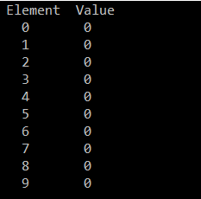
OUTPUT:
0
Quick yak:
Discussion can be quickly done on
%s%13s
%7d%13d
Used in the program
n[0]
n[1]
0
n[2]
0
n[3]
0
n[4]
0
n[5]
0
n[6]
0
n[7]
0
n[8]
0
n[9]
0

Slide 12
//PROGRAM TO PRINT VALUES OF TABLE OF 2
#include <stdio.h>
#define N 10 // N is size of array
int main()
{
int table[ N ]; //array declaration
int i;
for ( i = 0; i < N; i++ )
{
table[ i ] = 2 + 2*i; // initialize elements of array 2 to 20
}
printf(" [%s] \t %s \n", "Index", "Value" );
for ( i = 0; i < N; i++ )
{
printf( " %d \t %d \n", i, table[i] );
}
return 0;
}

Slide 13
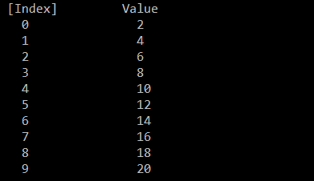
OUTPUT:
n[0]
2
n[1]
4
n[2]
6
n[3]
8
n[4]
10
n[5]
12
n[6]
14
n[7]
16
n[8]
18
n[9]
20
Q: WAP to take 8 numbers as input from the user and calculate the average using ARRAYS.

Slide 14

//TO PRINT ADDRESS OF THE ARRAY.
#include<stdio.h>
int main()
{
char abc[10];
printf("Address of &array[0] abc = %p\n",&abc[0]);
printf("Address of array abc = %d", &abc);
return 0;
}
OUTPUT:

Slide 15
Character Arrays
Initialized using string literals
  char string1[ ] = "first";
  It is equivalent to
  char string1[ ] = { 'f', 'i', 'r', 's', 't', '\0' };
    Null character ‘\0’: terminates strings/ signifies end of string
    string1 actually has 6 elements.
  Can access individual characters
    string1[ 3 ] is character ‘s’
  Array name is address of array, so & not needed for scanf
      scanf( "%s", string2 );
    Reads characters until whitespace encountered

Slide 16
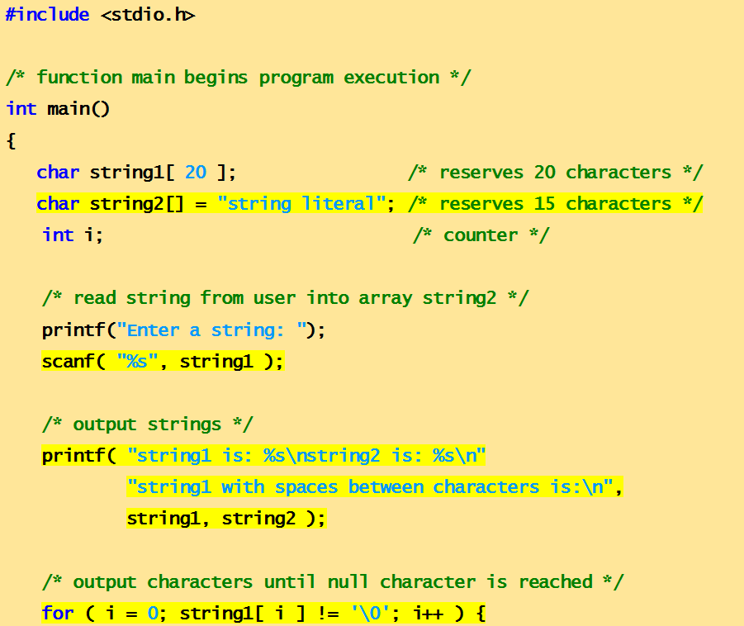
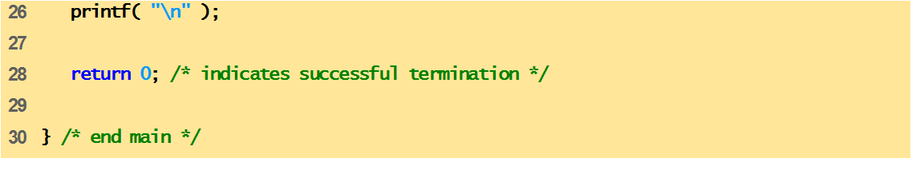
Program to print character array as strings.
,
Enter a string: Hello
string1 is: Hello
string2 is: string literal

Slide 17
Passing Arrays to Function
2 WAYS TO PASS FUNCTIONS
Pass array element by element
Pass entire array

Slide 18
I. Pass entire array
Entire array can be passed as an argument to the function.
Function gets complete access to the original array.
While passing entire array, Address of first element is passed to function, any changes made inside function, directly affects the Original value.
int modifyArray(int b[], int arraySize);
Function passing method: “Pass by Address”

Slide 19
II. Pass array element by element
Elements are passed to the function as argument
Duplicate carbon copy of Original variable is passed to function
So any changes made inside function does not affects the original value
Function doesn’t get complete access to the original array element.
int modifyElement(int e);
Function passing method: “Pass by Value”

Slide 20
Passing Arrays to Functions
Function prototype
void modifyArray(int b[], int arraySize);
  Parameter names optional in prototype
    int b[] could be written int [ ]
    int arraySize could be simply int
  int modifyArray(int [], int);
Function call
int a[SIZE];
modifyArray(a, SIZE);

Slide 21
Passing complete array to functions
#include<stdio.h>
float findAverage(int marks[]); //function declaration
int main()
{
float avg;
int marks[ ] = {99, 90, 96, 93, 95};
avg = findAverage(marks); // name of the array is passed as argument.
printf("Average marks = %.1f", avg);
return 0;
}
float findAverage(int marks[]) //function calling
{
int i, sum = 0; float avg;
for (i = 0; i <= 4; i++)
{
sum += marks[i];
}
avg = (sum / 5);
return avg;
}

Slide 22
Passing individual array elements to functions
#include <stdio.h>
void display(int age)
{
printf("%d", age);
}
int main()
{
int ageArray[] = { 2, 3, 4 };
display(ageArray[2]); //Passing array element ageArray[2] only.
return 0;
}

Slide 23
Next Class:
Applications of Arrays

