Slide 1
CSE101-Lec#16
Array searching and sorting techniques

Slide 2
Outline
Introduction
Linear search
Binary search
Bubble sort

Slide 3
Introduction
The process of finding a particular element of an array is called SEARCHING.
Search an array for a key value, called ITEM.
Searching techniques:
  Linear search
  Binary search

Slide 4
Linear search
Linear search
  Simple
  Compare each element of array with key value
  Useful for small and unsorted arrays
It simply examines each element sequentially, starting with the first element, until it finds the key element or it reaches the end of the array.
Example: If you were looking for someone on a moving passenger train, you would use a sequential search.

Slide 5
Program of linear search in an array.
#include<stdio.h>
int main()
{
int a[10], i, item, n;
printf("Enter number of elements of an array:\n");
scanf("%d",&n);
printf("\nEnter the elements \n");
for(i=0; i<n; i++)
scanf("%d", &a[i]);
printf("\nEnter item to search: ");
scanf("%d", &item);
for(i=0; i<10; i++)
{
if(item == a[i])
{
printf("\nItem found at location %d", i+1);
break;
}
}
if(i>9)
printf("\nItem does not exist.");
return 0;
}

Slide 6
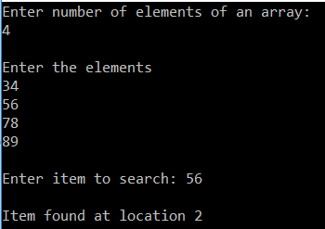
OUTPUT

Slide 7
Binary Search
Binary search
  Applicable for sorted arrays
The algorithm locates the middle element of the array and compares it to the key value.
  Compares middle element with the key
    If equal, match found
    If key < middle, looks in left half of middle
    If key > middle, looks in right half of middle
    Repeat (the algorithm is repeated on one-quarter of the original array.)

Slide 8
Binary search
  It repeatedly divides the sequence in two, each time restricting the search to the half that would contain the element.
  This is a tremendous increase in performance over the linear search that required comparing the search key to an average of half of the array elements.
  You might use the binary search to look up a word in a dictionary

Slide 9
#include<stdio.h>
int main()
{
int loc=-1, key, beg=0,last=9,mid;
int a[10]={ 2,4,6,8,10,12,37,45,68,89};//sorted array
printf("Enter integer value to search in sorted array:");
scanf( "%d", &key );
while(beg<=last)
{
mid = (beg + last) / 2; // determine middle element
if(a[mid]==key)
{
loc=mid; //save the location of element.
break;
}
else if(a[mid]>key) //key less than middle element
{
last=mid-1;
}
else if(a[mid]<key) //key greater than middle element
{
beg=mid+1;
} //end of if else
} //end of while
if(loc!=-1)
{
printf("element found at %d", loc+1);
}
else
{
printf("element not found");
}
return 0;
}
Program of binary search in an array

Slide 10
Enter integer to search in sorted array:
4
Element found at 2
Enter integer search in sorted array:
85
Element not found
output

Slide 11
Sorting
Sorting data
  Important computing application
  Virtually every organization must sort some data

Slide 12
Bubble Sort: Idea
Idea: bubble in water.
  Bubble in water moves upward. Why?
How?
  When a bubble moves upward, the water from above will move downward to fill in the space left by the bubble.

Slide 13
Bubble Sort Example
9, 6, 2, 12, 11, 9, 3, 7
6, 9, 2, 12, 11, 9, 3, 7
Bubblesort compares the numbers in pairs from left to right exchanging when necessary. Here the first number is compared to the second and as it is larger they are exchanged.
6, 2, 9, 12, 11, 9, 3, 7
Now the next pair of numbers are compared. Again the 9 is the larger and so this pair is also exchanged.
6, 2, 9, 12, 11, 9, 3, 7
In the third comparison, the 9 is not larger than the 12 so no exchange is made. We move on to compare the next pair without any change to the list.
6, 2, 9, 11, 12, 9, 3, 7
The 12 is larger than the 11 so they are exchanged.
6, 2, 9, 11, 9, 12, 3, 7
The twelve is greater than the 9 so they are exchanged
The end of the list has been reached so this is the end of the first pass. The twelve at the end of the list must be largest number in the list and so is now in the correct position. We now start a new pass from left to right.
6, 2, 9, 11, 9, 3, 12, 7
The 12 is greater than the 3 so they are exchanged.
6, 2, 9, 11, 9, 3, 7, 12
The 12 is greater than the 7 so they are exchanged.

Slide 14
Bubble Sort Example
First Pass
6, 2, 9, 11, 9, 3, 7, 12
Second Pass
6, 2, 9, 11, 9, 3, 7, 12
2, 6, 9, 11, 9, 3, 7, 12
2, 6, 9, 9, 11, 3, 7, 12
2, 6, 9, 9, 3, 11, 7, 12
2, 6, 9, 9, 3, 7, 11, 12
Notice that this time we do not have to compare the last two numbers as we know the 12 is in position. This pass therefore only requires 6 comparisons.

Slide 15
Bubble Sort Example
First Pass
6, 2, 9, 11, 9, 3, 7, 12
Second Pass
2, 6, 9, 9, 3, 7, 11, 12
Third Pass
2, 6, 9, 9, 3, 7, 11, 12
2, 6, 9, 3, 9, 7, 11, 12
2, 6, 9, 3, 7, 9, 11, 12
This time the 11 and 12 are in position. This pass therefore only requires 5 comparisons.

Slide 16
Bubble Sort Example
First Pass
6, 2, 9, 11, 9, 3, 7, 12
Second Pass
2, 6, 9, 9, 3, 7, 11, 12
Third Pass
2, 6, 9, 3, 7, 9, 11, 12
Fourth Pass
2, 6, 9, 3, 7, 9, 11, 12
2, 6, 3, 9, 7, 9, 11, 12
2, 6, 3, 7, 9, 9, 11, 12
Each pass requires fewer comparisons. This time only 4 are needed.

Slide 17
Bubble Sort Example
First Pass
6, 2, 9, 11, 9, 3, 7, 12
Second Pass
2, 6, 9, 9, 3, 7, 11, 12
Third Pass
2, 6, 9, 3, 7, 9, 11, 12
Fourth Pass
2, 6, 3, 7, 9, 9, 11, 12
Fifth Pass
2, 6, 3, 7, 9, 9, 11, 12
2, 3, 6, 7, 9, 9, 11, 12
The list is now sorted but the algorithm does not know this until it completes a pass with no exchanges.

Slide 18
Bubble Sort Example
First Pass
6, 2, 9, 11, 9, 3, 7, 12
Second Pass
2, 6, 9, 9, 3, 7, 11, 12
Third Pass
2, 6, 9, 3, 7, 9, 11, 12
Fourth Pass
2, 6, 3, 7, 9, 9, 11, 12
Fifth Pass
This pass no exchanges are made so the algorithm knows the list is sorted. It can therefore save time by not doing the final pass. With other lists this check could save much more work.
2, 3, 6, 7, 9, 9, 11, 12
Sixth Pass
2, 3, 6, 7, 9, 9, 11, 12

Slide 19
Bubble Sort Example
Quiz Time
Which number is definitely in its correct position at the end of the first pass?
Answer: The last number must be the largest.
How does the number of comparisons required change as the pass number increases?
Answer: Each pass requires one fewer comparison than the last.
How does the algorithm know when the list is sorted?
Answer: When a pass with no exchanges occurs.
What is the maximum number of comparisons required for a list of 10 numbers?
Answer: 9 comparisons, then 8, 7, 6, 5, 4, 3, 2, 1 so total 45

Slide 20
Bubble Sort
#include<stdio.h>
#include<conio.h>
#include<stdio.h>
void bubble_sort(int [],int);
int main()
{
int a[30],n,i;
printf("\nEnter no of elements :");
scanf("%d",&n);
printf("\nEnter array elements :");
for(i=0;i<n;i++)
scanf("%d",&a[i]);
bubble_sort(a,n);
}
void bubble_sort(int a[],int n)
{
int i,j,k,temp;
printf("\nUnsorted Data:\n");
for(k=0;k<n;k++)
printf("%5d",a[k]);
for(i=1;i< n;i++)
{
for(j=0;j< n-1;j++)
{
if(a[j]>a[j+1])
{
temp=a[j];
a[j]=a[j+1];
a[j+1]=temp;
}
}
}
printf("\nafter interchange\n");
for(k=0;k< n;k++)
printf("%5d",a[k]);
getch();
}

Slide 21
#include<stdio.h>
#include<string.h>
#include<conio.h>
int main()
{
char s[5][20],t[20];
int i,j;
//clrscr();
printf("Enter any five strings : \n");
for(i=0;i<5;i++)
scanf("%s",s[i]);
for(i=1;i<5;i++)
{
for(j=1;j<5;j++)
{
if(strcmp(s[j-1],s[j])>0)
{
strcpy(t,s[j-1]);
strcpy(s[j-1],s[j]);
strcpy(s[j],t);
}
}
}
printf("Strings in order are : ");
for(i=0;i<5;i++)
printf("\n%s",s[i]);
getch();
}
Sort Set of string alphabetically

Slide 22
Bubble sort
Bubble sort (sinking sort)
A simple but inefficient sorting technique.
  Several passes through the array
  Successive pairs of elements are compared
    If increasing order (or identical ), no change
    If decreasing order, elements exchanged
  Repeat

Slide 23
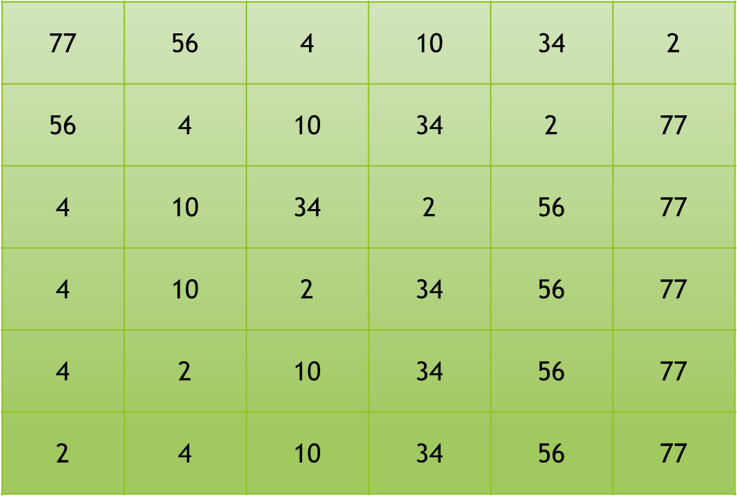
Bubble sort
Comparing successive elements
Original array
After pass 1
After pass 2
After pass 3
After pass 4
After pass 5
Total number of pass required for sorting: n-1

Slide 24
Bubble sort
It’s called bubble sort or sinking sort because smaller values gradually “bubble” their way to the top of the array (i.e., toward the first element) like air bubbles rising in water, while the larger values sink to the bottom (end) of the array.
The technique uses nested loops to make several passes through the array.
  Each pass compares successive pairs of elements.
  If a pair is in increasing order (or the values are equal), the bubble sort leaves the values as they are.
  If a pair is in decreasing order, the bubble sort swaps their values in the array.

Slide 25
Bubble sort
The first pass compares the first two elements of the array and swaps their values if necessary. It then compares the second and third elements in the array. The end of this pass compares the last two elements in the array and swaps them if necessary.
After one pass, the largest element will be in the last index. After two passes, the largest two elements will be in the last two indices.

Slide 26
BUBBLE SORT
#include <stdio.h>
int main()
{
int a[10] = { 2, 6, 4, 8, 10, 12, 89, 68, 45, 37 };
int pass, temp; // temporary location used to swap array elements
printf( "Data items in original order" );
for ( i = 0; i < 10; ++i ) {
printf( "%4d", a[ i ] );
} // end for
for ( pass = 1; pass < 10; ++pass ) // loop to control number of passes
{
// loop to control number of comparisons per pass
for ( i = 0; i < 10 - 1; ++i ) {
// compare adjacent elements and swap them if first element is greater than second element
if ( a[ i ] > a[ i + 1 ] ) {
hold = a[ i ];
a[ i ] = a[ i + 1 ];
a[ i + 1 ] = hold;
} // end if
} // end inner for
} // end outer for
printf( "\nData items in ascending order" );
for ( i = 0; i < 10; ++i ) {
printf( "%4d", a[ i ] );
} // end for
} // end main

Slide 27
OUTPUT
Data items in original order
2 6 4 8 10 12 89 68 45 37
Data items in ascending order
2 4 6 8 10 12 37 45 68 89

Slide 28
Next Class: Defining and
initializing strings

