Slide 1
CSE101-Lec#3
Constant
Variable
Expression

Slide 2
Outline
In this lecture we will study
  Constant
  Variable
  Expression

Slide 3
Tokens
We have seen that Tokens are broadly classified as:
  Identifiers
  Keywords
  Constants
  Variables
  Strings
  Operators
  Special character

Slide 4


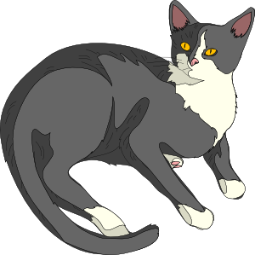



Constants
Lion
Spanner

Slide 5
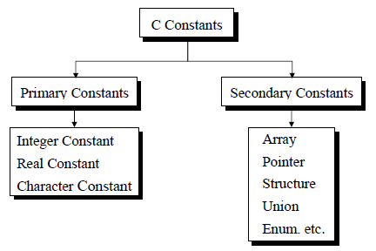

Constants
The entity which do not change throughout the execution are called constants.
Types of Primary constants:
  Integer constant
  Character constant
  Floating point constants
  String constants
Name of person remains same through out the life, example: Amit, Shubham, etc.

Slide 6

Character constants
  Constants enclosed in single quotes(‘ ’).
  It can be any letter from character set.
String Constants
  Set of zero or more characters enclosed in double quotes (eg: “ ” )
  It is represented as sequence of characters within double quotes.
  Example : ‘\n’, ‘\t’ or ‘a’
  Example : “This is C programming”

Slide 7
Integer Constants
  When the constant contains only digits without any decimal part
Floating Constant
  Constants that contains number with decimal points
  Example : 5;
  -987;
  Example : 3.14;
  309.89

Slide 8
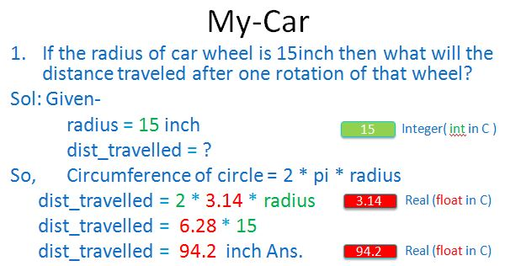
My-Car
In My-Car problem the constant value is 3.14 which is the value of pi and always same.
pi = 3.14
Therefore:
dist_travelled = 2 * pi * radius.
pi is a floating point constant.

Slide 9
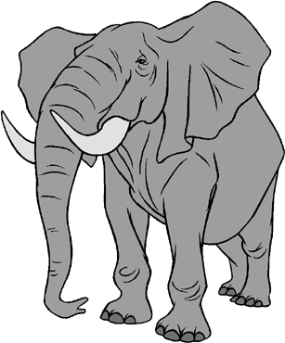



Variables
Animal
Tool

Slide 10

Variables
Variable is an entity which may change.
Variable is used to hold result and reserve memory for the data.
datatype variable_name;
The naming of variable is done by following the same rules of identifier naming.
Eg. What is your hobby?
The answer could be reading, dancing, drawing, etc.
So the answer to such questions may change during the life time of the person

Slide 11
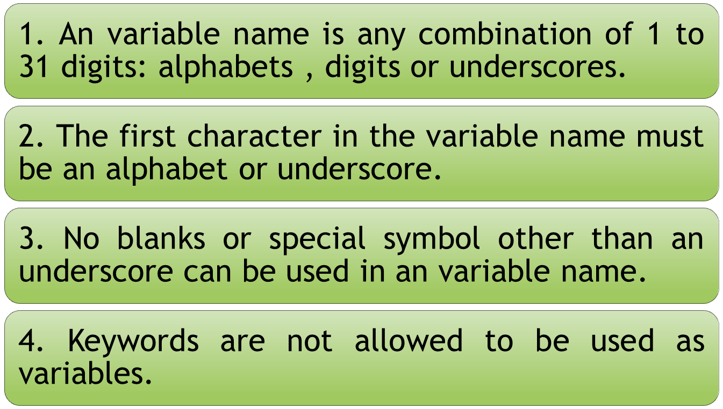
Rules for naming a Variable

Slide 12

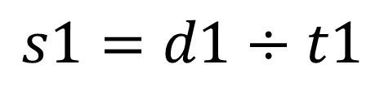
Variables
Let us build some variables:
For speed of car we need to know
Distance traveled
Time taken to travel the distance
Variables to be declared as
Speed, s1, speed_of_car
Distance, d1, dist
Time, t1, time_of_travel
Notes:
Variable is data name used for storing a data value

Slide 13
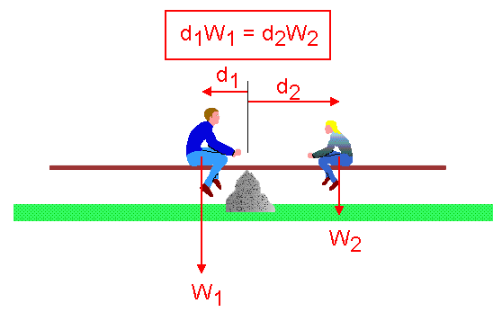
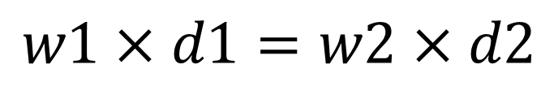
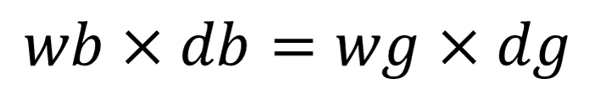
See-Saw
A bit more complex situation see-saw
Variables to be declared as
Weight_boy, w1
Distance_boy, d1
Weight_girl, w2
Distance_girl, d2
It is to be assessed that at what distance 50Kg girl should sit in order to balance a boy of 70Kg sitting 2m away from the center ‘o’
Notes:
Variable is data name used for storing a data value

Slide 14
Variable Initialization
Assigning some value to the variable at time of creation of variable is known as variable initialization.
datatype variable_name = value;
Example: int radius= 15;
float pi = 3.14;
char grade = ‘A’;
Notes:
During declaration no memory space is allocated to an identifier.
Definition of identifier means the declaration of identifier + reservation of space for it in memory

Slide 15
Expressions
Expressions are the statements or the instruction given to computer to perform some operation.
Every expression results in some value that can be stored in a variable.
Following are few example of expressions in program:
  Expression to calculate speed of a car.
    Speed=distance/time
  Expression to find similarity of two things.
    c=value1>value2
Notes:
A=b+c….three operands and 2 operators

Slide 16
Expressions in C are basically operators acting on operands.
An operand is an entity on which operation is to be performed.
An operator specifies the operation to be applied on operands.
Expressions are made of one or more operands.
Statements like :
a = b + c,
++z
300 > (8 * k)
Example: addition of two numbers, 5+8, these numbers will be operands.
Example: The addition, subtraction, etc will be operators

Slide 17
Types of Expressions
The type of expression depend upon the type of operator used in the expression.
It can be:
  Arithmetic operators.
  3 + 6 = 9
  4 * 2 = 8
  Relational or logical operators.
  height_boy>=height_girl
  Increment and decrement operator.
  count=count++

Slide 18
After this : Operators
Types of operators

