Slide 1
CSE101-Lec#1
Programming Methodologies
C Program Development Environment
Algorithm and Pseudo code

Slide 2
Outline
Program Development Environment of C
Structured programming
Algorithms

Slide 3
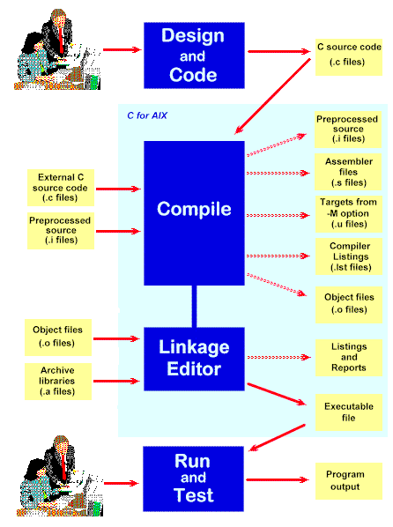
C Program Development Environment
A C program must go through various phases such as:
  Creating a program with editor
  Execution of preprocessor program
  Compilation
  Linking
  Loading
  Executing

Slide 4
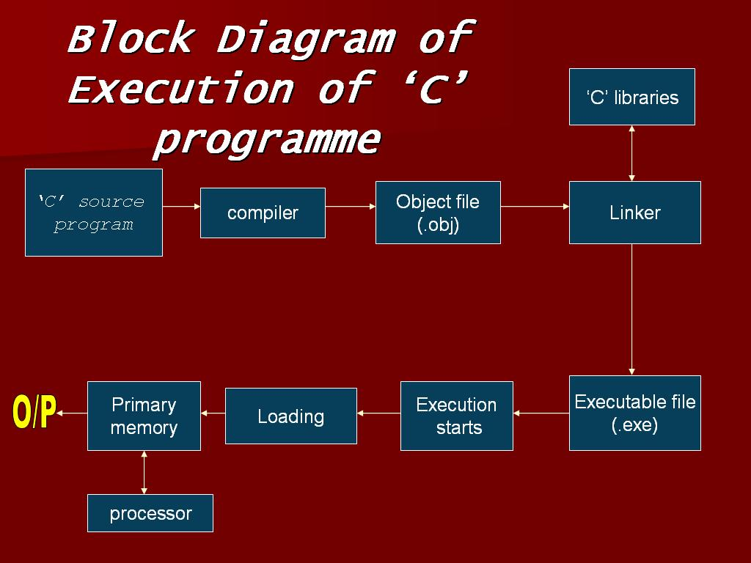

Slide 5
Editor
Program is created in
the editor and stored
on disk.
Disk
Preprocessor
Disk
Preprocessor program
processes the code.
Compiler creates
object code and stores
it on disk.
Compiler
Disk
Linker links the object
code with the libraries,
Linker
Disk
Primary Memory
Loader
Loader puts program in memory.
Disk
.
.
.
.
.
.
Primary Memory
CPU
CPU takes each
instruction and
executes it, possibly
storing new data
values as the program
executes.
.
.
.
.
.
.

Slide 6
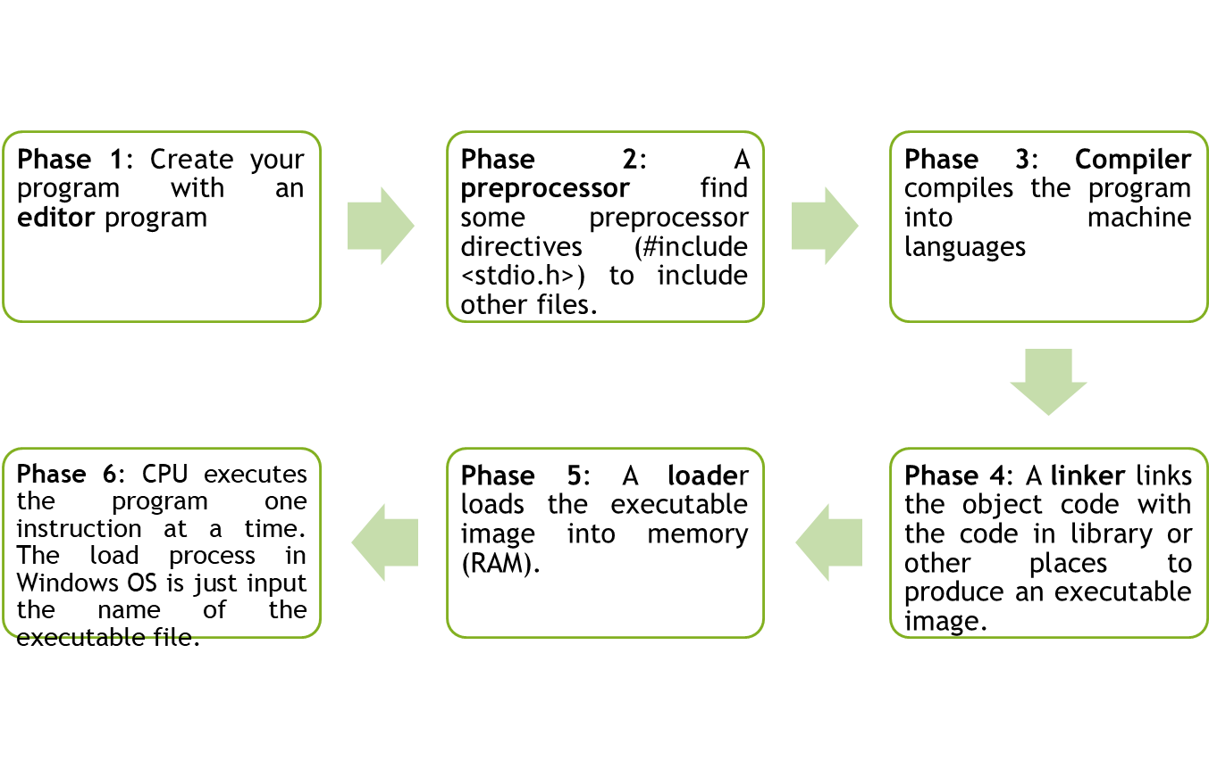
C Program Development Environment(cont.)

Slide 7
Program Development Tools
Algorithm
Flow chart
Pseudo-code

Slide 8
Algorithm
Algorithm is defined as “ the finite set of steps, which provide a chain of action for solving a problem”
It is step by step solution to given problem.
Well organized, pre-arranged and defined textual computational module

Slide 9
Characteristics of good Algorithm
Correctness - terminates on ALL inputs (even invalid inputs!) and outputs the correct answer.
Simplicity - each step of the algorithm performs one logical step in solving the problem.
Precision - each step of the algorithm is unambiguous in meaning.
Comprehensibility - the algorithm is easy to read and understand.
Abstraction - presents the solution steps precisely and concisely without referring to low-level (program code) details.
Efficient - Gives results rapidly based on the problem size; does not waste any space or time.
Easy to Implement - relatively easy to translate into a programming language.

Slide 10
Steps to create an Algorithm
1. Identify the Inputs
What data do I need?
How will I get the data?
In what format will the data be?
2. Identify the Outputs
What outputs do I need to return to the user?
What format should the outputs take?

Slide 11
Steps to create an Algorithm
3. Identify the Processes
How can I manipulate data to produce meaningful results?
Data vs. Information
4. Break the Solution to steps
By breaking the solution to the steps we can easily understand the logic of program

Slide 12

Example of Algorithm
To establish a telephone communication
Step 1: Dial a phone number
Step 2: Phone rings at the called party
Step 3: Caller waits for the response
Step 4: Called party picks up the phone
Step 5: Conversation begins between them
Step 6: After the conversation, both disconnect the call

Slide 13
Pseudocode
  Pseudocode is similar to everyday English language, its convenient and user friendly.
  Informal language that helps programmers develop algorithms. Pseudocode is a "text-based" detail (algorithmic) design tool.
It’s not a actual computer programming language.
Pseudocode consist only of action statements :
  Each of steps will be written via operators and statements equivalent to some programming language instructions.
  The only difference will be that the exact syntax of the programming language will not be followed.

Slide 14
Pseudo code: Add 2 Numbers
Set A = 4.
Set B = 2.
Calculate Sum = A + B.
Print Sum.

Slide 15
Flow Chart
Flow Chart is pictorial representation of an algorithm.
Whatever we have done in algorithm we can represent it in picture.
It is easy to understand.
Shows the flow of the instruction

Slide 16
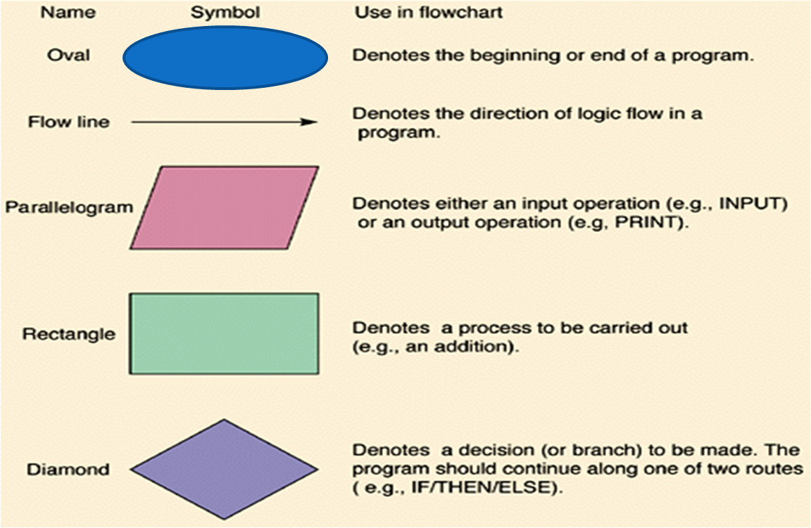
Flow Chart Symbols

Slide 17

Flow Chart: Add 2 Numbers
START
Quick yak:
students !! draw a flow chart for going to a movie…
TAKE TWO NUMBERS A and B
FIND SUM=A+B
PRINT SUM
STOP

Slide 18
Program in C: Add 2 Numbers
#include<stdio.h>
void main()
{
int a=4;
int b= 2;
int sum;
sum=a+b;
printf(“Sum is: %d”, sum);
}
Sum is: 6

Slide 19
Program in C
#include<stdio.h>
#include<conio.h>
int main()
{
int pricePerKg = 45;
float quantityInKg = 7.5;
float total_price;
total_price = pricePerKg * quantityInKg;
printf(“%f”, total_price );
getch();
return 0;
}
337.5

Slide 20
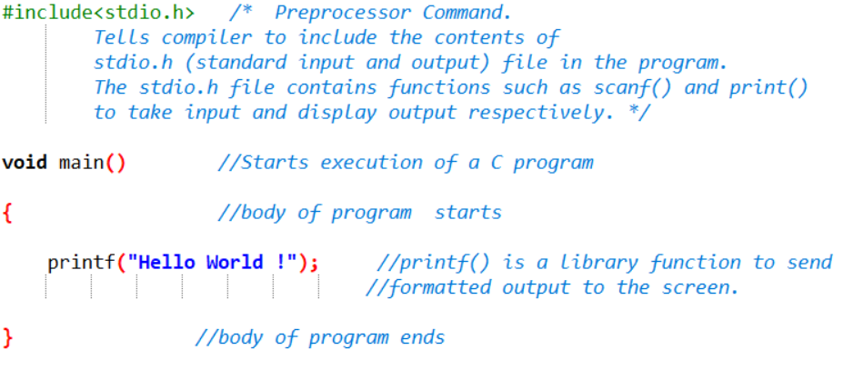
Example

Slide 21
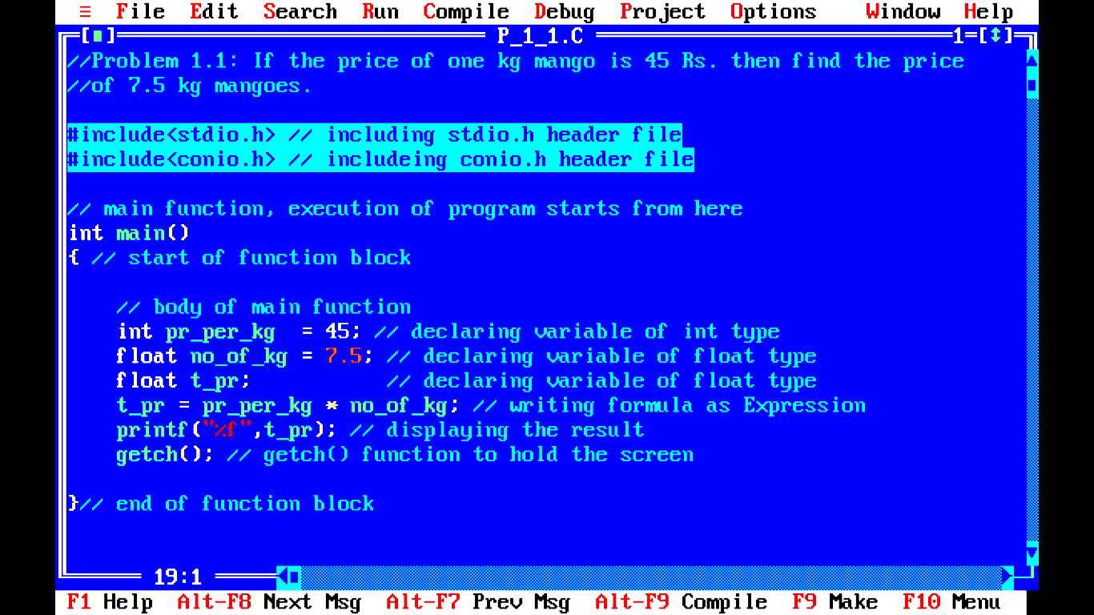
Structure of C program

Slide 22
Explanation
A simple C program consists of
  Comments (optional)
    //
    /*….*/
  Including header files
    #include<header file name>
  Functions
    main function as special function
    Other user defined functions (optional)
Let’s discuss these in detail..

Slide 23
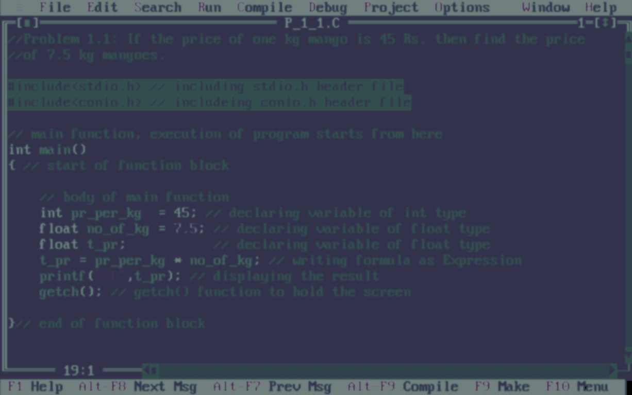
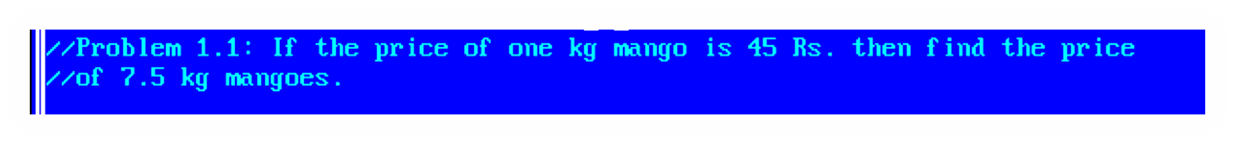
Comments
Two forward slashes ‘ // ’ (double forward slashes), are used to write single line comment
The next combination ‘ /*……..*/ ’ (forward slash with asterisk) is used for commenting multiple lines
These comments are not being executed by compiler
* comment can appear anywhere in a program where a white space can appear

Slide 24


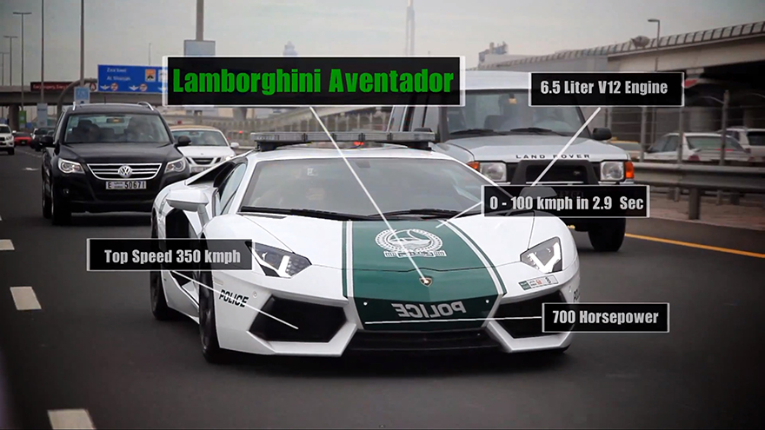
Comments
Enhances readability of program
Real life example
C code example
Fuel consumption: 16.0 L/100 km
Carbon fiber engine bonnet
//Prog. Name: addition of integers
//Another format
/*Prog. Name: addition of integers
Student Name: Mr J. Bond
UID: 007
Section: M4571 */
#include<stdio.h>
#include<conio.h>
int main()
{
}
Front tyre: 255/35 ZR19

Slide 25
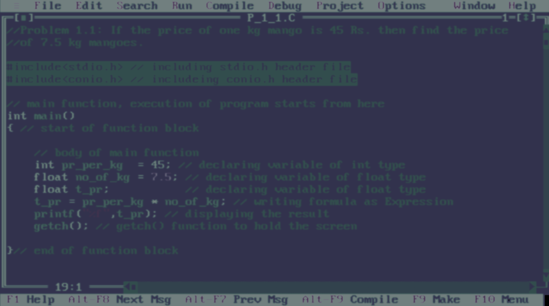

Header files
The next two lines are command for including header files
These two lines must be included in every C program
  stdio.h: standard input output header file for functions printf(),scanf(),... and so on
  conio.h: console input output header file for functions getch()…. and so on
Here ‘ # ‘ is called preprocessor directive

Slide 26



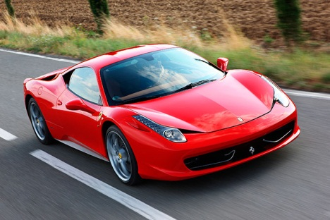
Header files
Real life example
C code example
//Sample program
#include<stdio.h> //header file for printf()
#include<conio.h> //header file for getch()
int main()
{
//stdio.h is providing printf() function
printf(“Car is under process”);
//conio.h is providing getch() function
getch();
}
Ferrari car as output
Output:
Car is under process

Slide 27
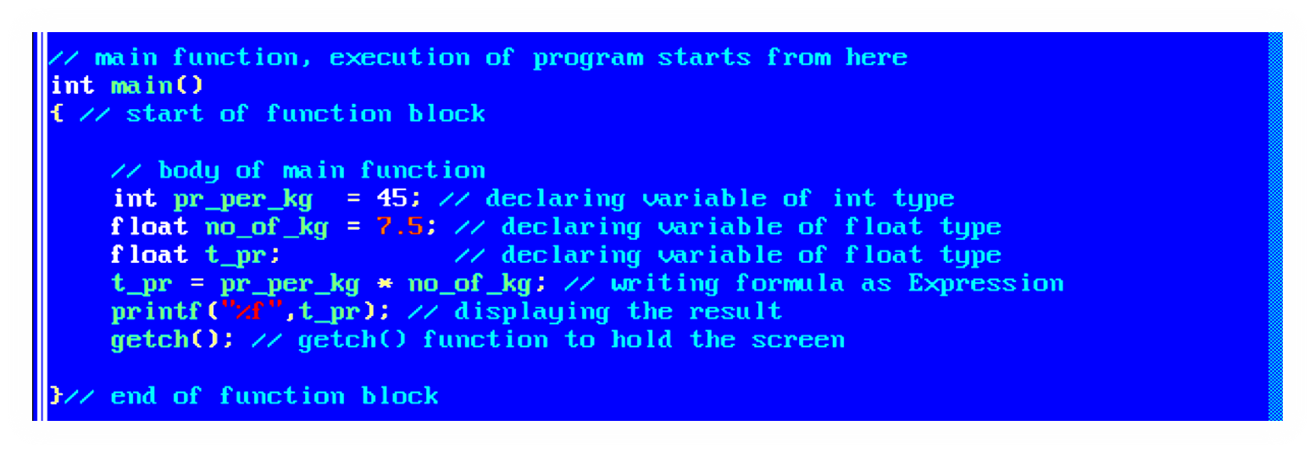
Function
main() as special function, execution starts from here
A program must have a single main() function
A program without main() function wont work
main() function will call other functions

Slide 28
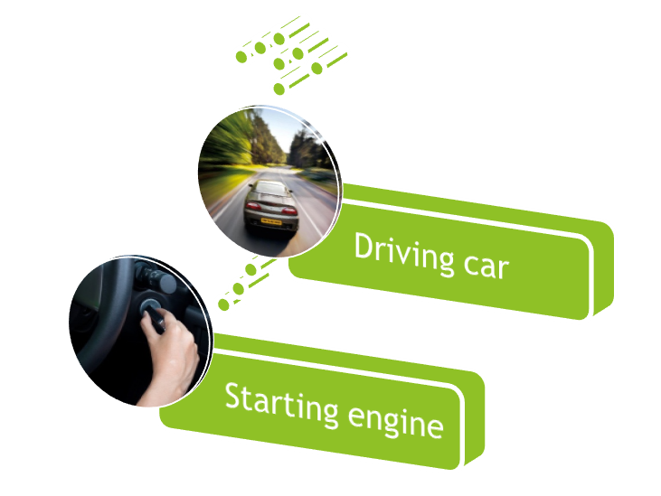
main function in real life
Real life example
C code example
Before driving the car, we must start the car, a car won’t be driven without starting
Similarly our program must have a main function to start a program
//Prog. Name: display name
#include<stdio.h>
#include<conio.h>
int main()
{
printf(“My name is Aman”);
getch();
}
Output:
My name is Aman

Slide 29
Next Class: Components of C
Identifier and Keywords
Data Type

