Slide 1
CSE101-Lec#6
CONTROL STRUCTURES (REPETITION STRUCTURE)
JUMP STATEMENTS

Slide 2
Outline
Repetition structure/Control Loop Statements
  for statement
  while statement
  do-while statement
Jump Statements
  break
  continue
  goto
  return

Slide 3
Difference between if-else and switch
Basis for Comparison | if-else | switch
Basic | Which statement will be executed depend upon the output of the expression inside if statement. | Which statement will be executed is decided by user.
Expression | if-else statement uses multiple statement for multiple choices. | switch statement uses single expression for multiple choices.
Testing | if-else statement test for equality as well as for logical expression. | switch statement test only for equality.
Evaluation | if statement evaluates integer, character, pointer or floating-point type or boolean type. | switch statement evaluates only character or integer value.
Sequence of Execution | Either if statement will be executed or else statement is executed. | switch statement execute one case after another till a break statement is appeared or the end of switch statement is reached.
Default Execution | If the condition inside if statements is false, then by default the else statement is executed if created. | If the condition inside switch statements does not match with any of cases, for that instance the default statements is executed if created.
Editing | It is difficult to edit the if-else statement, if the nested if-else statement is used. | It is easy to edit switch cases as, they are recognized easily.
Conclusion:
The switch statement is easy to edit as it has created the separate cases for different statements whereas, in nested if-else statements it become difficult to identify the statements to be edited.

Slide 4

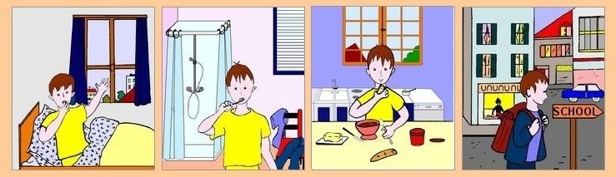

Repetition(Going to School)
Day = Monday to Saturday

Slide 5

Repetition Statement
A repetition statement allows you to specify that an action is to be repeated while some condition remains true.
Quick yak:
Share that if one might have known this earlier: How easy it might have been to undergo the punishment of writing 100 times
“I will not talk in class” in school.

Slide 6
Looping (repetition)
What if we want to display hello 500 times?
  Should we write 500 printf statements or equivalent ?
Obviously not.
It means that we need some programming facility to repeat certain works.
Such facility is available in form of looping statements.

Slide 7
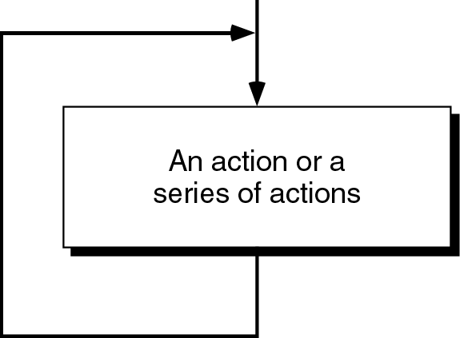
Loop
The main idea of a loop is to repeat an action or a series of actions.
The concept of a loop without condition

Slide 8
But, when to stop looping?
In the following flowchart, the action is executed over and over again. It never stops – This is called an infinite loop
Solution – put a condition to tell the loop either continue looping or stop.

Slide 9
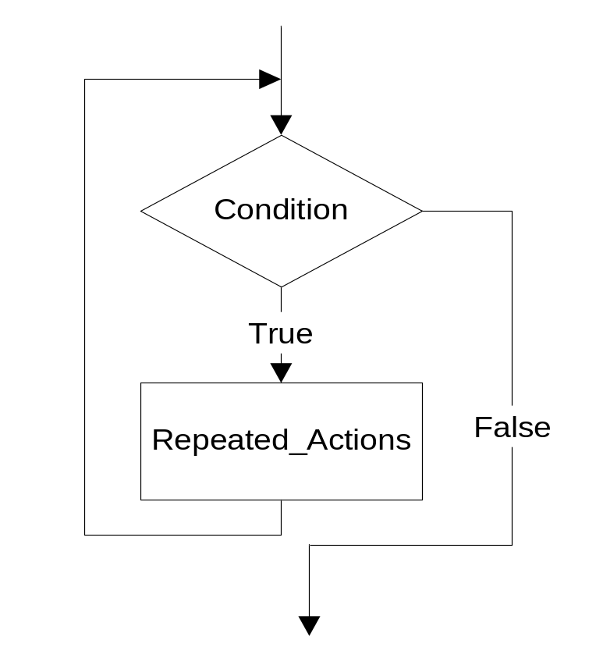
Loop
A loop has two parts – body and condition
Body – a statement or a block of statements that will be repeated.
Condition – is used to control the iteration – either to continue or stop iterating.

Slide 10
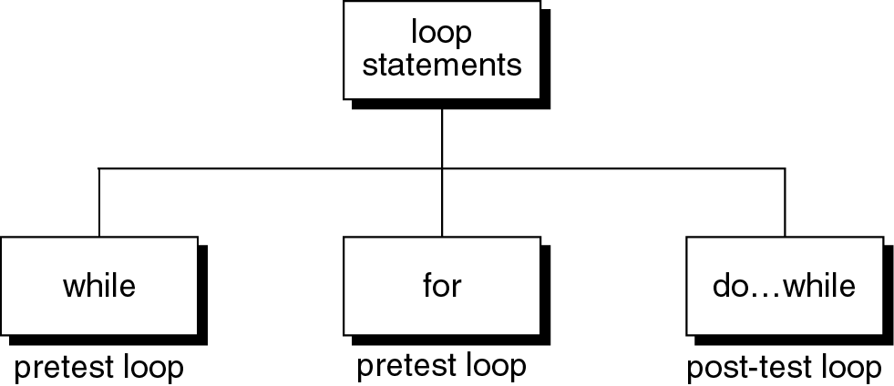
Loop statements
C provides three loop statements:

Slide 11
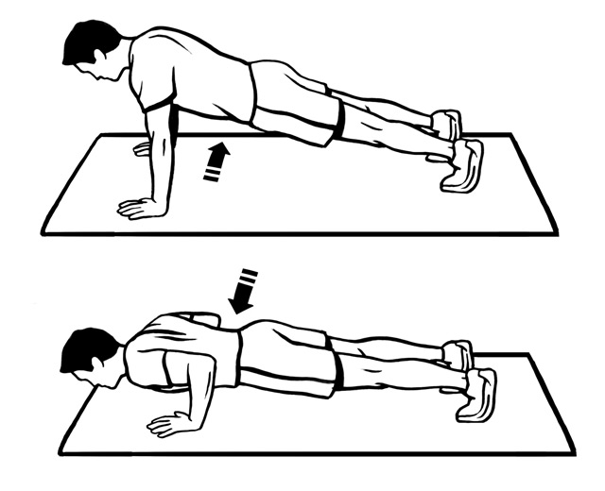
The “while” Statement in C
The syntax of while statement in C:
while (loop repetition condition)
{
statement;
updating control;
}
Syntax
While fatigue level is not reached

Slide 12
while statement
while(loop repetition condition)
{
Statements;
}
Loop repetition condition is the condition which controls the loop.
The statement is repeated as long as the loop repetition condition is true.
A loop is called an infinite loop if the loop repetition condition is always true.

Slide 13
Example: This while statement prints numbers 10 down to 1
Do TEN push ups imposes a count condition

Slide 14
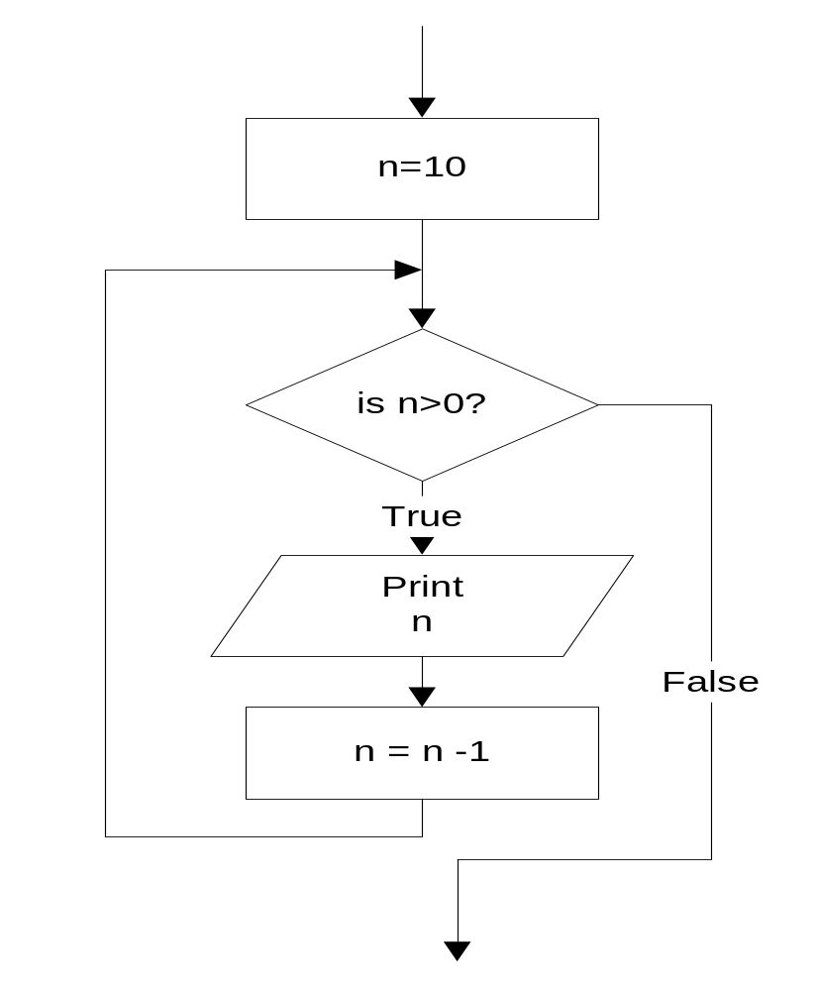
while statement
#include<stdio.h>
int main()
{
int n=10;
while (n>0){
printf(“%d ”, n);
n=n-1;
}
}
10 9 8 7 6 5 4 3 2 1

Slide 15
The for Statement in C
The syntax of for statement in C:
The initialization-expression set the initial value of the loop control variable.
The loop-repetition-condition test the value of the loop control variable.
The update-expression update the loop control variable.
for (initialization-expression;
loop-repetition-condition;
update-expression){
statement;
}
Syntax

Slide 16
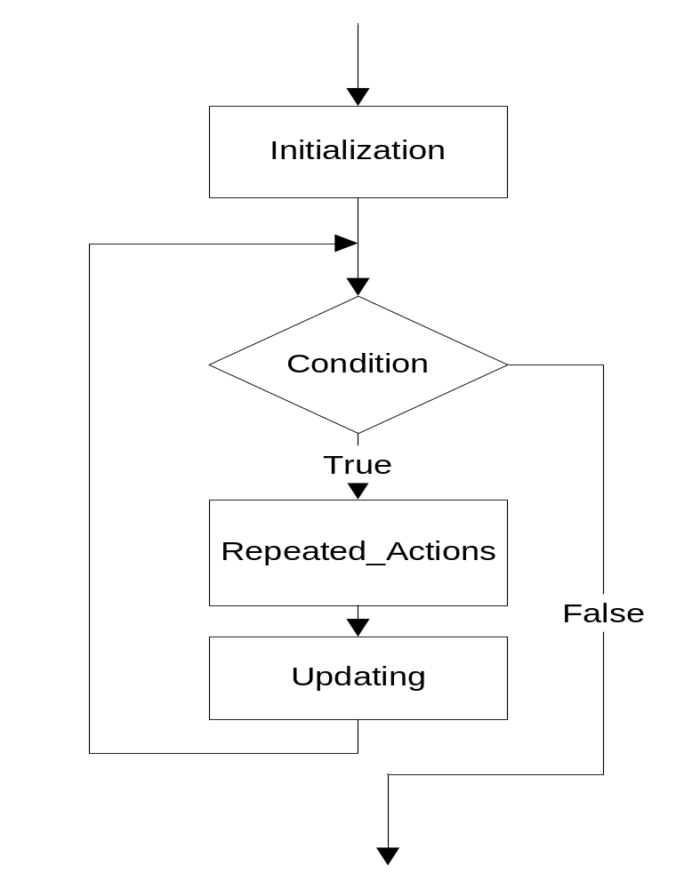
for statement
for (Initialization; Condition; Updating)
{
Repeated_Actions;
}

Slide 17
for statement
Example: This for statement prints numbers 10 down to 1
#include<stdio.h>
int main()
{
int n;
for (n=10; n>0; n=n-1){
printf(“%d ”, n);
}
}
10 9 8 7 6 5 4 3 2 1
Do TEN push ups = for count=1; count<=10; count++

Slide 18
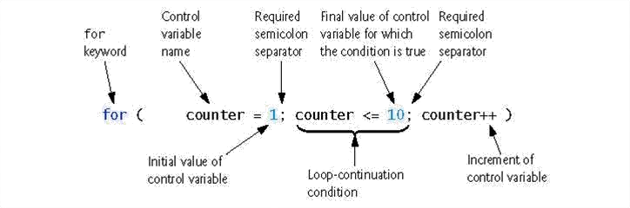

Slide 19
Nested Loops
Nested loops consist of an outer loop with one or more inner loops.
  Eg:
for (i=1;i<=100;i++){
for(j=1;j<=50;j++){
…
}
}
The above loop will run for 100*50 iterations.
Outer loop
Inner loop

Slide 20
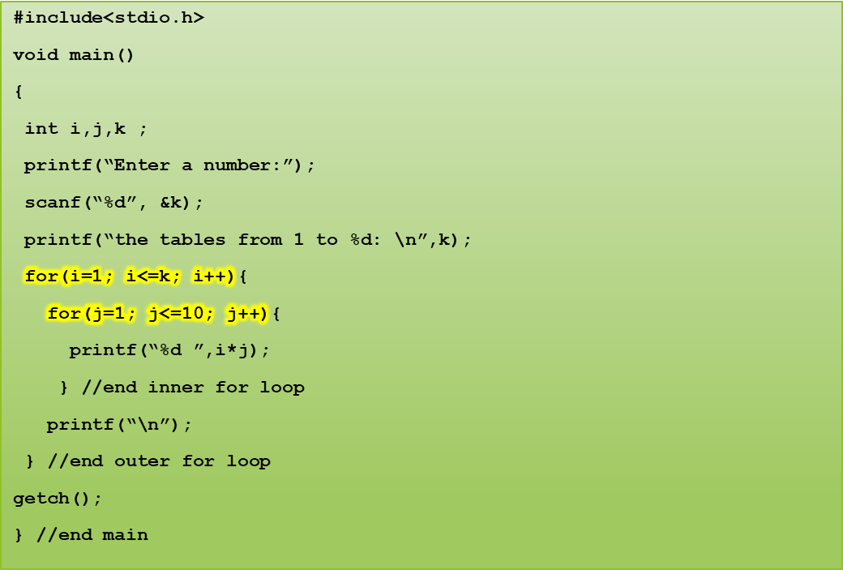
Program to print tables up to a given number.
Enter a number
4
The tables from 1 to 4
1 2 3 4 5 6 7 8 9 10
2 4 6 8 10 12 14 16 18 20
3 6 9 12 15 18 21 24 27 30
4 8 12 16 20 24 28 32 36 40
Notes:
K =100
Number: 1 cube: 1
Number:2 cube: 8
Number: 3 cube: 27
Number: 4 cube: 64

Slide 21
Program to display a pattern.
#include<stdio.h>
#include<conio.h>
void main()
{
int i,j;
printf(“Displaying right angled triangle for 5 rows”);
for(i=1 ; i<=5 ; i++)
{
for(j=1 ; j<=i ; j++)
{ printf(“* ”);}
printf(“\n”);
}
}
Quick yak:
Tell them to display various patterns, ex: reverse right angle triangle, isometric triangle etc.
Displaying right angled triangle for 5 rows
*
* *
* * *
* * * *
* * * * *

Slide 22
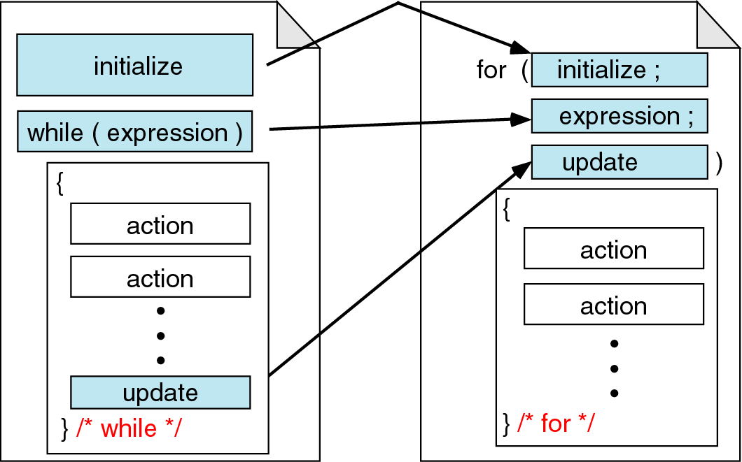
While vs. for statements
Quick yak:
Daily life ex:
While: (date<=last day of class)
{Attend class;
}
For: (rad=1;rad<=10; rad++)
Circle(x,y,rad)
Will make 10 concentric circles
Comparing for and while loops

Slide 23
The do-while Statement in C
The syntax of do-while statement in C:
The statement executed at least one time.
For second time, If the condition is true, then the statement is repeated else the loop is exited.
do
{
statement;
} while (condition);
Syntax
5-<number>

Slide 24
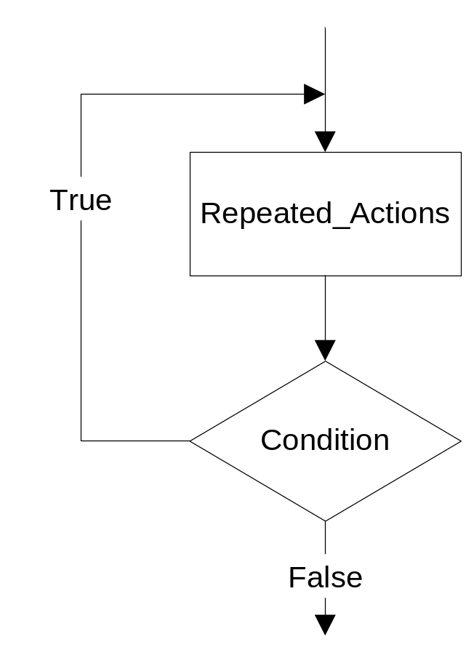
do…while statement
do
{
Repeated_Actions;
} while (Condition);

Slide 25
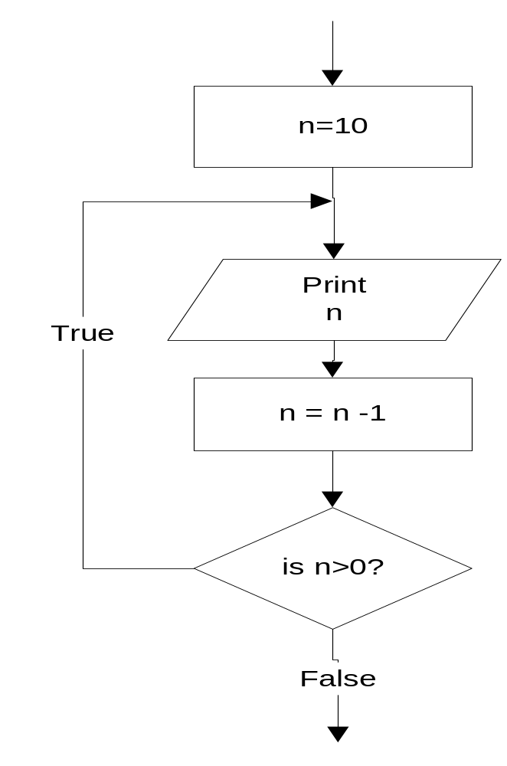
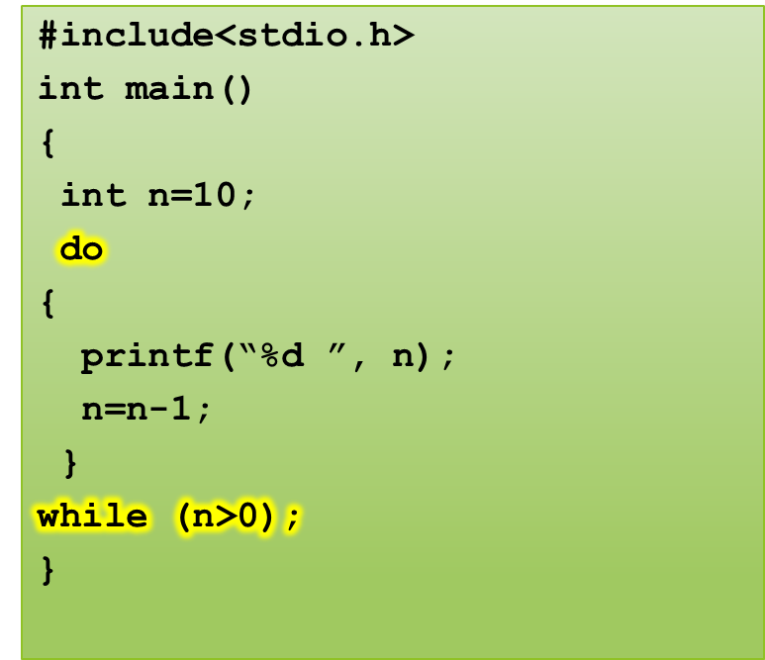
do…while statement
Example: this do…while statement prints numbers 10 down to 1
10 9 8 7 6 5 4 3 2 1

Slide 26
Difference between while and do..while
while loop | do..while loop
1. Condition is specified at the top | 1. Condition is mentioned at the bottom
2. Body statements are executed when the condition is satisfied | 2. Body statements are executed at least once even if the expression value evaluates to false
3. It is an entry controlled loop | 3. It is an exit controlled loop
4.Syntax: while (condition) statement; | 4.Syntax: do { statements; } while (condition);

Slide 27
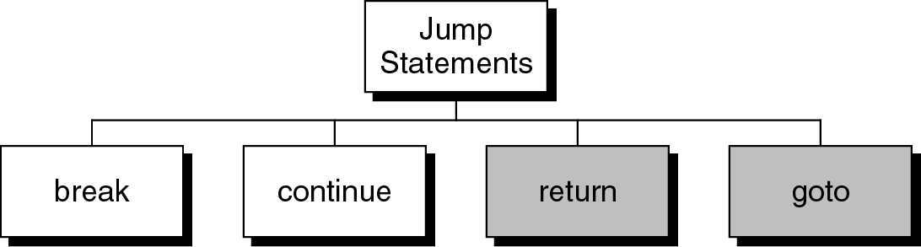
Jump statements
You have learn that, the repetition of a loop is controlled by the loop condition.
C provides another way to control the loop, by using jump statements.
There are four jump statements:

Slide 28
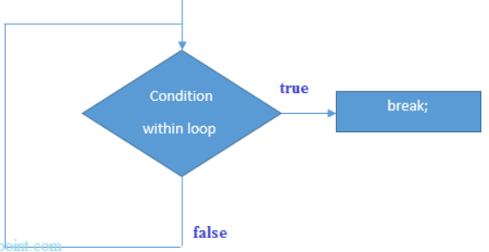
break statement
break is a keyword.
break allows the programmer to terminate the loop.

Slide 29
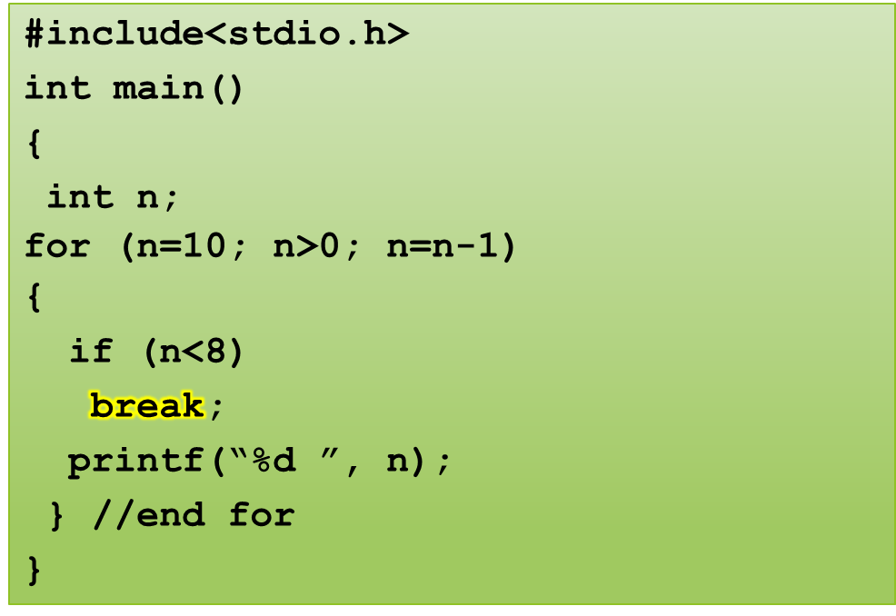
break statement
Program to show use of break statement.
10 9 8

Slide 30
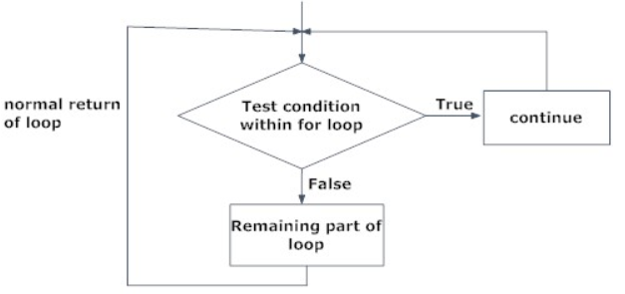
continue statement
continue statement is exactly opposite to break.
continue statement is used for continuing the next iteration of the loop statements
When it occurs in the loop, it does not terminate, but skips the statements after this statement

Slide 31
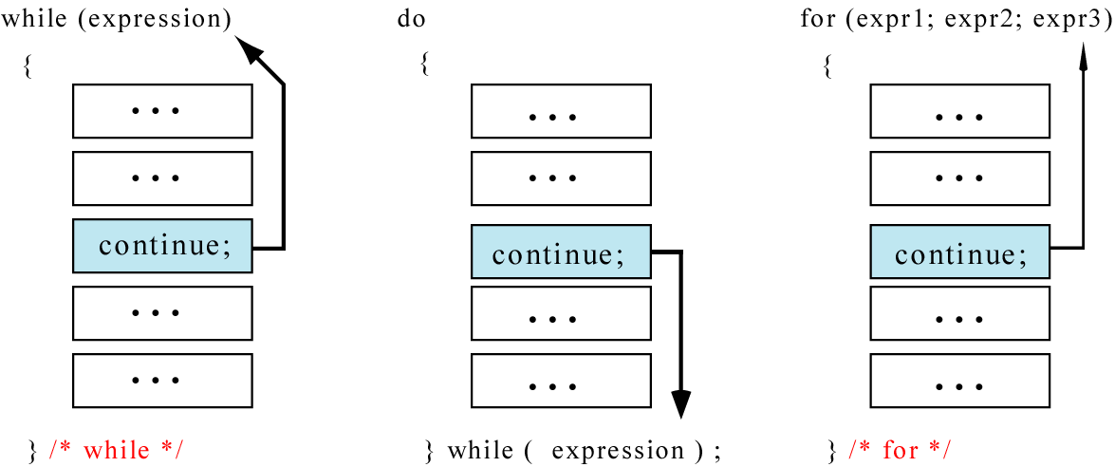
continue statement
In while and do…while loops, the continue statement transfers the control to the loop condition.
In for loop, the continue statement transfers the control to the updating part.

Slide 32
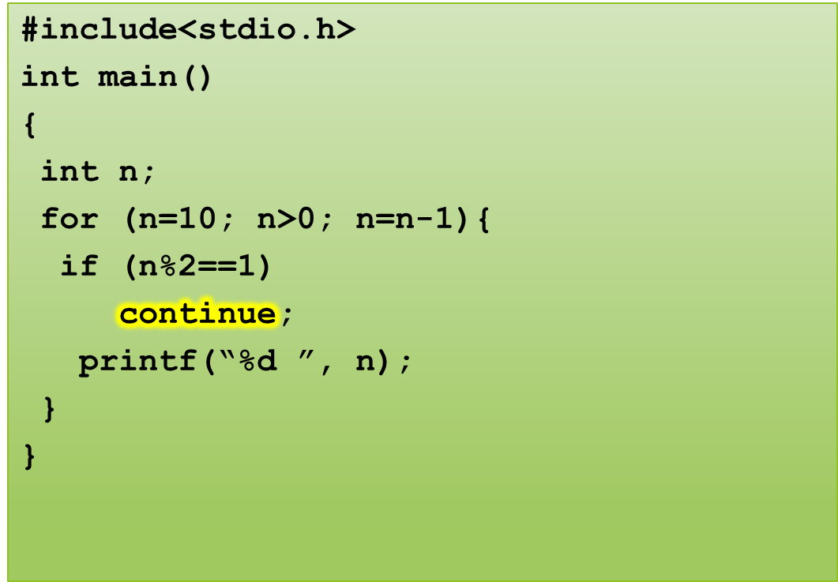
continue statement
Program to show the use of continue statement in for loop
10 8 6 4 2

Slide 33
continue statement
#include<stdio.h>
int main()
{
int n = 10;
while(n>0){
printf(“%d”, n);
if (n%2==1)
continue;
n = n –1;
}
}
Program to show the use of continue statement in for loop
For n=9, loop goes to infinite
execution
The loop then prints number 9 over and over again. It never stops.
10 9 9 9 9 9 …………

Slide 34
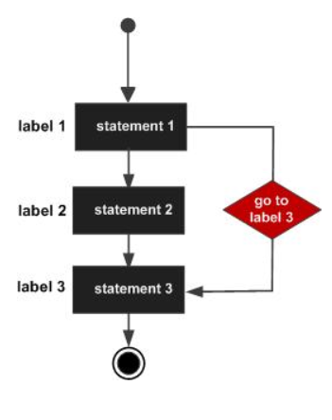
Goto statement
Unconditionally transfer control.
goto may be used for transferring control from one place to another.
The syntax is:
goto identifier;

Slide 35
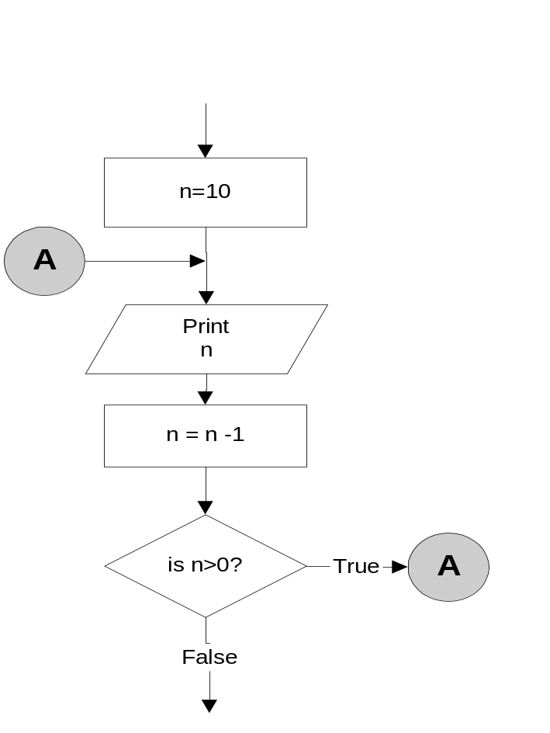
goto statement
n=10;
A:
printf(“%d “, n);
n = n -1;
if (n>0)
goto A;
Output:
10 9 8 7 6 5 4 3 2 1

Slide 36
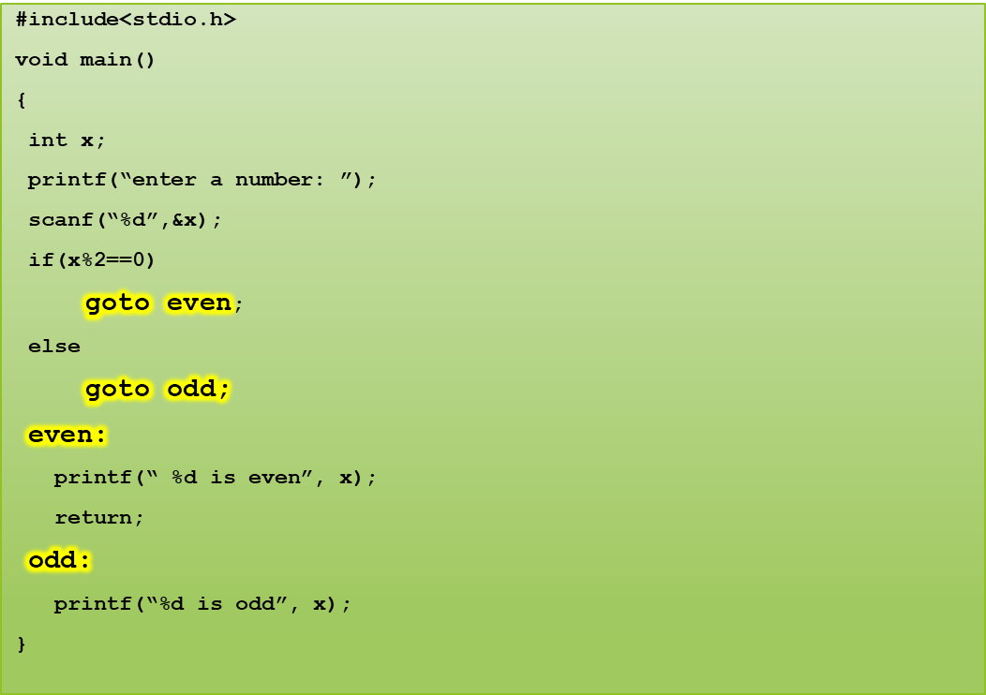
Program to show goto statement.
enter a number: 18
18 is even

Slide 37
return statement
Exits the function.
The return value could be any valid expression that returns a value:
i. a constant
ii. a variable
iii. a calculation, for instance (a + b) * c
iv. call to another function that returns a value
The syntax is:
return [expression];
For example,
int sqr (int x){
return (x*x);
}

Slide 38
Next Class: Formatted and Unformatted Input / Output functions

