Slide 1
CSE101-Lec#13
Storage Classes and Scope Rules

Slide 2
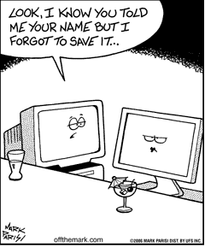
Outline
Storage Classes
  auto
  static
  extern
  register
Scope Rules

Slide 3
Storage Classes
Storage class specifies
  Storage duration: how long the variable retains a particular value
  Scope: or visibility of the variable i.e the portion of the program within which the variables are recognized.

Slide 4
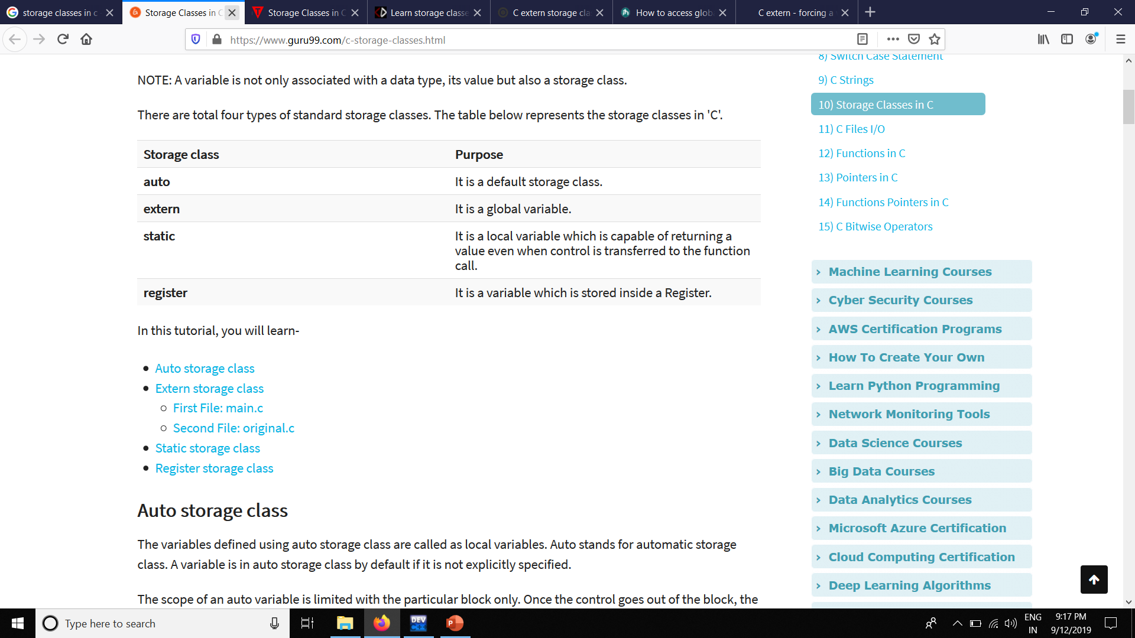

Slide 5
Automatic
Automatic variables: auto
Scope: Variable are local to the function block inside which they are defined.
Default Initial Value: Any random value i.e. garbage value.
Lifetime: Till the end of the function/method block where the variable is defined.
A variable declared inside a function without any storage class specification, is by default an automatic variable. They are created when a function is called and are destroyed automatically when the function's execution is completed. Automatic variables can also be called local variables because they are local to a function. By default they are assigned garbage value by the compiler.
Example:
#include<stdio.h>
int main()
{
int detail;
or
auto int details; //Both are same
}

Slide 6
Register
Register variable: register
Scope: Local to the function in which it is declared.
Default initial value: Any random value i.e garbage value
Lifetime: Till the end of function/method block, in which the variable is defined.
Register variables inform the compiler to store the variable in CPU register instead of memory. Register variables have faster accessibility than a normal variable. Generally, the frequently used variables are kept in registers. But only a few variables can be placed inside registers. One application of register storage class can be in using loops, where the variable gets used a number of times in the program, in a very short span of time.
NOTE: We can never get the address of such variables.
Example:
register int number;

Slide 7
Static
Static variables: static
Scope: Local to the block in which the variable is defined
Default initial value: 0(Zero).
Lifetime: Till the whole program doesn't finish its execution.
A static variable tells the compiler to persist/save the variable until the end of program. Instead of creating and destroying a variable every time when it comes into and goes out of scope, static variable is initialized only once and remains into existence till the end of the program. A static variable can either be internal or external depending upon the place of declaration. Scope of internal static variable remains inside the function in which it is defined. External static variables remain restricted to scope of file in which they are declared.
Example:
#include <stdio.h>
int display();
int main()
{
display();
display();
}
int display()
{
static int c = 0;
printf("%d\n ",c);
c += 5;
}
Output:
0
5

Slide 8
External/Global
Scope: Global i.e. everywhere in the program.
Default initial value: 0(zero).
Lifetime: Till the program doesn't finish its execution, you can access global variables.
A variable that is declared outside any function is a Global Variable. Global variables remain available throughout the program execution. By default, initial value of the Global variable is 0(zero). One important thing to remember about global variable is that their values can be changed by any function in the program.
Example:
#include <stdio.h>
int g; //gloval variable(EXTERNAL)
int print()
{
g = 10;
printf("g = %d\n", g);
}
int main()
{
g = 7;
printf("g = %d\n", g);
print();
return 0; }
Output:
g= 7
g= 10

Slide 9
Scope Rules
The scope of a variable is the portion of a program where the variable has meaning (where it exists).
A global variable has global (unlimited) scope.
A local variable’s scope is restricted to the function that declares the variable.
A block variable’s scope is restricted to the block in which the variable is declared.

Slide 10
Local variables
Parameters and variables declared inside the definition of a function are local.
They only exist inside the function body.
Once the function returns, the variables no longer exist!
  That’s fine! We don’t need them anymore!

Slide 11
Block Variables
You can also declare variables that exist only within the body of a compound statement (a block):
{
int f;
…
…
}

Slide 12
Global variables
You can declare variables outside of any function definition – these variables are global variables.
Any function can access/change global variables.

Slide 13
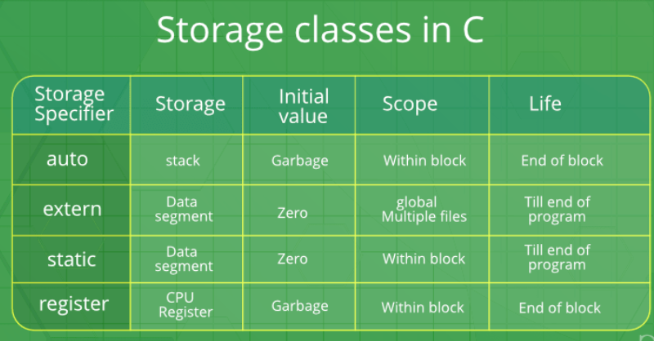

Slide 14
#include <stdio.h>
extern int x = 9; // declaring and initializing an extern variable
int z = 10; // declaring and initialing a global variable z
int main()
{
auto int a = 32; // declaring an auto variable
register char b = 'G'; // declaring a register variable
extern int z; // telling the compiler that the variable z is an extern variable
printf("\n the auto integer 'a': %d\n",a); // printing the extern variables 'x' and 'z'
printf("\n extern integers 'x' and 'z' %d and %d\n", x, z); // printing the register variable 'b'
printf("\n register character 'b': %c\n",b); // value of extern variables x and z modified
x = 2; z = 5; printf("\n extern integers 'x' and'z' : %d and %d\n",x,z);
while (x > 0)
{
static int y; //value is NOT initialized to 5 y++;
printf("The value of y is %d\n",y);
x--;
}
return 0;
}

Slide 15
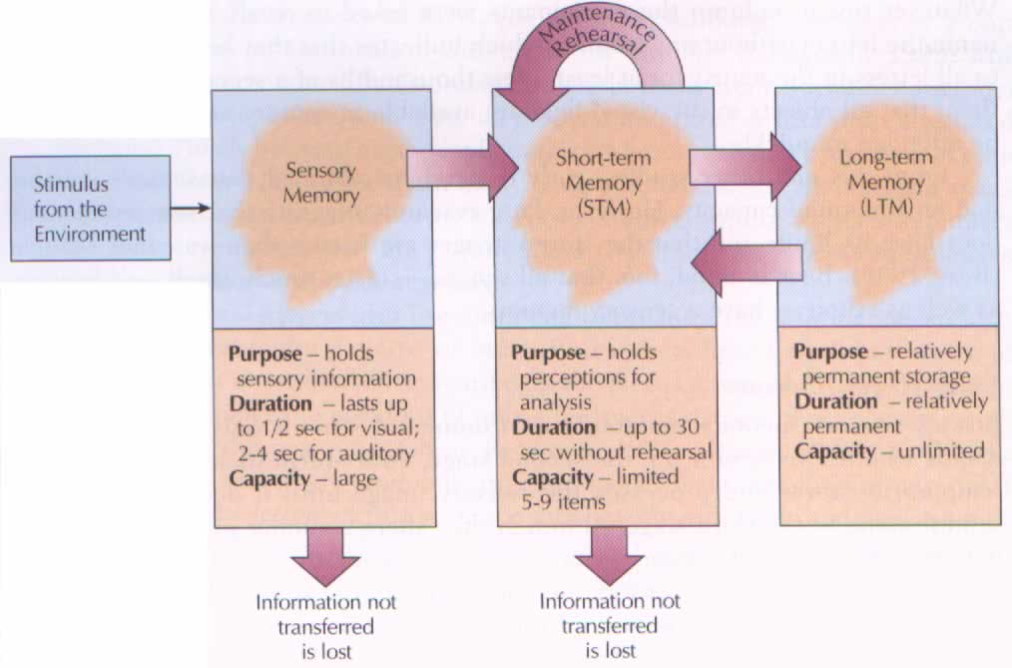
Example

Slide 16
Next Lecture
Working with hundreds of variables collectively ….?? (Arrays and Strings)

