Slide 1
CSE101-Lec#20
ARRAY AND POINTERS

Slide 2
Outline
Pointer to Array
  Pointer to group of 1D arrays
Array of pointers.

Slide 3
Pointer to Array
Array name itself is an address or pointer. It points to the first element(0th element) of array.
The arrays are accessed by pointers in same way as we access arrays using array name.
Consider an array b[5] and a pointer bPtr:
  bPtr[3] is same as b[3]

Slide 4
Program to find the mean of array using array name as a pointer.
//Calculate mean using array name as pointer
#include<stdio.h>
int main()
{
int a[] = {3, 7, -1, 4, 6};
int i, sum = 0; //compute mean of values in array a
for(i=0; i<5; i++)
{
sum += *(a + i);
}
float mean = sum/(float)5;
printf("Mean = %.2f\n", mean);
return 0;
}

Slide 5
Program to find the mean of array using pointer to array.
#include<stdio.h>
int main()
{
int a[] = {3, 7, -1, 4, 6};
int i, sum = 0;
int *ptr = a;
for(i=0; i<5; i++)
{
sum += *(ptr + i);
}
float mean = sum/(float)5;
printf("Mean = %.2f\n", mean);
return 0;
}

Slide 6
Practice Session
Practice various programs of arrays and same program by using pointer to array.
  Example program:
    Find sum of squares and sum of cubes of array elements using pointers.
    To copy elements of one array to another using pointer to array.
    To find the maximum value out of the array elements.
    All the operations possible on arrays.
Notes:
Here various programs should be practiced in class in detail.

Slide 7
Pointer to group of 1D Arrays
1-D array can be represented in terms of a pointer (array name) and an subscript.
2-D array can also be represented with an equivalent pointer notation.
A 2-D array is actually a collection of 1-D arrays.
Therefore , we can define a 2-D array as a pointer to a group of contiguous 1-D arrays.
2 D array declaration can be written as
data-type (*ptrvar) [expression 2];
rather than
data type array[expression 1] [expression 2];

Slide 8
Eg: myArray[10][20] is 2 D array having 10 rows and 20 columns. The item in row 2 and column 5 can be accessed by writing:
myArray[2][5];
or
*(*(myArray+2)+5)

Slide 9
myArray is a 2 D array having rows and 20 columns. We can declare x as:
int (*myArray)[20];
Rather than
int myArray[10][20];
In this first declaration, myArray is defined to be a pointer to a group of contiguous 1 –D 20 element integer arrays.
Thus myArray points to the first 20 element array which is actually the first row i.e row 0 of original 2 D array.
Similarly, (myArray+1) points to the second 20 element array and so on.

Slide 10
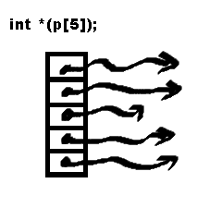
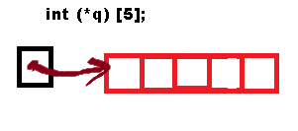
#include<stdio.h>
#include<stdlib.h>
void main()
{
int *p[5]; //2-D
int (*q)[5]; //1-D
printf("%d %d \n",sizeof(int), sizeof(int *));
printf("%d %d \n",sizeof(p), sizeof(p[0]));
printf("%d %d \n",sizeof(q), sizeof(*q));
}
4*5=20
4*5=20

Slide 11
Array of pointers
#include <stdio.h>
main () {
int var[] = {10, 100, 200};
int i, *ptr[3]; //Array of 3 pointers
for ( i = 0; i < 3; i++) {
ptr[i] = &var[i]; /* assign the address of integer. */
}
for ( i = 0; i < 3; i++) {
printf("Value of var[%d] = %d\n", i, *ptr[i] );
}
}

Slide 12
Arrays of Pointers
We can have arrays of pointers since pointers are variables.
An array of pointers is a collection of addresses.
A common use of an array of pointers is to form an array of strings, referred to simply as a string array.
Each entry in the array is a string, but in C a string is essentially a pointer to its first character.
So each entry in an array of strings is actually a pointer to the first character of a string.

Slide 13
Arrays of Pointers
The suit[4] portion of the definition indicates an array of 4 elements.
Example:
const char *suit[ 4 ] = {"Hearts","Diamonds", "Clubs", "Spades" };
The char * portion of the declaration indicates that each element of array suit is of type “pointer to char.”

Slide 14

Arrays of Pointers
  char * indicates that each element of suit is a “pointer to a char”
  The strings are not actually stored in the array suit, only pointers to the strings are stored
suit[0]
’H’
’e’
’a’
’r’
’t’
’s’
’\0’
Quick yak:
Students can be asked to create an array of pointers to store their Address
suit[1]
’D’
’i’
’a’
’m’
’o’
’n’
’d’
’s’
’\0’
suit[2]
’C’
’l’
’u’
’b’
’s’
’\0’
suit[3]
’S’
’p’
’a’
’d’
’e’
’s’
’\0’
  suit array has a fixed size, but strings can be of any size

Slide 15
Arrays of Pointers
The four strings are 7, 9, 6 and 7 characters long, respectively.
Although it appears as though these strings are being placed in the suit array, only pointers are actually stored in the array
Each pointer points to the first character of its corresponding string.
Thus, even though the suit array is fixed in size, it provides access to character strings of any length.

Slide 16
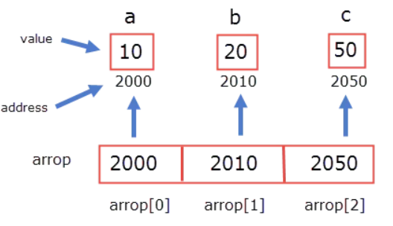
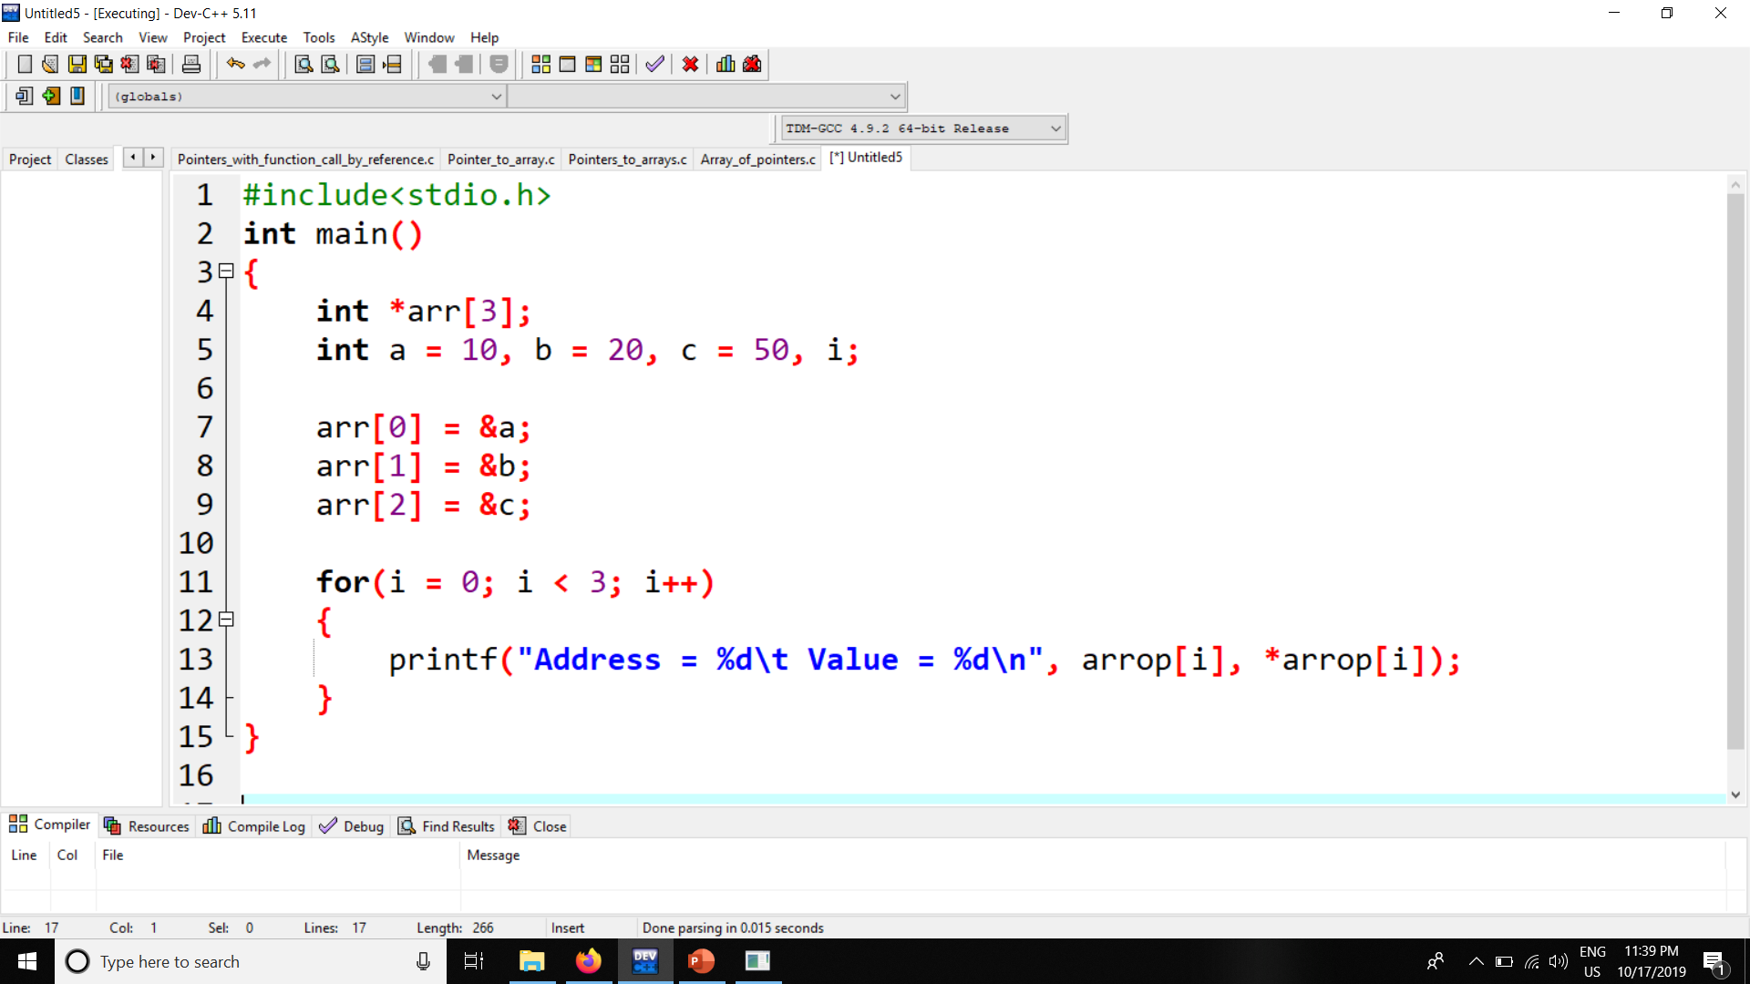

Slide 17
Program to show array of pointers.
#include<stdio.h>
void main()
{
int i;
char *suit[4]={"spades","hearts","clubs“,“diamonds”};
printf(“The suit of cards have:”);
for(i=0; i<4; i++){
printf("%s\n",suit[i]);
}
}
The suit of cards have:
spades
hearts
clubs
diamonds
Notes:
Output: 10 20 30
10 20 30

Slide 18
However pointers and arrays are different:
A pointer is a variable. We can do
pa = a and pa++.
An Array is not a variable.
a = pa and a++ ARE ILLEGAL

Slide 19
QUIZ

Slide 20
Q:1. Consider a compiler where int takes 4 bytes, char takes 1 byte and pointer takes 4 bytes.
#include <stdio.h> int main()
{ int arri[] = {1, 2 ,3}; int *ptri = arri; char arrc[] = {1, 2 ,3}; char *ptrc = arrc; printf("sizeof arri[] = %d ", sizeof(arri)); printf("sizeof ptri = %d ", sizeof(ptri)); printf("sizeof arrc[] = %d ", sizeof(arrc)); printf("sizeof ptrc = %d ", sizeof(ptrc)); return 0;
}
A. sizeof arri[] = 3 sizeof ptri = 4 sizeof arrc[] = 3 sizeof ptrc = 4
B. sizeof arri[] = 12 sizeof ptri = 4 sizeof arrc[] = 3 sizeof ptrc = 1
C. sizeof arri[] = 3 sizeof ptri = 4 sizeof arrc[] = 3 sizeof ptrc = 1
D. sizeof arri[] = 12 sizeof ptri = 4 sizeof arrc[] = 3 sizeof ptrc = 4
Solution: (d) Size of an array is number of elements multiplied by the type of element, that is why we get sizeof arri as 12 and sizeof arrc as 3. Size of a pointer is fixed for a compiler. All pointer types take same number of bytes for a compiler. That is why we get 4 for both ptri and ptrc.

Slide 21
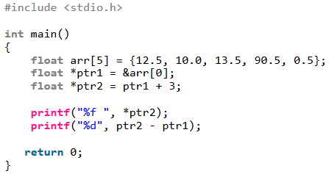

Q:2. Assume that float takes 4 bytes, predict the output of following program:
A
B
C
D
Solution: (a) When we add a value x to a pointer p, the value of the resultant expression is p + x*sizeof(*p) where sizeof(*p) means size of data type pointed by p. That is why ptr2 is incremented to point to arr[3] in the above code. Same rule applies for subtraction. Note that only integral values can be added or subtracted from a pointer. We can also subtract or compare two pointers of same type.

Slide 22
Q:3. The reason for using pointers in a C program is:
A. Pointers allow different functions to share and modify their local variables.
B. To pass large structures so that complete copy of the structure can be avoided.
C. Pointers enable complex “linked" data structures like linked lists and binary trees.
D. All of the above
Solution: (d)

Slide 23
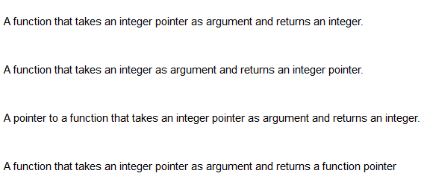
Q:4. What does the following C-statement declare? int ( * f) (int * ) ;
A.
B.
C.
D.
Solution: (c)

Slide 24
Q:5. What do the following declaration signify? char **argv; a. argv is a pointer to pointer. b. argv is a pointer to a char pointer. c. argv is a function pointer. d. argv is a member of function pointer.
Solution: (b)

Slide 25
Q:6. Assume int is 4 bytes, char is 1 byte and float is 4 bytes. Also, assume that pointer size is 4 bytes (i.e. typical case) What’s the size returned for each of sizeof() operator?
(A) 4 4 4
(B) 1 4 4
(C) 1 4 8
(D) None of the above
Solution: (a) Irrespective of the type of pointer, the size for a pointer is always same. So whether it’s pointer to char or pointer to float, the size of any pointer would be same. Even size of a pointer to user defined data type (e.g. struct) is also would be same.

Slide 26
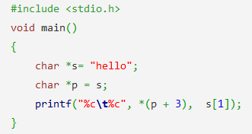
Q: 7. What is the output of this C code? a) h e b) l l c) l o d) l e
Solution: (d)

Slide 27
Next Class: Dynamic Memory Management

