Slide 1
Inheritance

Slide 2
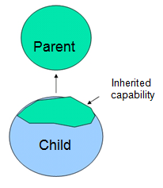
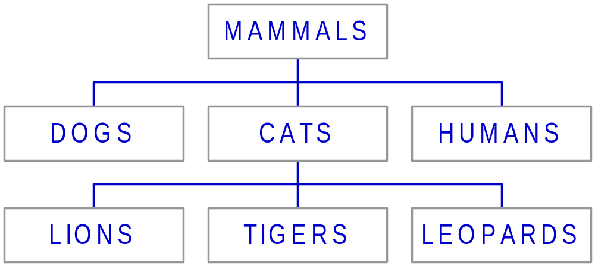
Definition
This mechanism of deriving a new class from existing/old class is called “inheritance”.
The old class is known as “base” class, “super” class or “parent” class”
The new class is known as “sub” class “derived” class, or “child”
class.
Example:

Slide 3
Inheritance: Benifits
Reusability--building new components by utilizing existing components- is yet another important aspect of OO paradigm.
It is always good/ “productive” if we are able to reuse something that is already exists rather than creating the same all over again.
This is achieve by creating new classes, reusing the properties of existing classes.
It saves money , time etc.
To use a class that is already created and tested properly saves the effort of testing and developing same again.
In C++ one class is tested and adapted properly can be used by the programmers to suit there requirements.

Slide 4
Introduction
Means: - Derivation
Reusability → feature of C++
Old class → base class, ancestor, parent, superclass.
New class→ derived class, descendent, child, subclass.
Advantages: - 1) saves time & effort
2) Reduces cost
3) Increases reliability

Slide 5
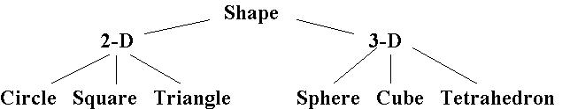
Inheritance (continued)
This hierarchy could, of course, be continued for more levels.
Each level inherits the attributes of the above level. Shape is the base class. 2-D and 3-D are derived from Shape and Circle, Square, and Triangle are derived from 2-D. Similarly, Sphere, Cube, and Tetrahedron are derived from 3-D.
Notes:
Engineering H192
Winter 2005
Lecture 28
Instructor notes:
As this slide points out, the hierarchy in our shape example could be extended even further down, as well as horizontally. We could come up with more 2D and 3D shapes and more specific examples of some of the shapes supplied here. For example, underneath Triangle we might have classes for Equilateral, Isosceles, and Right triangles. We could consider replacing Square with “Four Sided” and underneath the Four Sided class having Square, Rectangle, Trapezoid, etc. So, we can see that depending on the need, the hierarchy can be extended both vertically and horizontally.
The main thing to reemphasize is that classes inherit the characteristics of their “parent” or “base” classes. Classes that are one level above another class are said to be “direct base classes” of those immediately below. Classes that are more than one level above are “indirect base classes”. Hence 3D is a direct base class to Cube and Shape is an indirect base class to Cube.
How exactly we do the inheriting in C++ is briefly introduced on the next slide and with an example after that.

Slide 6
Defining Derived Classes
Syntax: -
class DerivedClassName : AccessSpecifier BaseClassName
{
::::::::::::
:::::::::::: //members of the derived class
::::::::::::
};
The access specifiers is optional & can be public, private (by default), and protected

Slide 7
Access specifiers of derivation
  The public access specifier
  The protected access specifier
  The private access specifier

Slide 8
Examples
Class ABC : XYZ //private derivation
{ Members of ABC};
Class ABC : protected XYZ //public derivation
{ Members of ABC};
Class ABC : public XYZ //public derivation
{Members of ABC};
Class ABC : XYZ //private derivation by default
{Members of ABC};

Slide 9
Public Inheritance
class A : public B
{ // Class A now inherits the members of Class B
// with no change in the “access specifier” for
} // the inherited members
public base class (B)
public members
protected members
private members
derived class (A)
public
protected
inherited but not accessible
Notes:
Engineering H192
Winter 2005
Lecture 28
Instructor notes:
When specifying the inheritance of a derived class from a base class, we have three options public, protected, and private. Here we look at public inheritance. This is the most common form of inheritance. When we refer to public inheritance here we are referring to the base class access specifier (the word immediately to the left of the base class name). This is different from the access specifier for the data members.
So, when we do a public inheritance of derived class A from base class B, the members that were public in B are inherited as public in A. The members that were protected in B are inherited as protected in B. And, those that were private in B, are inherited as private in A but they are not accessible because they are already private in B. So, inherited members that are private in the base class will not be accessible via member functions in the derived class. That means, the only way for the derived class to access an inherited member that was private in the base class is for there to be a public member function in the base class B that accesses any private members in B. It is for this reason that we have the protected specifier.

Slide 10
Public derivation
aseClass b
{ private:
int base_a;
protected:
int base_b;
public:
void base_set();
};
Class derived: public base
{
private: int derived_x;
protected: int derived_y;
public: void derived_set();
};
Class derived: public base
{
private:
int derived_x;
protected:
int base_b;
int derived_y;
public:
void base_set();
void derived_set();
};

Slide 11
Public derivation(actual at back end)
Class base
{ private:
int base_a;
protected:
int base_b;
public:
void base_set();
};
Class derived: public base
{
private:
int derived_a;
protected:
int base_b;
int derived_b;
public:
void base_set();
void derived_set();
};

Slide 12
Private Inheritance
class A : private B
{ // Class A now inherits the members of Class B
// with public and protected members
} // “promoted” to private
private base class (B)
public members
protected members
private members
derived class (A)
private
private
inherited but not accessible
Notes:
Engineering H192
Winter 2005
Lecture 28
Instructor notes:
Finally we look at private inheritance. In this case, members that were public or protected in the base class are “promoted” to the more restricted access specifier state of private in the derived class. This means that these members will be accessible by member functions of the derived class, but they will not be accessible in another derived class, that is one or more below A in the hierarchy. Again, base class members that were already private are private in the derived class, but they are not accessible by member functions of the derived class A because they are already private to the base class B.

Slide 13
Private derivation
Class base
{
private:
int base_a;
protected:
int base_b;
public:
void base_set();
};
Class derived: private base
{ private: int derived_x;
protected: int derived_y;
public: void derived_set(); };
/* Actual view

Slide 14
Protected Inheritance
class A : protected B
{ // Class A now inherits the members of Class B
// with public members “promoted” to protected
} // but no other changes to the inherited members
protected base class (B)
public members
protected members
private members
derived class (A)
protected
protected
inherited but not accessible
Notes:
Engineering H192
Winter 2005
Lecture 28
Instructor notes:
Here we look at protected inheritance. In this case, members that were public in the base class are “promoted” to the more restricted access specifier state of protected in the derived class. The protected inherited members retain their original access level in the derived class.

Slide 15
Protected derivation
Class base {
private:
int base_a;
protected:
int base_b;
public:
void base_set();
};
Class derived: protected base {
private: int derived_x;
protected: int derived_y;
public:
void derived_set(); };
/* Class derived: protected base{
private:
int derived_y;
protected:
int base_b;
int derived_y;
void base_set();
public:
void derived_set();
}; */

Slide 16
Class B
Privatev --a
Protected ---b
Public ---c
Not Inheritable
ClassD2:private B
Class D1:public B
Private
Protected
Public
Private
Protected
Public
Class X:public D1:protected D2
Private
Protected
Public

Slide 17
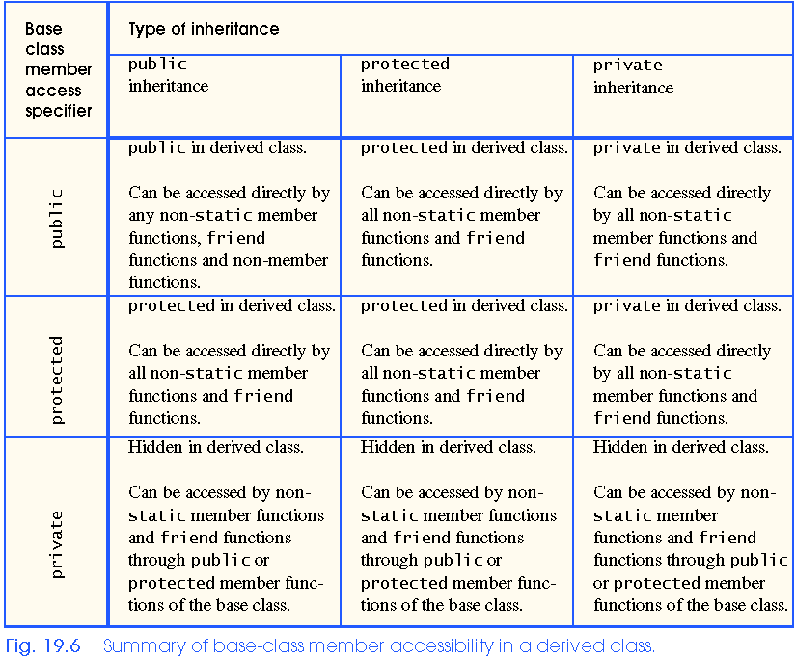

Slide 18
Inheritance (continued)
class Shape
{
public:
int GetColor ( ) ;
protected: // so derived classes can access it
int color;
};
class Two_D : public Shape
{
// put members specific to 2D shapes here
};
class Three_D : public Shape
{
// put members specific to 3D shapes here
};
Notes:
Engineering H192
Winter 2005
Lecture 28
Instructor notes:
Here we see a quick example of making use of inheritance based on our Shape class and its derived classes. Note that Shape has a public member function and a protected data member. If the data member color were private, rather than protected, then it would not be accessible from the derived classes Two_D, Three_D, Square, Cube and any other derived classes that might be created.
Both Two_D and Three_D inherit all of the data members and member functions that Shape contains while also, presumably, having functions and data that are specific to each of them.

Slide 19
Inheritance (continued)
class Square : public Two_D int main ( )
{ { Square mySquare;
public: Cube myCube;
float getArea ( ) ; mySquare.getColor ( );
protected: mySquare.getArea ( );
float edge_length; myCube.getColor ( );
} ; myCube.getVolume ( );
class Cube : public Three_D }
{
public:
float getVolume ( ) ;
protected:
float edge_length;
} ;
Notes:
Engineering H192
Winter 2005
Lecture 28
Instructor notes:
On this slide we have the derived classes Square and Cube which are derived from Two_D and Three_D respectively. Again the data members in these derived classes are protected so that classes further derived from Square and/or Cube would be able to access the edge_length member through the further derived classes’ member functions.
A point to reemphasize...Square, for example, has all of the characteristics of Two_D as well as all of the characteristics of Shape without having to specify them explicitly in the class definition.

Slide 20
Forms/levels of Inheritance
Single Inheritance
Multilevel Inheritance
Multiple Inheritance
Hierarchical Inheritance
Hybrid Inheritance
Multipath Inheritance

Slide 21
Single Inheritance
Derivation of a single class from one base class.
X → base class & Y → derived class. This type of involves one base class & one derived class. Further no class is derived from Y.
X
Y

Slide 22
Multilevel Inheritance
Derivation of a class from another derived class.
X → top base class & Y → derived class of X. Further Z is derived from Y. Here, Y is not just derived class, but also base class for Z. Further Z can be used as base class.
X
Y
Z

Slide 23
Multiple Inheritance
Derivation of a class from two or more base classes.
X & Y→ top base class. Further Z is derived from X & Y. Further Z is not used as base class.
X
Y
Z

Slide 24
Hierarchical Inheritance
Derivation of two or more classes from a single base class.
W → base class & X, Y, Z → derived classes. Further X, Y, Z are not used as base classes.
W
X
Y
Z

Slide 25
Hybrid Inheritance
Derivation of a class involving two or more forms of inheritance. Multilevel + Multiple = Hybrid.
Class Y is derived from X. Single type inheritance. Derived class Y acts as a base class. The class Z is derived from classes Y & W.
X
Y
W
Z

Slide 26
Multipath Inheritance
Derivation of a class from two or more classes that are derived from the same base class.
X → base class. Classes Y & W → derived from base class X. Further, class Z → derived from Y & W. Since, Y & W have inherited same members of X.
X
Y
W
Z

