Slide 1
C++ Templates

Slide 2
Objective
Function and class templates
Multiple parameters
Overloading
Limitations

Slide 3
Templates
Templates allows us to create a single function
or class for a group of similar function or class
in generic manner.
Templates provide us the code that is independent of the data type.
Generic Programming

Slide 4
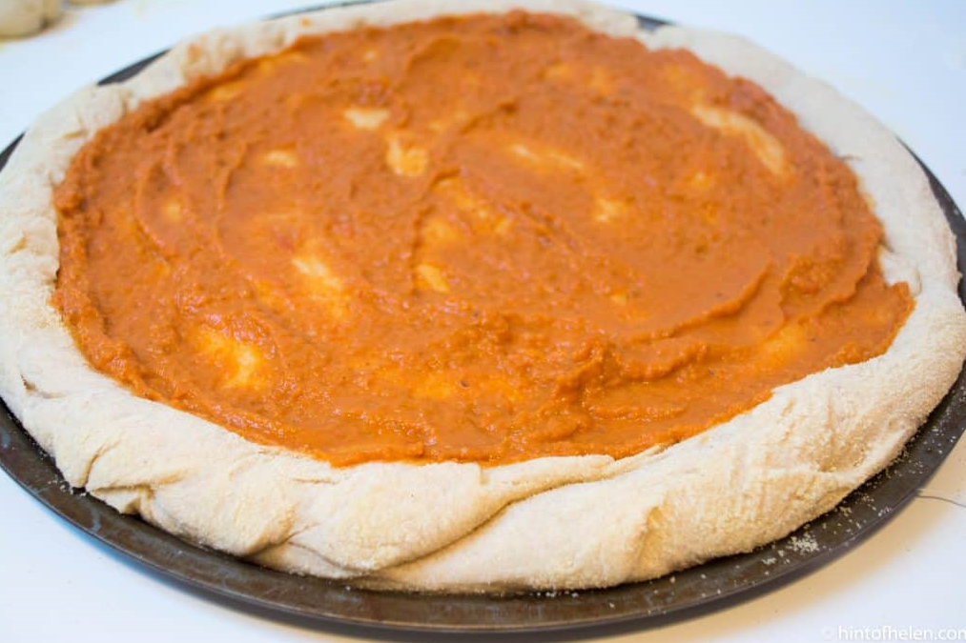

Slide 5
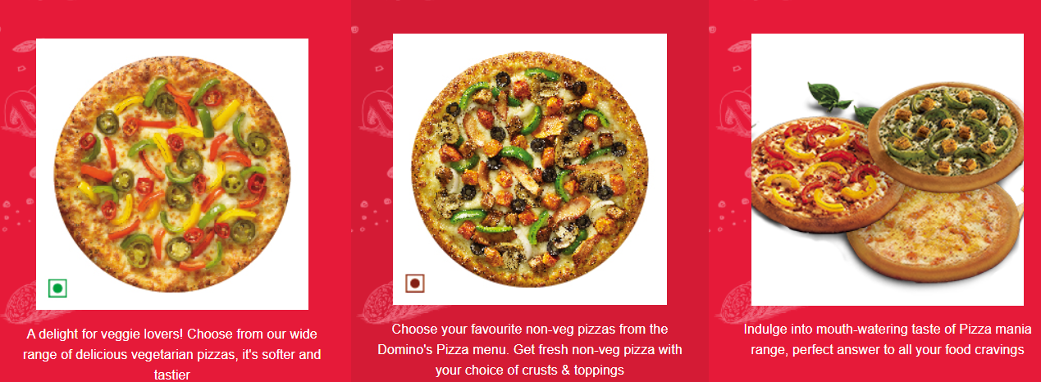

Slide 6
Templates can be represented in two ways:
Function templates
Class templates

Slide 7
Need of template
PROBLEM STATEMENT
Void sum(int, int)
Void sum(float, float)
2 different functions, 2 different definitions, more code usage
To avoid this we use templates

Slide 8
C++ Function Templates
Approaches for functions that implement identical tasks for different data types
  Naïve Approach
  Function Overloading
  Function Template
Instantiating a Function Templates

Slide 9
SYNTAX FOR FUNCTION TEMPLATE
Syntax of Function Template
template < class T>
ret_type func_name(parameter_list)
{
// body of function.
}

Slide 10
Example of a Function Template
template<class SomeType>
void Print( SomeType val )
{
cout << "***Debug" << endl;
cout << "Value is " << val << endl;
}
Template parameter
(class, user defined type, built-in types)
To output the traced values, we insert:
Template argument
Print<int>(sum);
Print<char>(initial);
Print<float>(angle);

Slide 11
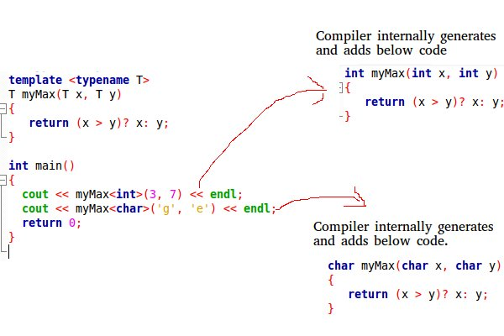
Source:geeksforgeeks.org

Slide 12
Function Template
They allow to create generic functions
They admit any data type as parameters
They return a value without having to overload the function with all the possible data types.

Slide 13
PROGRAM
LET US CHECK TEMPLATS THROUGH PROGRAM
PROBLEM STATEMENT
SOLUTION

Slide 14
Function Templates with Multiple Parameters
We can use more than one generic type in the template function by using the comma to separate the list.
Synatx:
template<class T1, class T2,.....>
return_type fun_name (arguments of type T1, T2....)
{ // body of function. }

Slide 15
Overloading a Function Template
Overloaded template functions can differ in the parameter list.
Let's understand this through a simple example using compiler:

Slide 16
Limitation of Generic Functions
Generic functions perform the same operation for all the versions of a function except the data type differs.
Let's see a simple example of an overloaded function which cannot be replaced by the generic function as both the functions have different functionalities.

Slide 17
Class Template
A class can have members based on generic types means
their data type is not defined at the time of creation of
the class and whose members use these generic types.
Syntax:
template <class T>
class class_name
{
//class defination
};

Slide 18
Instance of a class
main
{
Mix<int> obj(10,20);
Cout<<“max value is”<<obj.max();
}

Slide 19
Multiple parameters
template<class Type1, class type2…….>
Return_type function_n ame( type1 a, type2 b)
{
……….//template function body
}

Slide 20
Another Template Example: passing two parameters
template <class T, int size>
class Stack {...
};
non-type parameter

Slide 21
Member functions
Syntax
Template<class T>
returntype classname<T> ::functionname(arg list)

Slide 22
THANK YOU

