Slide 1

Hiring Process Analytics

Slide 2
Task1
. Hiring Analysis: The hiring process involves bringing new individuals into the organization for various roles.
Your Task: Determine the gender distribution of hires. How many males and females have been hired by the company?
Male:2563
Female:1856

Slide 3
Task 2
Salary Analysis: The average salary is calculated by adding up the salaries of a group of employees and then dividing the total by the number of employees.
Your Task: What is the average salary offered by this company? Use Excel functions to calculate this.
Average:49983.03

Slide 4
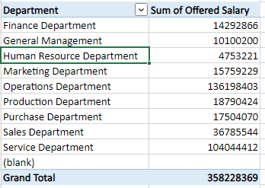
Task3
Salary Distribution: Class intervals represent ranges of values, in this case, salary ranges. The class interval is the difference between the upper and lower limits of a class.
Your Task: Create class intervals for the salaries in the company. This will help you understand the salary distribution.

Slide 5
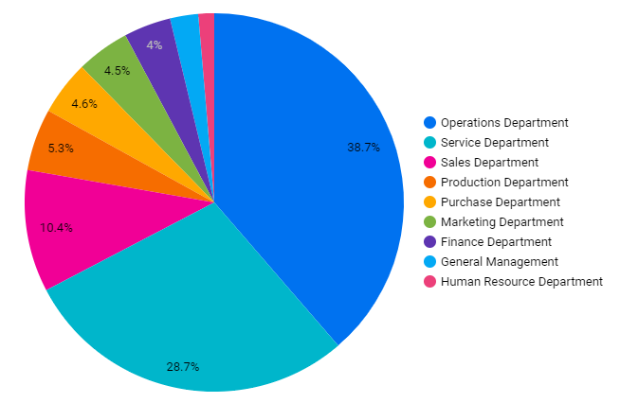
Task4
Departmental Analysis: Visualizing data through charts and plots is a crucial part of data analysis.
Your Task: Use a pie chart, bar graph, or any other suitable visualization to show the proportion of people working in different departments.

Slide 6
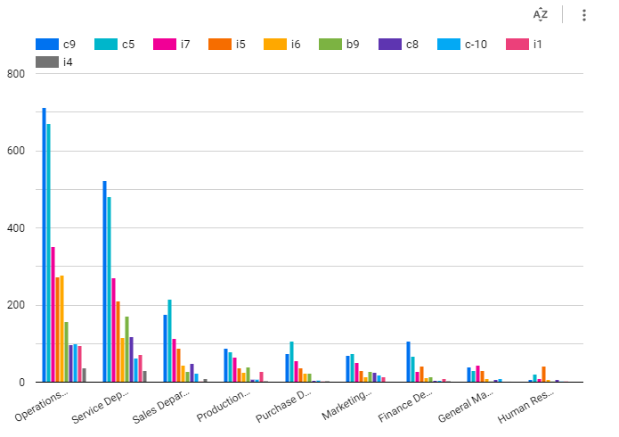
Task5
Position Tier Analysis: Different positions within a company often have different tiers or levels.
Your Task: Use a chart or graph to represent the different position tiers within the company. This will help you understand the distribution of positions across different tiers.

