Slide 1
IMDB Movie Analysis

Slide 2
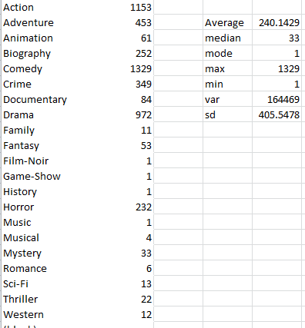
Task1
A. Movie Genre Analysis: Analyze the distribution of movie genres and their impact on the IMDB score.
Task: Determine the most common genres of movies in the dataset. Then, for each genre, calculate descriptive statistics (mean, median, mode, range, variance, standard deviation) of the IMDB scores.

Slide 3
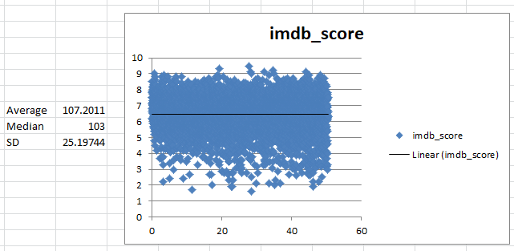
Task2
B. Movie Duration Analysis: Analyze the distribution of movie durations and its impact on the IMDB score.
Task: Analyze the distribution of movie durations and identify the relationship between movie duration and IMDB score.

Slide 4
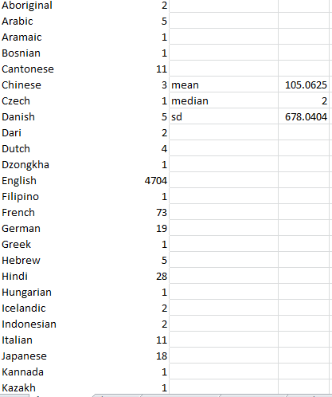
Task3
C. Language Analysis: Situation: Examine the distribution of movies based on their language.
Task: Determine the most common languages used in movies and analyze their impact on the IMDB score using descriptive statistics.

Slide 5
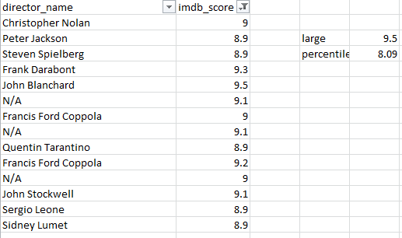
Task4
Director Analysis: Influence of directors on movie ratings.
Task: Identify the top directors based on their average IMDB score and analyze their contribution to the success of movies using percentile calculations.

Slide 6
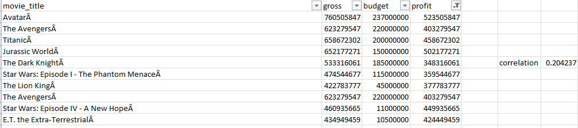
Task5
E. Budget Analysis: Explore the relationship between movie budgets and their financial success.
Task: Analyze the correlation between movie budgets and gross earnings, and identify the movies with the highest profit margin.

Slide 7
Hyperlinks
Excel:https://docs.google.com/spreadsheets/d/1naRm91rzTDNr2Y8J_hTREQgPIeJR_WHr/edit?usp=sharing&ouid=109330305611183196317&rtpof=true&sd=true

