Slide 1
Driver Drowsiness Detection
Watching the driver through a webcam and raising an alarm when they get sleepy
Project Review
Team members: Name 1, Name 2, Name 3, Name 4
Guide: Prof. Name
Department, College Name
Notes:
Introduce the team and the project in one line: we built a system that uses a normal webcam to check if a driver looks drowsy and warns them.

Slide 2
Problem Statement
Tired drivers often don't notice they are getting sleepy until it is too late.
Long highway trips, night shifts and truck driving make it worse.
Most cars on the road have no system that keeps an eye on the driver.
Existing solutions are mostly built into expensive cars.
91,000
police-reported crashes in the US in 2017 involved drowsy drivers
Our question: can we spot drowsiness using just a normal webcam and a small ML model?
Source: NHTSA
Notes:
Explain why this matters. Drowsy driving is common and dangerous, and most people can't afford cars with driver monitoring. That's what pushed us to try a low-cost webcam based approach.

Slide 3
Objectives
1
Train a model
2
Build a web app
that looks at a face and says Alert or Drowsy
that checks the webcam feed live, in the browser
3
Cut false alarms
4
Warn the driver
by looking at the last few frames, not just one
with a beeping alarm if drowsiness lasts 5 seconds
Notes:
Walk through the four goals. The main idea: a model for single frames, plus logic on top so we don't beep every time someone blinks.

Slide 4
Dataset: UTA-RLDD
60
~30 hrs
2
people recorded
of real video
classes we used
Real people filmed with their own phones/webcams at home and in cars
"Active" videos → Alert, "Fatigue" videos → Drowsy (we dropped the middle "low vigilance" class)
Frames taken from the videos and split into train / validation / test folders
About 65% Alert and 35% Drowsy, so the data is a bit unbalanced
Dataset link: kaggle.com/datasets/minhngt02/uta-rldd
Notes:
UTA Real-Life Drowsiness Dataset from Kaggle. The good thing is it's real people in real settings, not actors. We kept only two classes to make it a clean yes/no problem.

Slide 5
Methodology: How It Works
Step 1
Step 2
Step 3
Step 4
Step 5
Webcam frame
Preprocess + CV
YOLOv8 classifier
Check recent frames
Alert driver
Browser grabs a picture from the camera
OpenCV decode, resize, plus HOG / Sobel / flow features
Gives a probability of Alert vs Drowsy
Look at the last 10 results, not just one
Show status and beep if drowsy for 5 s
Step 2 runs four classic computer vision techniques on every frame. They are explained on the next slide.
Notes:
This is the full pipeline in five steps. Stress step 4: one frame can be wrong (blinking, looking down), so we decide based on a short history of frames.

Slide 6
Computer Vision Features (OpenCV)
HOG
Sobel + Otsu
Morphology
Optical Flow
Oriented gradients
Edge detection
Cleaning the edge map
Farneback method
Histogram of Oriented Gradients: turns the face into a pattern of edge directions. Frame resized to 128×128, 8×8 cells, 9 direction bins.
Gaussian blur, then Sobel in x and y to find edges. Otsu picks the threshold automatically to make a black/white edge map.
Opening removes small noise dots, closing fills small gaps. Uses a 5×5 kernel on the Sobel output.
Compares the current frame with the previous one to see how much the head and face moved.
Output: 8,100-value feature vector
Output: Edge density (% of edge pixels)
Output: Cleaned edge density
Output: Mean and max motion
All four run in the backend for every frame. Their values are sent back with the prediction and shown in the web app.
Notes:
These are the classic CV techniques in our project, all done with OpenCV in cv_features.py. HOG describes the shape of the face using edge directions. Sobel finds edges and Otsu thresholding turns them into a binary map. Morphology cleans that map. Optical flow compares two frames in a row to measure movement, for example head nodding. The frontend sends the previous frame along with the current one so optical flow can be computed.

Slide 7
Model and Training
Why YOLOv8n-cls?
Setting | Value
Base model | yolov8n-cls.pt
Image size | 224 × 224
Batch size | 16
Epochs run | 25
Classes | Alert, Drowsy
Output | best.pt (used in backend)
"n" = nano, the smallest YOLOv8 model
Runs fast enough on a normal CPU
Starts from pre-trained weights, so it learns faster with less data
Ultralytics library makes training and saving the model simple
Notes:
We picked the smallest YOLOv8 classification model because it has to run in real time. Training ran for 25 epochs and the best checkpoint was saved and copied into the backend.

Slide 8
Implementation: System Setup
Frontend
Backend
Model
Next.js 14 + React
FastAPI (Python)
YOLOv8n-cls (PyTorch)
Opens the webcam
Sends frames to the backend
Shows status, confidence, alert level
Plays the alarm sound
/predict and /health APIs
Image handling with OpenCV
Keeps recent history per session
Packaged with Docker
Loaded once at startup
Returns Alert / Drowsy probability
Trained weights: best.pt
Image goes as a POST request → JSON result comes back
Notes:
Three parts. Frontend in the browser, backend API in Python, and the trained model inside the backend. Frontend sends a picture, backend replies with the result in JSON.

Slide 9
Implementation: Deciding When to Alert
1. Lower threshold
0 Safe
A frame counts as drowsy if the drowsy probability is 0.20 or more (not the usual 0.50). Missing a sleepy driver is worse than an extra warning. We picked this value by testing on the validation set.
Driver looks alert
1 Caution
30%+ drowsy, or 2 in a row
2. Look at the last 10 frames
2 Warning
One bad frame (a blink, looking down) shouldn't trigger anything. We count how many recent frames were drowsy and how many came in a row. The browser beeps after 5 seconds of continuous drowsiness.
3 drowsy frames in a row
3 Danger
5 in a row → pull over
Notes:
This is the part we spent time tuning. The model alone gives a number per frame. We lowered the cut-off so we catch more drowsy cases, then used the history of frames to decide the alert level, so it doesn't beep on a single blink.

Slide 10
Results: Training Progress
85.4%
best accuracy, reached at epoch 15
Validation loss went down from 0.53 to about 0.42
Accuracy jumps around between epochs, so we kept the best checkpoint
Notes:
Accuracy is noisy from epoch to epoch because many frames come from the same videos and look similar. The best checkpoint was around 85 percent, and that's the one we deployed.

Slide 11
Results: Where the Model Gets It Right and Wrong
 | Predicted Alert | Predicted Drowsy
Actually Alert | 897 | 15
Actually Drowsy | 253 | 659
85.3%
97.8%
Overall accuracy
Drowsy precision
72.3%
98.4%
Drowsy recall
Alert recall
Validation set: 1,824 images, default 0.5 cut-off
When it says drowsy, it's almost always right. But it misses some drowsy frames, which is why we lowered the threshold and use frame history.
Notes:
Read the table: 897 alert frames correct, 659 drowsy correct. The weak spot is 253 drowsy frames called alert. That's the reason for the 0.20 threshold and the multi-frame logic from the earlier slide.

Slide 12
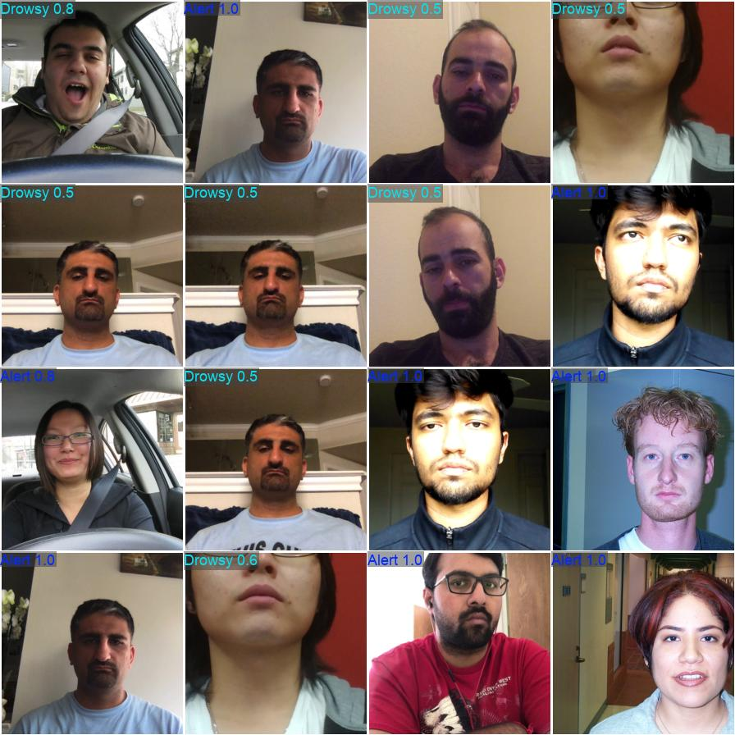
Outputs
Paste a screenshot of the web app here
What the web app shows:
Green / red status card (Alert or Drowsy) with confidence
Alert level 0–3 and a short advice message
Beeping alarm after 5 s of drowsiness
Model predictions on validation images (label + confidence)
Notes:
Left side is straight from training: each face with the model's guess and confidence. On the right, show the app screenshot, or switch to the live demo here.

Slide 13
Conclusion
What we did
Limitations
Future work
Built a full working system: webcam → model → alarm
About 85% accuracy per frame with a small model that runs on CPU
HOG, Sobel, morphology and optical flow features for every frame
Frame history cuts down false alarms
Misses ~28% of drowsy frames when looking at one frame alone
Lighting, glasses and camera angle affect results
Add eye-closure and yawn checks using face landmarks
Add the middle "low vigilance" level from the dataset
Test it in a real car and run it on a phone or small device
Notes:
Be honest about limits: it works, but catching drowsy faces from a single frame is the weak point, and lighting or glasses can affect it. Future work is about adding eye and yawn checks and testing in a real car.

Slide 14
Thank You
Questions?

