Slide 1
Driver Drowsiness Detection
Watching the driver through a webcam and raising an alarm when they get sleepy
CSE411 Computer Vision And It’s Principles
Team 25
Vangara Sridhar (2023BCS0106) | Suragouni Sahithi (2023BCS0070)
Vatte Ramya Sri (2023BCS0208) | Abhay Devanand Sawale (2023BCS0046)
Notes:
Introduce the team and the project in one line: we built a system that uses a normal webcam to check if a driver looks drowsy and warns them.

Slide 2
Problem Statement
Driver drowsiness can go unnoticed until it affects attention and reaction time. NHTSA estimated that 91,000 police-reported crashes in the United States involved drowsy drivers in 2017.
This project explores webcam-based frame classification and a sustained browser alert.
91,000
police-reported crashes in the US in 2017 involved drowsy drivers
Our question: can a webcam classify Alert and Drowsy frames and provide a timely warning?
Source: NHTSA, 2017 estimate
Notes:
Explain why this matters. Drowsy driving is common and dangerous, and most people can't afford cars with driver monitoring. That's what pushed us to try a low-cost webcam based approach.
Sources: NHTSA, Drowsy Driving: https://www.nhtsa.gov/risky-driving/drowsy-driving

Slide 3
Objectives
1
Train a model
2
Build a web app
that looks at a face and says Alert or Drowsy
that checks the webcam feed live, in the browser
3
Cut false alarms
4
Warn the driver
by looking at the last few frames, not just one
with a beeping alarm if drowsiness lasts 5 seconds
Notes:
Walk through the four goals. The main idea: a model for single frames, plus logic on top so we don't beep every time someone blinks.

Slide 4
Dataset: UTA-RLDD
60
~30 hrs
2
people recorded
of real video
classes we used
UTA-RLDD includes about 30 hours from 60 participants. Recordings were made at home or university, with cameras positioned to approximate a dashboard view.
This project maps Active → Alert and Fatigue → Drowsy; Low Vigilant is excluded. Training split: 64.7% Alert / 35.3% Drowsy; validation and test are separate.
Dataset: UTA-RLDD project page and Kaggle
Notes:
UTA Real-Life Drowsiness Dataset from Kaggle. The good thing is it's real people in real settings, not actors. We kept only two classes to make it a clean yes/no problem.
Sources: UTA-RLDD project page: https://sites.google.com/view/utarldd/home ; dataset: https://www.kaggle.com/datasets/minhngt02/uta-rldd

Slide 5
Methodology: How It Works
Step 1
Step 2
Step 3
Step 4
Step 5
Webcam frame
Preprocess + CV
YOLOv8 classifier
Check recent frames
Alert driver
Browser grabs a picture from the camera
OpenCV decodes BGR to RGB; HOG resizes to 128×128. YOLO handles its own input sizing.
Gives a probability of Alert vs Drowsy
Look at the last 10 results, not just one
Show status and beep if drowsy for 5 s
HOG, Sobel and morphology use the current frame; optical flow also needs the previous frame. These CV values are returned as metadata and do not change the YOLO class decision.
Notes:
This is the full pipeline in five steps. Stress step 4: one frame can be wrong (blinking, looking down), so we decide based on a short history of frames.

Slide 6
Computer Vision Features (OpenCV)
HOG
Sobel + Otsu
Morphology
Optical Flow
Oriented gradients
Edge detection
Cleaning the edge map
Farneback method
Computes edge-orientation patterns over the full input frame (no face crop).
Gaussian blur, then Sobel in x and y to find edges. Otsu picks the threshold automatically to make a black/white edge map.
Opening removes small noise dots, closing fills small gaps. Uses a 5×5 kernel on the Sobel output.
Farneback compares current and previous full-frame pixels to estimate motion; it does not isolate head or face movement.
Output: 8,100-value feature vector
Output: Edge density (% of edge pixels)
Output: Cleaned edge density
Output: Mean and max motion
CV values are returned with each prediction for display. Optical flow is available after a previous frame exists; the features are not fused into YOLO classification.
Notes:
These are the classic CV techniques in our project, all done with OpenCV in cv_features.py. HOG describes the shape of the face using edge directions. Sobel finds edges and Otsu thresholding turns them into a binary map. Morphology cleans that map. Optical flow compares two frames in a row to measure movement, for example head nodding. The frontend sends the previous frame along with the current one so optical flow can be computed.

Slide 7
Model and Training
Why YOLOv8n-cls?
Setting | Value
Base model | yolov8n-cls.pt
Image size | 224 × 224
Batch size | 16
Epochs run | 25
Classes | Alert, Drowsy
Output | best.pt (used in backend)
YOLOv8n-cls, pretrained | Input: 224 px | Batch: 16 | Up to 50 epochs; early stopped at 25 | Best validation top-1: 85.36% at epoch 15 | Held-out test top-1: 85.37% (909 images) | CPU model inference: about 3.4 ms/image
Notes:
We picked the smallest YOLOv8 classification model because it has to run in real time. Training ran for 25 epochs and the best checkpoint was saved and copied into the backend.

Slide 8
Implementation: System Setup
Frontend
Backend
Model
Next.js 14 + React
FastAPI (Python)
YOLOv8n-cls (PyTorch)
Opens the webcam
Sends frames to the backend
Shows status, confidence, alert level
Plays the alarm sound
/predict and /health APIs
Image handling with OpenCV
Keeps recent history per session
Packaged with Docker
Model loads once at startup | Returns Alert / Drowsy probability | Uses the trained best.pt weights | Dockerfile is included for deployment
Image goes as a POST request → JSON result comes back
Notes:
Three parts. Frontend in the browser, backend API in Python, and the trained model inside the backend. Frontend sends a picture, backend replies with the result in JSON.

Slide 9
Implementation: Deciding When to Alert
1. Lower threshold
0 Safe
Validation tuning selected 0.20: a frame is Drowsy when its Drowsy probability is at least 0.20.
Driver looks alert
1 Caution
30%+ drowsy, or 2 in a row
2. Look at the last 10 frames
2 Warning
The backend summarizes recent predictions over up to 10 frames. The browser audio alarm waits for 5 seconds of continuous Drowsy status.
3 drowsy frames in a row
3 Danger
5 in a row → pull over
Notes:
This is the part we spent time tuning. The model alone gives a number per frame. We lowered the cut-off so we catch more drowsy cases, then used the history of frames to decide the alert level, so it doesn't beep on a single blink.

Slide 10
Results: Training Progress
85.4%
best validation top-1 accuracy, reached at epoch 15
Training used 50 maximum epochs and early stopped at 25. Validation loss: 0.5275 at epoch 1, minimum 0.4174 at epoch 22, and 0.4624 at epoch 25.
Notes:
Accuracy is noisy from epoch to epoch because many frames come from the same videos and look similar. The best checkpoint was around 85 percent, and that's the one we deployed.
Sources: Project training history: ml_pipeline/models/drowsiness_detection/results.csv; held-out evaluation output: ml_pipeline/evaluate.py

Slide 11
Results: Where the Model Gets It Right and Wrong
 | Predicted Alert | Predicted Drowsy
Actually Alert | 897 | 15
Actually Drowsy | 253 | 659
85.3%
97.8%
Overall accuracy
Drowsy precision
72.3%
98.4%
Drowsy recall
Alert recall
Validation set: 1,824 images; classifier cut-off 0.50
At the validation-tuned 0.20 threshold, the sweep measured 92.2% accuracy, 89.7% Drowsy recall and a 5.4% Alert false-alarm rate. These are validation results; held-out test top-1 was 85.37%.
Notes:
Read the table: 897 alert frames correct, 659 drowsy correct. The weak spot is 253 drowsy frames called alert. That's the reason for the 0.20 threshold and the multi-frame logic from the earlier slide.
Sources: Project validation threshold sweep and confusion matrix: ml_pipeline/tune_threshold.py and ml_pipeline/models/drowsiness_detection/confusion_matrix_normalized.png

Slide 12
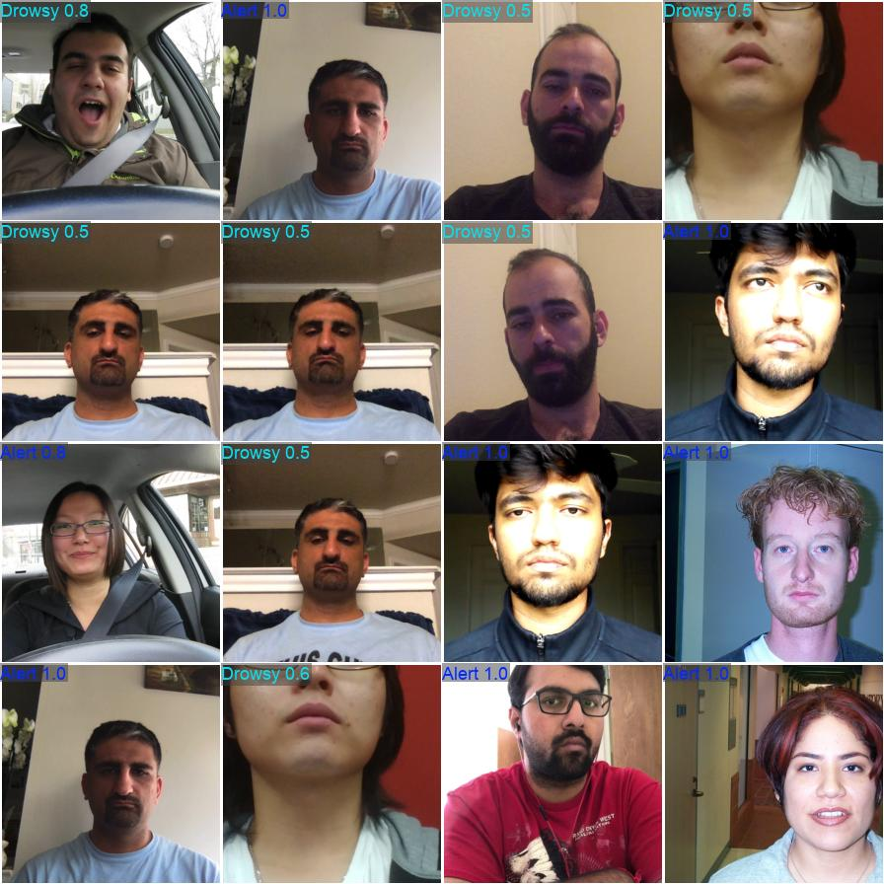
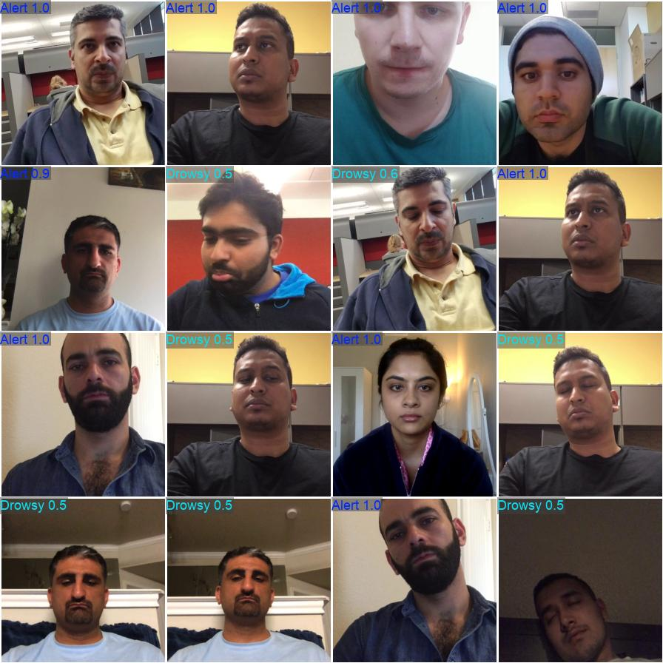
Outputs
Saved validation predictions (not a live UI capture)
What the web app shows:
Green / red status card (Alert or Drowsy) with confidence
Alert level 0–3 and a short advice message
Beeping alarm after 5 s of drowsiness
Model predictions on validation images (label + confidence)
Notes:
The left panel shows saved YOLO validation predictions; the right panel summarizes the implemented web app features. The image is not a live app screenshot.

Slide 13
Conclusion
What we did
Limitations
Future work
Integrated webcam capture, YOLOv8 classification, backend API and temporal status
Held-out test top-1: 85.37%; model-only CPU inference: about 3.4 ms/image
HOG, Sobel, morphology and Farneback flow are computed as CV metadata, not fused into YOLO
At classifier cut-off 0.50, validation Drowsy recall was 72.3%. The tuned 0.20 threshold raised validation recall to 89.7% with a 5.4% Alert false-alarm rate.
Lighting, glasses and camera angle can affect predictions.
Add eye-closure and yawn checks using face landmarks
Add the middle "low vigilance" level from the dataset
Test it in a real car and run it on a phone or small device
Notes:
Be honest about limits: it works, but catching drowsy faces from a single frame is the weak point, and lighting or glasses can affect it. Future work is about adding eye and yawn checks and testing in a real car.

Slide 14
Thank You

