Slide 1
KPI CARDS
Total titles
8807
Movies
6131
TV Shows
2676
Countries
80+
Rating
TV-MA
Latest
2021

Slide 2
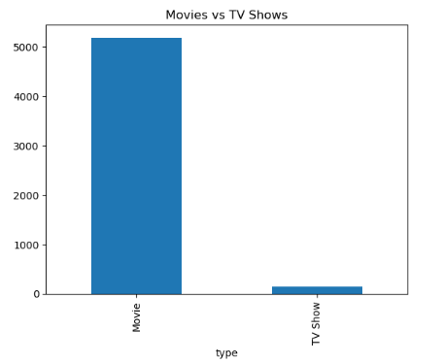
MOVIES VS TV SHOWS

Slide 3
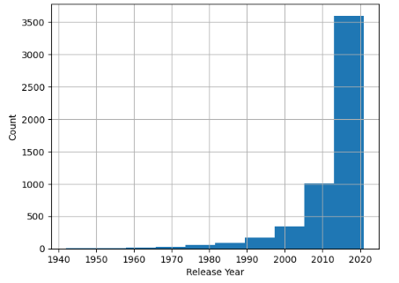
DISTRIBUTION OF RELEASE YEARS

Slide 4
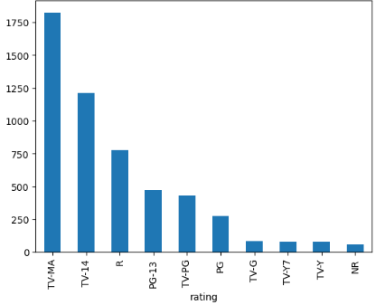
TOP RATINGS

Slide 5
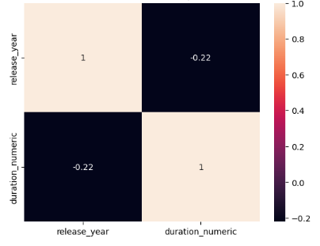
CORRELATION HEATMAP

