Slide 1
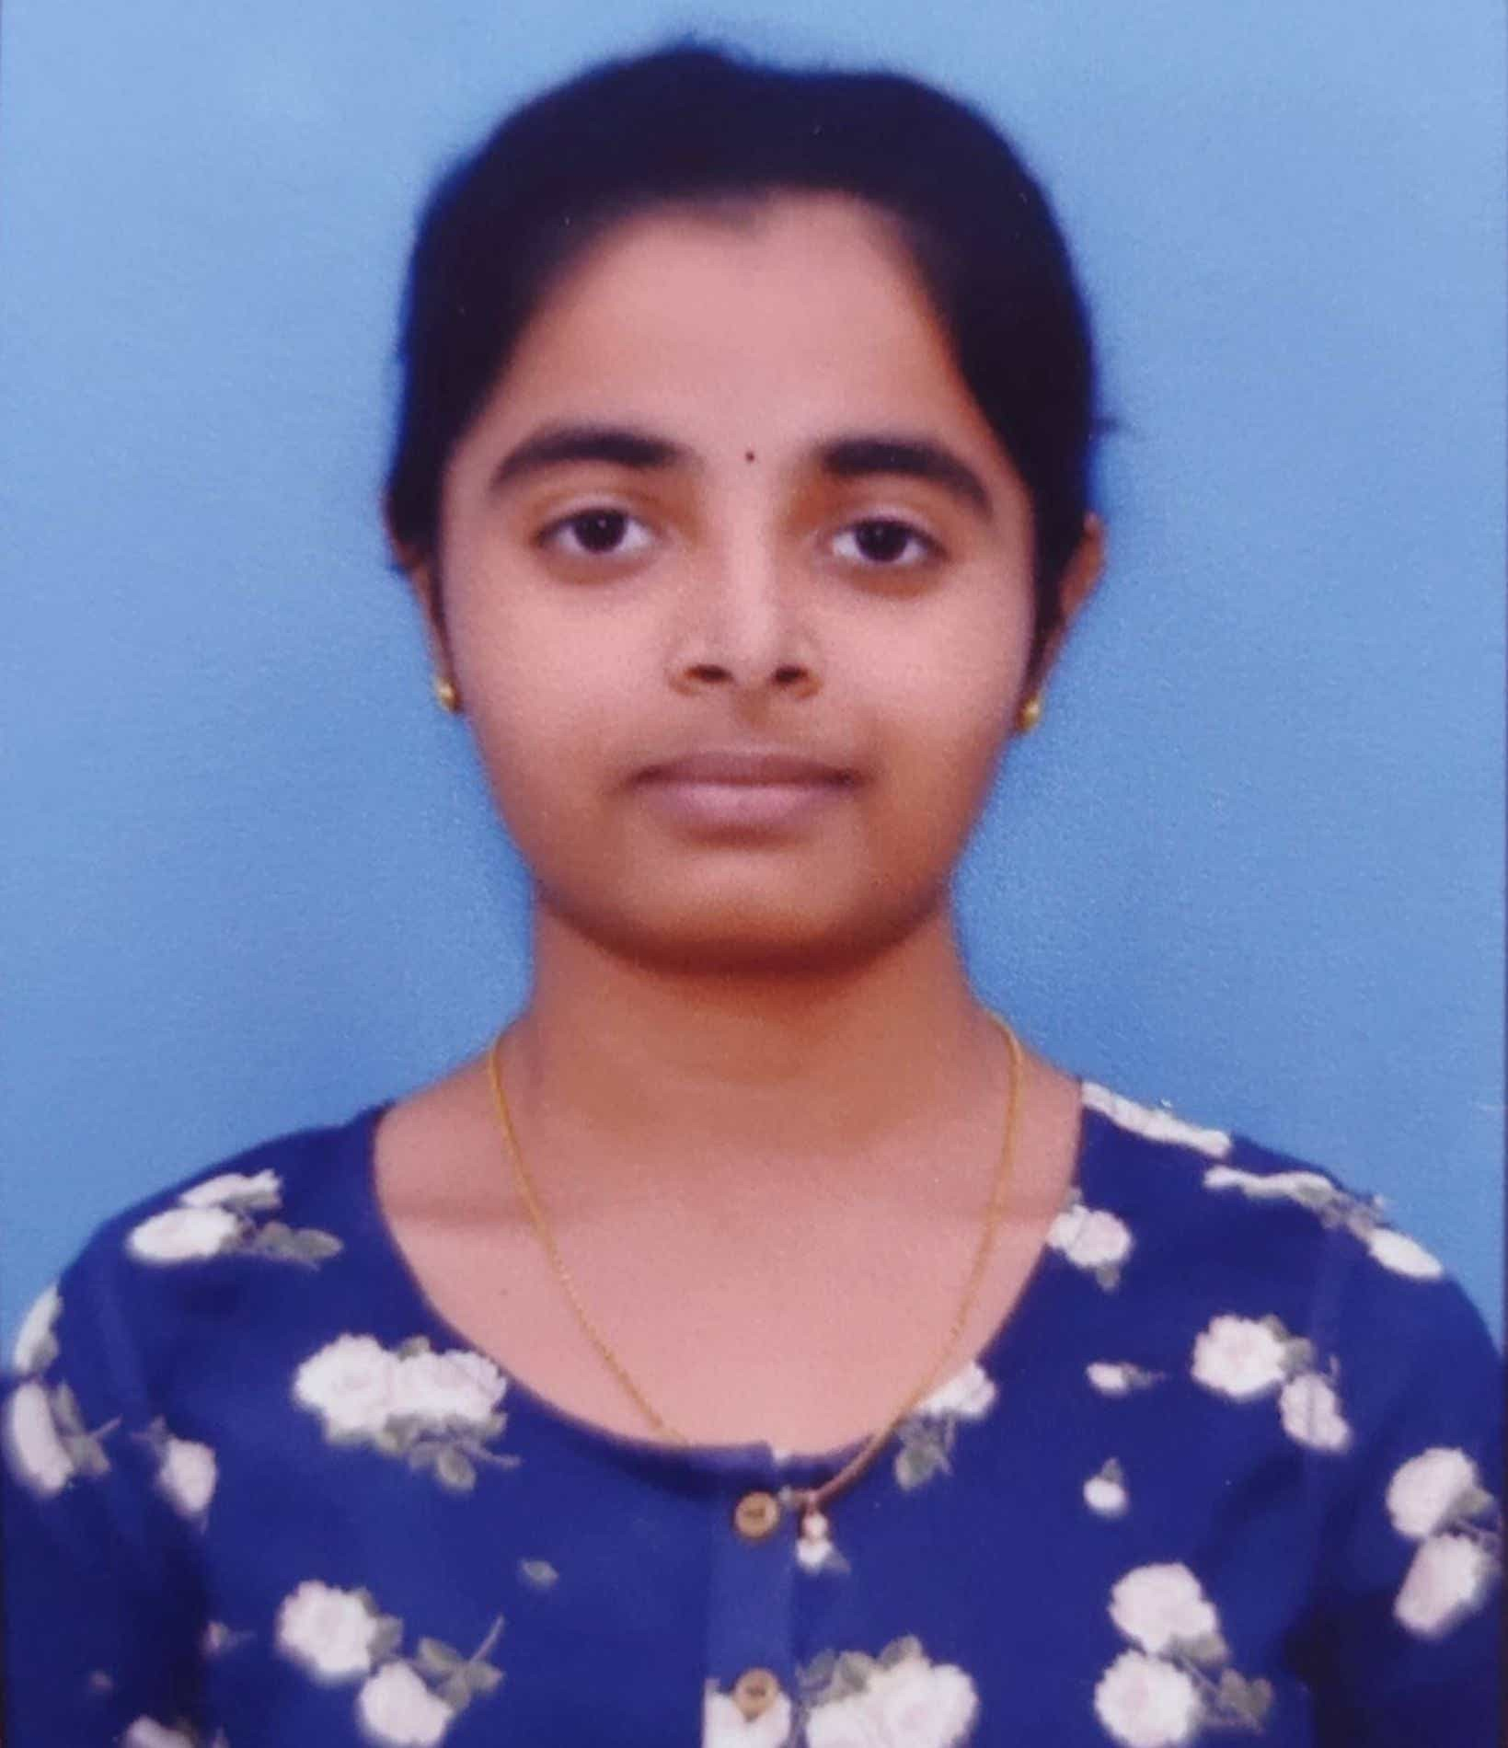
Name: Krothagorla Sai Venkata Sahithi Email Id: sahithiyadavksvs5@gmail.com Shri Vishnu Engineering college for women AndraPradesh Front End Development(FED) 12-06-2023 to 24-07-2023

Slide 2

Creating a Netflix clone website using Html, CSS, Javascript

Slide 3
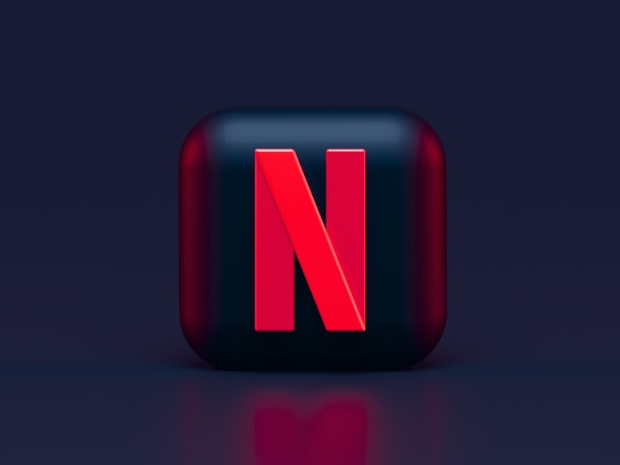
PROJECT TOPIC: A clone website is developed based on Netflix using html tags ,css and javascript.

Slide 4
AGENDA Creating a clone website involves replicating the design, functionality, and features of an existing website. For aspiring web developers or designers, creating a Netflix clone can be an excellent learning opportunity. It allows us to apply our skills and gain hands-on experience in building a complex and feature-rich website.

Slide 5
PROJECT OVER VIEW
The primary objective is to mimic Netflix's core features, such as user registration, browsing movie and TV show catalogs, creating watchlists, recommending content based on user preferences, and providing a streaming experience.
The clone can be used as a testbed to assess market demand and user response to a video streaming service with a Netflix-like model. It helps validate whether such a platform is viable and appeals to the target audience.

Slide 6
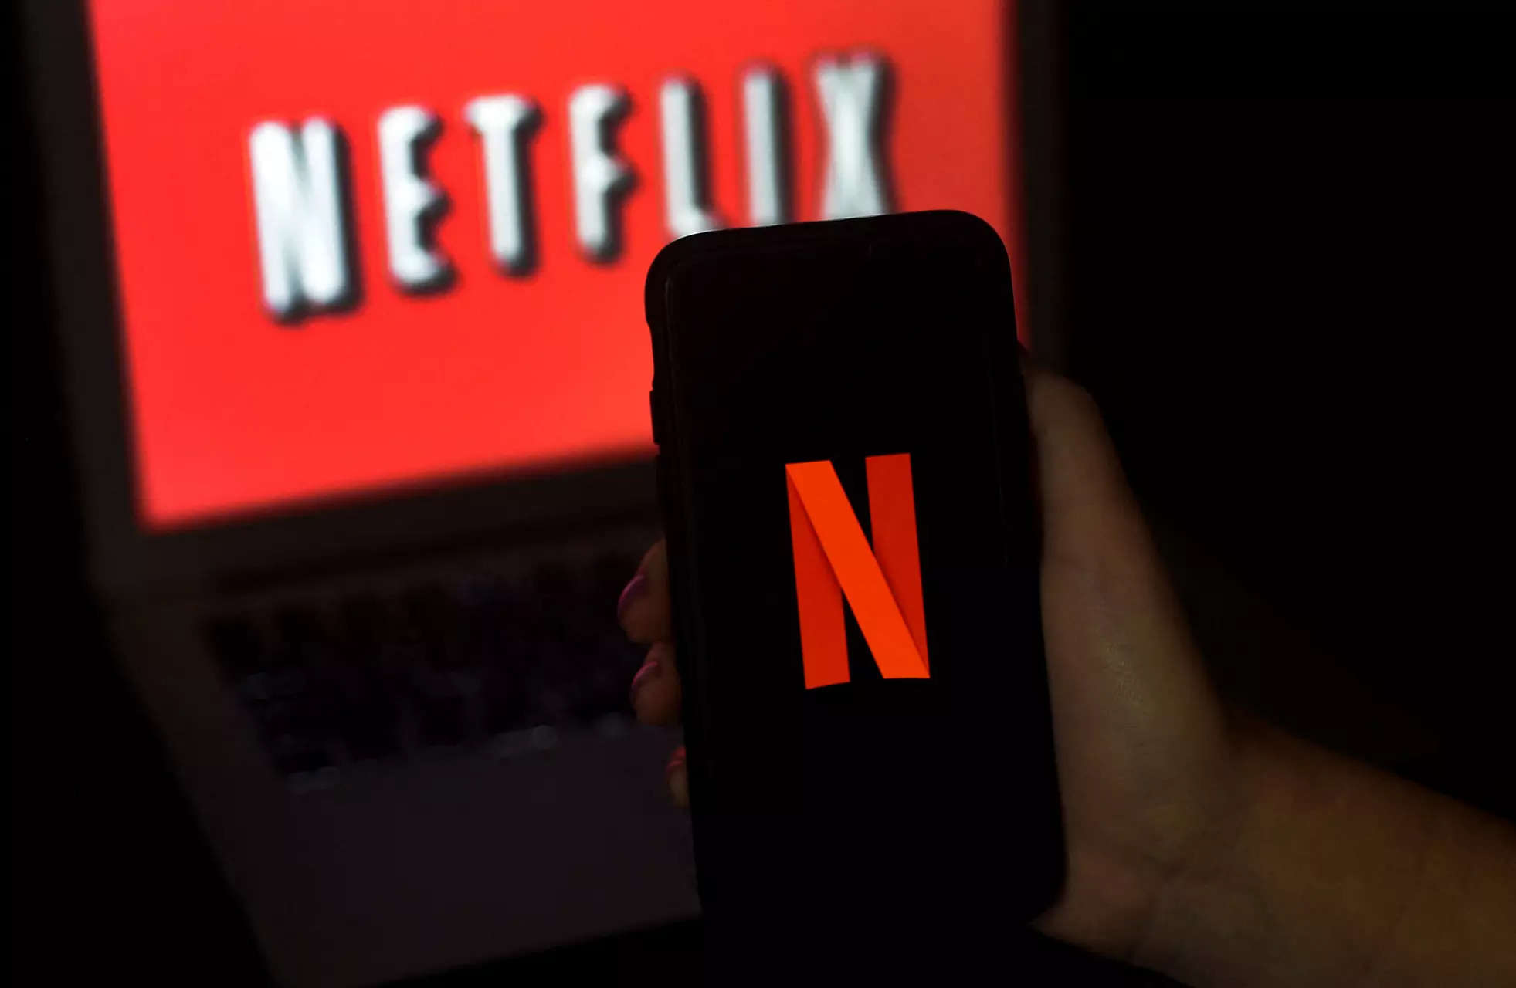
WHO ARE THE END USERS?
The end users of a Netflix clone website are individuals who visit and use the platform to access and stream video content. These users are typically interested in watching movies, TV shows, documentaries, and other video content online. The Netflix clone website aims to provide a similar streaming experience to the original Netflix platform, offering a wide range of content for users to enjoy.

Slide 7
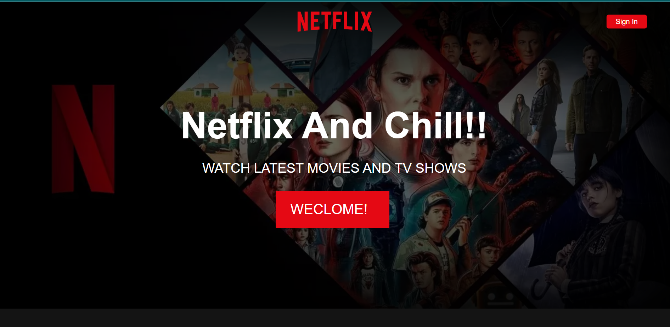
SOLUTION AND PRESENTATION
A well-designed and user-friendly clone website can attract and retain users, leading to increased engagement. Positive user experiences and access to a wide range of appealing content can encourage users to spend more time on the platform.

Slide 8
MODELLING:
HTML and CSS play crucial roles in replicating the visual appearance and layout of the original platform.
HTML is used to recreate the structure of the web pages on the original website. This involves understanding the layout, navigation menus, headers, footers, and other elements present on the pages.
CSS is essential for replicating the visual appearance of the original website. You'll create CSS rules to style HTML elements, defining colors, fonts, spacing, and positioning

Slide 9
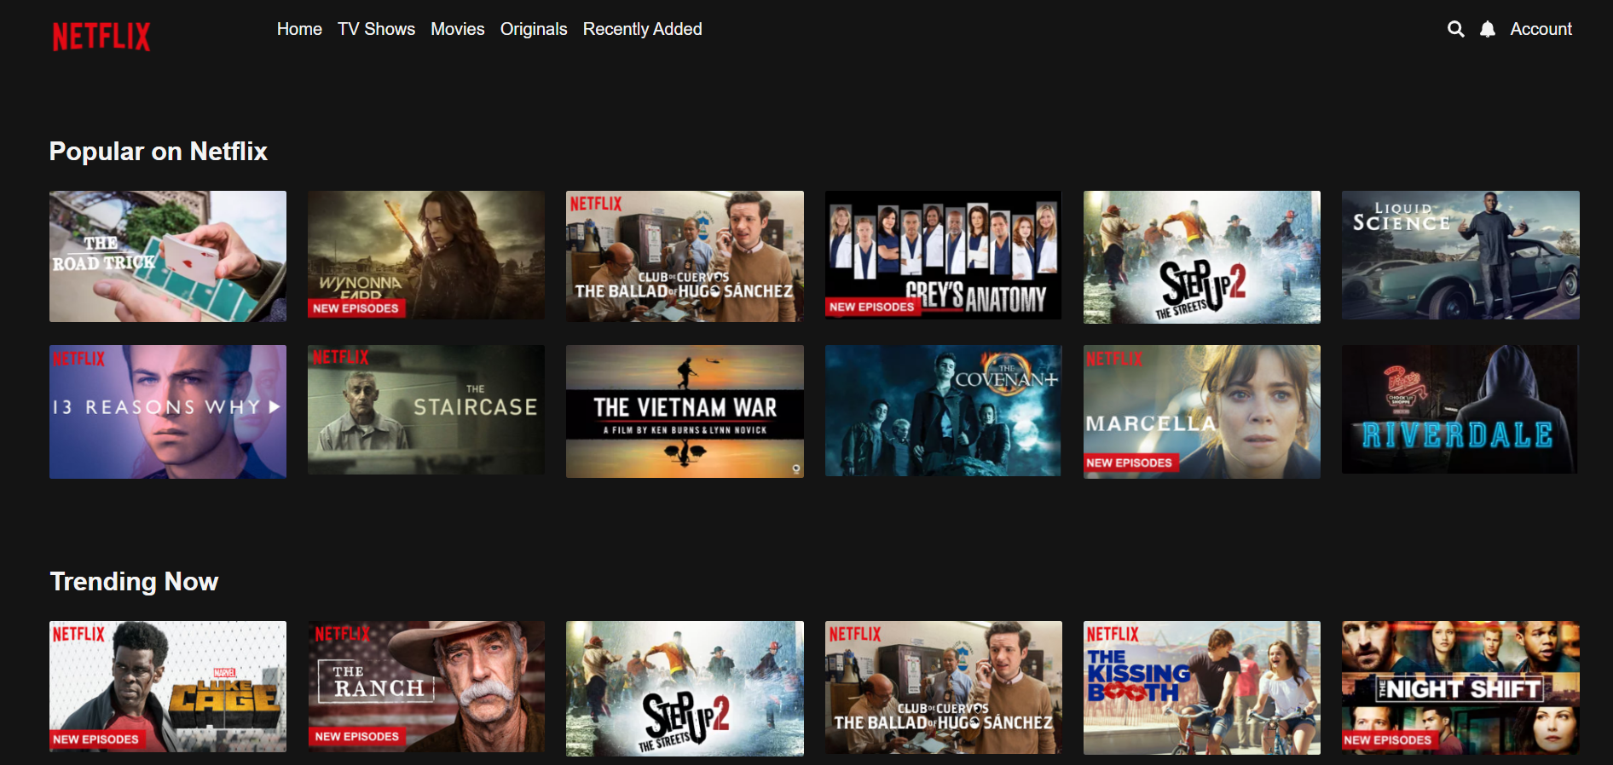
RESULT:
https://github.com/sahithi-ksvs/NetflixClone.git

Slide 10


