Slide 1
AUTO MPG ( Linear regression and decision tree )

Slide 2
ABSTRACT
In this project, we mainly discussed about fuel efficiency in the cars. We only used the Auto-MPG dataset which includes nine basic attributes of the cars. In order to understand the correlation between the attributes of the cars, we make the dataset suitable for the functions that we will use. Thereafter we did visualization, some subtasks and predict the mpg with using Both Linear Regression and Decision Tree method.

Slide 3
INTRODUCTION
Before buying a car, we should check the miles per gallon to see the fuel efficiency of that car. Although the attributes of any two cars is highly similar, the mpg’s of the cars may be very different. Our motivation to choose this dataset is an important topic because mpg of the car that we will buy, greatly affects our fuel cost in long term. You can find the Auto-MPG dataset easily from the Kaggle by searching "Auto-MPG Dataset”. Then you can download the “csv” file by clicking “Download” button and see the data that we are going to analyze.

Slide 4
When we have a look at attributes of the dataset, it consists of nine attributes; mpg, cylinders, displacement, horsepower, weight, acceleration, model year, origin and car name. Most of the attributes are clear as their names suggest, but origin attribute may cause confusion. Origin attributes takes three values which 1,2 and 3. It shows that the car’s country of manufacture. For example, it shows INDIA, Japan, USA respectively, Besides, our dataset has 398 records and that is a quite enough number to do predictions with processing a data.
You can find the Auto-MPG dataset easily from the Kaggle by searching "Auto-MPG Dataset”. Then you can download the “csv” file by clicking “Download” button and see the data that we are going to analyze.

Slide 5
Attribute Information:
mpg: continuous
cylinders: multi-valued discrete
displacement: continuous
horsepower: continuous
weight: continuous
acceleration: continuous
model year: multi-valued discrete
origin: multi-valued discrete
car name: string (unique for each instance)

Slide 6
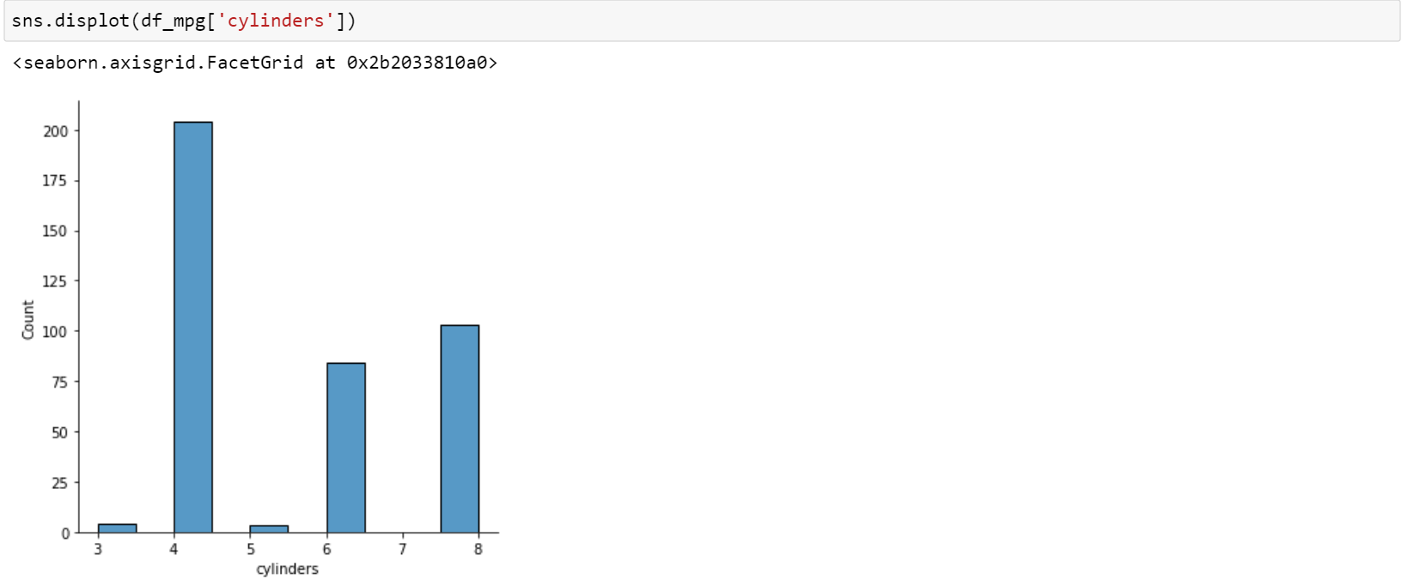

Slide 7
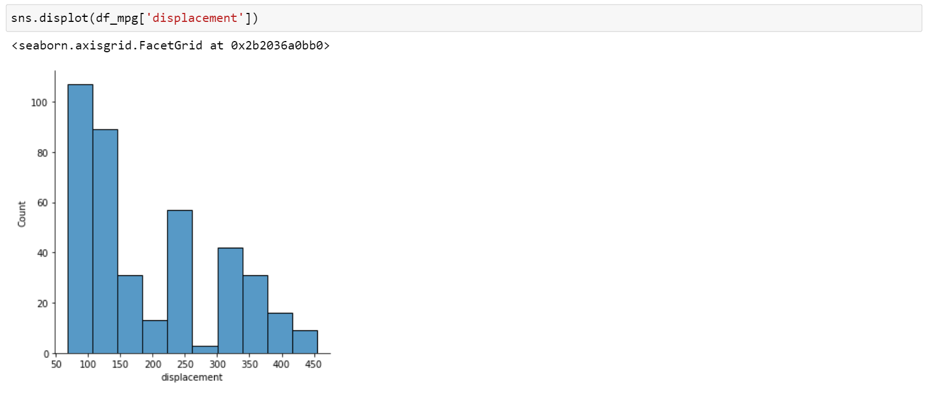

Slide 8
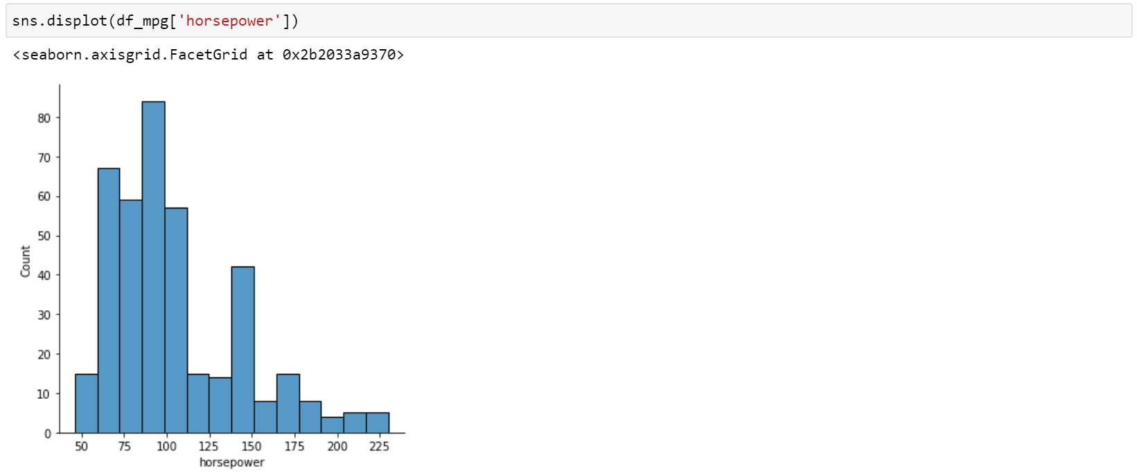

Slide 9
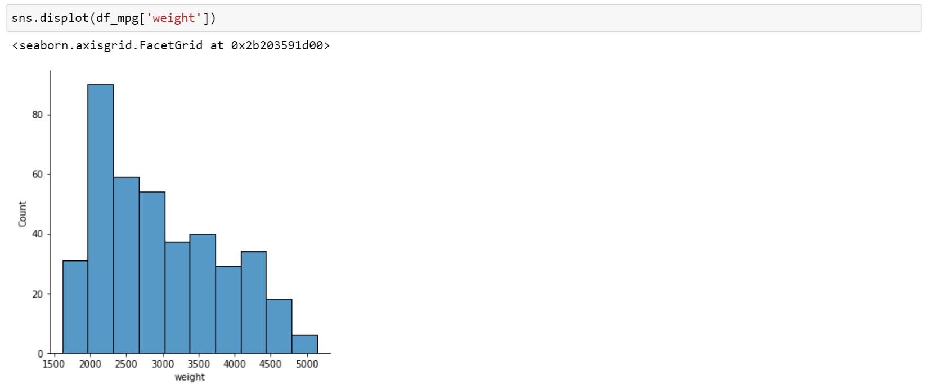

Slide 10
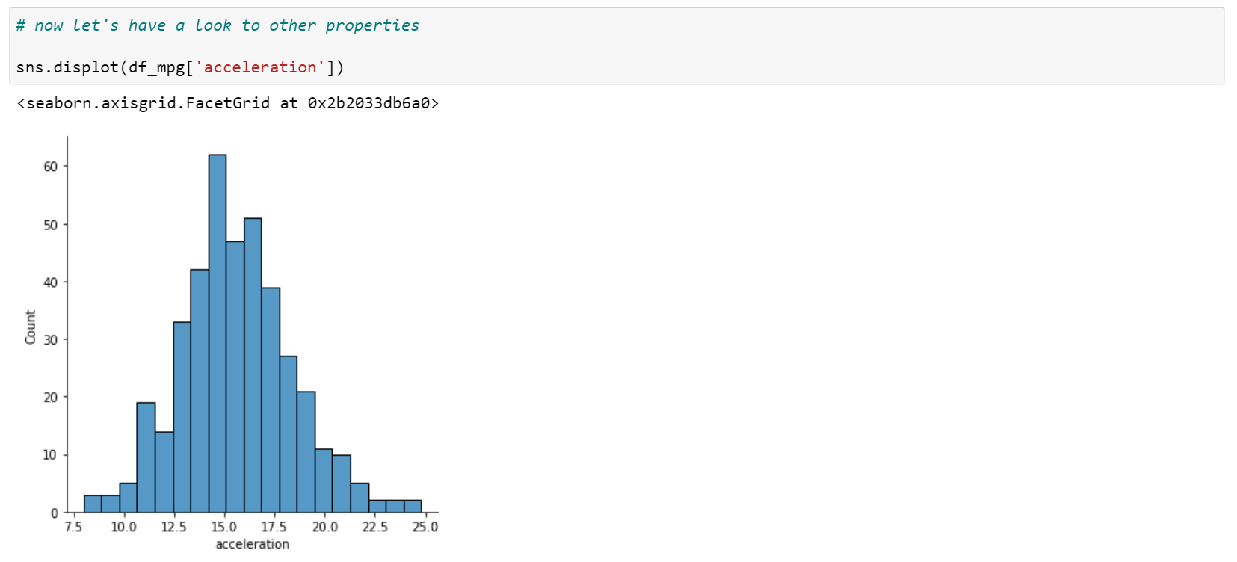

Slide 11
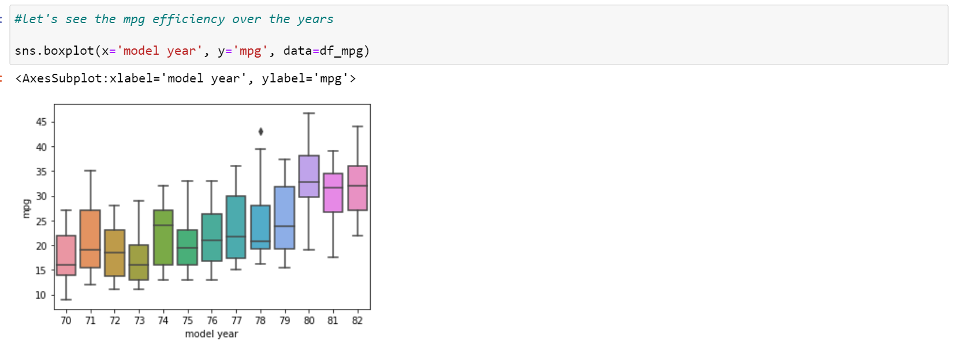

Slide 12
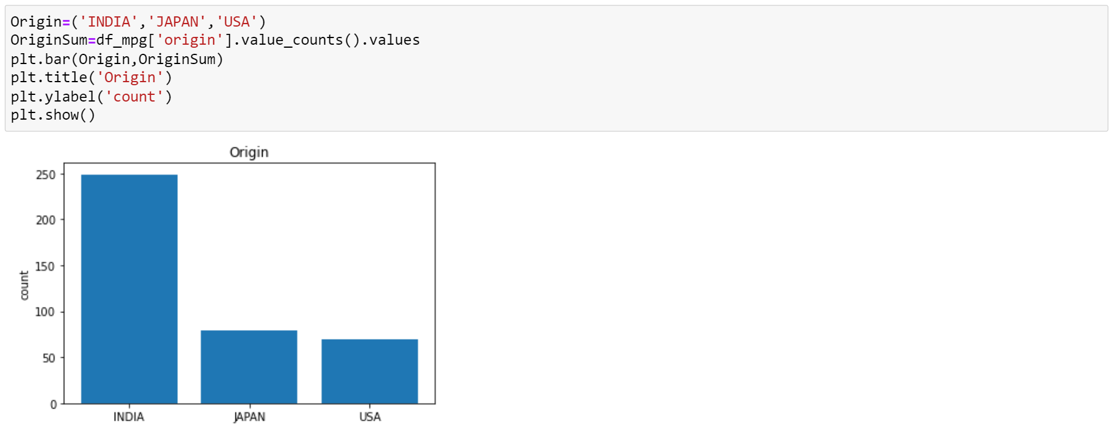

Slide 13
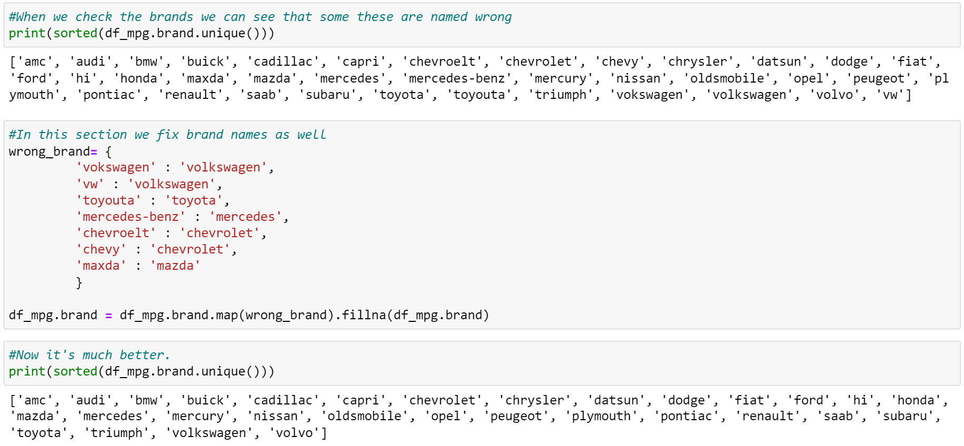

Slide 14
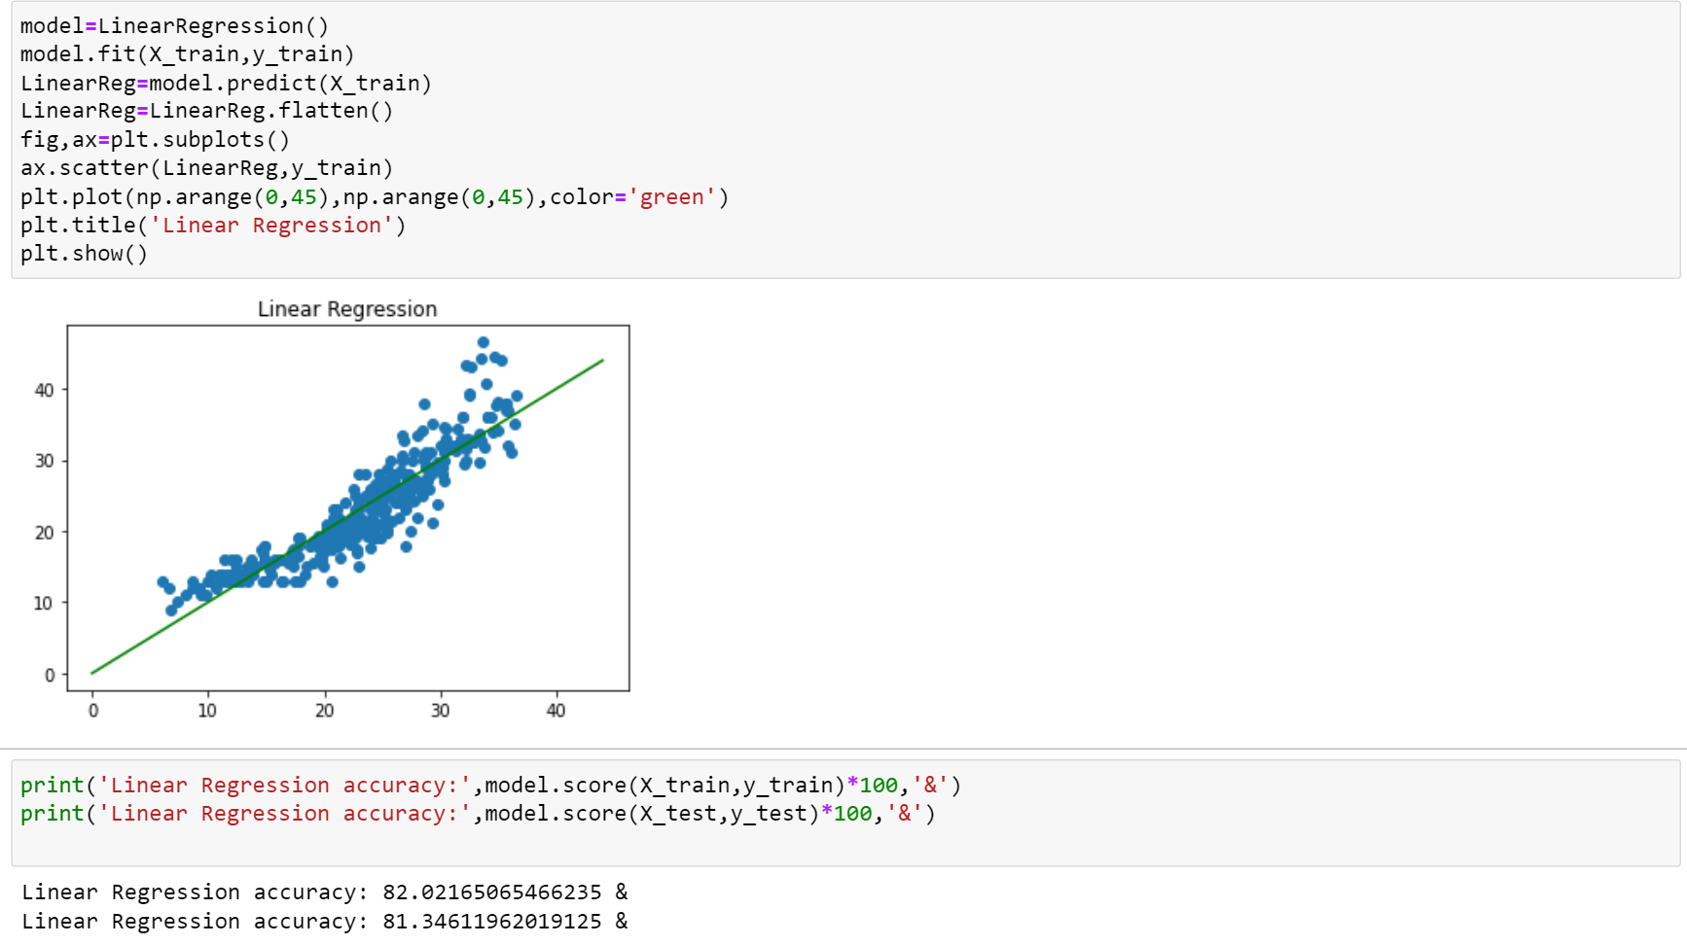

Slide 15
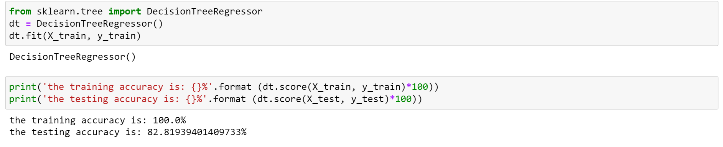

Slide 16
RESULT
After we have analyzed the data, we can see that there is a pattern with this data. Usually most of the cars have 4 cylinders and they are top tier with mpg. Weight of the car has the most impact on mpg. People tend to buy their cars from the brand Ford. The most efficient year was 1980 and after that with the data we have, we can see that it decreases next 2 years. Finally, with linear regression and decision tree method we are able to predict mpg values.

Slide 17
CONCLUSION
Main finding of this project are, cylinders, displacement, horsepower and weight are inversely proportional to mpg while acceleration, model year and origin are directly proportional to mpg. That means while inversely proportional ones are increasing, mpg is decreasing but while directly proportional ones are increasing, mpg also increases. And most related variable to mpg, as you can see in the graph is weight with”- 0.8317409332443351”
Main obstacle of this project is that we do not know some of the cars’ horsepower and it is shown as ‘?’ so we calculate the average value and change ‘?’ with it. To sum up we learn that mpg may depend on many features of car therefore we should consider the features which are highly correlated with mpg before buying a car.

Slide 18


