Slide 1
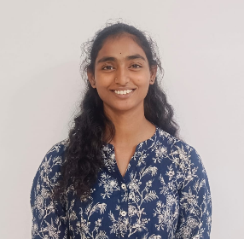
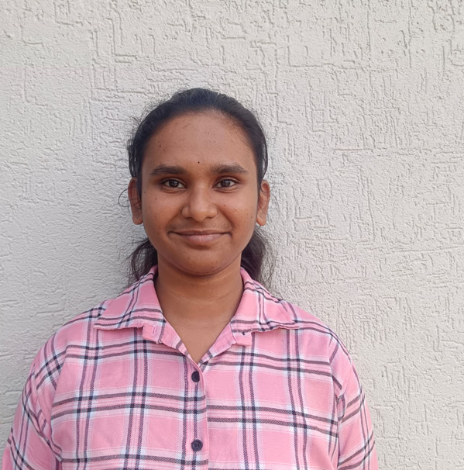
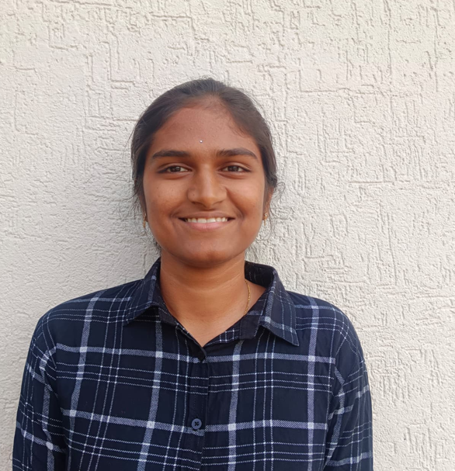
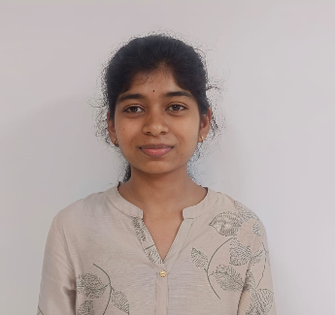
9th Edition TECHgium®
PID No. TG0915687
Virtual POC Round
Integrated Multi-Objective Optimization Framework for Automotive Passenger Comfort and Handling via Coupled Biodynamic-Vehicle Suspension Modelling
Author 1
Photo
Author 2
Photo
Author 3
Photo
Author 4
Photo
K.Vyshnavi
J.Gayathri
K.Deepthi
K.Sahithi
B V Raju Institute of Technology, Narsapur, Telangana

Slide 2

Challenge Statement
Passenger Comfort Modelling in an Automotive Suspension System
Establish and validate a mathematical model that accurately represents passenger comfort parameters within a defined suspension system under real-time driving conditions. The model should be capable of simulating comfort dynamics and be supported by physical testing to ensure correlation between theoretical predictions and actual ride experiences.

Slide 3
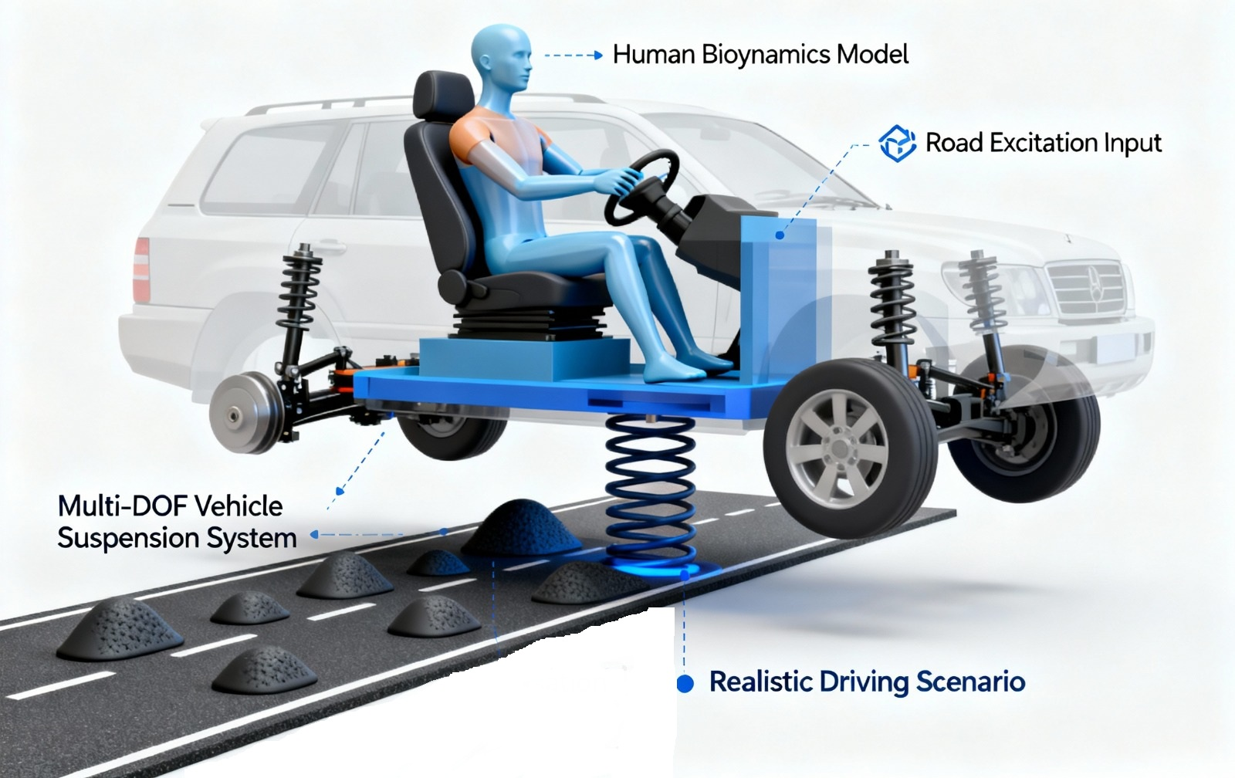
Concept / Proposed Solution
Developing mathematical suspension model combined with a full car and human biodynamic system, and simulating it under realistic road vibrations.
Comfort metrics such as RMS(Root Mean Square), VDV(Vibration Dose Value)and shock indices are calculated from the resulting accelerations and translated into meaningful comfort scores.
Finally, the model is validated using SIL and HIL environments for ECU testing and suspension control tuning.

Slide 4
Feedback from previous rounds
Mentor Feedback
Validate real-time feasibility using actual vehicle seat acceleration data.
Ensure model stability under real sensor noise
Avoid arbitrary comfort threshold selection
Implementation
Collected accelerations data from a moving car using MPU9250 sensor.
Used real sensor signals for model evaluation
Verified execution behaviour under practical conditions
Adopted ISO 2631 vibration standards

Slide 5

SWOT Analysis
STRENGTHS
WEAKNESS
ISO 2631–based comfort metrics
Multi-parameter analysis (RMS, VDV, SI)
Real-time Simulink implementation
Comfort analysis for various car models.
Limited real-vehicle testing.
OPPORTUNITIES
THREATS
Adaptive suspension control: Comfort metrics used to adjust damping in real time.
HIL / ECU deployment: Model validated and implemented on real automotive controllers.
Intelligent comfort optimization: AI-based tuning to improve passenger ride comfort.
Road & environment variability

Slide 6
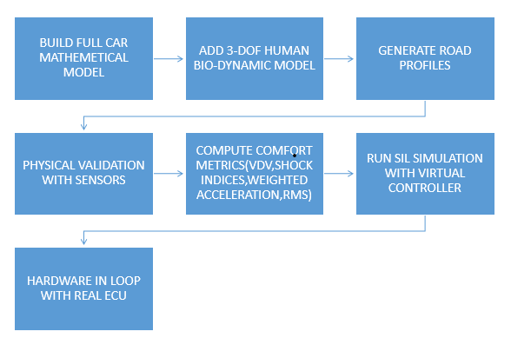
Implementation (1/2)

Slide 7
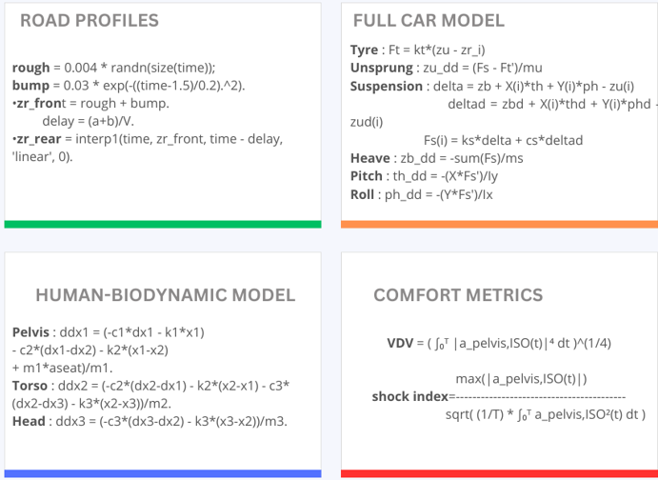
Implementation (2/2)

Slide 8
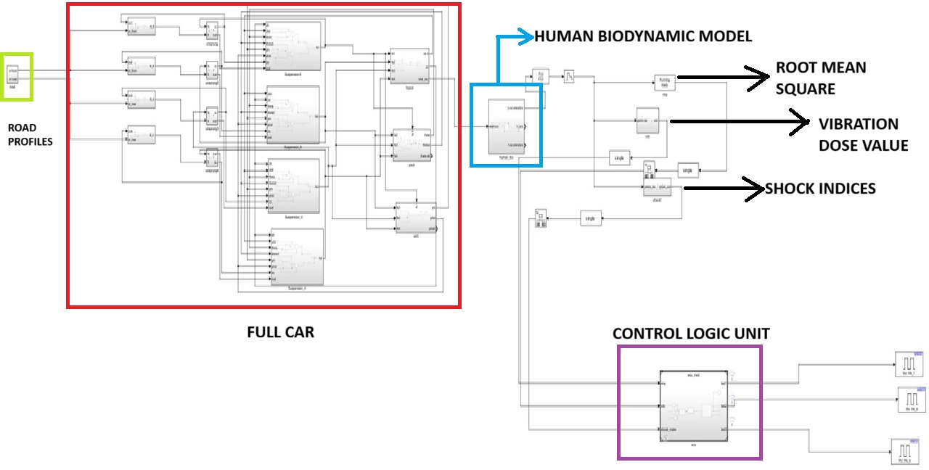
POC / Prototype Demo
SIMULINK MODEL

Slide 9
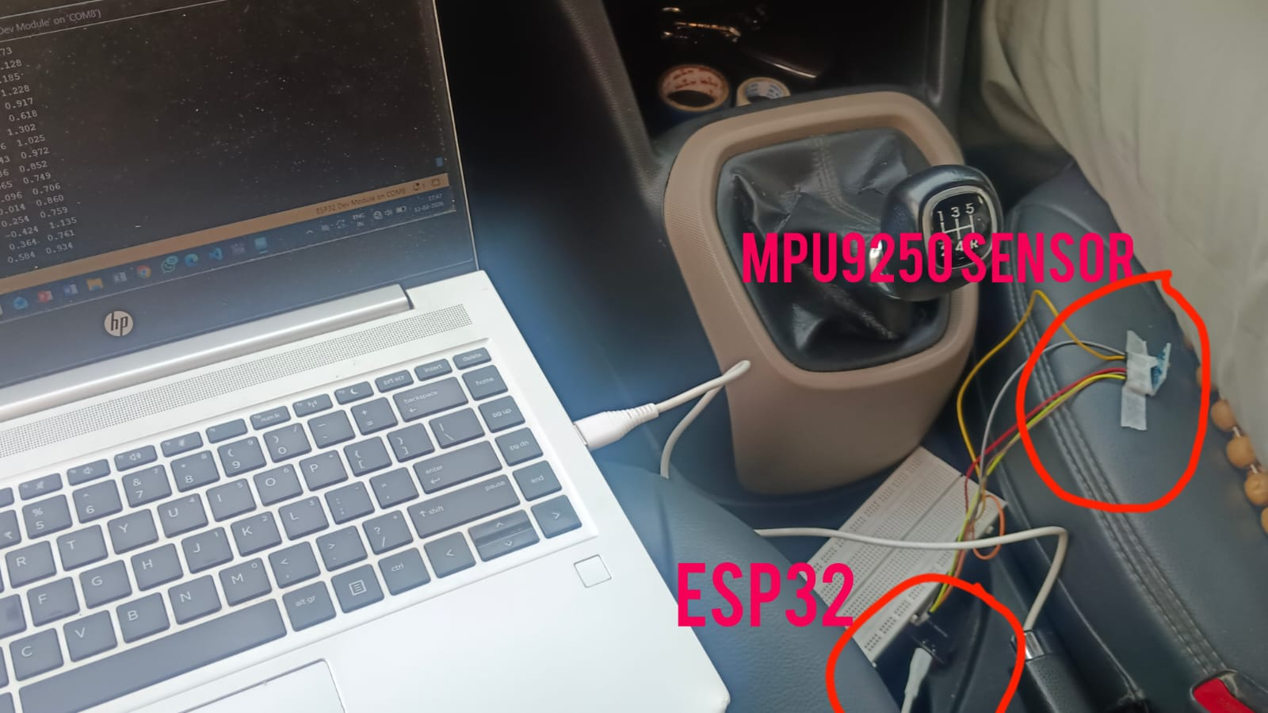
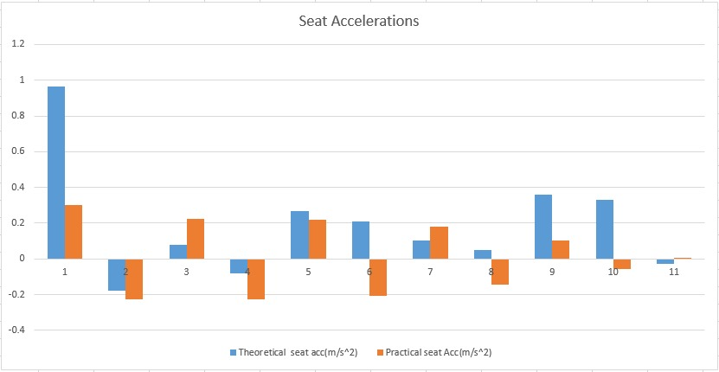
Testing / Analysis (1/4)
Sensor Deployment
Comparison between theoretical and practical seat acceleration

Slide 10
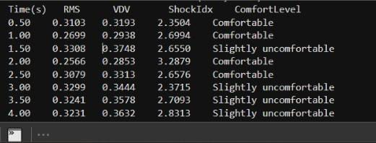
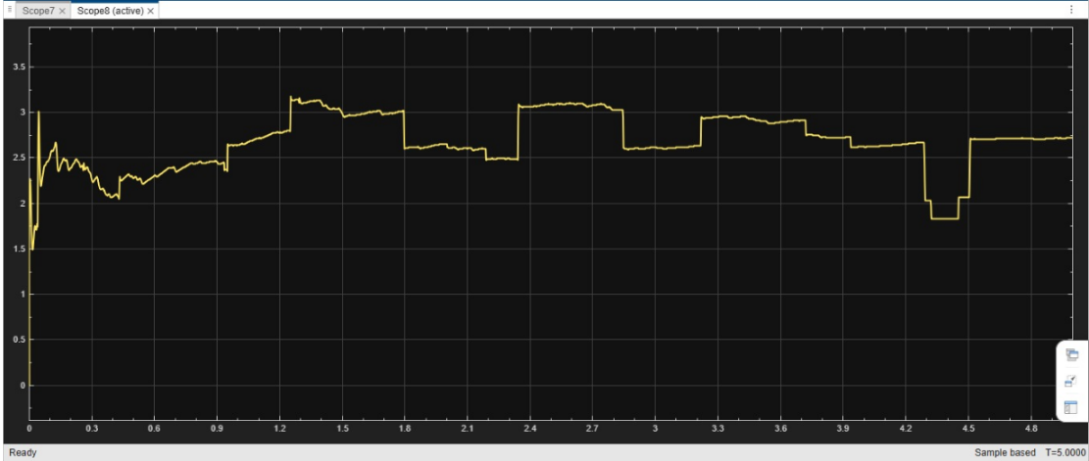
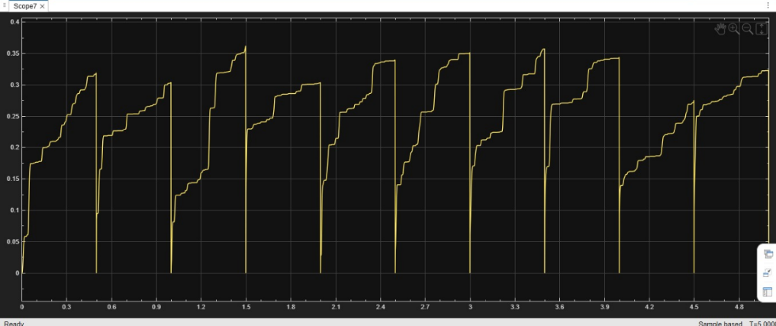
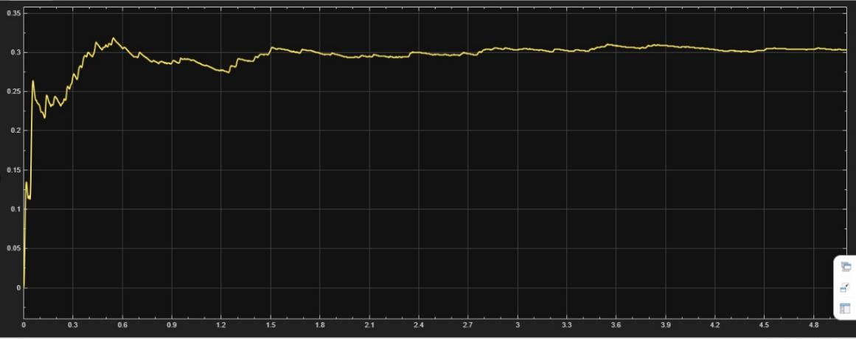
Testing / Analysis (2/4)
MATLAB SIMULATION
Shock Index
RMS
VDV

Slide 11
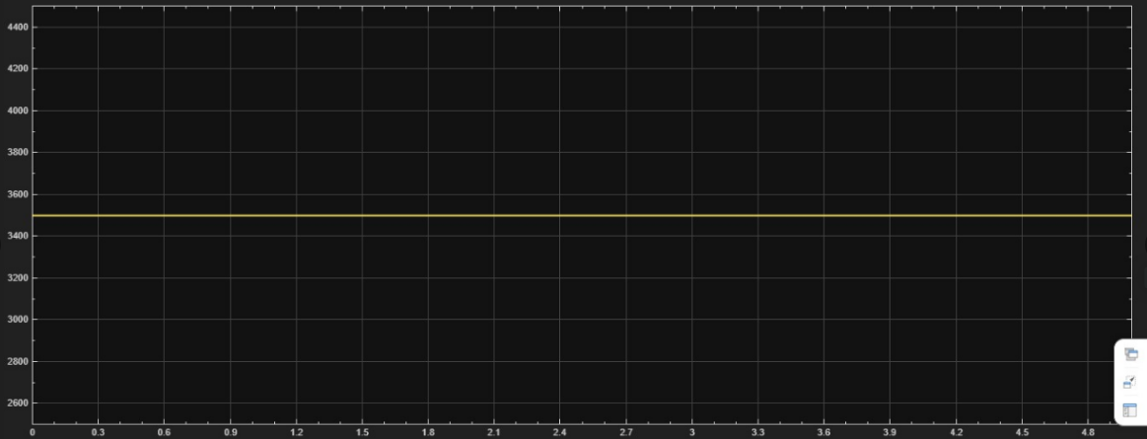
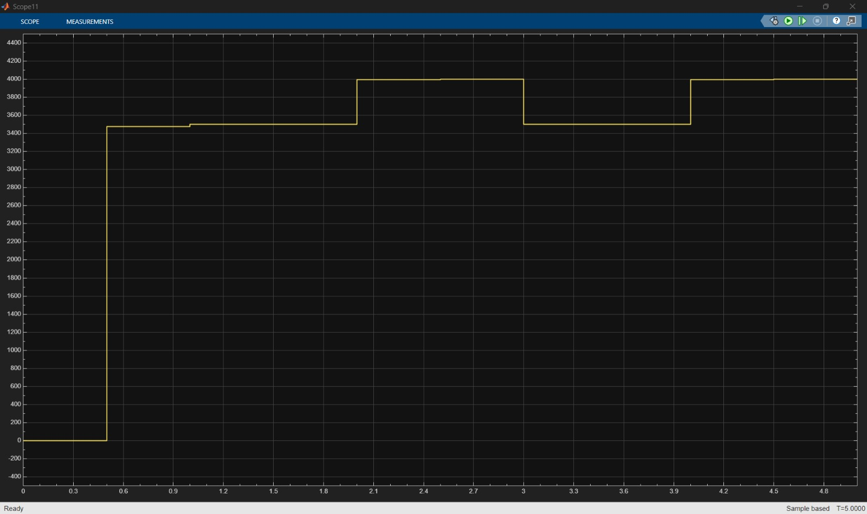
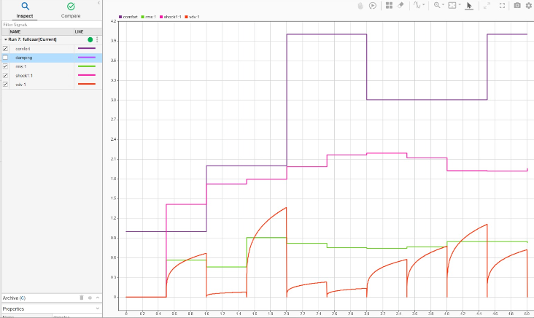
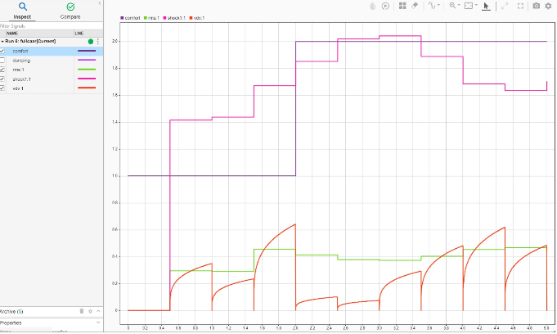
Testing / Analysis (3/4)
fig 1: FIXED DAMPING
fig 2:ADAPTIVE DAMPING
Fig 3: LOW DAMPING
Fig 4: HIGH DAMPING

Slide 12
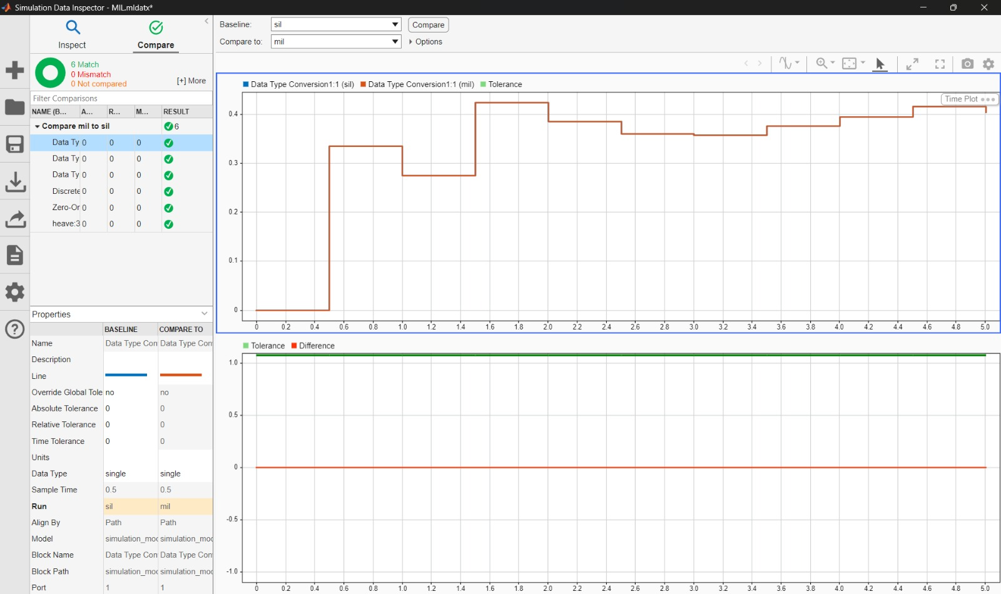
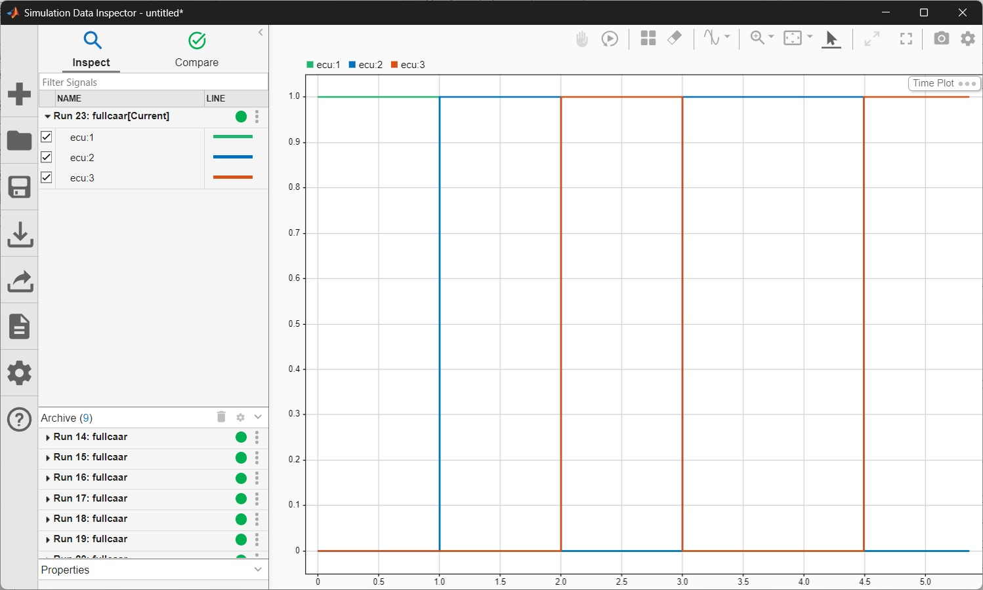
Testing/ Analysis(4/4)
Simulink Test
Hardware-In-Loop

Slide 13
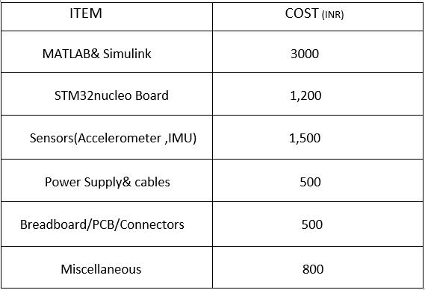
Cost for POC
Cost for POC
Total estimated cost:4,500-7000(in rupees)

Slide 14
Result & Conclusion
The car–human model successfully evaluated passenger comfort under uneven road input.
RMS, VDV, and Shock Index effectively measured vibration severity and exposure.
ISO 2631 weighting was used to assess ride comfort standards.
The model supports real-time and SIL/HIL implementation.
Model executed stably under real-time constraints.
SIL and HIL validation improved confidence for ECU deployment.

Slide 15
References
Z. Wang, C. Liu, X. Zheng, L. Zhao, and Y. Qiu, “Advancements in Semi-Active Automotive Suspension Systems with Magnetorheological Dampers: A Review,” Applied Sciences, vol. 14, no. 17, article 7866, Sep. 4, 2024.
Wu, J., Zhou, H., Liu, Z., “Ride Comfort Optimization via Speed Planning and Preview Semi-Active Suspension Control for Autonomous Vehicles on Uneven Roads,” IEEE Transactions on Vehicular Technology may 2020.
K. Asarar, “Predicting comfort in autonomous driving from vibration signals,” M.S. thesis, Dept. of Automatic Control, School of Electrical Eng. and Comp. Sci., 2021.
R. Wawryszczuk, “Methods of Passenger Ride Comfort Evaluation — Tests for ISO 2631,” Int. J. Environ. Res. Public Health, 2023
A. Patel, R. Shah, and K. Mehta, “Mathematical modelling and simulation of suspension system” International Journal for Research in Applied Science & Engineering Technology (IJRASET),

Slide 16
Thank You

