Slide 1

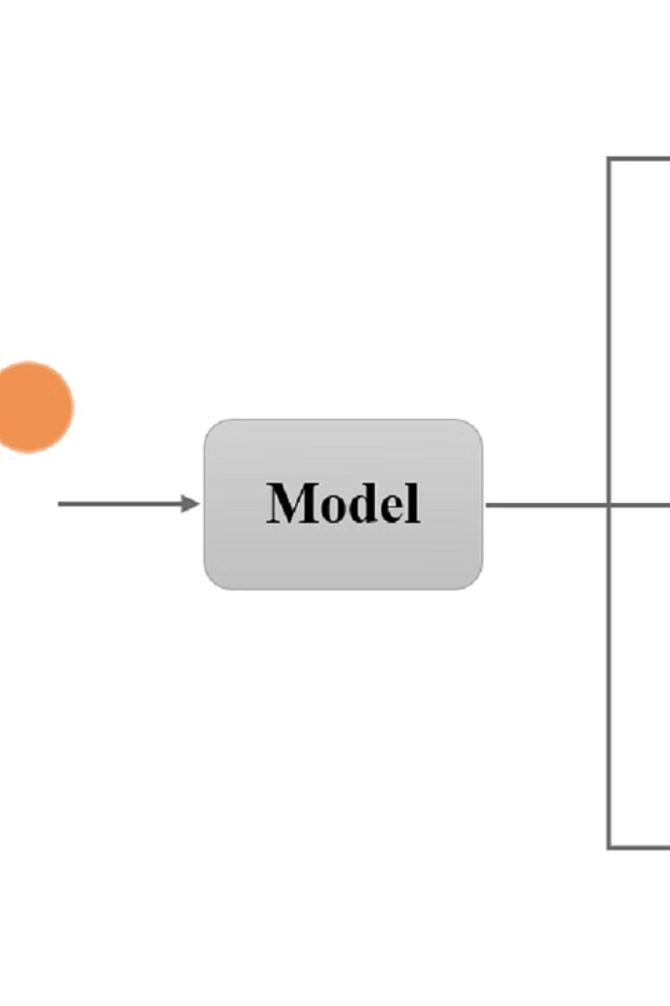


HDFS Operations in AI: Managing Big Data for Intelligent Insights
Enhancing Data Management for Artificial Intelligence Workflows
by katikireddy sai sahithi

Slide 2
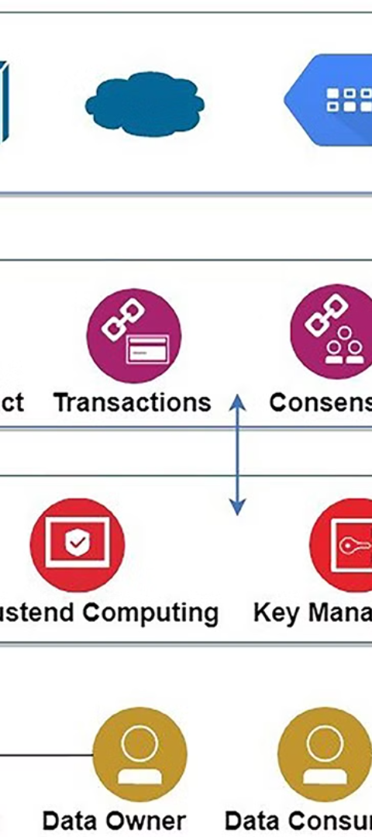
Introduction
1
Synergy between AI and HDFS
2
Organized Data Importance
Efficient data management is vital for AI integration with HDFS.
Organized data is crucial for effective AI processing and analysis.

Slide 3
Hadoop Storage File System (HDFS)
Create the Directory Structure in HDFS
Move Files from Local to HDFS
Command: hdfs dfs -mkdir -p /user/your_username/your_directory
Command: hdfs dfs -put /path/to/local/file /user/your_username/your_directory/
Establishing directory structures in HDFS for optimal data organization.
Enabling the transfer of data from local Unix/Linux machines to HDFS.
Rooted in the idea of seamless AI data processing.
Fundamental for preparing data for AI analysis.

Slide 4
Viewing Data Contents, Files, and Directory
See Contents of Files in HDFS
See Contents of Files in HDFS Directory
Command: hdfs dfs -cat /user/your_username/your_directory/your_file
Command: hdfs dfs -ls /user/your_username/your_directory/
Visualizing the contents of specific files in HDFS.
Listing files and directories aids AI practitioners in managing data.
Essential for AI professionals during data exploration.
Supports effective data tracking and retrieval for AI tasks.

Slide 5
Getting Files from HDFS to Local Disk
Copy a File from HDFS to the Local File System
Command: hdfs dfs -get /user/your_username/your_directory/your_file /path/to/local/destination
Facilitates the extraction of files from HDFS for local analysis.
Essential step for AI professionals before data processing.

Slide 6

Integration with AI
1
Seamless Integration
2
Applications in AI
AIs leverage HDFS for scalable storage and processing.
AI algorithms utilize HDFS for efficient data storage.

Slide 7

Future Directions
1
Advancements in Integration
2
Addressing Challenges
Anticipated progress in AI-HDFS integration for advanced data management.
Opportunities to improve efficiency throughout AI-HDFS integration.

Slide 8
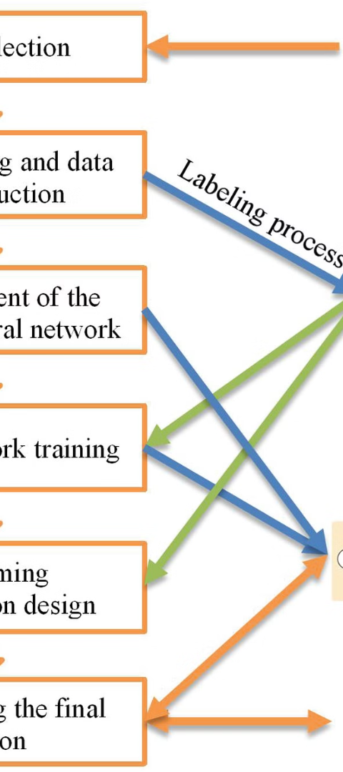
Conclusion
Streamlined Data Management
Explore AI-HDFS Integration
Essential for optimizing AI workflows and data processing.
Encourage audience exploration of the robust AI-HDFS collaboration.

