Slide 1

CASE STUDY – MAKE MY TRIP

Slide 2
GROUP SAM
SAHITHI.P
AISHWARYA.S
MANVITHA.B

Slide 3
ABOUT
MakeMyTrip Limited is an Indian online travel company founded in 2000.
Headquartered in Gurugram, Haryana,the company provides online travel services including flight tickets, domestic and international.
It also provides holiday packages, hotel reservations, and rail and bus tickets.

Slide 4
URL
https://www.makemytrip.com

Slide 5
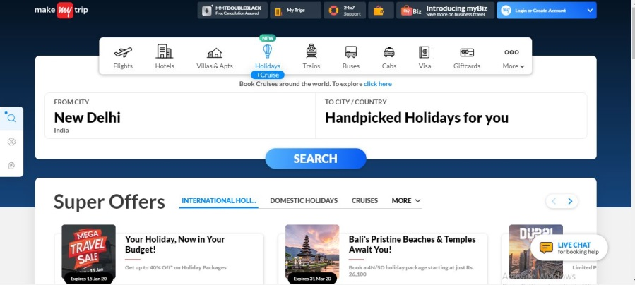
GET SET TO EXPLORE!!!!
Select your destination and get ready to explore

Slide 6
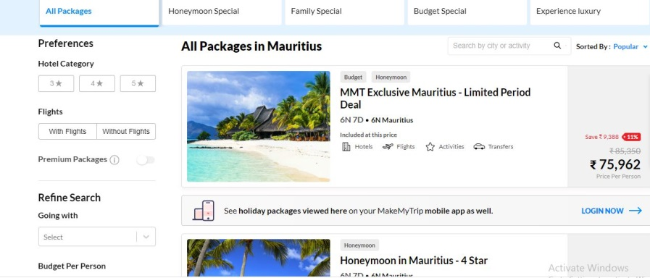
Filter your searches based on budget and money in your pocket

Slide 7
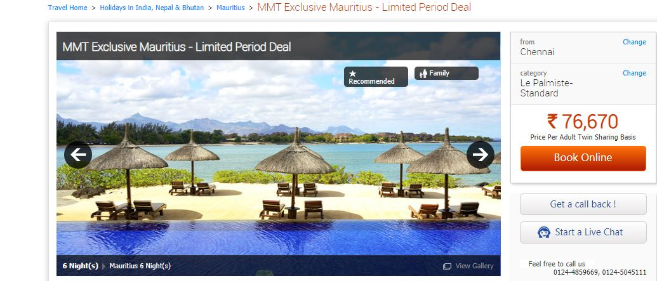
Get a virtual view of your dream destination

Slide 8
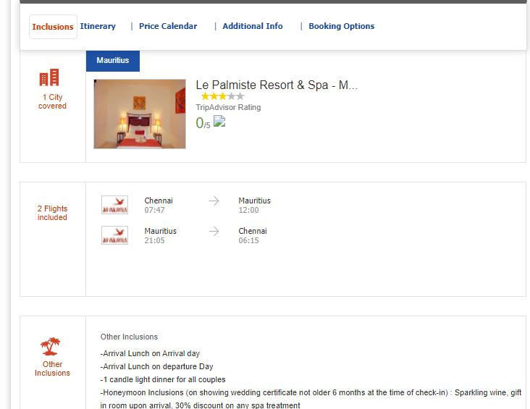
Checkout the amenities

Slide 9
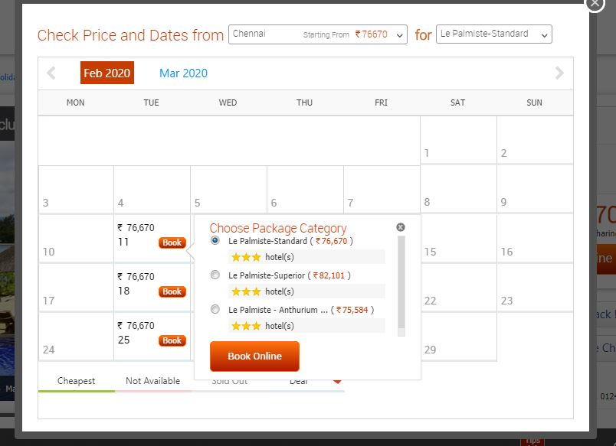
Book your date and pack your bag

Slide 10
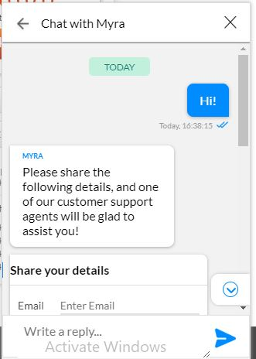
For additional support

Slide 11
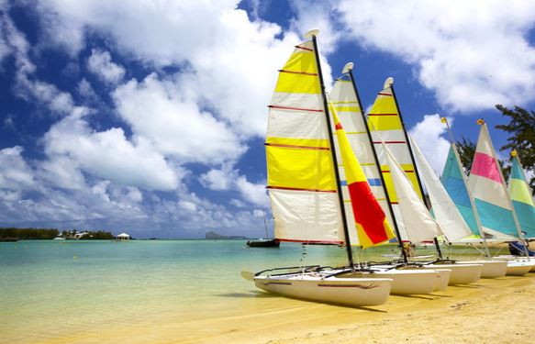
THANK YOU

