Slide 1

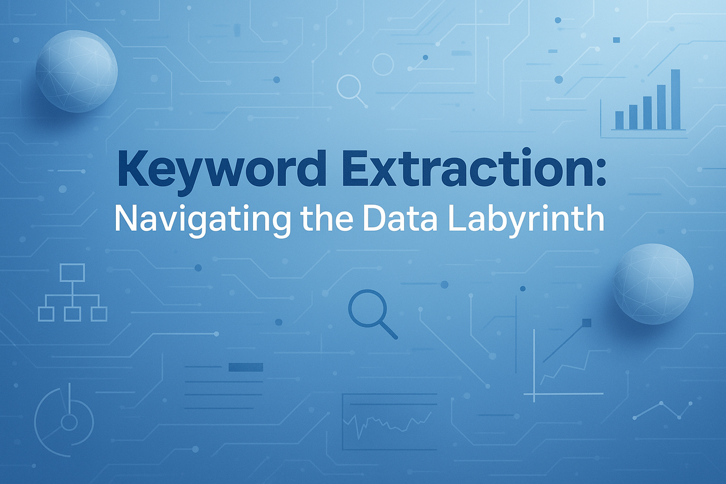
Keyword Extraction
Navigating the Data Labyrinth
PRESENTED BY
Meet Jaiswal - AP23110010913
Yasodhar Gubba - AP23110010512
Naveed Ahammed - AP23110010269
Jaqueen Agneshia Christy - AP23110011238
Christina Evangelin - AP23110011273

Slide 2
Problem and Objective Overview
PROBLEM
OBJECTIVE
Many documents contain essential ideas that are difficult to notice because they are surrounded by large volumes of text. Manually reading and skimming through articles, research papers, and reports is time-consuming and often leads to missing important points. With the rapid growth of digital content, there is a strong need for a faster way to understand the main topics without going through every line in detail.
The objective of this project is to automatically extract the most relevant keywords from any given text using the TF-IDF technique. To make this process accessible, a simple web interface is provided for users to paste or upload documents, while a REST API enables automated extraction for developers and external systems. This allows both technical and non-technical users to quickly identify key ideas and understand the core meaning of long text.

Slide 3
System Architecture and Tech Stack
SYSTEM ARCHITECTURE
TECH STACK
  Flask (UI Layer): Handles user interaction — text input, uploads, previews
  FastAPI (API Layer): Processes text and returns keywords as JSON
  Communication: UI sends requests to /api/keywords for live results
  Integration: Starlette mounts Flask (WSGI) + FastAPI (ASGI) together
  Server: Uvicorn runs the unified application with async performance
  Programming & Frameworks:
    Python, Flask, FastAPI, Starlette
  NLP & ML:
    Scikit-learn (TF-IDF Vectorizer)
  Frontend:
    HTML, CSS, JavaScript
  Server & Tools:
    Uvicorn, Pydantic validation, pytest testing
FLOW
Browser → Flask UI → FastAPI API → TF-IDF Engine

Slide 4
TF-IDF Keyword Extraction
RANKING & SELECTION
PREPROCESSING
VECTORIZATION
  Convert text to lowercase
  Remove unwanted characters using regex
  Optional normalization to reduce word suffixes
  (e.g., “running” → “run”, “studies” → “study”)
  TfidfVectorizer(stop_words="english", ngram_range=(1,2))
  Captures important words and short key phrases
  TF-IDF score determines word importance
  Higher score = more relevant to the document
  User controls:
    Max Keywords (e.g., 25)
    Keyword density (e.g., 35%)

Slide 5
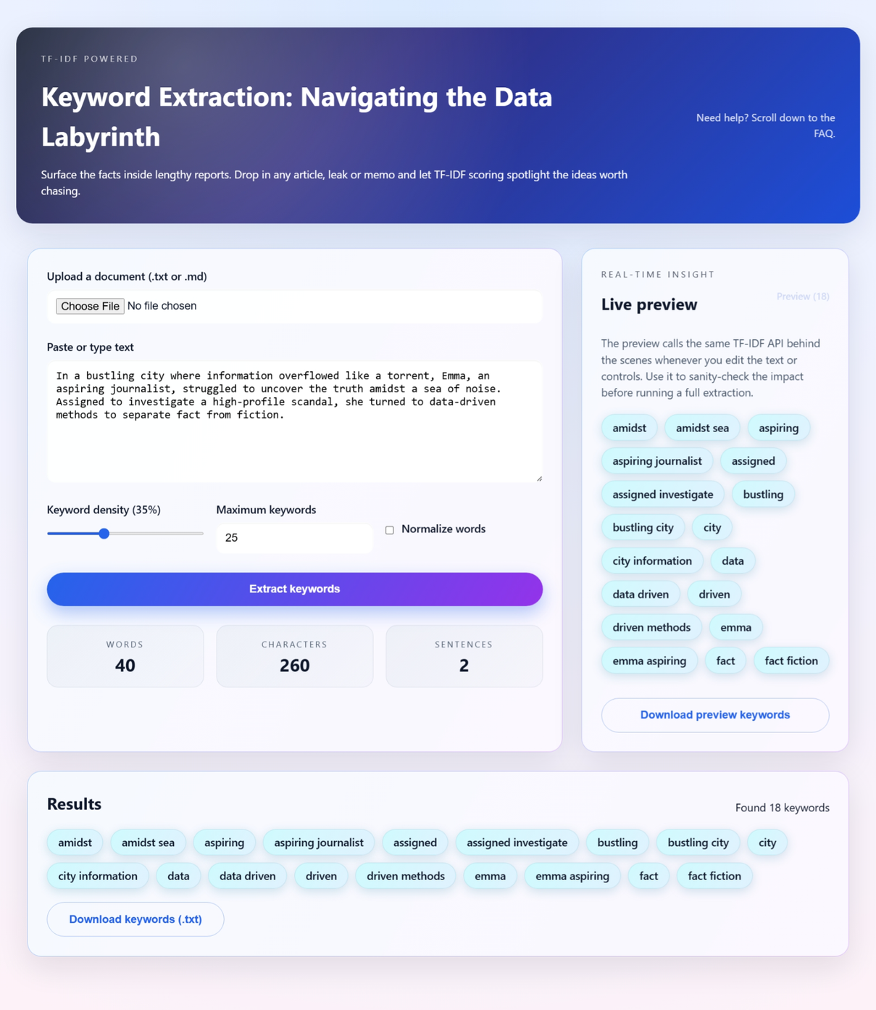
Features of the App
EASY-TO-USE WEB APP
  Paste text or upload .txt / .md files
  Simple controls to adjust keyword density and limit
  Toggle for normalization (reduces word variations)
  Keywords shown as neat chips with frequency indicators
  Instant results with automatic live preview
SMART KEYWORD EXTRACTION
  TF-IDF–based ranking with stop-word removal
  Detects meaningful 1–2 word phrases
  Ensures only top-scoring keywords are selected
BUILT-IN TEXT INSIGHTS
  Shows total words, characters, and sentence count
  Helps users understand input quality

Slide 6
Results, Testing, and Limitations Overview
RESULTS
LIMITATIONS
  Successfully extracts relevant keywords from long documents
  Captures meaningful single and double-word phrases
  Works well for articles, blogs, and project summaries
  Helps quickly identify main topics and concepts
  TF-IDF is lexical — does not fully understand meaning
  Works on one document at a time, no multi-file context
  Basic normalization — not as strong as lemmatization
  Currently supports only .txt and .md files
  Does not detect synonyms or relations between keywords
TESTING
FUTURE IMPROVEMENTS
  Pytest smoke tests verify keyword extraction logic
  Checked behaviour for:
    Blank text handling
    Output type and length correctness
    Limits on keyword count and ratio
    Validates overall reliability of the feature
  Add spaCy-based lemmatization for better linguistic accuracy
  Support multi-document corpus keyword extraction
  Allow export formats like CSV/JSON
  Add custom stopword list and UI theme enhancements

Slide 7
Thank You

