Slide 1

TriageIQ:AI Powered Ticket Intelligence System
Team 12
Aakanksha Govindaraju 2384001
Kiran Kulkarni 2330104
Gowtham Chowdam 2397801
Sahithi Akunoor 2447497
Yasasvi Nalla 2444910

Slide 2
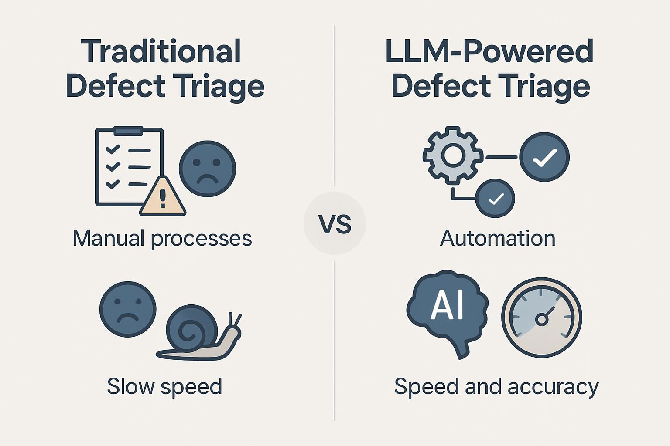
Overview
Large-scale systems generate high volumes of tickets → manual triage is slow & inconsistent
Critical issues risk misclassification and SLA delays
We introduce TriageIQ, an end-to-end system that combines:
Machine learning for prediction
Retrieval for context
Generative AI for assistance
Designed with a human-in-the-loop approach to ensure reliability and real-world usability

Slide 3
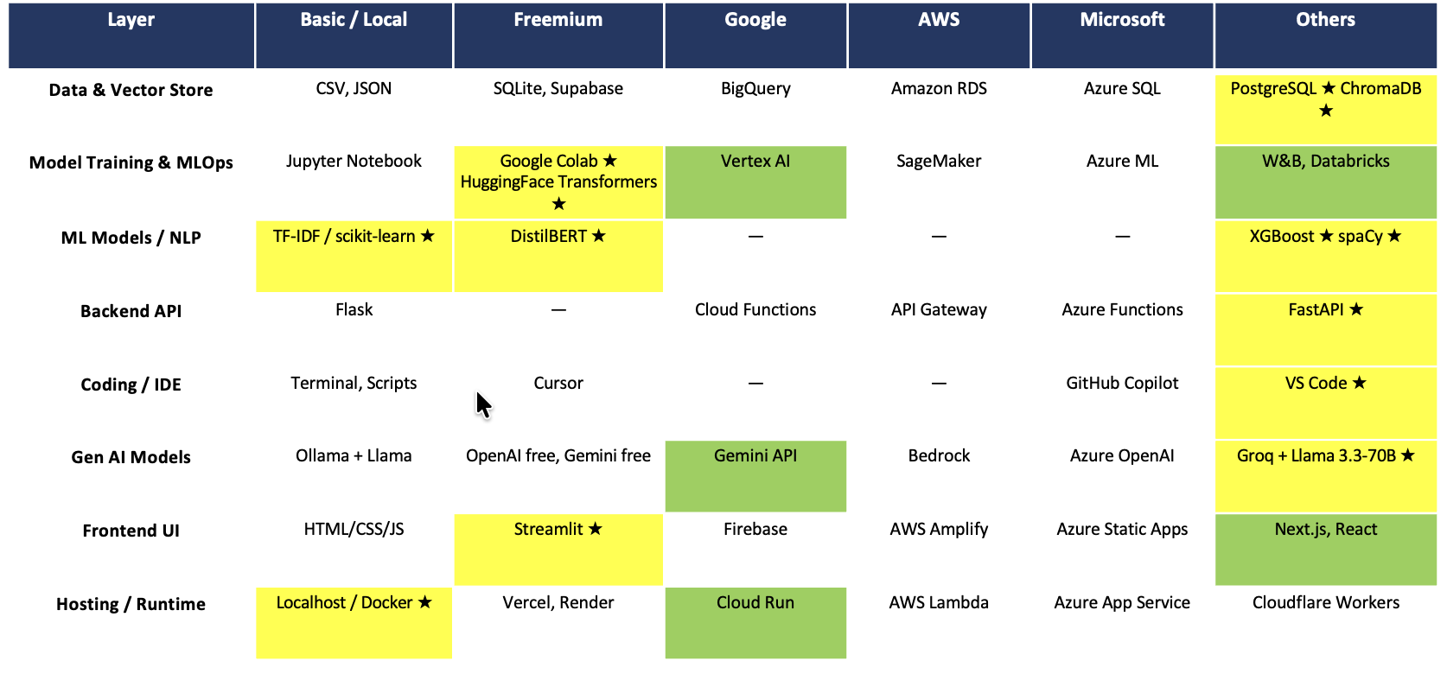
AI Tech Stack — TriageIQ
★ Implemented
Ideal Stack

Slide 4
System Architecture
LAYER 1 — Data & Storage
PostgreSQL (tickets, reviews, analytics) | ChromaDB (18 KB documents, vector embeddings) | Docker Volumes (model persistence)
LAYER 2 — AI Pipeline (5 Steps)
01 DistilBERT Issue classifier — Bug / New Feature / Improvement / Task / Test (Acc=0.617, F1=0.593)
02 XGBoost Priority predictor — P1 Blocker to P5 Trivial (Acc=0.558)
03 spaCy Entity extractor — versions, error types, frameworks, libraries
04 ChromaDB RAG Retrieves top-3 KB chunks to ground LLM response
05 Llama 3.3-70B (Groq) Summary + clarifying questions + maintainer draft reply + LLM-as-judge evaluation
LAYER 3 — Application
FastAPI (REST backend, 10 endpoints) | Streamlit (multi-page UI: New Issue, Inbox, Detail, Analytics, Train Models) | Docker Compose (3 containers)
Human-in-the-Loop: Maintainer reviews AI draft, edits, assigns, approves or rejects each ticket

Slide 5
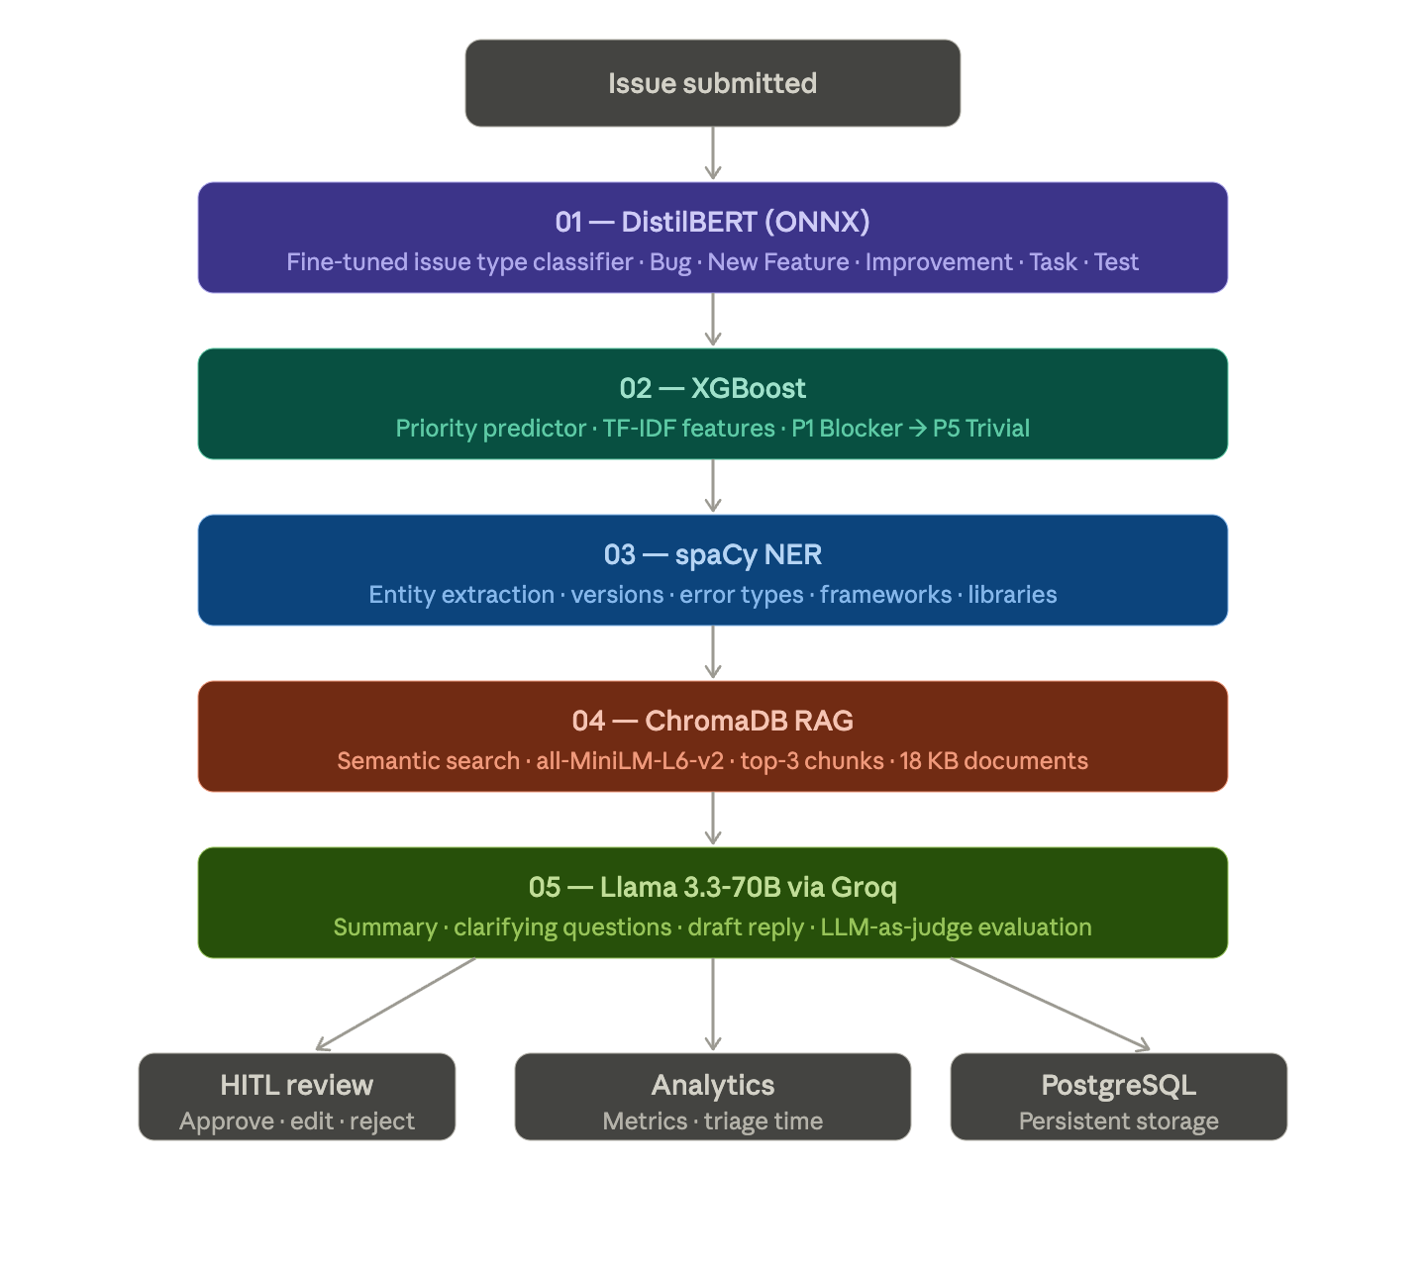
Project Pipeline

Slide 6

Challenges & Learnings
CHALLENGES | LEARNINGS
Severe class imbalance in both issue type (Bug 54% vs Test <1%) and priority (P3 67% vs P1 3%) — models default to majority class, making P1/P2 detection unreliable | CAP/MIN resampling for DistilBERT, balanced sample weights for XGBoost, and rule-based escalation for high-risk P1/P2 tickets.
Noisy OSS priority labels — same bug description assigned P1 in one project and P3 in another; model learns inconsistent ground truth | Priority prediction from text alone has a fundamental ceiling; HITL correction is not just a safety net but a necessary component for reliable triage
Extracting meaningful features from Docker — frontend container cannot access backend filesystem; required multipart file upload API for CSV training | Gained experience in building a designing Docker-native APIs; no shared filesystem between containers
Integrating multiple components (Streamlit st.radio ignores programmatic index — had to use st.switch_page() pattern (same as working inbox→detail nav) to reliably redirect between pages | Learned how to combine Streamlit single-page app navigation patterns and session state management for reliable page switching

Slide 7

Key Insights & Conclusion
Model Performance
DistilBERT Classifier: Acc=0.617, Macro F1=0.593, Weighted F1=0.621
XGBoost Predictor: Acc=0.558, Macro F1=0.256, Weighted F1=0.553
Efficiency Gain
~2-5 seconds
per ticket (vs. 15-30 minutes manual triage in active OSS projects)
End-to-End Automation
A developer's bug report was transformed into a fully structured triage result—including priority, entities, sources, summary, and a draft reply—in a single automated pipeline run.

Slide 8


