Slide 1



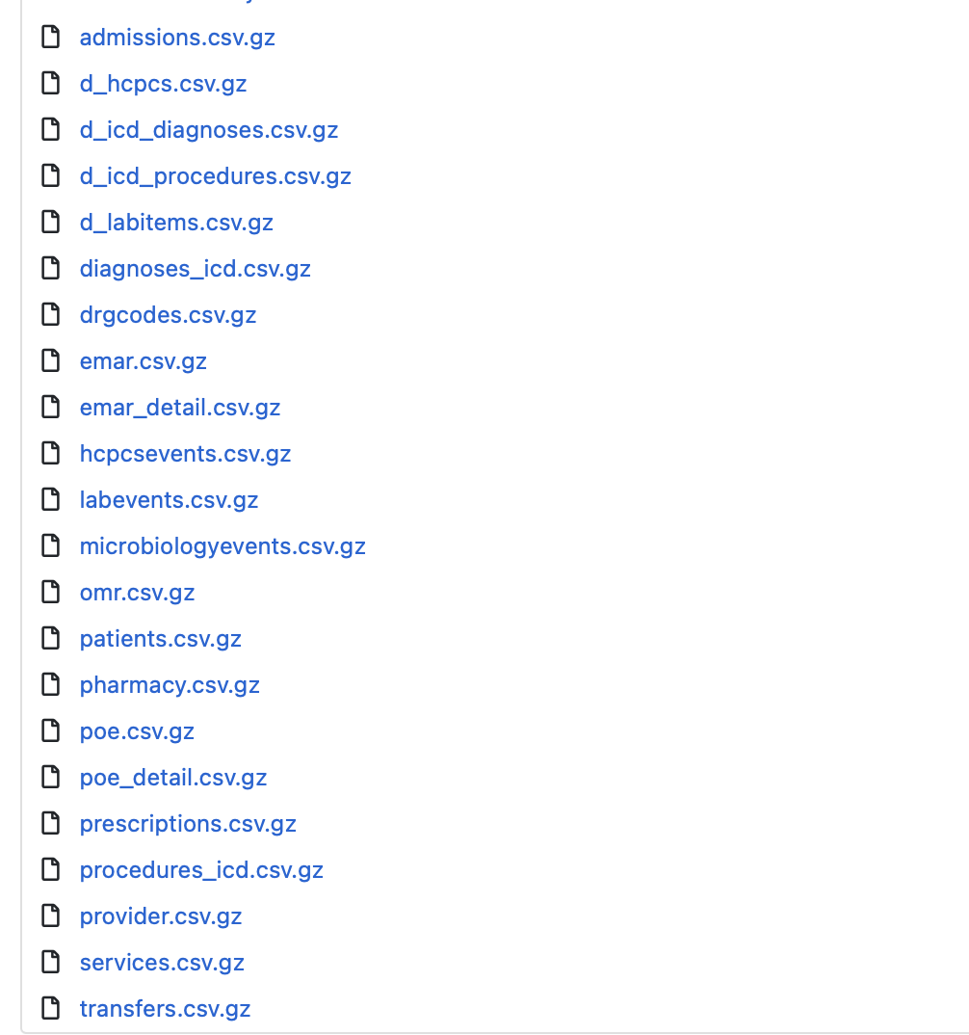
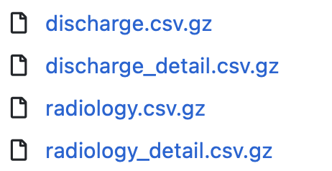

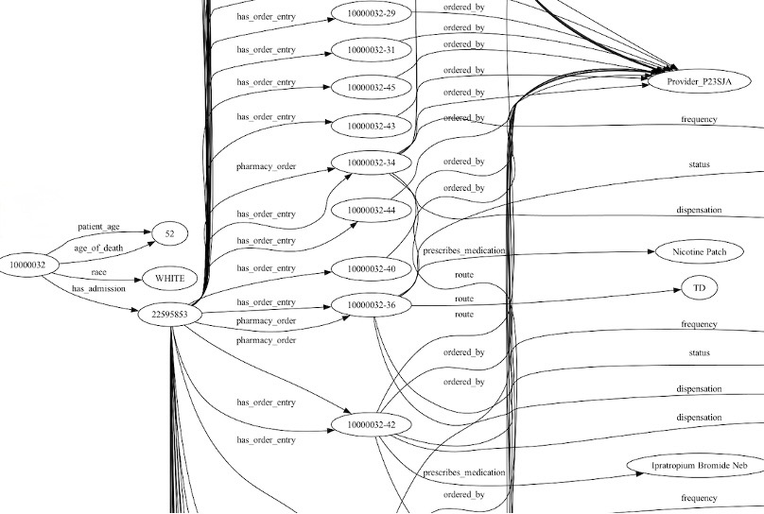







Med-KG: A General-Purpose Knowledge Graph for Understanding Clinical Interactions
Sahithi Ankireddy, Purvi Sehgal
Bridging structured knowledge and language understanding for broad clinical insights using Knowledge Graphs & Large Language Models
Motivation
Data
MIMIC-IV contains rich, multimodal data (e.g., notes, labs, prescriptions) that is decentralized across multiple files → knowledge graph enables structure
Incorporating tabular, textual and image data
Singular Application
Multiple Applications
MIMIC-IV
MIMIC-IV-Note
Other Medical Knowledge Graphs
Med-KG
Method
Med-KG Implementation: A General-Purpose Knowledge Graph for Understanding Clinical Interactions
1) Knowledge Graph Generation
Patient Info
OpenAI API Call
(patient_145, has_admission, admission1)
:
(admission1, is_diagnosed, atrial fibrillation)
MIMIC-IV
Admissions
(admission1, is_prescribed, diltiazem)
MIMIC-IV-Note
(patient_146, has_admission, admission1)
:
(admission1, is_diagnosed, arrythmia)
(admission1, is_prescribed, flecainide)
2) LLM Analysis for various Downstream Tasks
Between Patient A and B:
{
"diagnosis_similarity": 0.67,
”symptoms_similarity": 0.80,
….
"final_similarity_score": 0.735
}
Between Patient A and E:
{ … }
Task: Patient Similarity Analysis
OpenAI API Call
A
E
B
D
C
The knowledge graph containing all patients is provided as input.
Patient similarity downstream task
Applications
Future Work
Patient Similarity Analysis
How to identify similar patients to provide clinical decision-making support?
Are there differences in treatment among similar patients?
Provider
Expand Tasks
More Quantitative Evaluations
Mental Health Data: NIMH Archive
Are there anomalies in provider behavior (overprescribing, upcoding, etc.)?
How to quantify provider success rate?
Answer Clinical Research Questions
Acknowledgements
What types of physician order entries are discontinued?
What types of admissions result in inter-hospital transfers?
Thank you to Professor Adam Wierman for his support on this project through the Caltech CS 145 class.

